Slide 1
Mewaldt et al. (2001, 2007) fluence spectra from ACE data compiled for 1997 - 2000

Slide 2
Extend Year Coverage of ACE Spectrum at 1 AU
Obtain H and He spectra from IMP-8, Wind, ACE, Stereo A-B for 1973 – 2014 from VEPO
See following MSSP-1 plots from VEPO
Merge all spacecraft and instrument data into composite plot for proton and helium spectra
Show full 60 eV/n – 100 MeV/n helium spectrum (solid curve) from Mewaldt et al. (2001, 2007)
Extrapolate proton fluxes from the multiple source measurements down to 60 eV/n using spectral same spectral form of helium.
Results are time-averaged full composite spectra over ~ four solar cycles 1973 – 2014.
Full spectrum applicable to solar wind and SEP interactions with the Moon outside the Earth magnetosphere.
Can be extended to Mars orbit using periodic Ulysses traversals and other occasional measurements from Pioneer 10-11, Voyager 1-2, New Horizons, Galileo, and Cassini.
Can use these Ulysses etc measurements to determine time-average flux spectra at orbits of Jupiter, Saturn, Uranus, Neptune, and Pluto.

Slide 3
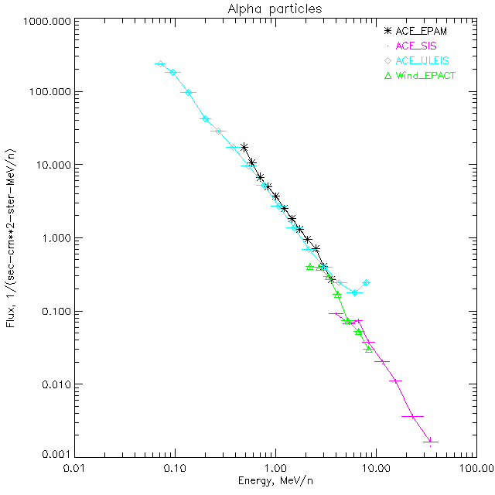
VEPO MSSP1 Plot
Averaged Spectra from 19980219 to 20140906

Slide 4
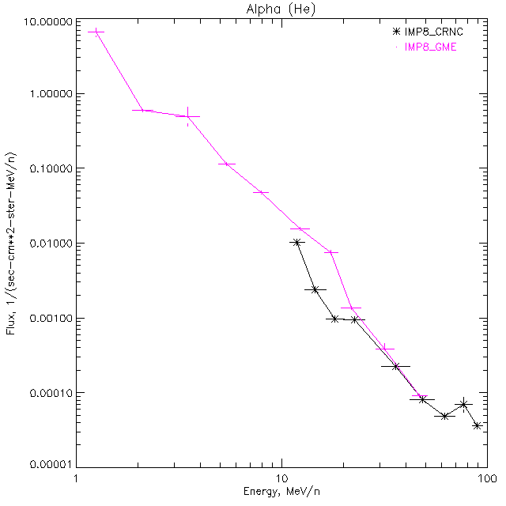
VEPO MSSP1 Plot
Averaged Spectra from 19731101 to 20011026

Slide 5
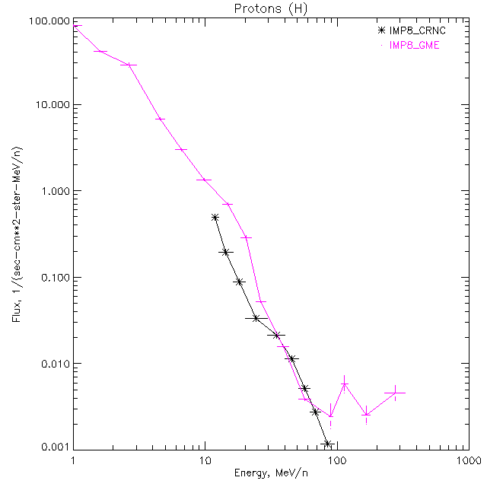
VEPO MSSP1 Plot
Averaged Spectra from 19731101 to 20011026

Slide 6
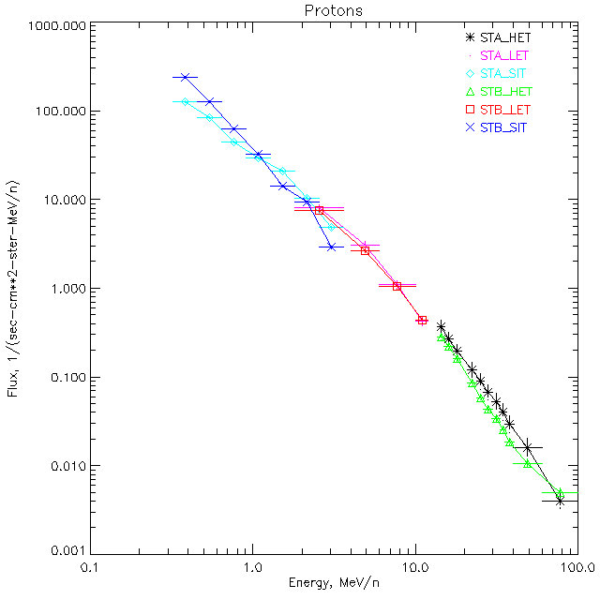
VEPO MSSP1 Plot
Averaged Spectra from 20070329 to 20140927

Slide 7
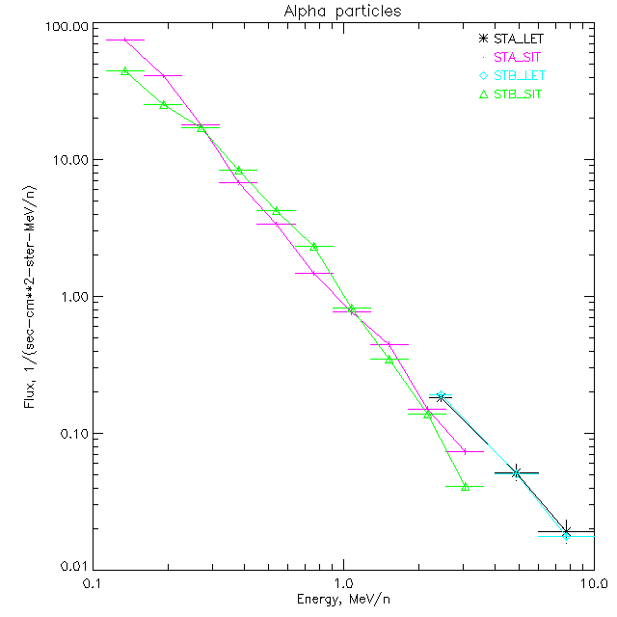
VEPO MSSP1 Plot
Averaged Spectra from 20070329 to 20140927

Slide 8
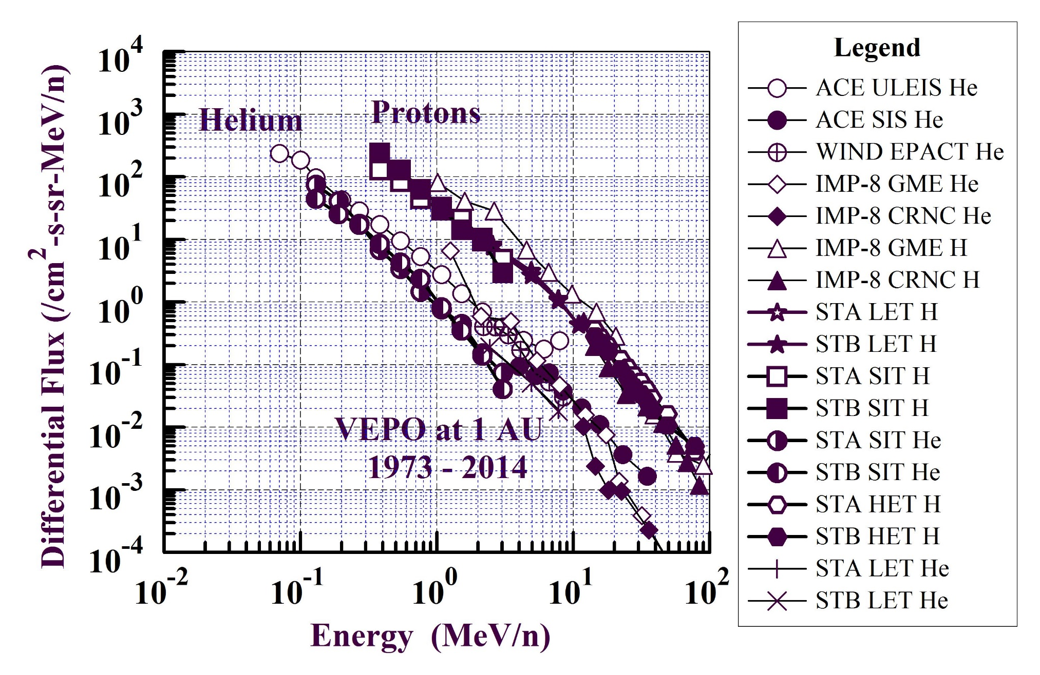
Composite Proton and Helium Spectra at 1 AU from VEPO MSSP-1 Data

Slide 9
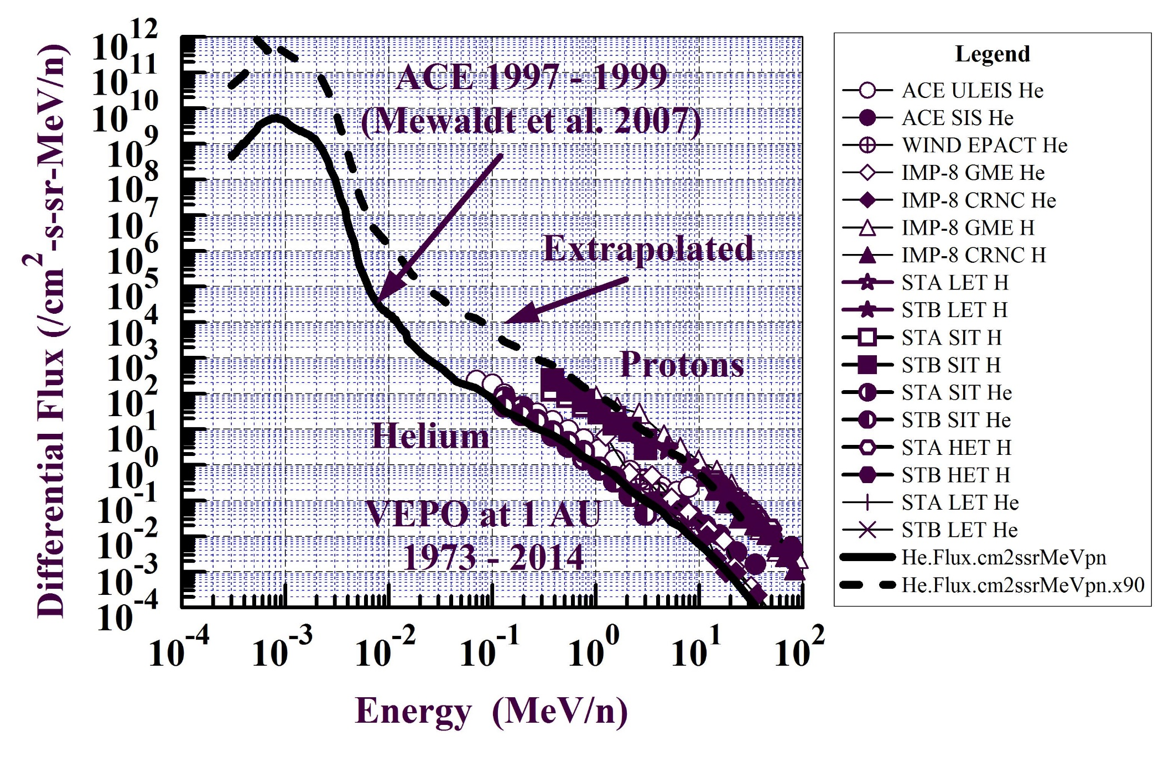
(1) Mewaldt et al. (2001) determined full 30 eV – 100 MeV spectrum for He from ACE.
(2) VEPO Spectra > 60 keV/n for protons and helium from IMP-8 GME-HET, WIND EPACT, ACE ULEIS-SIS, STEREO-AB HET-LET-SIS for 1973 – 2014.
(3) Extrapolate full spectrum for protons from VEPO > 60 keV/n measurements.

