Slide 1
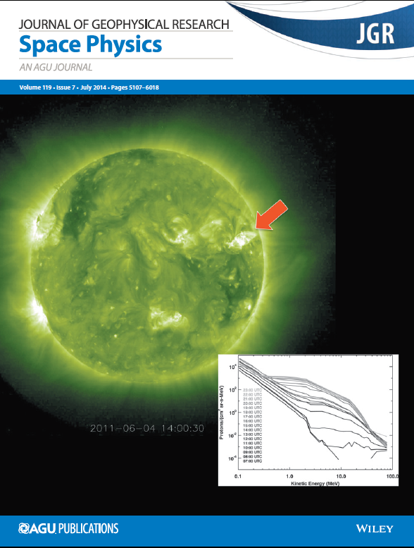
Solar Neutrons: A New Window into Solar Acceleration Processes
David J. Lawrence
The Johns Hopkins University Applied Physics Laboratory
Notes:
6
1

Slide 2
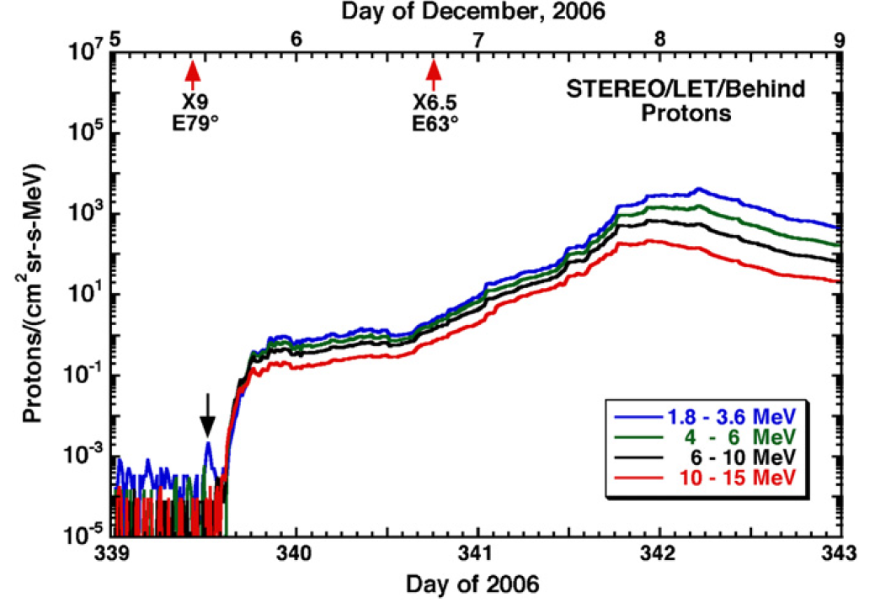
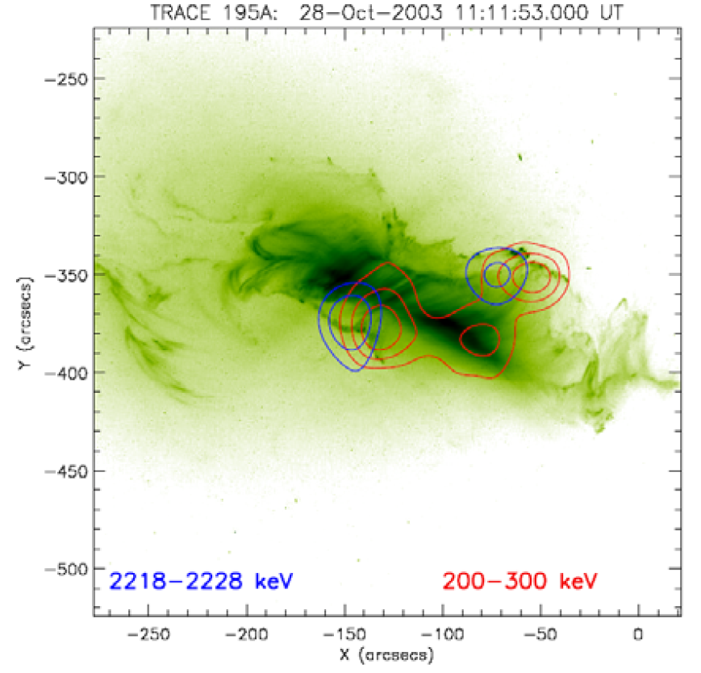
Information About Acceleration: Neutral Particles
X-rays, γ-rays, neutral atoms, neutrons
Energies range from keV to MeV.
Information return
No information loss from magnetic field interactions.
X-rays, γ-rays:
Provide primary information about electron/ion acceleration.
Ambigious information
Ion spectral shape, composition.
Neutrons:
Provide primary information about proton/heavy ion acceleration and composition.
Neutral atoms
Mewaldt et al., (2009)
NASA TRACE 195 Å image, with 2.223 MeV γ-ray line contours (blue) and hard X-ray electron brehsstrahlung (red)(Lin et al., 2008).

Slide 3
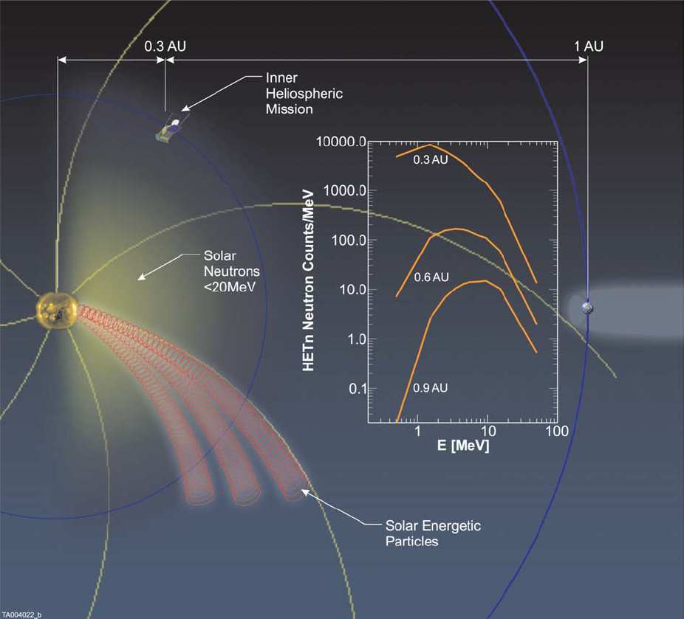
Solar Neutrons: Overview
Neutrons produced from proton/ion interactions.
Generally require proton energies greater than 10 – 30 MeV.
Heavy ions produce neutrons at lower energies (few MeV).
Neutrons probe acceleration processes:
>50 MeV neutrons: energetic ions near Sun.
<10 MeV neutrons: moderate energy ions and heavy ion composition.
Illustration of solar neutrons and energetic particles in the heliosphere (Posner, et al. 2005)

Slide 4
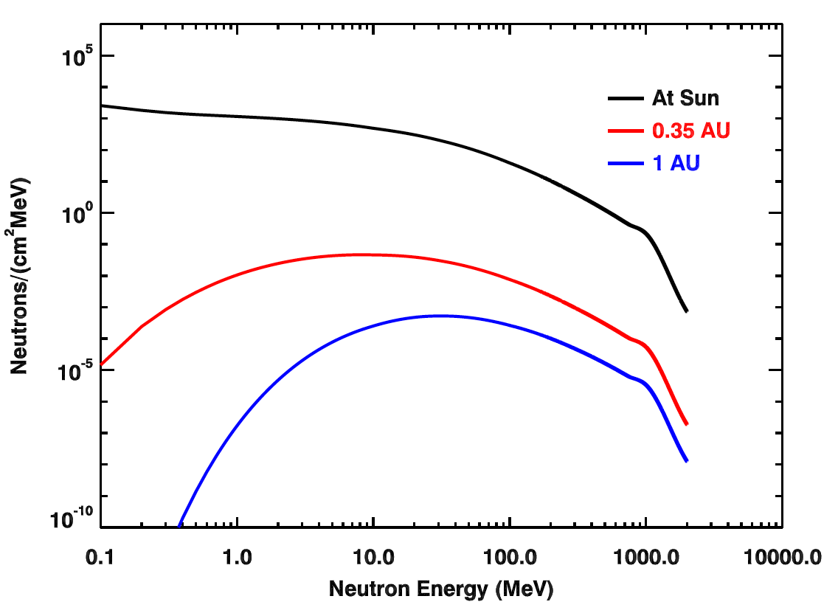
Solar Neutrons: Unique Features
Free-space neutrons have finite life.
Neutron half life is 15 minutes.
Detection strongly dependent on distance to Sun.
Existing measurements 20 MeV and higher.
Earth orbit: 20 – 100 MeV.
Ground based: few hundred MeV.
Prior to MESSENGER, no measurements of less than 10 MeV.
MESSENGER NS
Measurements at 1 AU

Slide 5
Summary of Papers
Feldman et al., (2010)
Detection of neutrons from Dec. 31, 2007 event.
Likely solar?
Share et al., (2011)
Neutrons from Dec. 31, 2007 likely created locally.
Lawrence et al., (2014)
Neutrons from June 4, 2011 event.
Stronger evidence for solar origin.
Share et al., (2014)
Disputed Lawrence et al., (2014) interpretation.
Neutrons likely created locally.
Lawrence et al., (2015)
Reply to Share et al., (2015) with additional gamma-ray evidence for solar origin.
Feldman et al., (2015)
Discussion of six more neutron events – possibly solar origin.

Slide 6
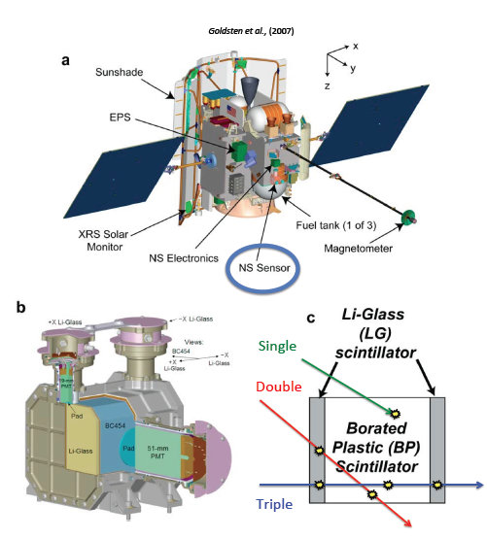
MESSENGER Neutron Spectrometer
MESSENGER has a Neutron Spectrometer (NS).
Measure neutrons with range of energies.
Sensitive to energetic particles.
Measure polar deposits and surface composition.
Available for “bonus” science.
First neutron detector at 0.3 – 0.4 AU.
Notes:
Area is 100 cm2 and has huge solid angle! Good acceptance for solar neutron studies.

Slide 7
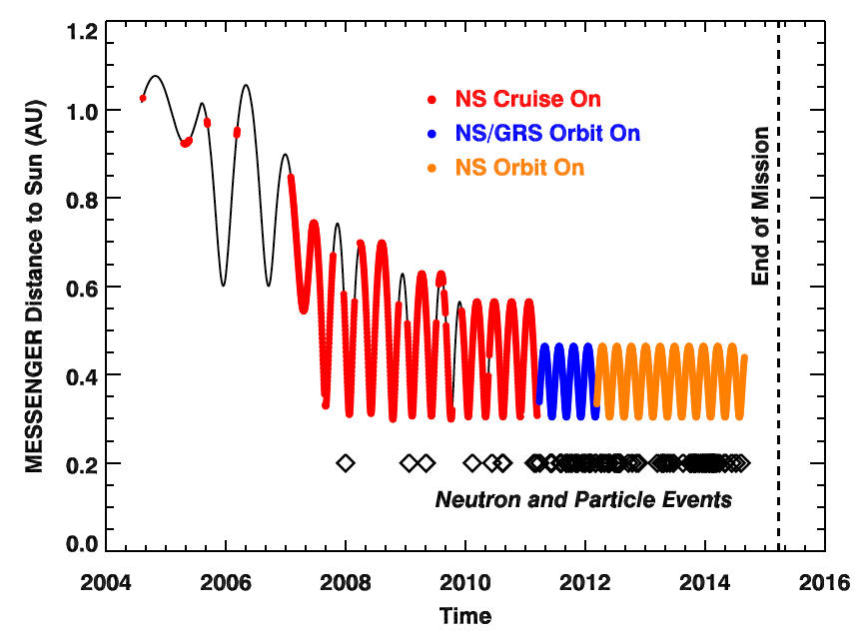
Approach to Mercury
MESSENGER launch August 2004.
Near-continuous NS operation from early 2007 to present.
Sun very quiet until 2011.
Two key neutron events
31 December 2007
4 June 2011.
Neutron events

Slide 8
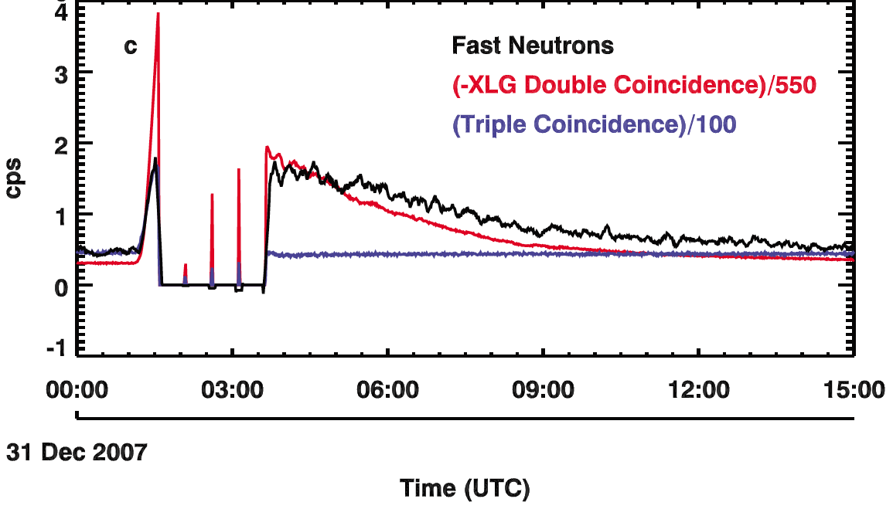
31 December 2007 Event
n: 0.5 – 8 MeV
p: 45<E<100 MeV
e: 7<E<25 MeV
p: >120 MeV
e: >30 MeV
Neutrons (0.5 – 8 MeV)
Medium-energy protons and/or electrons
High-energy protons and/or electrons
NS safing
Taken from Feldman et al., [2010]
NS observed non-Mercury enhanced fast neutrons on 31 December 2007 (Feldman et al., 2010).
Observed moderately energetic particles (protons, electrons, and/or ions) – related to M class flare.
Energetic protons can produce neutrons from spacecraft materials.
Are neutrons from the Sun or the spacecraft?

Slide 9
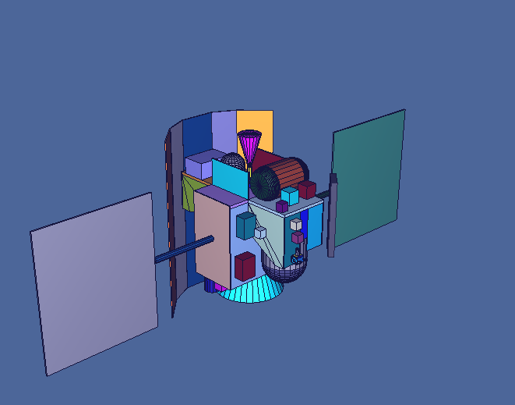
Where are the neutrons from?
Model neutron production with transport code MCNPX.
Model entire MESSENGER spacecraft.
Validated with Mercury neutrons and cosmic ray protons.
Assume energetic particles are protons and alpha particles.
Predict locally generated neutrons from incoming ions.
Measured 3.4 times more neutrons than predicted.
Likely solar origin?
Geometry model of MESSENGER spacecraft for MCNPX particle transport code
NOT SO FAST …

Slide 10
Are the 31 Dec. 2007 Neutrons Solar?
Share et al. (2011)
Inferred number of neutrons is unreasonably large.
Estimated local neutrons too small.
Underestimated energetic protons.
No measurement of ion energy spectrum and composition for event.
Underestimated local neutrons
Inaccurate reaction probabilities
Resolution
Less ambiguous energetic particle data.
Not possible on MESSENGER
Need types of detectors carried on ACE, STEREO, Solar Probe Plus.
Use assets at 1 AU (STEREO, ACE, GOES, etc).
Use improved reaction probabilities.
Done.
Measure less ambiguous neutron event.
See June 4, 2011.
✖
✔
✔
✔
Notes:
Unreasonably large, assuming standard impulsive flare event.

Slide 11
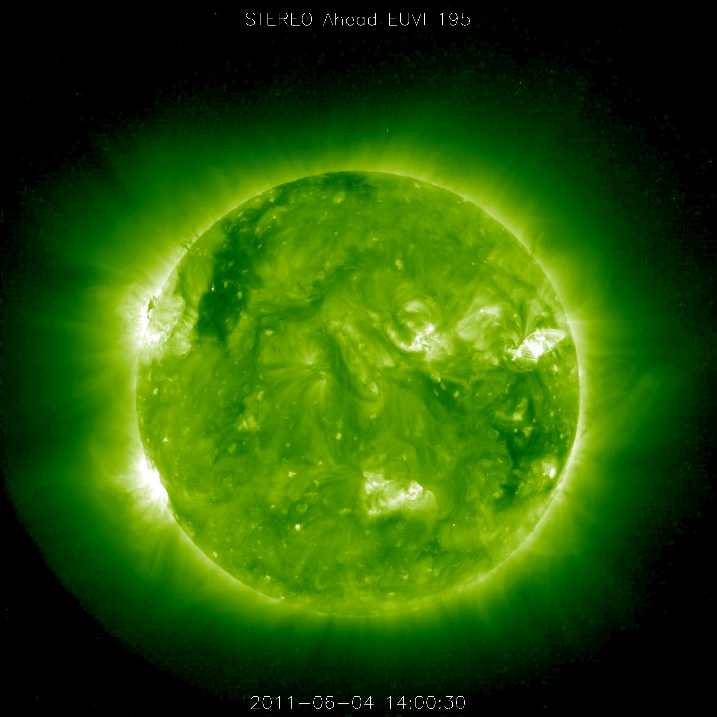
4 June 2011 Solar Particle Event
Solar event on opposite side of Sun, out of Earth field of view.
MESSENGER in near-direct line of sight of solar particle event.
STEREO-A had oblique view of 4 June solar particle event (red arrow).
First CME shock arrival time between 4 June 18:00 UTC and 5 June 0:00 UTC.
STEREO A
Mercury
Earth
WSA-ENLIL-CONE Model CME Evolution, http://iswa.ccmc.gsfc.nasa.gov
STEREO-A, http://stereo-ssc.nascom.nasa.gov

Slide 12
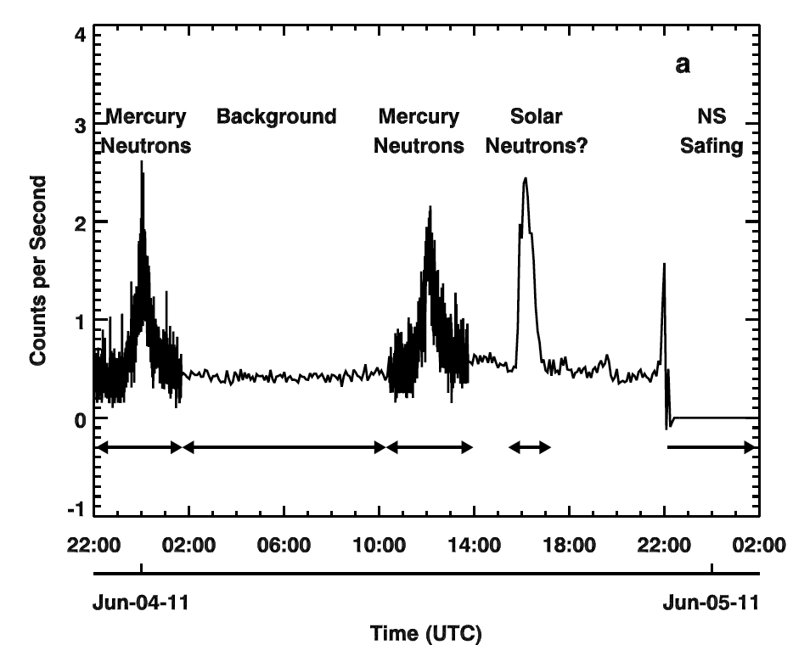
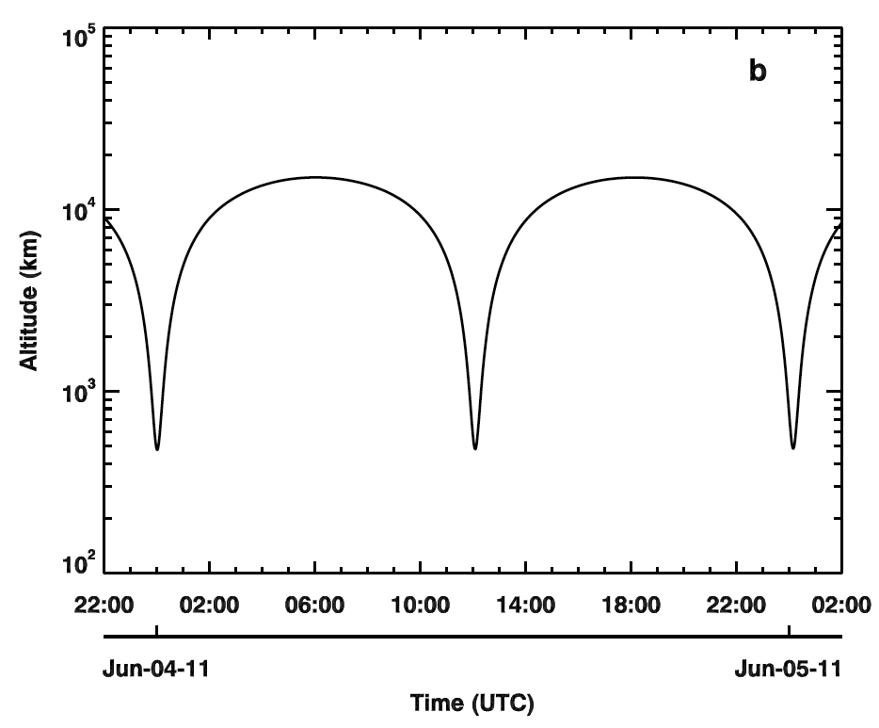
4 June 2011 Event
Fast neutrons at 15:45 UTC on 4 June 2011.
Six hours before start of large solar particle event
One-hour event duration
Neutrons not from Mercury.
Spacecraft far from planet.
Evidence for solar origin:
Lack of energetic (>45 MeV) protons.
Local neutron estimate.
Gamma-ray data.

Slide 13
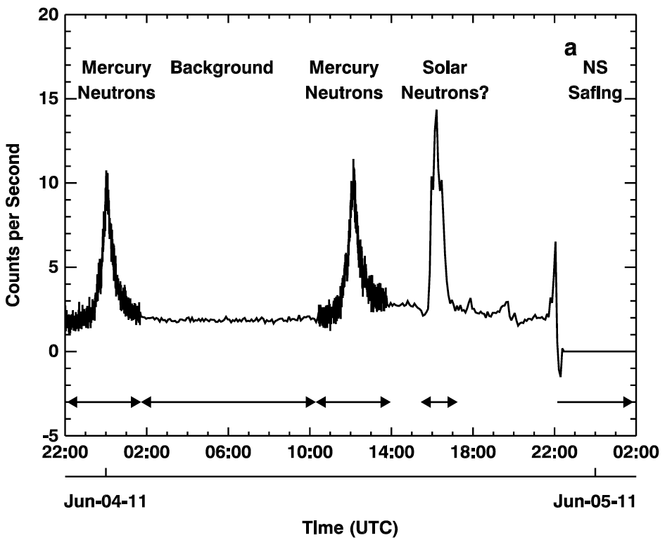
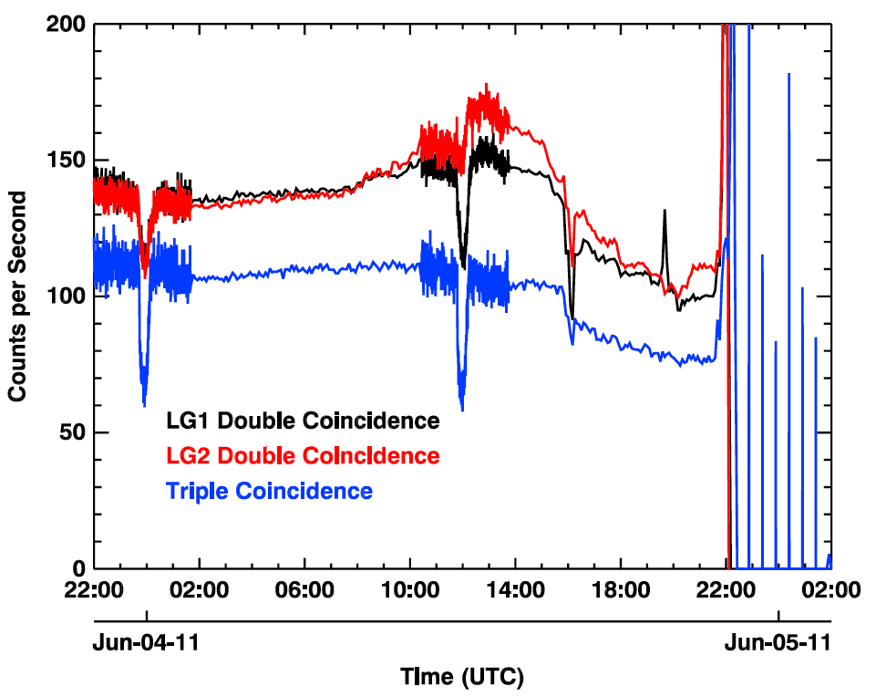
Evidence for Solar Neutrons #1: Measured Energetic Particles
No protons with energy > 45 MeV during neutron event.
Strong evidence against local neutrons.
p: 45<E<100 MeV
e: 7<E<25 MeV
p: >120 MeV
e: >30 MeV
Medium-energy protons and/or electrons
High-energy protons and/or electrons

Slide 14
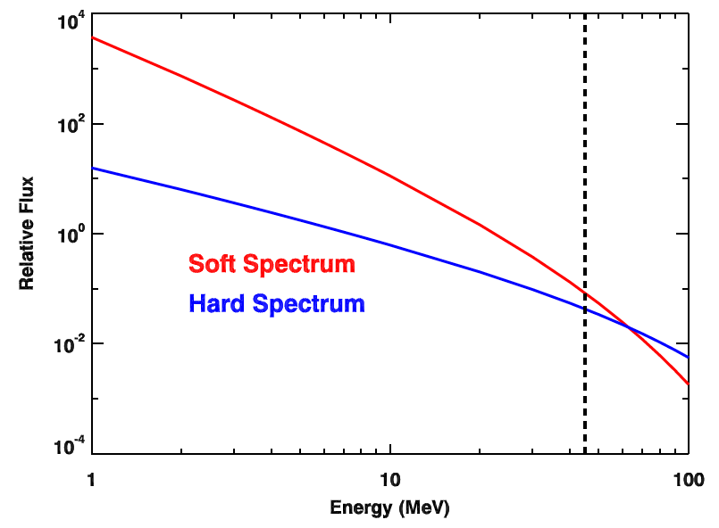
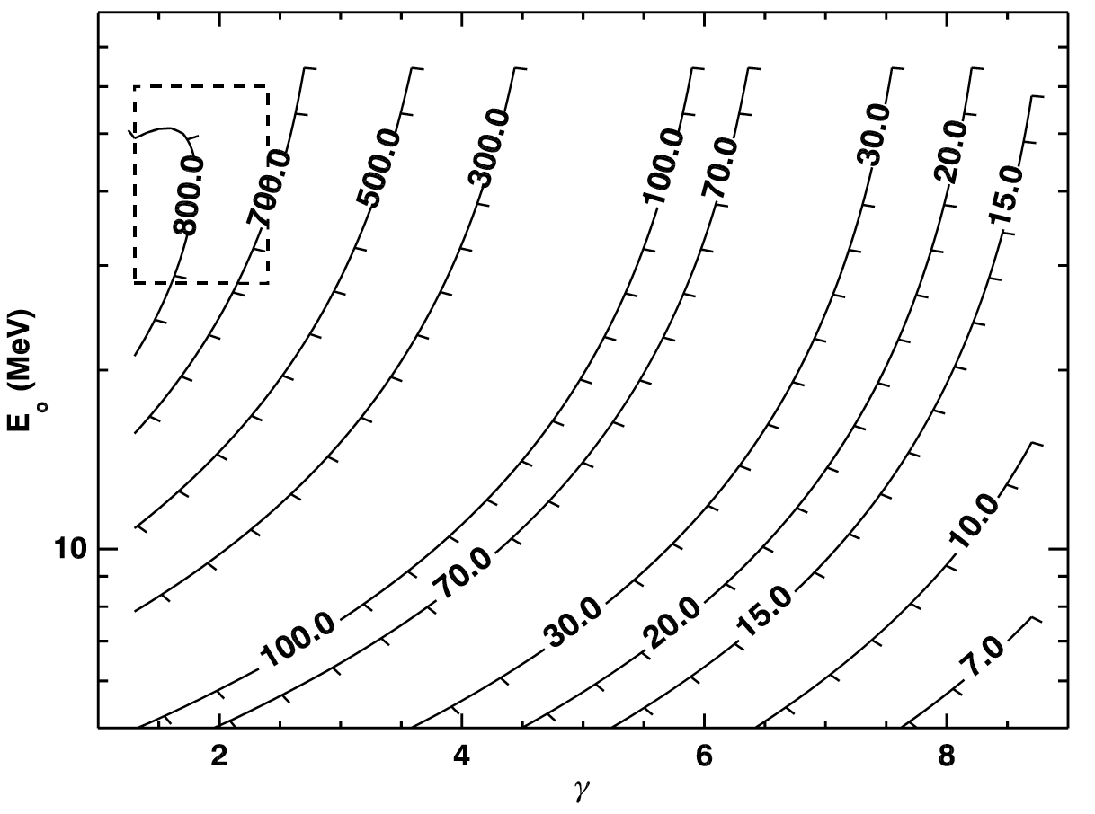
Evidence for Solar Neutrons #2: Estimate of Local Neutrons
Could lower-energy protons escape detection, but still produce neutrons?
Characterize proton spectra by:
Constrain spectral magnitude with >45 MeV measurements.
Estimate local neutrons
Measured 700 – 800 times more neutrons than estimated from local production.
Local neutrons would require unlikely proton spectrum.
NS Threshold
Constrain with NS
Typical proton spectra
Countours =
Measured/Predicted local

Slide 15
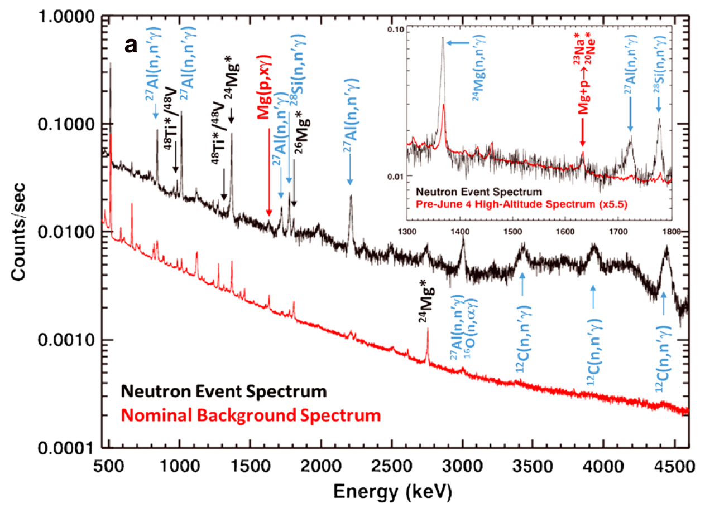
Evidence for Solar Neutrons #3: Gamma-ray Measurements
MESSENGER Gamma-Ray Spectrometer measured data during event.
Many lines produced by neutron reactions.
Consistent with either solar or local neutrons.
One line (1635 keV) only produced by proton reaction.
No count rate increase implies no energetic protons.
Notes:
Point out that proton peak does not change.

Slide 16
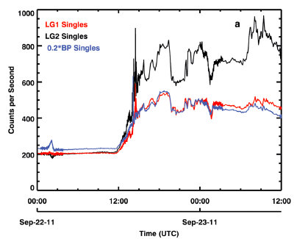
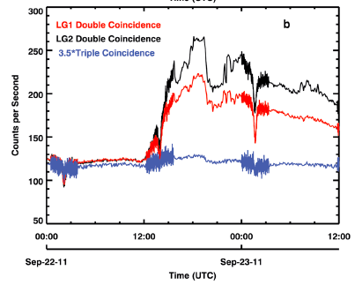
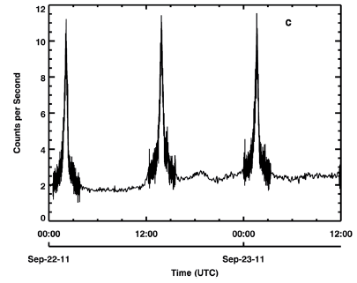
Evidence for Solar Neutrons #4: Gamma-ray Measurements
Singles
Coin.
Detect neutrons and energetic particles on 22 Sep. 2011.
What do gamma-rays show?
Neutrons
Notes:
Point out that proton peak does not change.

Slide 17
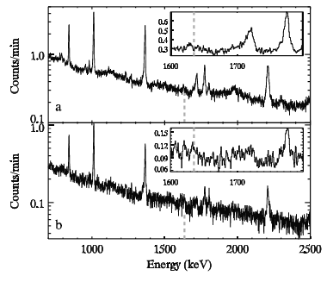
Evidence for Solar Neutrons #4: Gamma-ray Measurements
GRS operated for both June 4 and Sep. 22 events.
1635 keV peak enhanced by 2.4±0.4 on Sep. 22 compared to June 4.
>5σ detection.
Implies energetic protons present on Sep. 22.
Modeled solar-to-local neutron production is 1.5.
Consistent with local production on Sep. 22 but not on June 4.
June 4, 2011
Sep. 22, 2011
Notes:
Point out that proton peak does not change.

Slide 18
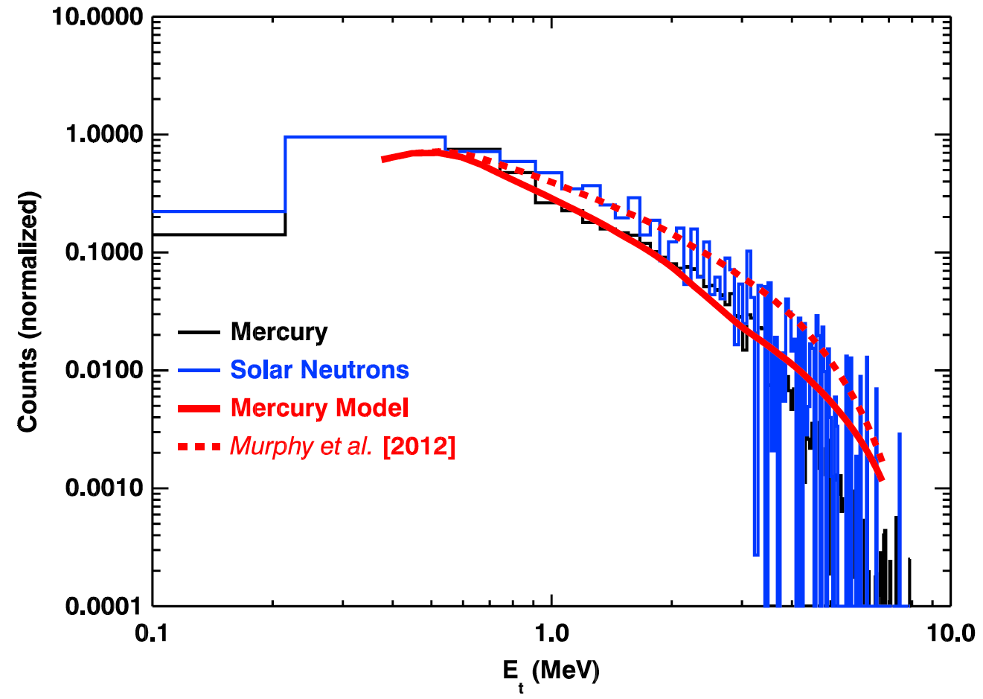
Evidence for Solar Neutrons (supporting): Energy Spectra
NS measures neutron energy spectrum.
Processed through spacecraft.
Neutron event enhancement at 0.7 – 3 MeV.
Model spectra to account for spacecraft processing
Use Mercury and solar neutron input spectra.
Solar neutron input consistent with neutron event measurement.
Solar neutron model
Notes:
We have modeled the spacecraft processing.

Slide 19
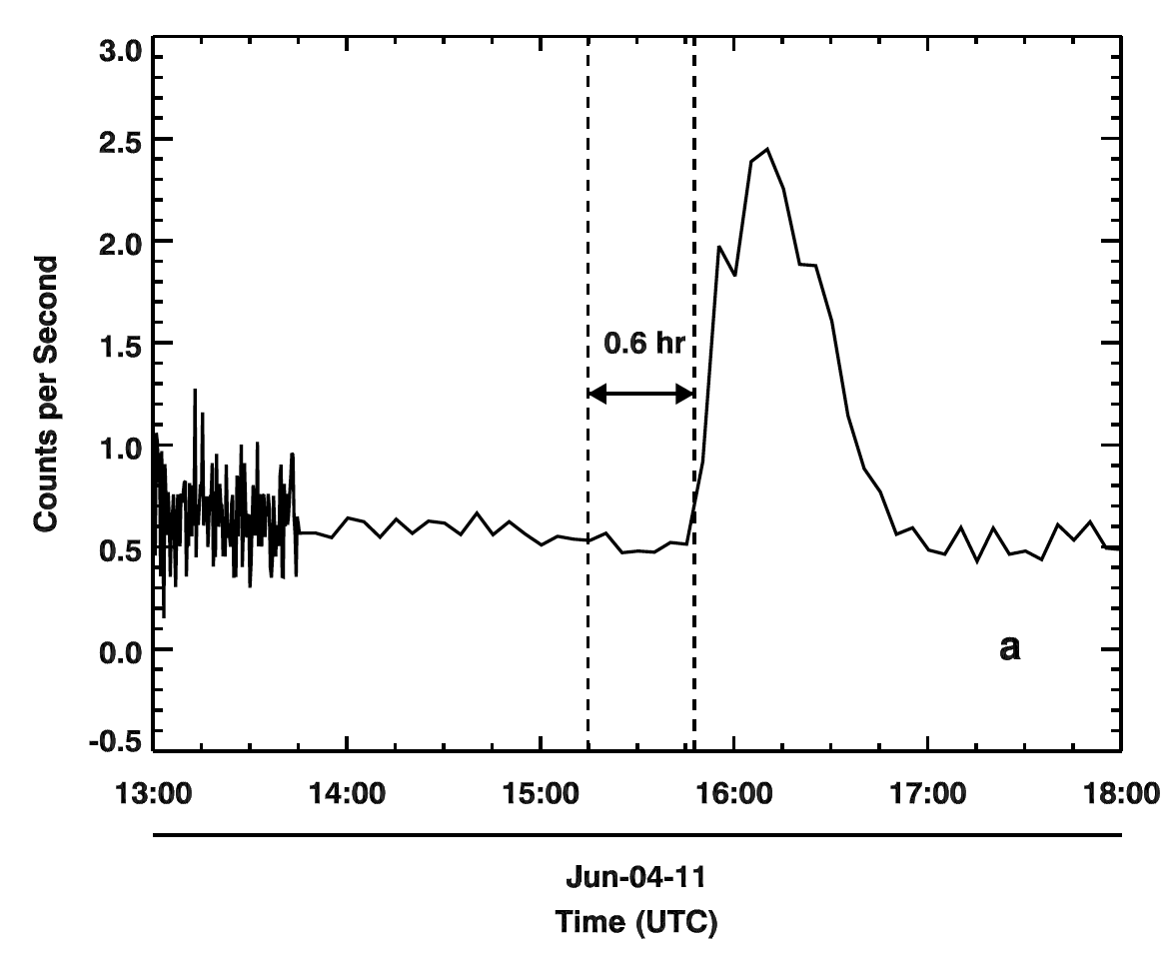
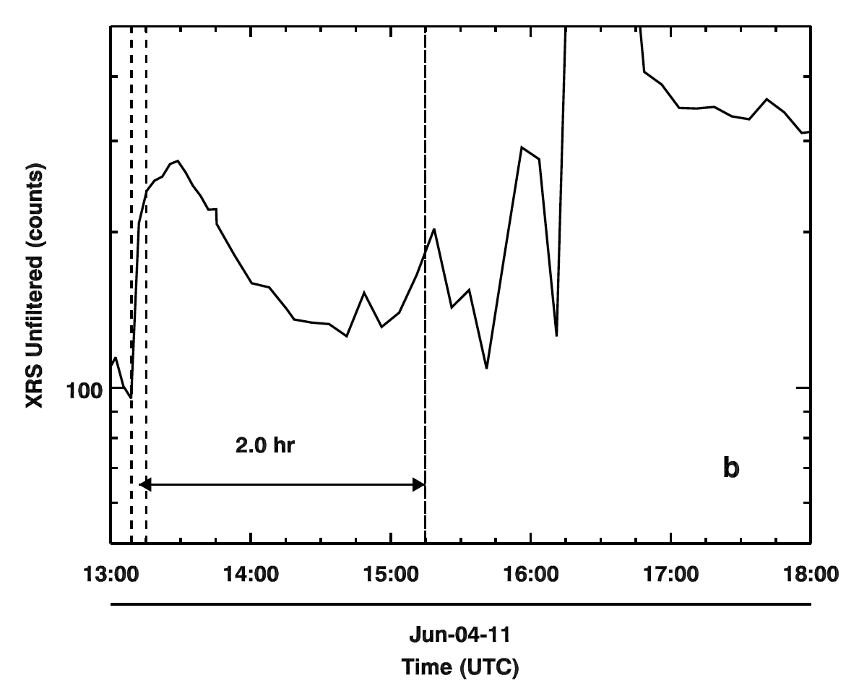
NS Event Timing
If initial neutrons have E ≈ 3 MeV, then neutrons left Sun 0.6 hour prior to detection
MESSENGER X-ray Spectrometer (XRS) detected enhanced X-ray flux 2.6 hours prior to observed start of neutron event
X-ray emission may be start of impulsive phase of flare event
X-ray emission occurred 2 hours prior to departure of 3 MeV neutrons from Sun
Fast
Neutrons
MESSENGER
X-rays

Slide 20
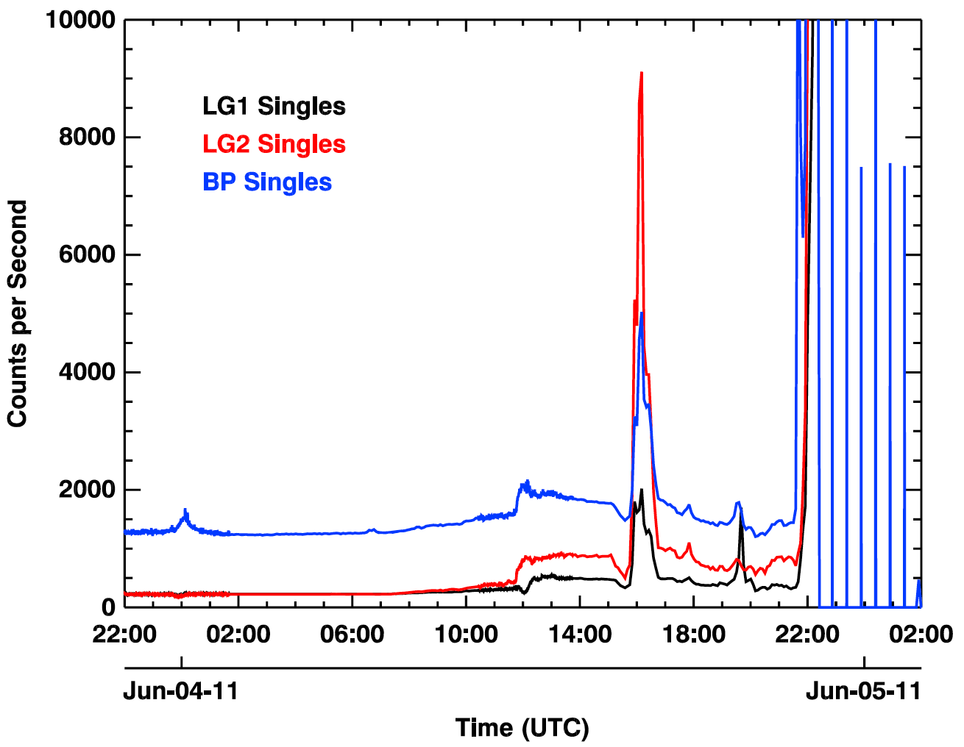
Solar Neutrons? Remaining Uncertainty
NS measures lower-energy particles (singles events).
Cannot tell difference between protons, electrons, gamma-rays.
Enhancement seen during neutron event.
Could be lower-energy protons.
Remember evidences #1, #2, #3, and #4.
May be characteristic of neutrons hitting a spacecraft.
How to resolve?
Cannot directly resolve with data.
MESSENGER payload cannot measure details of energetic particles.
Use transport and instrument models to infer energetic particle parameters.
Lower energy particles
protons 10<E<45 MeV and/or
electrons 0.6<E<4 MeV and/or
gamma-rays 0.6<E<4 MeV

Slide 21
Implications of June 4, 2011 Event
Multiple lines of evidence argue for solar origin.
Large number of neutrons at the Sun.
Scale from modeled fluence @ Sun (Murphy et al., 2012)
Neutrons (0.5 – 10 MeV): 2 x 10³¹ n/Sr.
Scale 0.05 – 1.5 GeV Earth-based measurements (Vilmer et al., 2011) from large flare to 0.5 – 10 MeV:
2.8 x 10³² – 5.8 x 10³⁴ n/Sr.
Neutrons produced by heavy ions?
Heavy ions have low-energy threshold for neutron production.
Information about soft ion spectra and low-density environments (Vilmer et al., 2011).
New type of event?
New information about solar acceleration and composition?
Maybe not
too large?

Slide 22
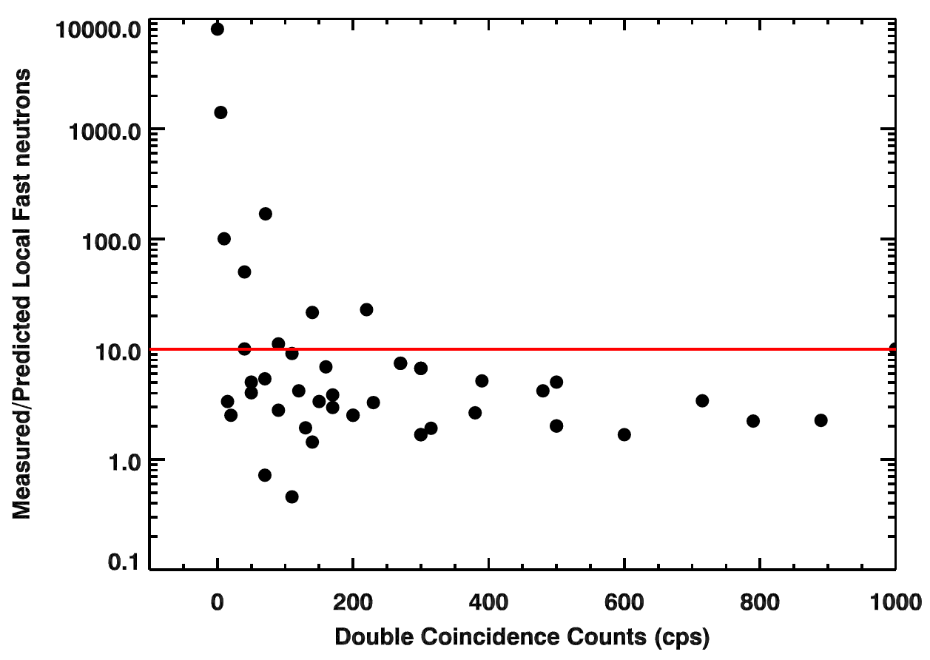
Future work
MESSENGER NS only neutron detector in inner heliosphere.
NS detected 54 neutron events.
12 events have large measured-to-predicted ratio (>10) – “likely solar”
Correlate with other datasets:
Japanese scintillating fiber (FIB) solar neutron detector on Space Station (Muraki et al., 2012).
Likely solar events
Measured/Predicted Local Neutrons
Number Protons with 45<E<120 MeV (count rate)

Slide 23
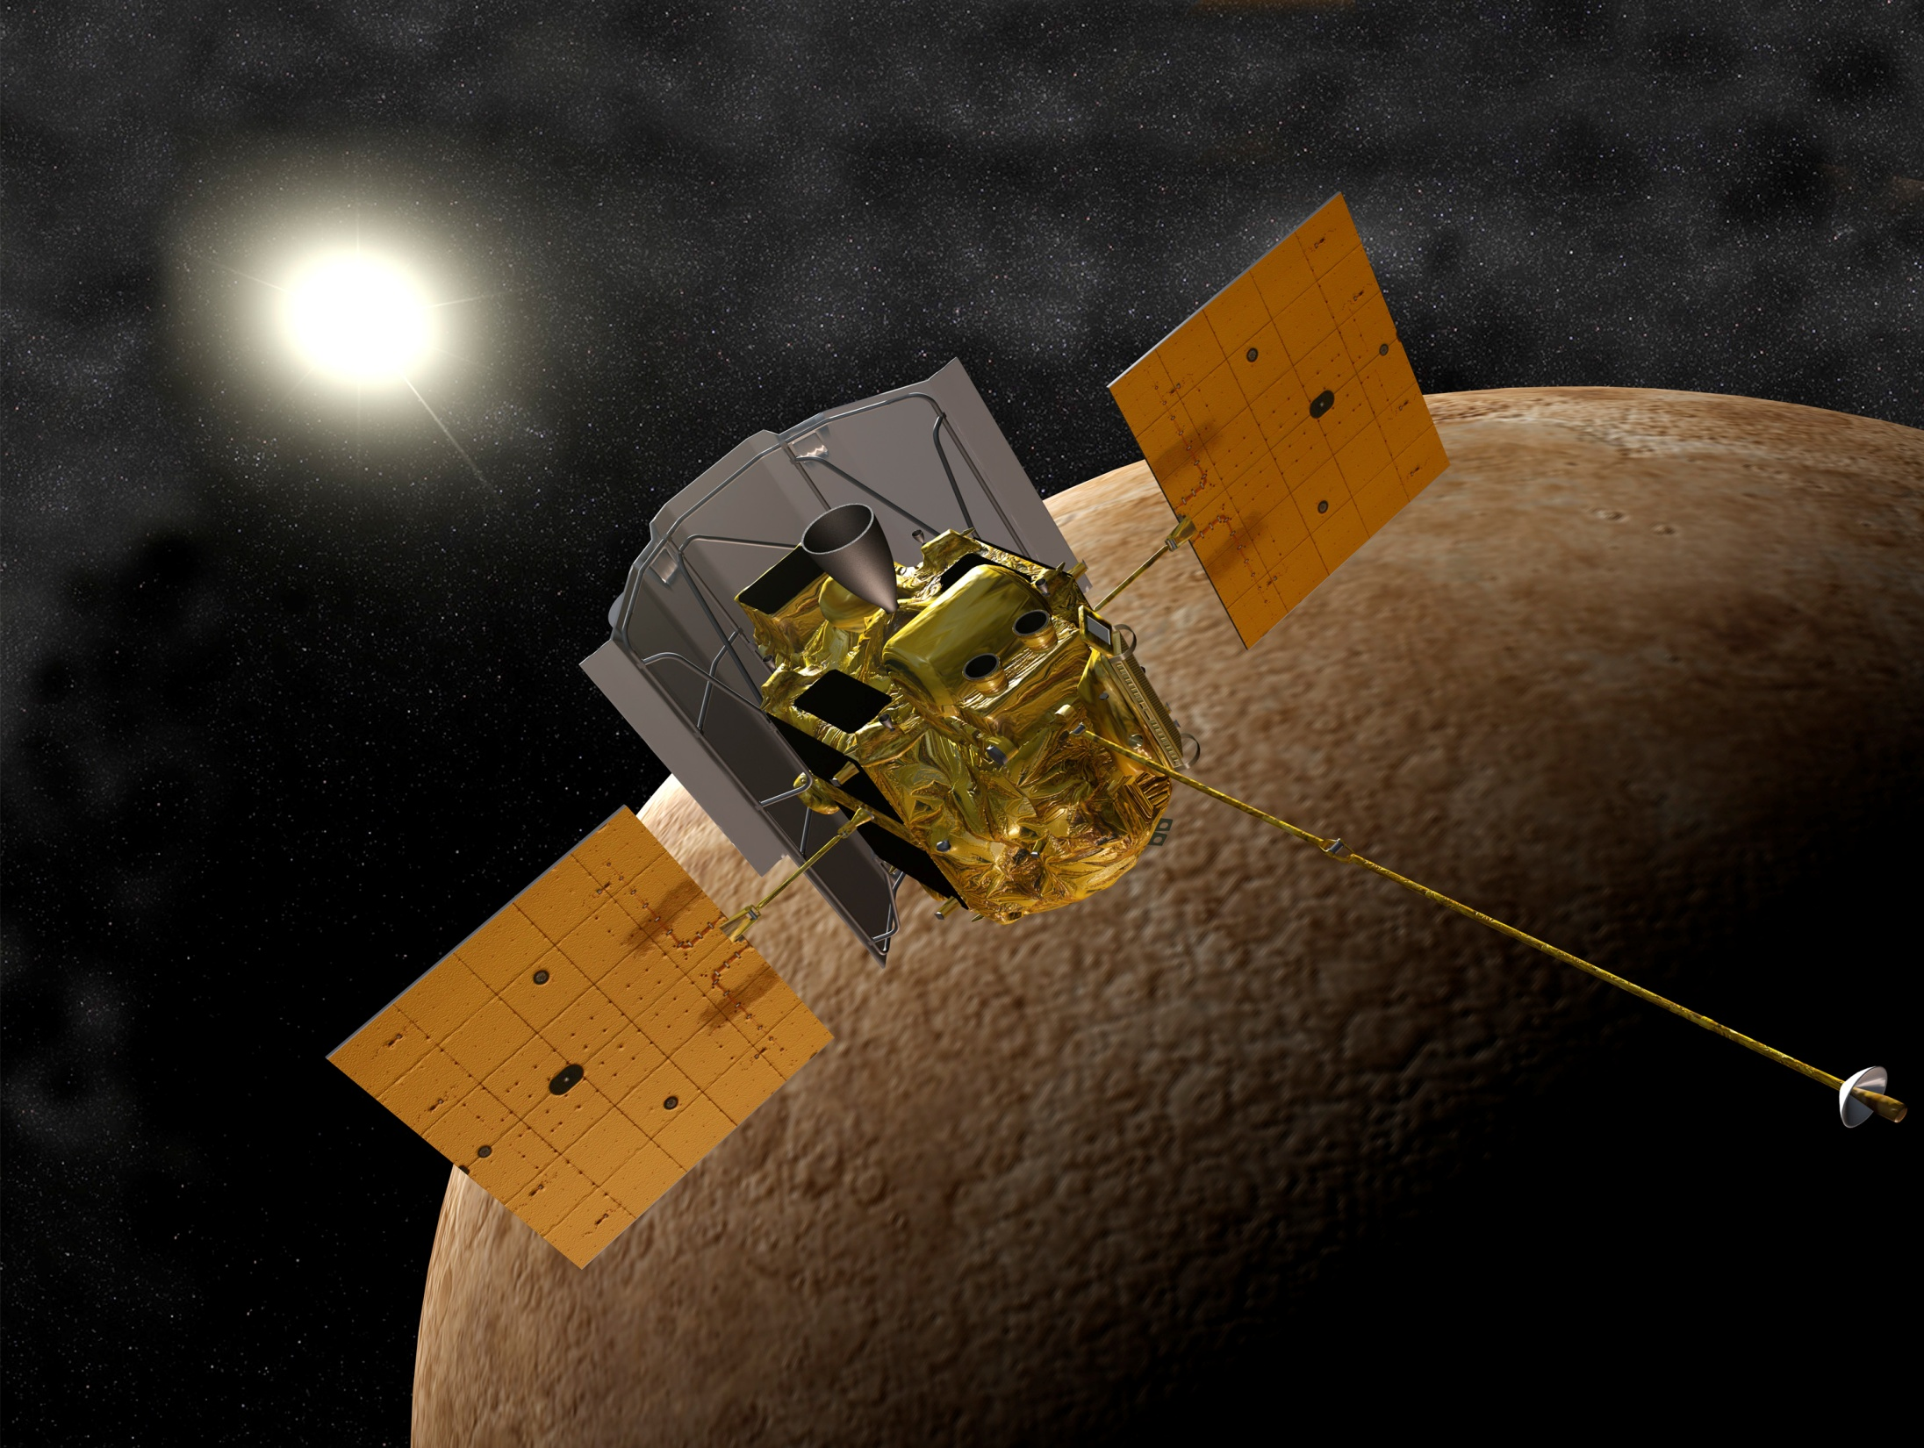
Conclusions
Bringing a neutron detector close to the Sun gave us something new.
New type of solar event; not predicted.
Might not be unusual during solar maximum
54 neutron events.
12 likely solar.
Use to understand solar acceleration/composition.
Expect new phenomona from upcoming missions (Solar Probe Plus, Solar Orbiter)
MESSENGER at Mercury with Sun in background

Slide 24
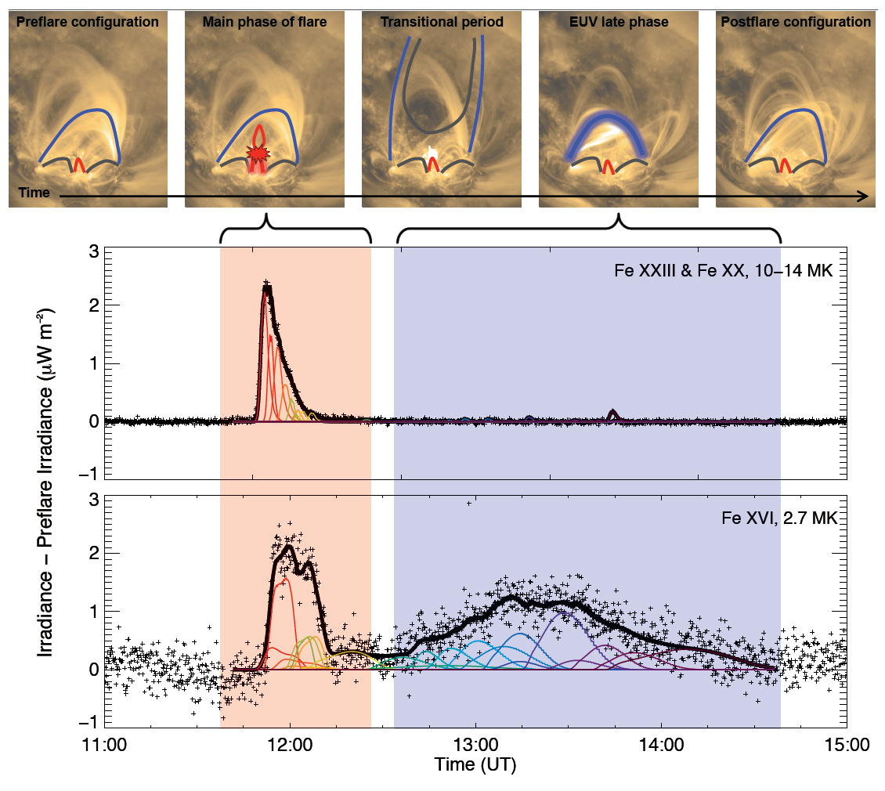
Relation to Late Phase EUV Flares?
Data from Solar Dynamics Observatory (SDO) EVE experiment identified new type of solar flare event (Woods et al., 2011)
Event type characterized by “late phase” extreme ultraviolet (EUV) emission
Late phase emission occurs 1 to 3 hours after impulsive emission and lasts few hours
Late phase emission occurs higher in corona than early, impulsive emission
Late phase delay timing and duration consistent with measured neutron emission
SDO EVE, http://www.nasa.gov/mission_pages/sdo

