Slide 1
Spring meeting ISSI team: status update
Emmanuel Dinnat
NASA Goddard Space Flight Center
Chapman University

Slide 2
Fortran code for two scale model update
Model code is being updated with following objectives:
Translation from French to English:
Files and Folders names (incl. Makefile) ✓
Comments ✓
Error and status messages ✓
Variable names (needed ?) ✓ (some natively in English, but legacy French)
Improve comments to ensure clarity of code to broader audience ✓
Remove debugging sections ✗
Final validation:
The code compiles without error on modern Fortran compilers ✓ (tested with gfortran only, x86_64 architecture)
The code produce accurate results compared to reference lookup table ✓ (tested on limited model selection)

Slide 3
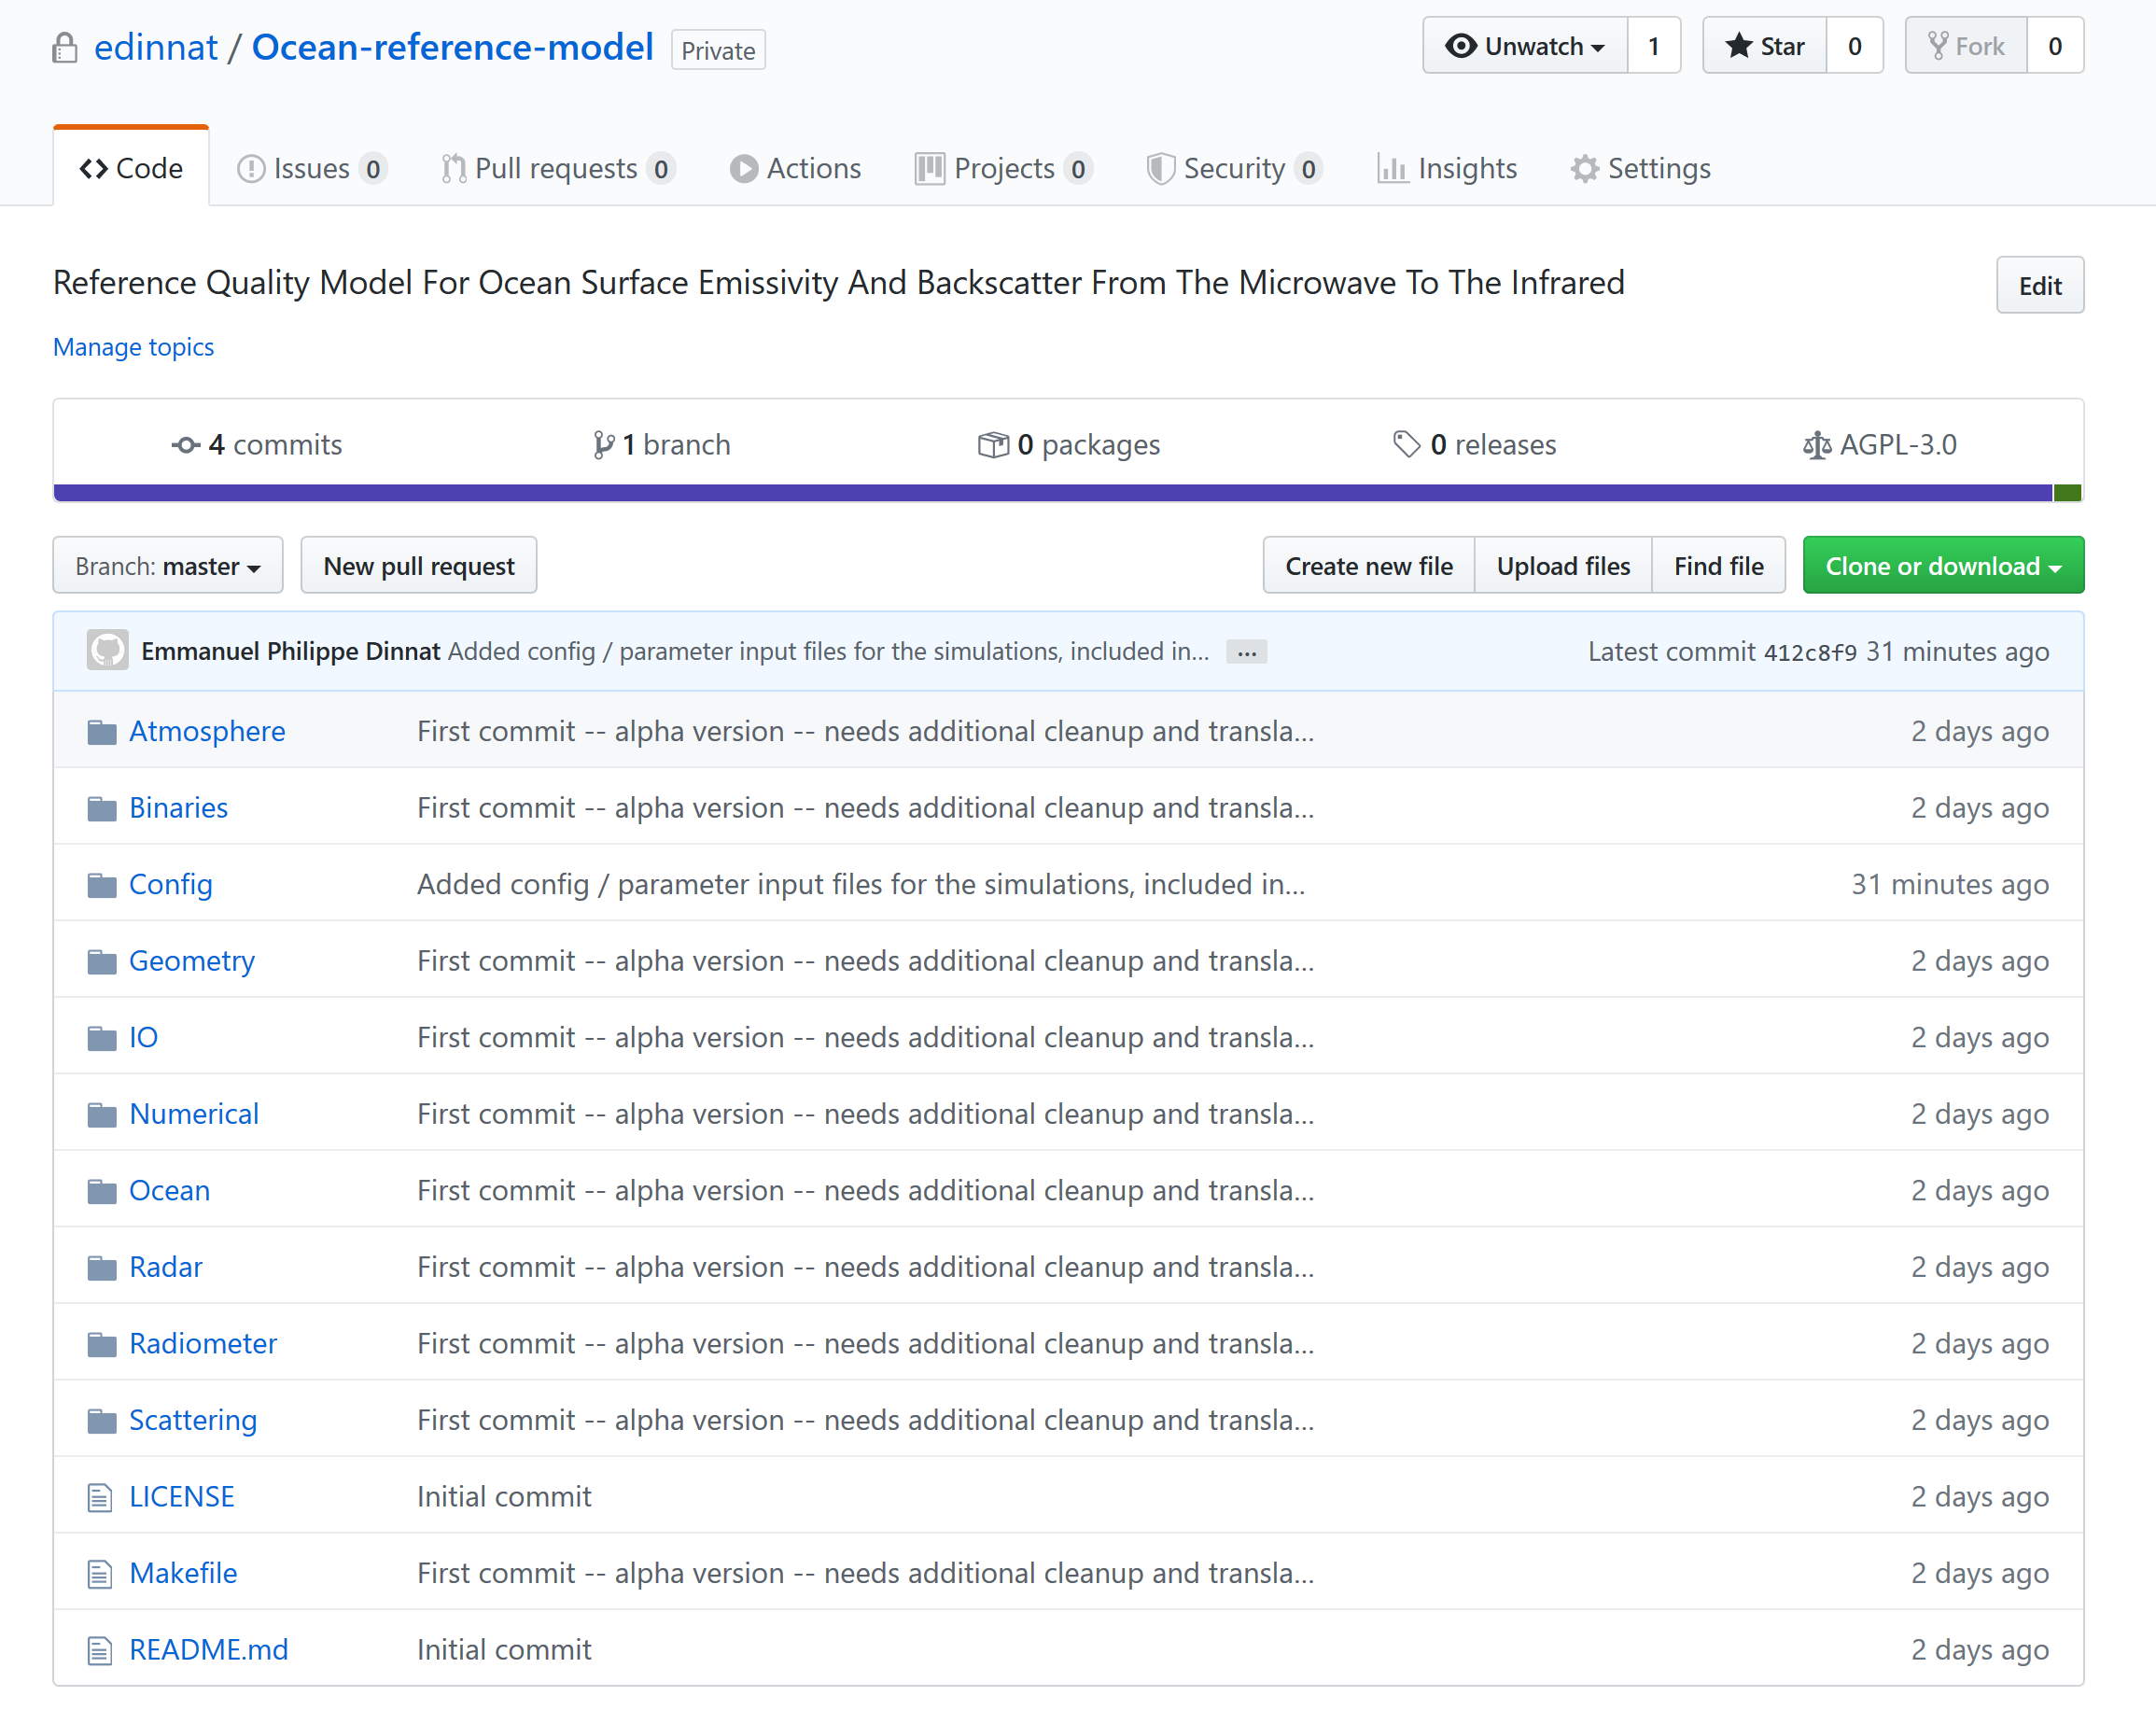
Code uploaded on GitHub with AGPL license
https://github.com/edinnat/Ocean-reference-model

