Slide 1






Correcting sea surface temperature spurious effects in salinity retrieved from spaceborne L-band Radiometer measurements
J. Boutin⁽¹⁾, J.L. Vergely⁽²⁾ , E. Dinnat ⁽³⁾, P. Waldteufel ⁽⁴⁾, Francesco D’Amico⁽⁵⁾, N. Reul⁽⁶⁾, A. Supply⁽¹⁾ and Clovis Thouvenin-Masson⁽¹⁾
⁽¹⁾
⁽²⁾
⁽³⁾
⁽⁴⁾
⁽⁵⁾
⁽⁶⁾

Slide 2
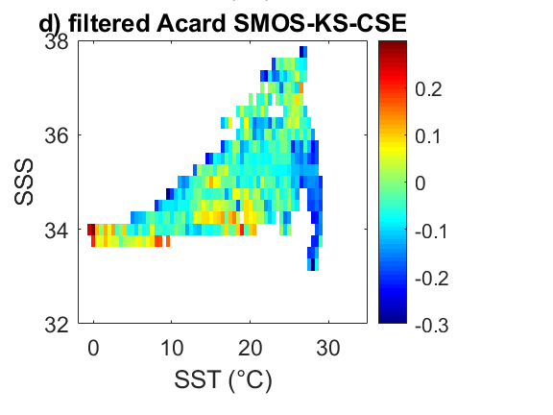
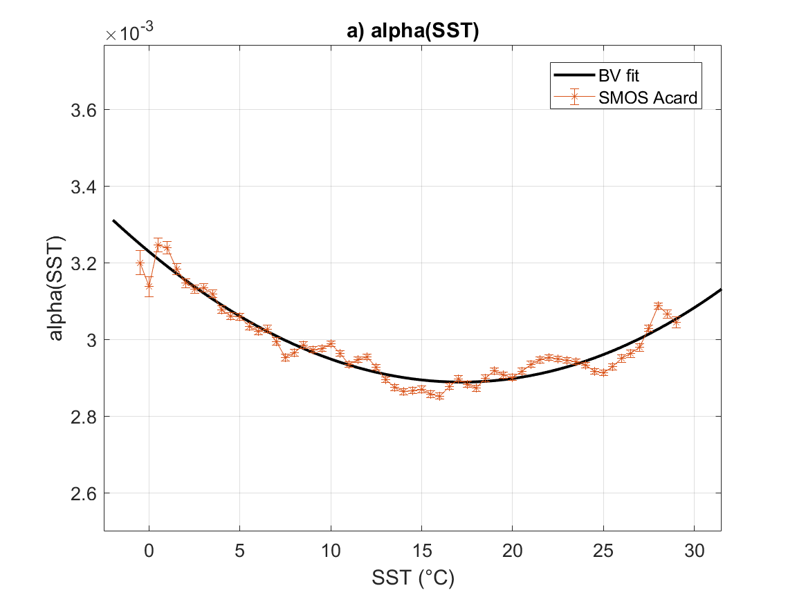
Adjustment of permittivity model
Use SMOS retrieved pseudo-dielectric constant (ACARD) (Waldteufel et al. 2004)
Adjust specific permittivity (α parameter) in Somaraju and Trumpf (ST) model at L-Band:
ACARD SMOS – ACARD KS
ST value derived from fits of Ellison, MW’04, Stogryn97 models
using in situ (Argo & ships) SST & SSS, after filtering and correction of conditionnal sampling effect, 5<WS<9m/s,
=>

Slide 3
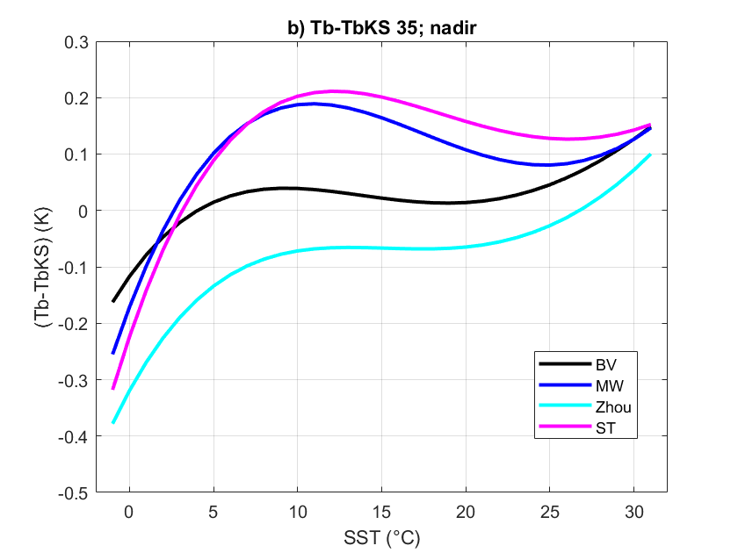
New BV parametrization of dielectric constant
Modelled Tb Adjust specific permittivity (α parameter) in ST model at L-Band:
New parametrization => close to KS at moderate SST, variation at low and high T parallel to Zhou at 35 and 33pss (absolute calibration is arbitrary)
Boutin et al., 2020

Slide 4
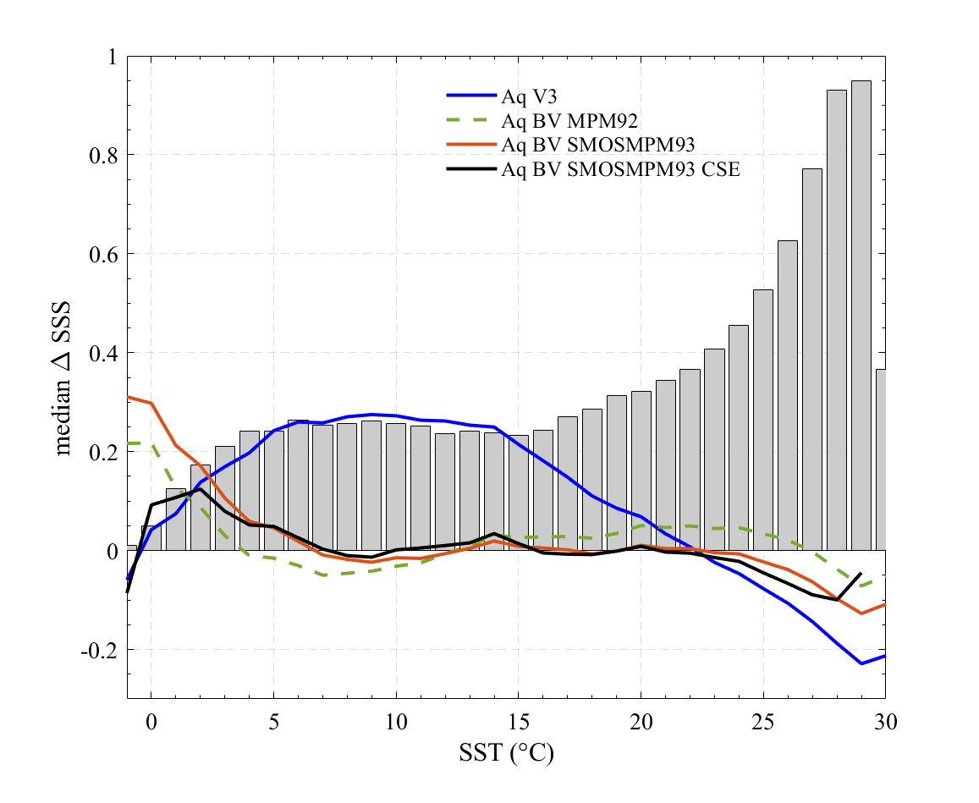
Validation using Aquarius data
KS
MW
MW
BV-Liebe 92
BV-SMOS-Liebe 93
BV + SMOS-Liebe93+ SST cond. effect
New BV dielectric constant => |SSSaq-SSSargo| <0.1
(and <0.05 between 5 and 25°C) – similar results when applied in SMOS processing

