Slide 1
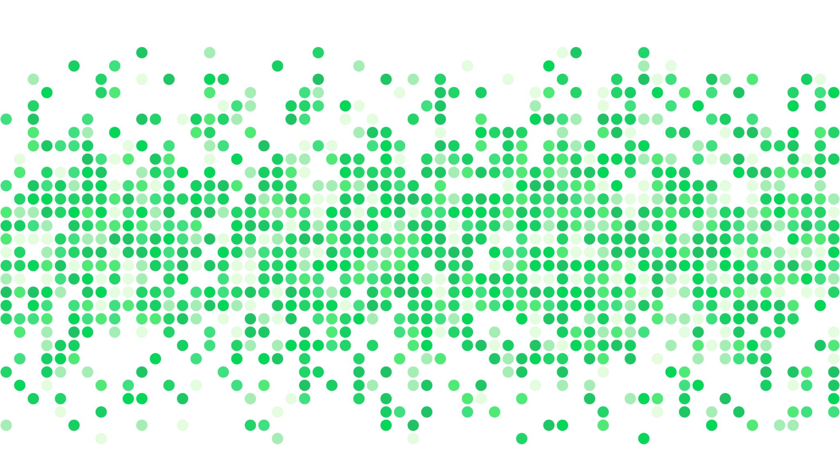
Dielectric Model Uncertainty
Thomas Meissner

Slide 2
Ellison – Meissner Wentz 2012.
SST from 0°C to 30°C in steps of 1°C.
SSS from 30 psu to 38 psu in steps of 0.5 psu.
∆TB surface = ∆Emissivity ·SST (Kelvin).
Earth Incidence Angle = 55°.
Freq [GHz] | Bias v-pol [K] | Bias h-pol [K] | SDEV v-pol [K] | SDEV h-pol [K]
1.4 | 1.05 | 0.54 | 0.11 | 0.07
7.0 | 1.13 | 0.63 | 0.16 | 0.09
10.7 | 1.26 | 0.72 | 0.24 | 0.15
18.7 | 1.61 | 0.98 | 0.48 | 0.32
37.0 | 2.57 | 1.78 | 0.87 | 0.70
89.0 | 4.52 | 4.20 | 1.11 | 1.42
Remove biases (systematic differences).
Part of ocean target calibration: <TB (satellite)> = <TB (ocean)>.
Focus on standard deviations.

Slide 3
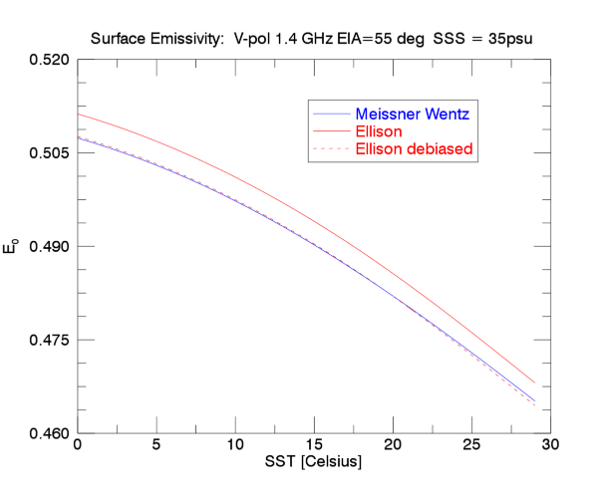
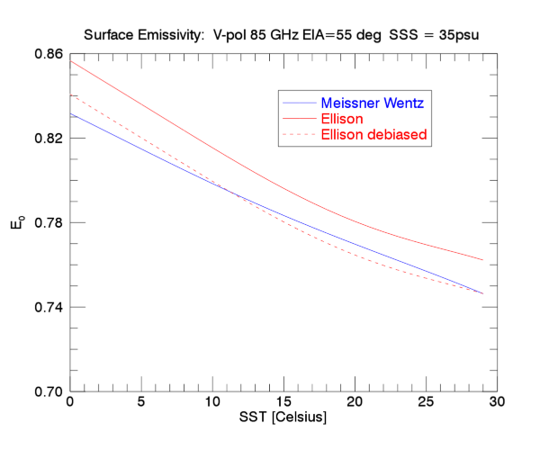
Error bar in emissivity = RMS difference between blue and red-dashed curves.

Slide 4
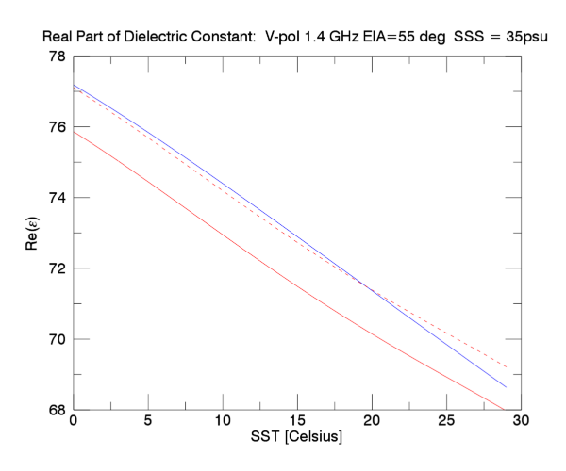
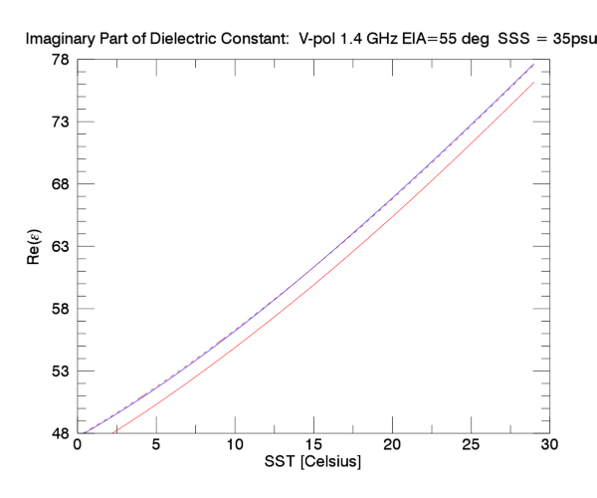
Error bar in Re(ε)/Im(ε) = RMS difference between blue and red-dashed curves.
Same method can be used to determine error bars in Debye parameters: ε_{S}, ε₁, ε∞, ν₁, ν₂, σ

