Slide 1
Sea foam modeling from
L band to millimeter wave frequencies
Progress report
A Reference Quality Model for Ocean Surface Emissivity and Backscatter from the Microwave to the Infrared
Team led by S. English (UK) & C. Prigent (FR)
Sponsor: ISSI (International Space Science Institute)
Magdalena D. Anguelova
maggie.anguelova@nrl.navy.mil
Science team meeting 2
30 April 2020
Via Internet

Slide 2
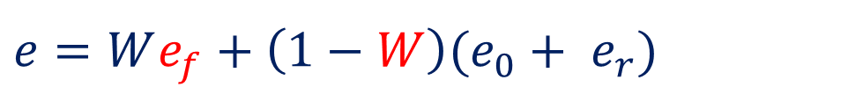
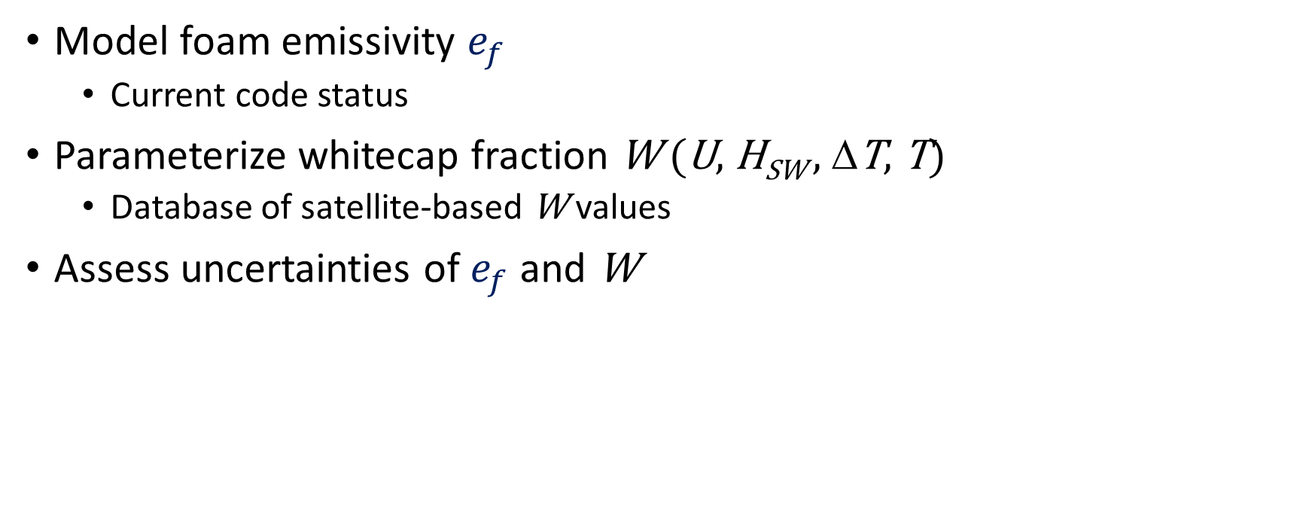

Topics related to modeling foam emissivity
$e=We_{f}+\left(1−W\right){(e_{0}+ e}_{r}$)
$W(U)=aUb$
Model foam emissivity $e_{f}$
  Current code status
Parameterize whitecap fraction W (U, H_{SW} , ΔT, T)
  Database of satellite-based W values
Assess uncertainties of $e_{f}$ and W

Slide 3
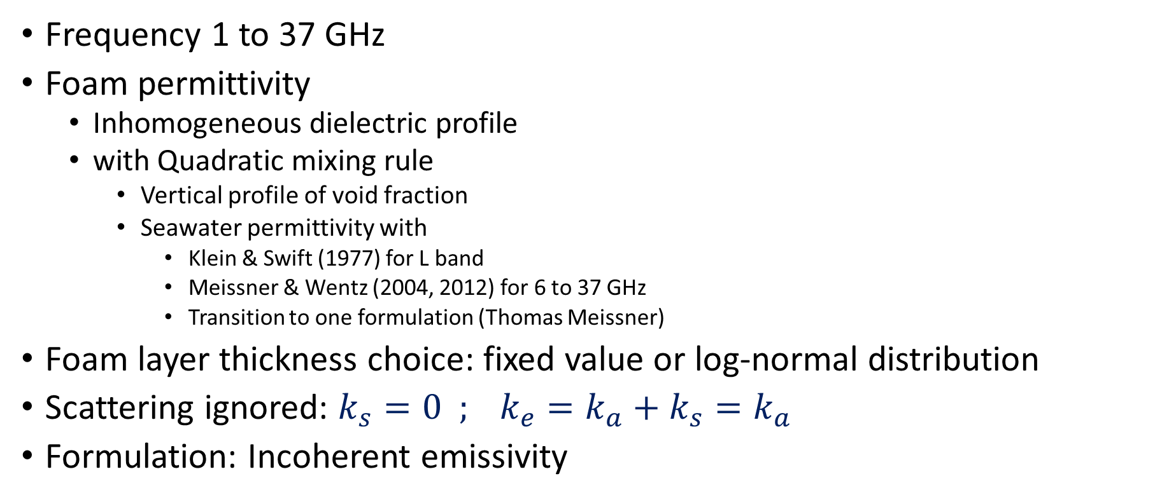
RTM for foam emissivity
Air, , ε₀=1
Frequency 1 to 37 GHz
Foam permittivity
  Inhomogeneous dielectric profile
  with Quadratic mixing rule
    Vertical profile of void fraction
    Seawater permittivity with
      Klein & Swift (1977) for L band
      Meissner & Wentz (2004, 2012) for 6 to 37 GHz
      Transition to one formulation (Thomas Meissner)
Foam layer thickness choice: fixed value or log-normal distribution
Scattering ignored: ${k_{s}=0 ; k}_{e}=k_{a}+k_{s}=k_{a}$
Formulation: Incoherent emissivity
z = 0
Foam, ε_{f} (z)
z = d
Seawater, , ε

Slide 4
Formulation of incoherent emissivity for a profile
dT_{str}= T_{s} .α_{f} . secθ_{f} dz
dz

Slide 5
Implementation of incoherent emissivity
LOCEAN implementation
  Yin et al. (2016) based on NRL model
  F90 code from Lise Kilic (Kilic et al., 2019)
NRL implementation
  Anguelova & Gaiser (2013)
  IDL code
Implementations differences
  Numerical integration
    Trapezoid vs. Simpson rules
  Calculations of r₂
    Formula error in NRL
    Improper subroutine inputs in LOCEAN
  Incoherent emissivity formulation
    NRL code uses the general e_{inc} formulation
    Ulaby et al. (1986) give formula for e_{inc} of a dielectric layer with constant parameters
    LOCEAN code uses a mix of the two formulations
2
2

Slide 6
Compare codes
Compare codes as they are
  1.4 GHz, fixed EIA
  Fixed layer thickness of 2 cm
  Void fraction from 95% to 1%
  MetOC conditions SST & SSS
Results: Small differences
    1% for e_{H} and 2% for e_{V}
Code modifications
  Calculations of r₂
    Formula error in NRL fixed
    LOCEAN subroutine inputs changed
  Everything else remains the same
New comparison results
  Increase in e_{H} and e_{V} by 1%-2% with both LOCEAN and NRL codes
  LOCEAN and NRL results differ by at most 1% for L band

Slide 7
To do next
Write all formulae to give to team members for check
Use LOCEAN F90 code as is with only r₂ modified for 6 to 37 GHz
Compare to NRL IDL code
Depending on differences, decide which formulation to use: full profile versus mixed profile-constant parameters
New module for thickness distribution as a choice
Continue work on scattering modeling for higher frequencies
Modify incoherent emissivity code to incorporate scattering

Slide 8
Whitecap fraction
Made whitecap database for 2014 and 2017
  W from WindSat
  Meteo variables from NAVGEM and ECMWF Reanalysis (ERA Interim)
  Ocean variables from WaveWatch III model: Partition windsea and swell
Parametrization W (U, H_{SW} , ΔT, T)
  New project starts in Oct 2020
  Will use this database to make new parametrizations
New ideas to use this whitecap database to assess W uncertainty
This summer: update W database from in situ data
  Use it for assessing the uncertainty of in situ W data
  Decide if in situ W data can serve as a reference for satellite W data

