Slide 1
Initial MW/IR model comparison
Stu Newman
ISSI team progress meeting
8 December 2020

Slide 2
Summary of models: | Ocean reference model (E. Dinnat) | IREMIS in RTTOV (J. Hocking, M. Matricardi)
Dielectric properties | Klein & Swift (1977) or Ellison (1998) | Hale & Querry (1973) Pinkley & Williams (1976) Newman et al. (2005)
Geometric optics (large scales, slope variance) | Cox & Munk (1954); or Elfouhaily (1997), Durden & Vesecky (1985) sea spectrum | Masuda (2006) including multiple reflections Cox & Munk (1954) or Ebuchi & Kizu (2002)
Bragg scattering (small scales) | Small perturbation method (two scale model) | ─
Foam | e.g. Monahan (1986) or other options for fraction; Stogryn (1972) emissivity | None

Slide 3
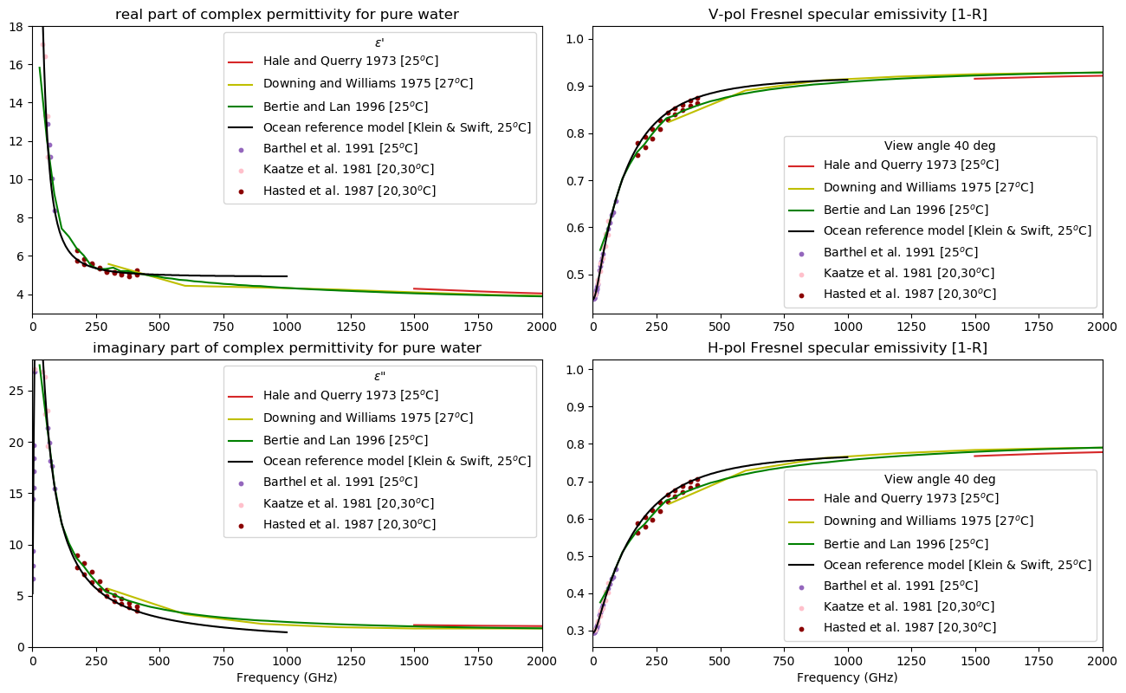
The complex dielectric constant of pure and sea water from microwave satellite observations
T. Meissner; F.J. Wentz (2004)

Slide 4
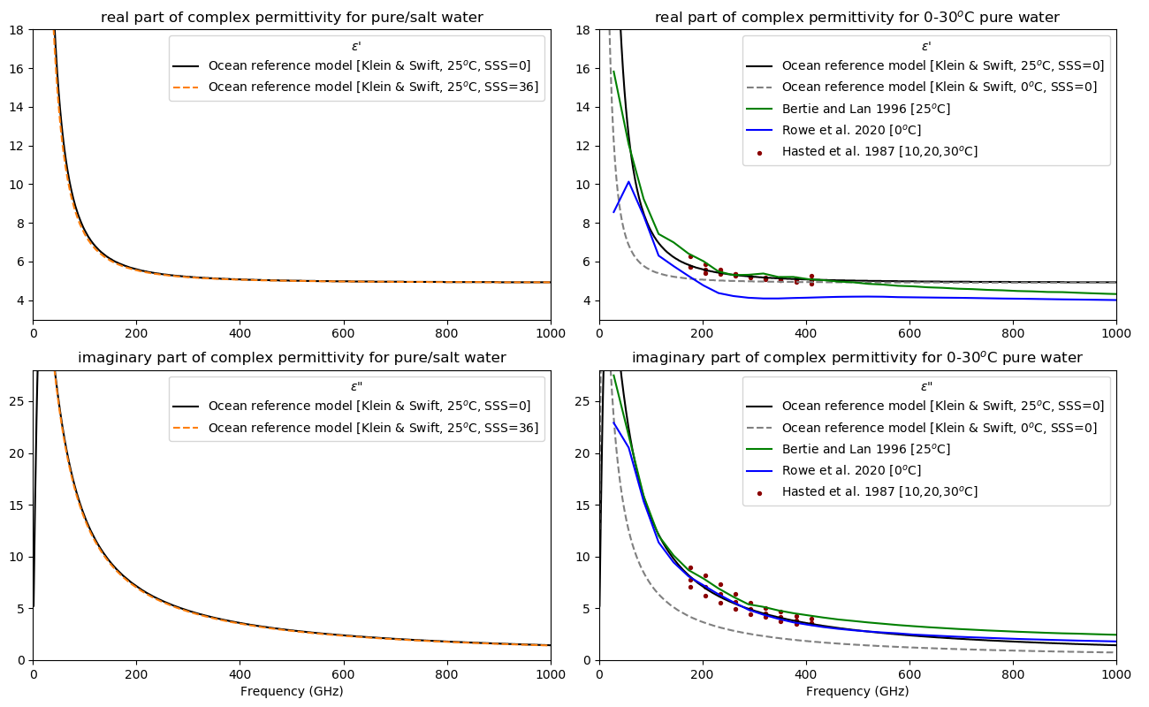

Slide 5
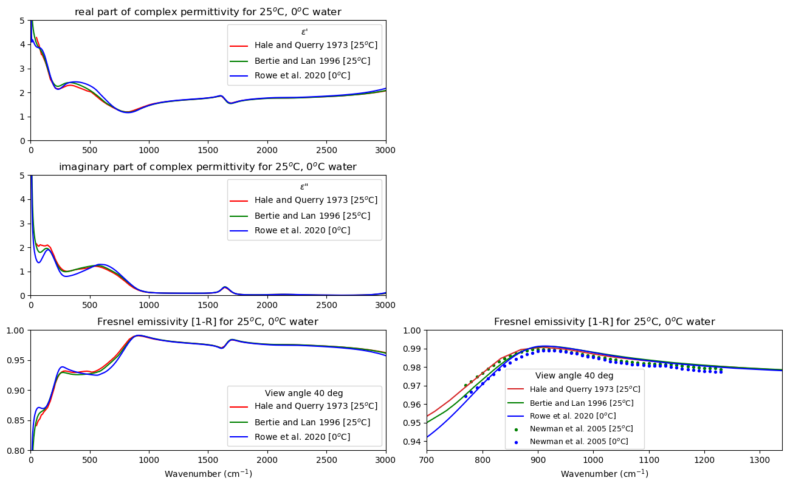
30000 GHz

Slide 6
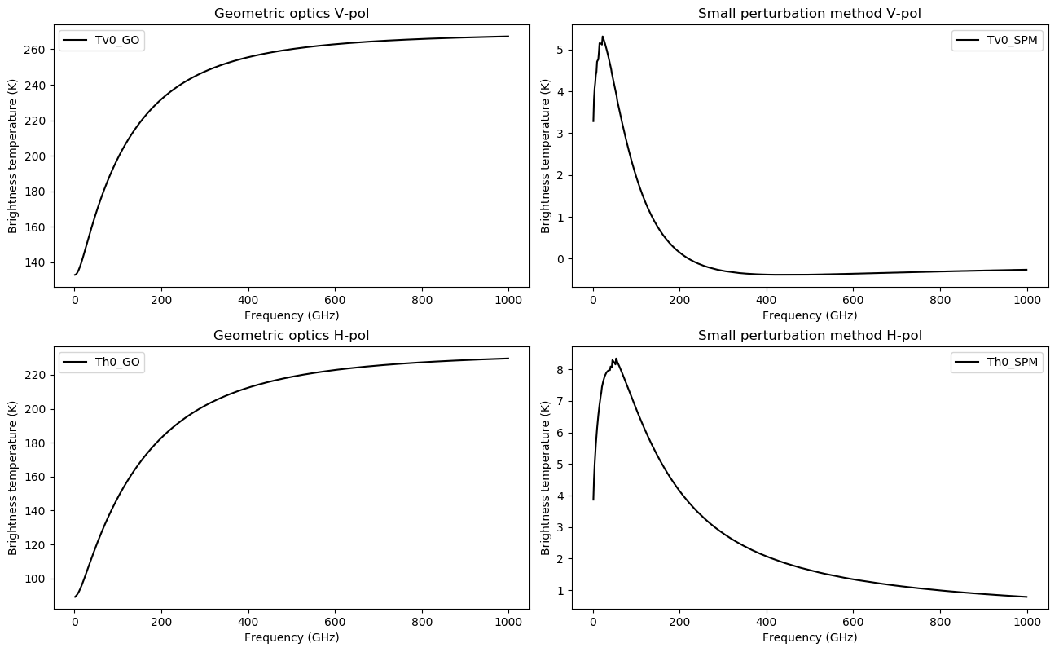
40° incidence angle
12 m/s wind speed
SST = 25°C
SSS = 36
Klein & Swift (1977) dielectric properties
Durden & Vesecky sea spectrum
Monahan (1986) foam fraction
Stogryn (1972) foam emissivity
Two-scale cutoff wavenumber(s) (rad/m)
[Used 2*pi/wavelength/N with N = 5]

Slide 7
Summary
In IR we have limited data on temperature and salinity dependence of water optical properties (preferably with uncertainty estimates)
Consider how to extend IR dielectric properties consistent with MW dielectric properties for full spectral coverage (Hale & Querry data baseline in the IR)
Issue of frequency range of applicability for single/double Debye models in MW
Consider appropriate two-scale cutoff wavenumber for extended spectral range in reference model
Next steps: compare E. Dinnat’s model with IREMIS for common inputs (same dielectric properties, same [Cox & Munk] slope distribution)

