Slide 1
Sea foam modeling from L band to millimeter wave frequencies Progress report
A Reference Quality Model for Ocean Surface Emissivity and Backscatter from the Microwave to the Infrared
Team led by S. English (UK) & C. Prigent (FR)
Sponsor: ISSI (International Space Science Institute)
Magdalena D. Anguelova
maggie.anguelova@nrl.navy.mil
DISTRIBUTION A: Approved for public release, distribution is unlimited

Slide 2
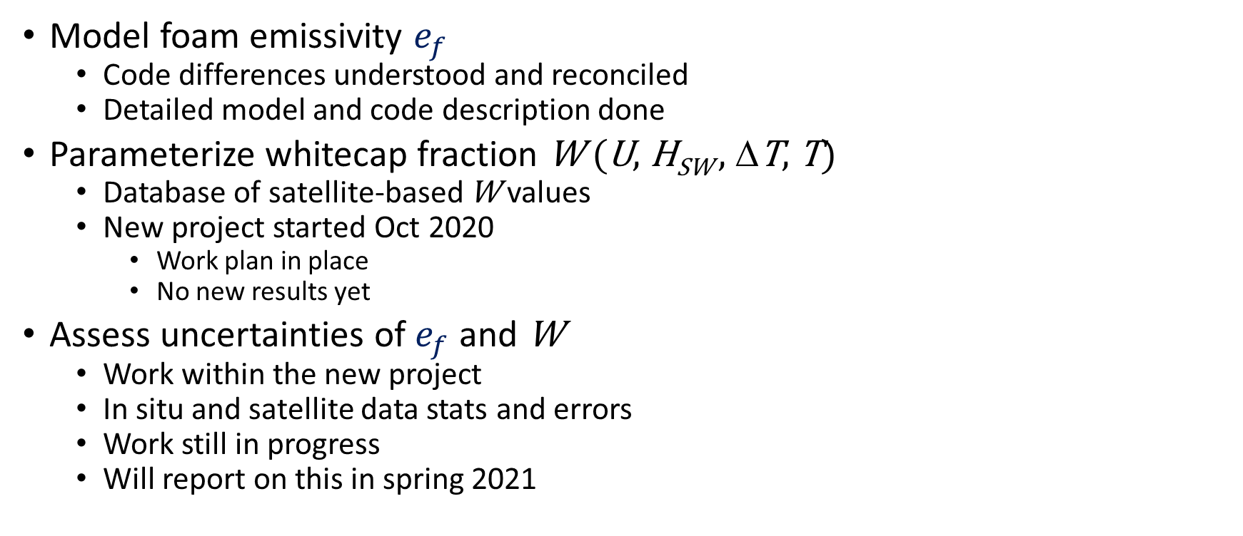
Topics related to modeling foam emissivity
$e=We_{f}+\left(1−W\right){(e_{0}+ e}_{r}$)
$W(U)=aUb$
Model foam emissivity $e_{f}$
Code differences understood and reconciled
Detailed model and code description done
Parameterize whitecap fraction W (U, H_{SW} , ΔT, T)
Database of satellite-based W values
New project started Oct 2020
Work plan in place
No new results yet
Assess uncertainties of $e_{f}$ and W
Work within the new project
In situ and satellite data stats and errors
Work still in progress
Will report on this in spring 2021

Slide 3
RTM for foam emissivity
Air, , ε₀=1
z = 0
Foam, ε_{f} (z)
Frequency 1 to 89 GHz
Foam permittivity ε_{f}
Inhomogeneous dielectric profile ε_{f} (z)
Use Quadratic mixing rule
Vertical profile of void fraction f_{a}(z)
Seawater permittivity ε
Foam layer thickness
Currently work with a fixed value
Will add module for log-normal distribution
Scattering
Currently ignored: ${k_{s}=0 k}_{e}=k_{a}$
Add ${ k}_{e}=k_{a}$ + $k_{s}$ for higher freqs
Work done on $k_{s}$ (will report later)
Emissivity model approach
Incoherent emissivity
Avoid bogus oscillations due to interference
z = d
Seawater, , ε
LOCEAN implementation
Yin et al. (2016) based on NRL model
F90 code from Lise Kilic (Kilic et al., 2019)
NRL implementation
Anguelova & Gaiser (2013)
IDL code

Slide 4
Implementation differences
Permittivity model for seawater
Klein & Swift (1977) for L band
Used in LOCEAN
Stogryn (1997) for 6 to 37 GHz
Used in NRL foam emissivity model
Meissner & Wentz (2004, 2012) for 6 to 37 GHz
Transition to this one formulation
Calculations of r₂
Formula error in NRL code fixed
Improper subroutine inputs in LOCEAN fixed
Numerical integration
Trapezoid vs. Simpson rules
Yield very small differences
Will use Simpson in the Reference RTM
Incoherent emissivity formulation
NRL code uses the general e_{inc} formulation for inhomogeneous layer
Ulaby et al. (1986) give e_{inc} in closed form for homogeneous layer (constant f_{a})
LOCEAN code uses a mix of the two formulations
Compare general vs closed form calculations
PD = |(a-b)/[(a+b)/2]|*100

Slide 5
Closed and general formulations of e_{f}
Ulaby et al. (1986): Closed form using homogeneous layer (e.g., foam with constant f_{a})
LOCEAN (F90): Closed form (above),
but use f_{a} profile for L₂ (quasi-closed)
NRL (IDL): General form,
use profile f_{a} for L₂ and separate terms

Slide 6
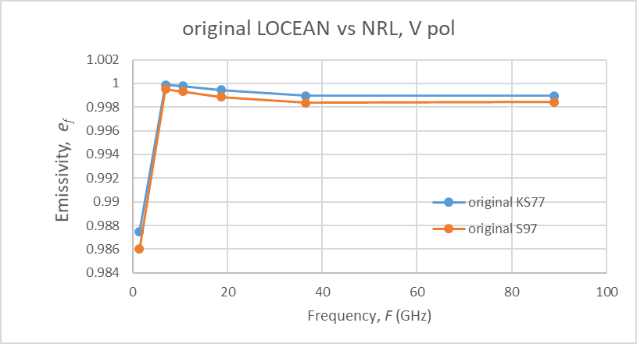
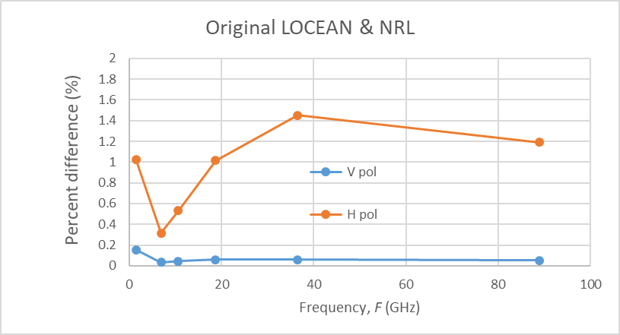
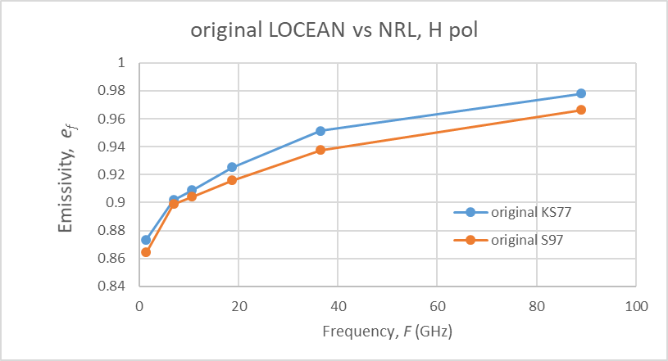
Original LOCEAN F90 and NRL IDL

Slide 7
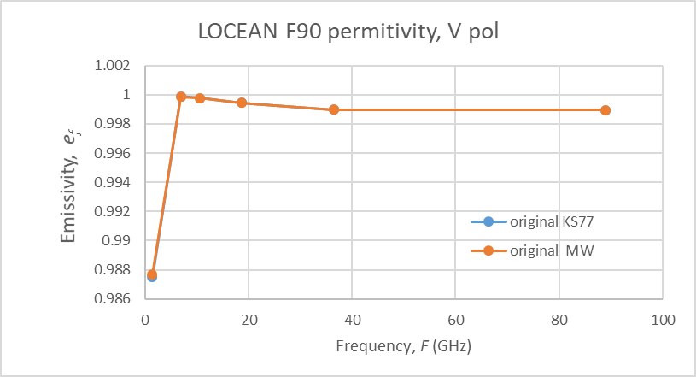
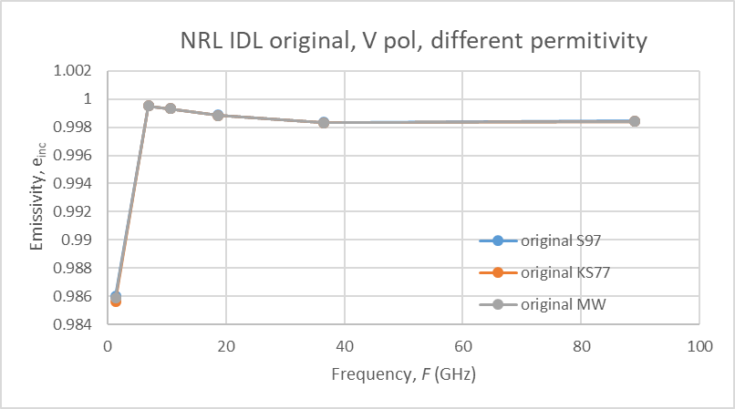
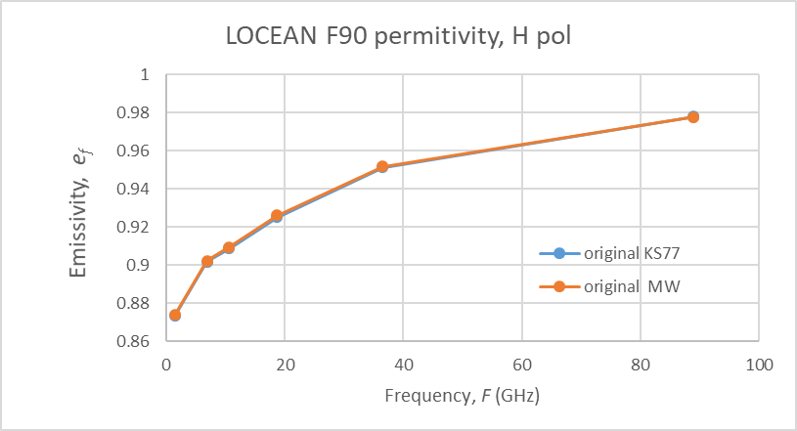
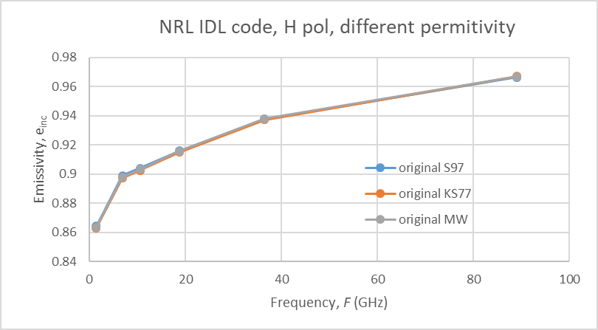
Permittivity model for seawater

Slide 8
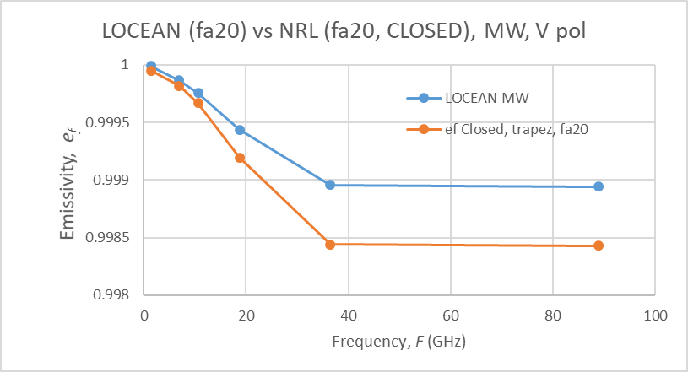
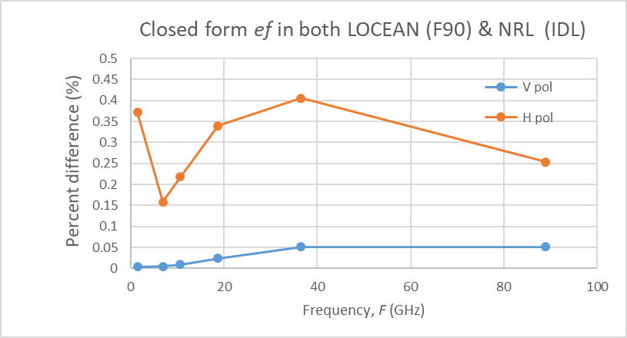
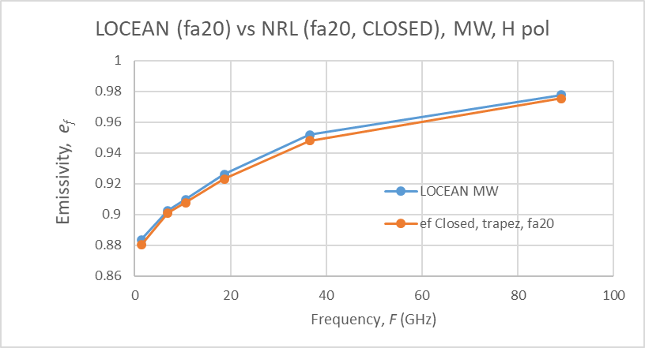
LOCEAN (F90) vs NRL (IDL) with closed form e_{f}
All other variables fixed or the same
Differences:
Trapezoidal vs Simpson rule
Different coding of r₂
Precision (double, yet differences)

Slide 9
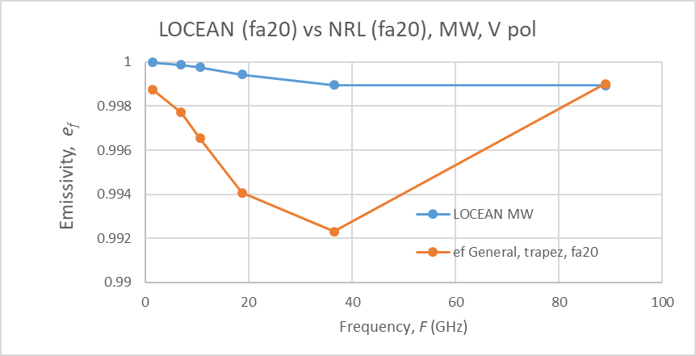
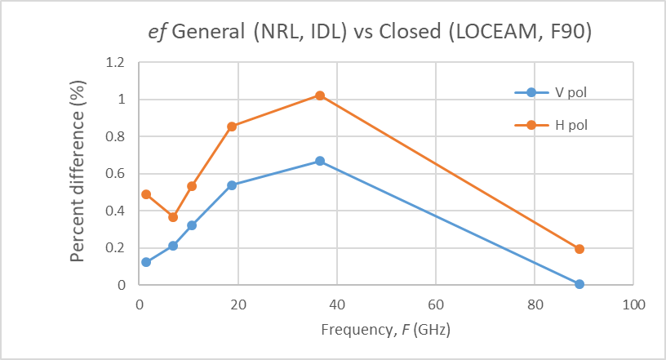
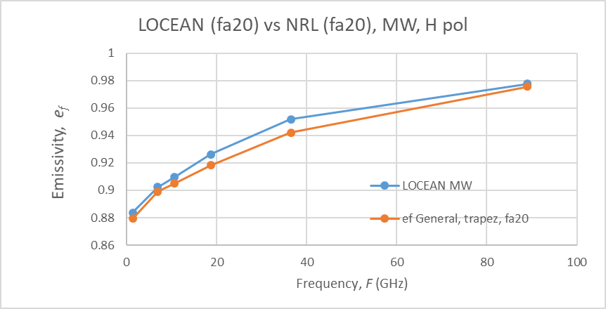
Closed (F90) vs General (IDL) formulation of e_{f}
Quasi-closed form e_{f} is acceptable approximation of the general e_{f} form
Still, differences would be noticeable for T_{B} values, which are O(100)
Code for Reference RTM
Make a version with quasi-closed form e_{f}
LOCEAN F90 with a few changes
Make a version for the general form e_{f}

Slide 10
To do next
On foam emissivity e_{f}
RefRTM code version with quasi-closed form e_{f}, MW, Simpson
Module for general form e_{f}
Module for thickness distribution as a choice (translate IDL to F90)
Foam emissivity at higher (mmW) freqs
Report results on scattering in foam at mmW freqs
Modify incoherent emissivity code to incorporate scattering
W parameterizations
Have the data, work upcoming
W uncertainty
First results on observation error of satellite W data
Convectional stats for in situ W data

