Slide 1
Dielectric Models of Sea-Water Comparison + Uncertainties Update
Thomas Meissner + Frank Wentz + Andrew Manaster
Remote Sensing Systems (RSS), Santa Rosa, USA
meissner@remss.com
presented at the ISSI Team Meeting
May, 18, 2021

Slide 2
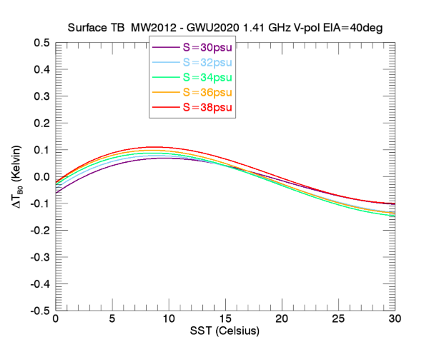
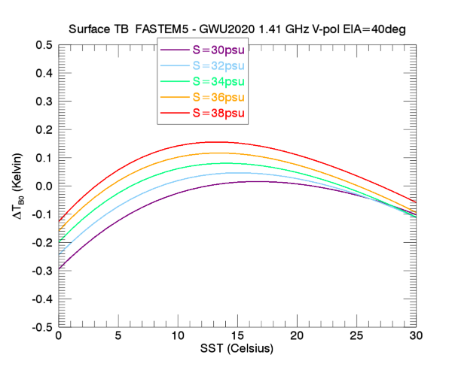
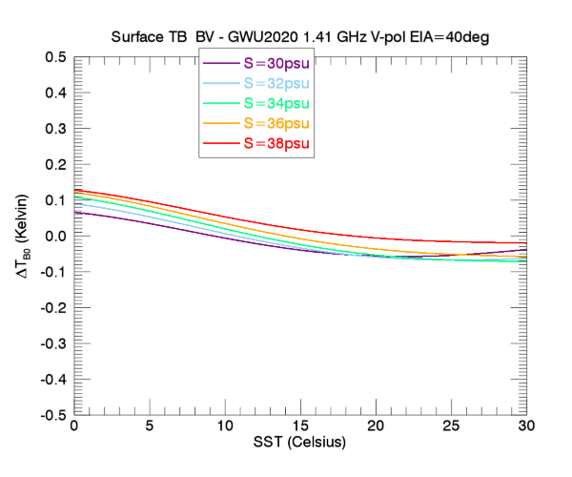
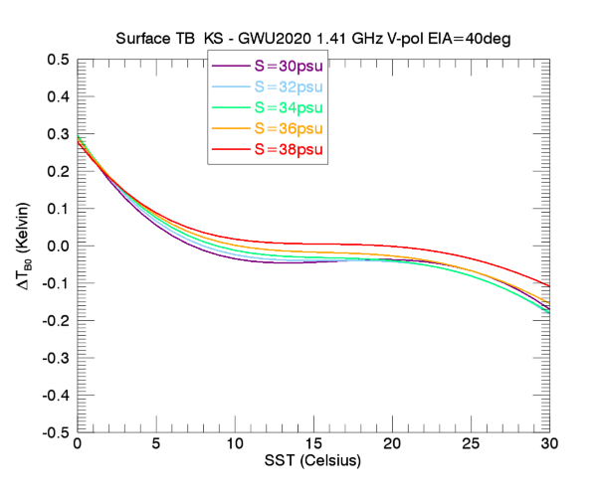
Comparison with GWU 2020 FREQ=1.41GHz, EIA=40°, V-pol
MW2012
FASTEM5
SST from 0°C to 30°C in steps of 1°C.
SSS from 30 psu to 38 psu in steps of 1 psu.
∆TB surface = ∆Emissivity ·SST (Kelvin).
Similar to MW
But larger SSS dispersion
BV2020
KS

Slide 3
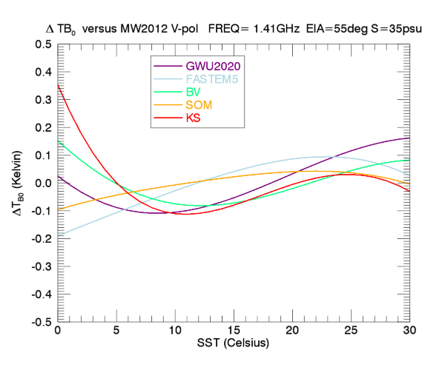
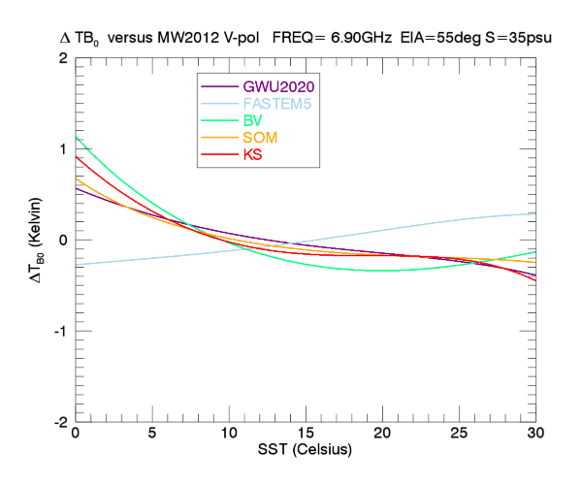
Surface TB versus Meissner-Wentz 2012 EIA=55° V-pol SSS=35psu Debiased
L-band
C-band
FASTEM5 stays very close to MW.
All other models ramp up significant SST gradient.
Unlikely to be usable in AMSR2 retrievals (SST, Wind).

Slide 4
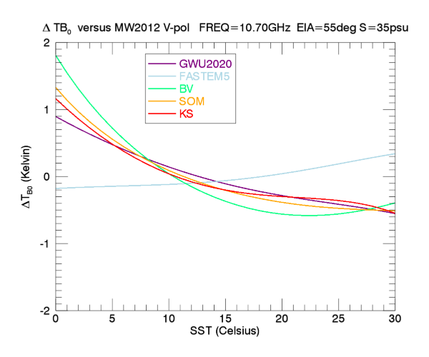
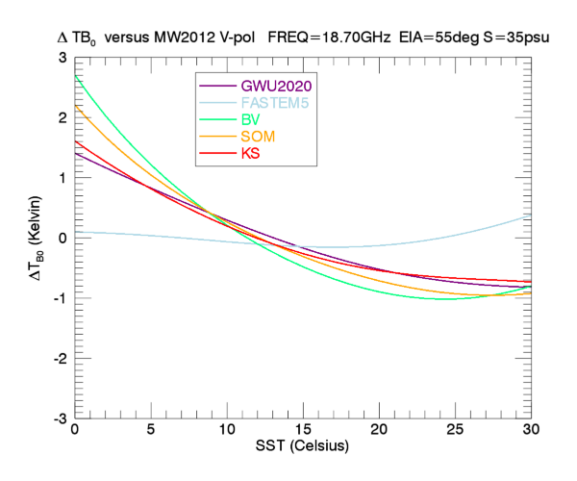
Surface TB versus Meissner-Wentz 2012 EIA=55° V-pol SSS=35psu Debiased
X-band
K-band
FASTEM5 stays very close to MW.
All other models ramp up significant SST gradient.
Unlikely to be usable in AMSR2 retrievals (SST, Wind).

Slide 5
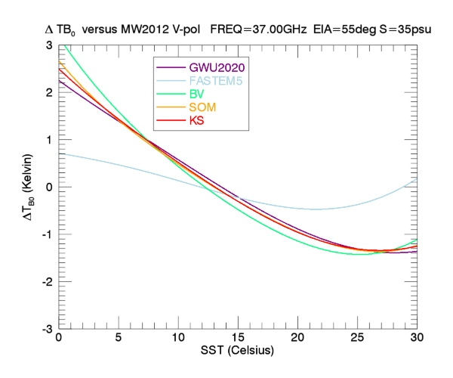
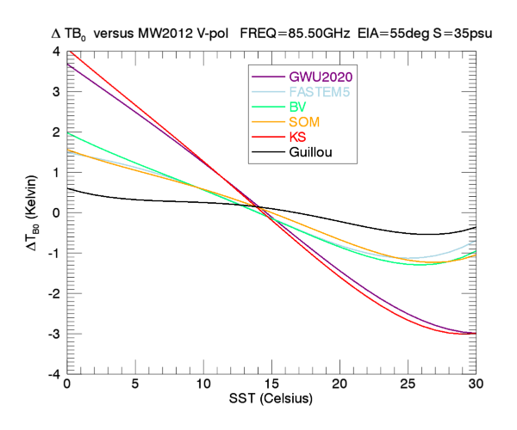
Surface TB versus Meissner-Wentz 2012 EIA=55° V-pol SSS=35psu Debiased
Ka-band
W-band
W-band dominated by ε∞, ε₁ and ν₂

Slide 6
Update: ST – MW (1)
ST expression for imaginary part reduces to conductivity term for low frequencies (ω≈0) :
ω_{eff} is about 1 THz.

Slide 7
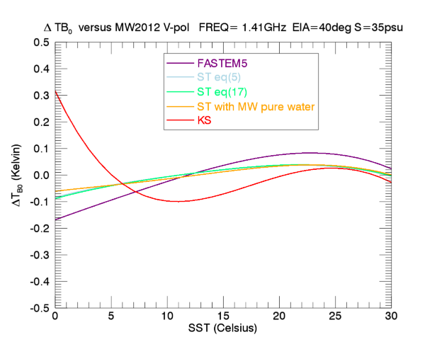
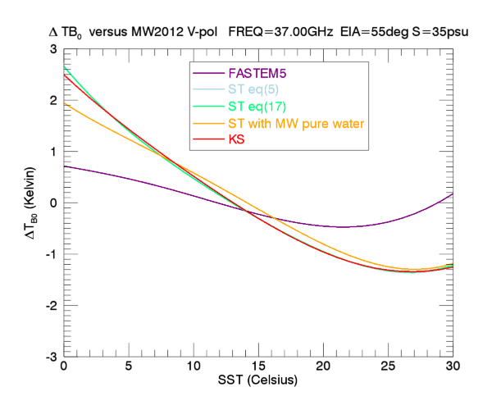
Update: ST – MW (2)
L-band
Ka-band
Blue curve : ST with conductivity term. Uses Stogryn expression for pure water.
Orange curve : ST with conductivity term. Uses MW expression for pure water.
Green curve: ST model without low-frequency approximation. Uses Stogryn expression for pure water = effectively same as blue curve.

Slide 8
Uncertainty Assessment

Slide 9
Radiometric Differences Surface TB EIA=55° V-pol SSS=35psu 0°C<SST<30°C
Overall bias
Can be removed in sensor calibration.
Could be bias in experimental set-up.
Of interest in the variability with SST and SSS over dynamic range encountered over ocean (last column).
Frequency [GHz] | Comparison | Bias (Kelvin) | Std.Dev (Kelvin)
1.41 | GWU2020 - MW2012 | -0.24 | 0.09
6.9 | FASTEM5 - MW2012 | 0.18 | 0.18
10.7 |  | 0.07 | 0.16
18.7 |  | -0.16 | 0.14
37.0 |  | -0.33 | 0.39
85.5 | Guillou1998 - MW2012 | -0.56 | 0.36
using laboratory measurements

Slide 10
Permittivity Differences SSS=35psu 0°C<SST<30°C Measurements/Models – MW2012 fit
Frequency [GHz] | Measurement Model | Re(ε) Bias | Re(ε) Std.Dev | Re(ε) Rel. Prec. | Im(ε) Bias | Im(ε) Std.Dev. | Im(ε) Rel. Prec.
1.41 | GWU2020 – MW | 0.51 | 0.30 | 0.4% | 0.28 | 0.28 | 0.4%
6.9 | FASTEM5 - MW | -0.29 | 0.96 | 1.6% | 0.73 | 0.30 | 0.8%
10.7 |  | -0.66 | 1.09 | 2.2% | 0.52 | 0.18 | 0.4%
18.7 |  | -0.82 | 0.86 | 2.7% | 0.06 | 0.50 | 1.4%
37.0 |  | -0.64 | 0.41 | 2.7% | -0.36 | 0.57 | 2.2%
85.5 | Guillou1998 – MW | 1.78 | 0.11 | 1.3% | 0.30 | 0.14 | 1.1%

Slide 11
Summary and Remaining Issues (1)
L-band: MW 2012, ST, BV 2020, GWU 2020 are within +/-0.1 K.
As good as one can hope for remote sensing applications.
Too many other large spurious signals that correlate with temperature: wind roughness, atmosphere, galaxy, …
Good agreement between MW and FASTEM for C-band and higher.
Little exception: I would not recommend FASTEM at L-band (spurious salinity dependence).
I would not endorse any of the other models (KS, GWU, ST, BV) above L-band in their current form.
Likely need to retrieval biases in SST, (wind, cloud, vapor, …)
Would require tuning of parameters.
It is not clear if and how much that could be done.

Slide 12
Summary and Remaining Issues (2)
Error (uncertainty) bars to be integrated into FORTRAN code.
Interpolation from tabulated values.

Slide 13
Additional Slides

Slide 14
GWU 2020
1.4 GHz laboratory measurements.
Single-Debye fit.
Shortcomings of earlier versions (unrealistic salinity dependence) have been corrected.
Can be considered for remote sensing applications
Salinity retrievals with L-band sensors (SMOS, Aquarius, SMAP).
Will likely require small adjustments in GMF, e.g. the SST dependence of the wind emissivity.
Comparison with MW: within +/-0.1 K over dynamical ocean range.
The GWU fit can only be used at L-band.
General Remark: It took 10+ years to complete all measurements and fits.
That reflects the challenge to measure the dielectric constant of sea-water in the laboratory.
Beware regarding published laboratory data as truth.
Screening with ocean remote sensing data is important and necessary.

Slide 15
Somaraju - Trumpf
Good physical model for ε_{S}(T_{S},SSS).
Valid at low frequencies (L-band).
Unlikely usable at higher frequencies without further adjustments.
SST biases.
Same applies to Boutin – Vergely.
General small ambiguity in L-band spaceborne salinity retrievals (SMOS, Aquarius, SMAP):
Temperature dependence in dielectric constant model.
Small temperature dependence in wind emissivity.
Hard to distinguish.

Slide 16
FASTEM5
General good agreement with Meissner-Wentz over very wide frequency range (L – W bands).
Both dielectric models are based on similar input.
Expected to have similar performance when used in
Satellite retrievals.
Assimilation.
Holds at S = 35 psu (global ocean average).
Little exception: Unrealistic looking salinity dispersion seems rather large.
Already visible at L-band compared to GWU, MW, SOM.
Might be a problem for L-band salinity retrievals in fresh-water areas (sea-ice melt off, river plumes)
Dispersion increases at higher frequencies.

