Slide 1
Comparisons of PARMIO with Other Modeling Activities
Fuzhong Weng and Lingli He
CMA Earth System Modeling and Prediction Centre
2022 ISSI Meeting on a reference quality model for surface emissivity and backscattering from the microwave to the infrared

Slide 2
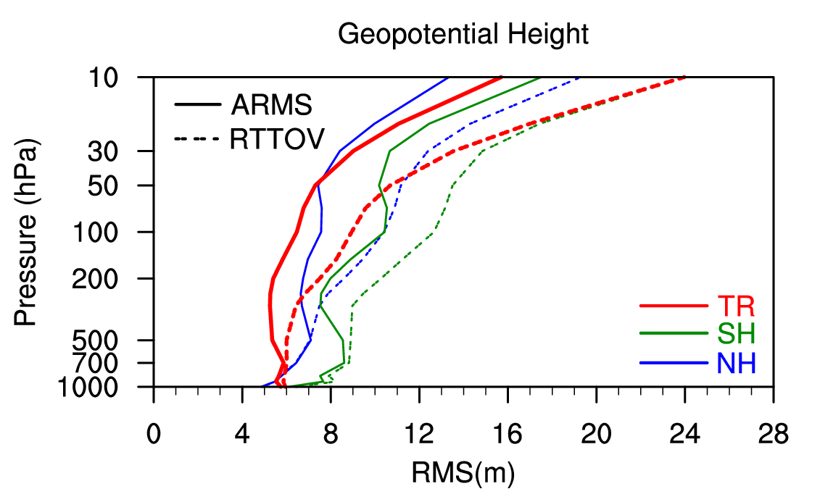
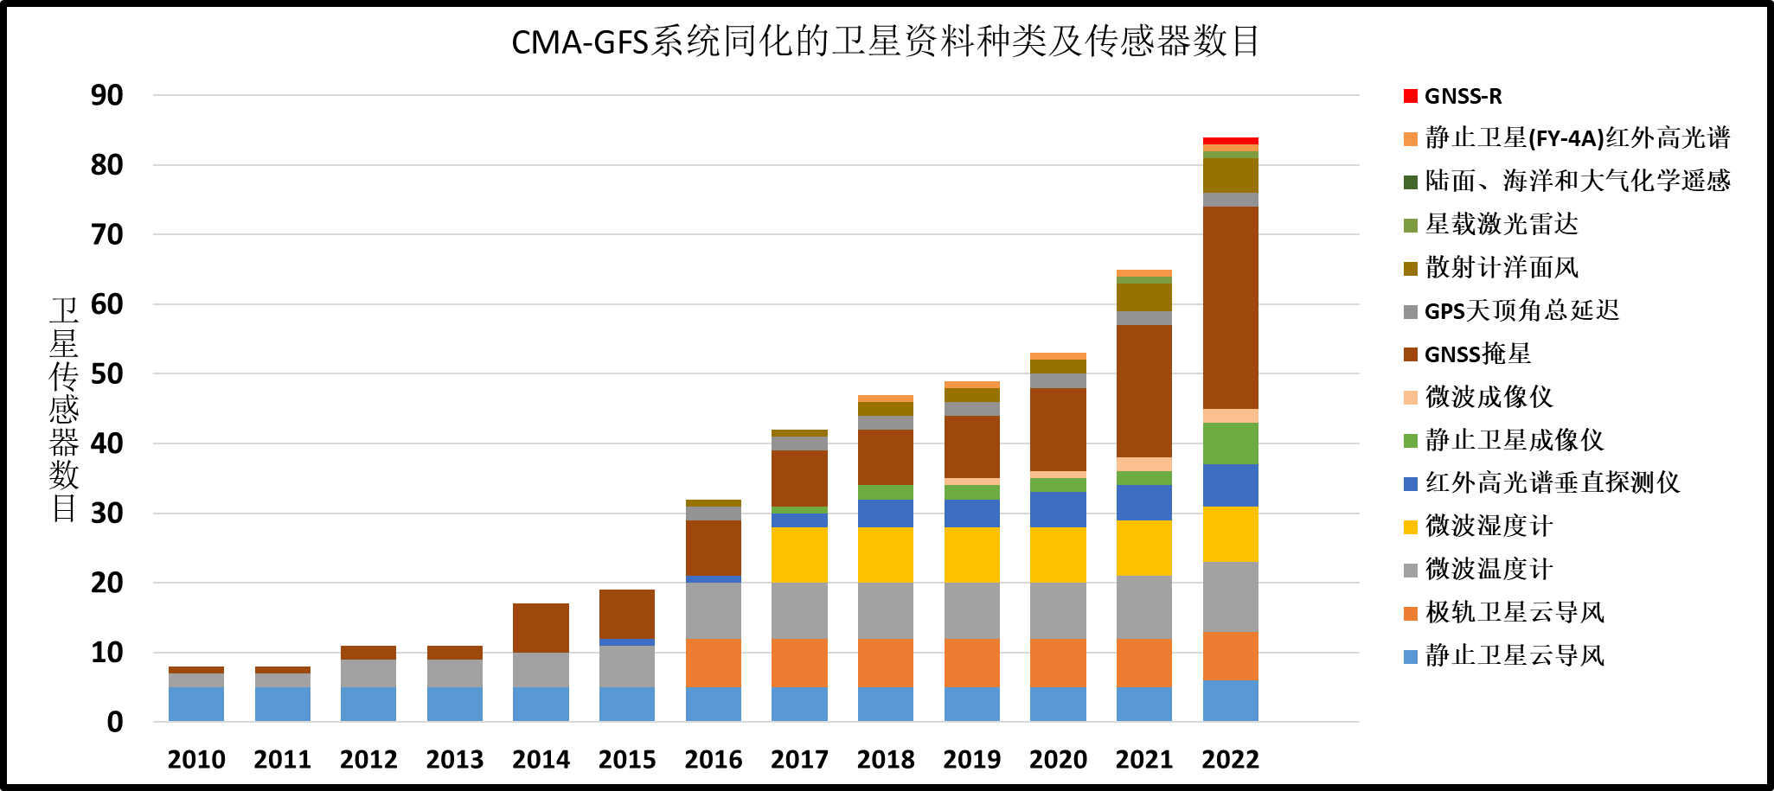
Satellite Data Assimilated in CMA-GFS through ARMS
ARMS has been successfully integrated into CMA-GFS 4dvar system and is supporting all IR and MW data assimilation.
ARMS significantly reduces the errors in the analysis field of the geopotential height
The impacts on the global forecasts are being evaluated
2

Slide 3
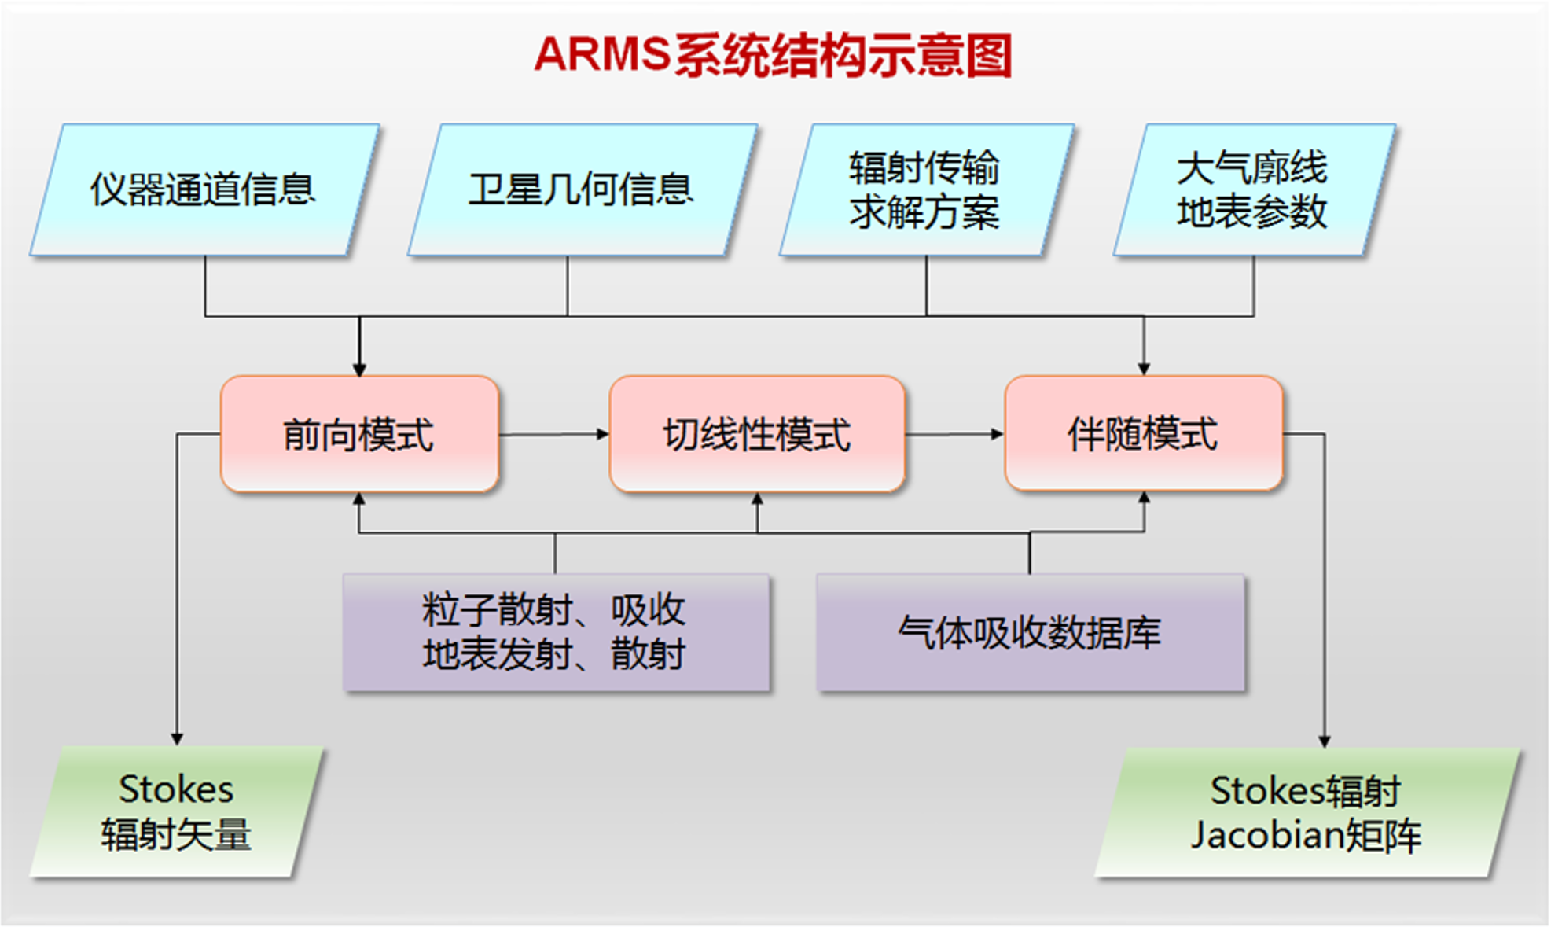
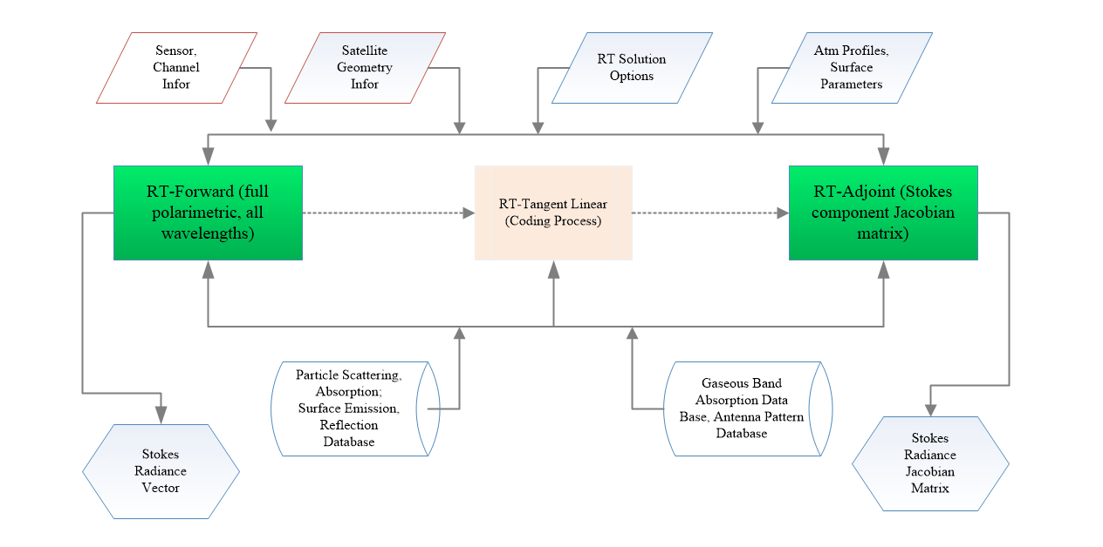
Advanced Radiative Transfer Modeling System (ARMS)
ARMS Special Features:
RT Solvers: ADA, P2S, VDISORT
Gas Absorption: SRF integrated absorption coefficients
Scattering LUT: Aerosols-T-matrix, Ice-DDA, Liquid-Mie
Surface Boundary: Emissivity and Reflectivity Matrices
Weng, F., X. Yu, Y. Duan, J. Yang, and J. Wang, 2020: Advanced Radiative Transfer Modeling System (ARMS): A new-generation satellite observation operator developed for numerical weather prediction and remote sensing applications. Adv. Atmos. Sci., 37(2), https://doi.org/10.1007/s00376-019-9170-2
3

Slide 4
ARMS Modular Function
Atmospheric gaseous absorption
Band absorption coeff trained by LBL spectroscopy data with sensor response functions
Variable gases (e.g. H2O, CO2, O3) .
Zeeman splitting effects near 60 GHz
Cloud/precipitation scattering and emission
Fast LUT optical models at all phases including non-spherical ice particles
Gamma size distributions
Aerosol scattering and emission
Types: dust, sea salt, organic/black carbon
Lognormal distributions
Surface emissivity/reflectivity
Two-scale ocean emissivity and reflectivity model
Geometrical optics for infrared ocean emissivity
Land microwave emissivity model
Land infrared emissivity data bases
Radiative transfer schemes
Advanced Doubling and Adding (ADA)
Polarized Two Stream (P2S)
Vector Discrete Ordinate Radiative Transfer (VDISORT)
Tangent Linear and Adjoint
Notes:
.

Slide 5
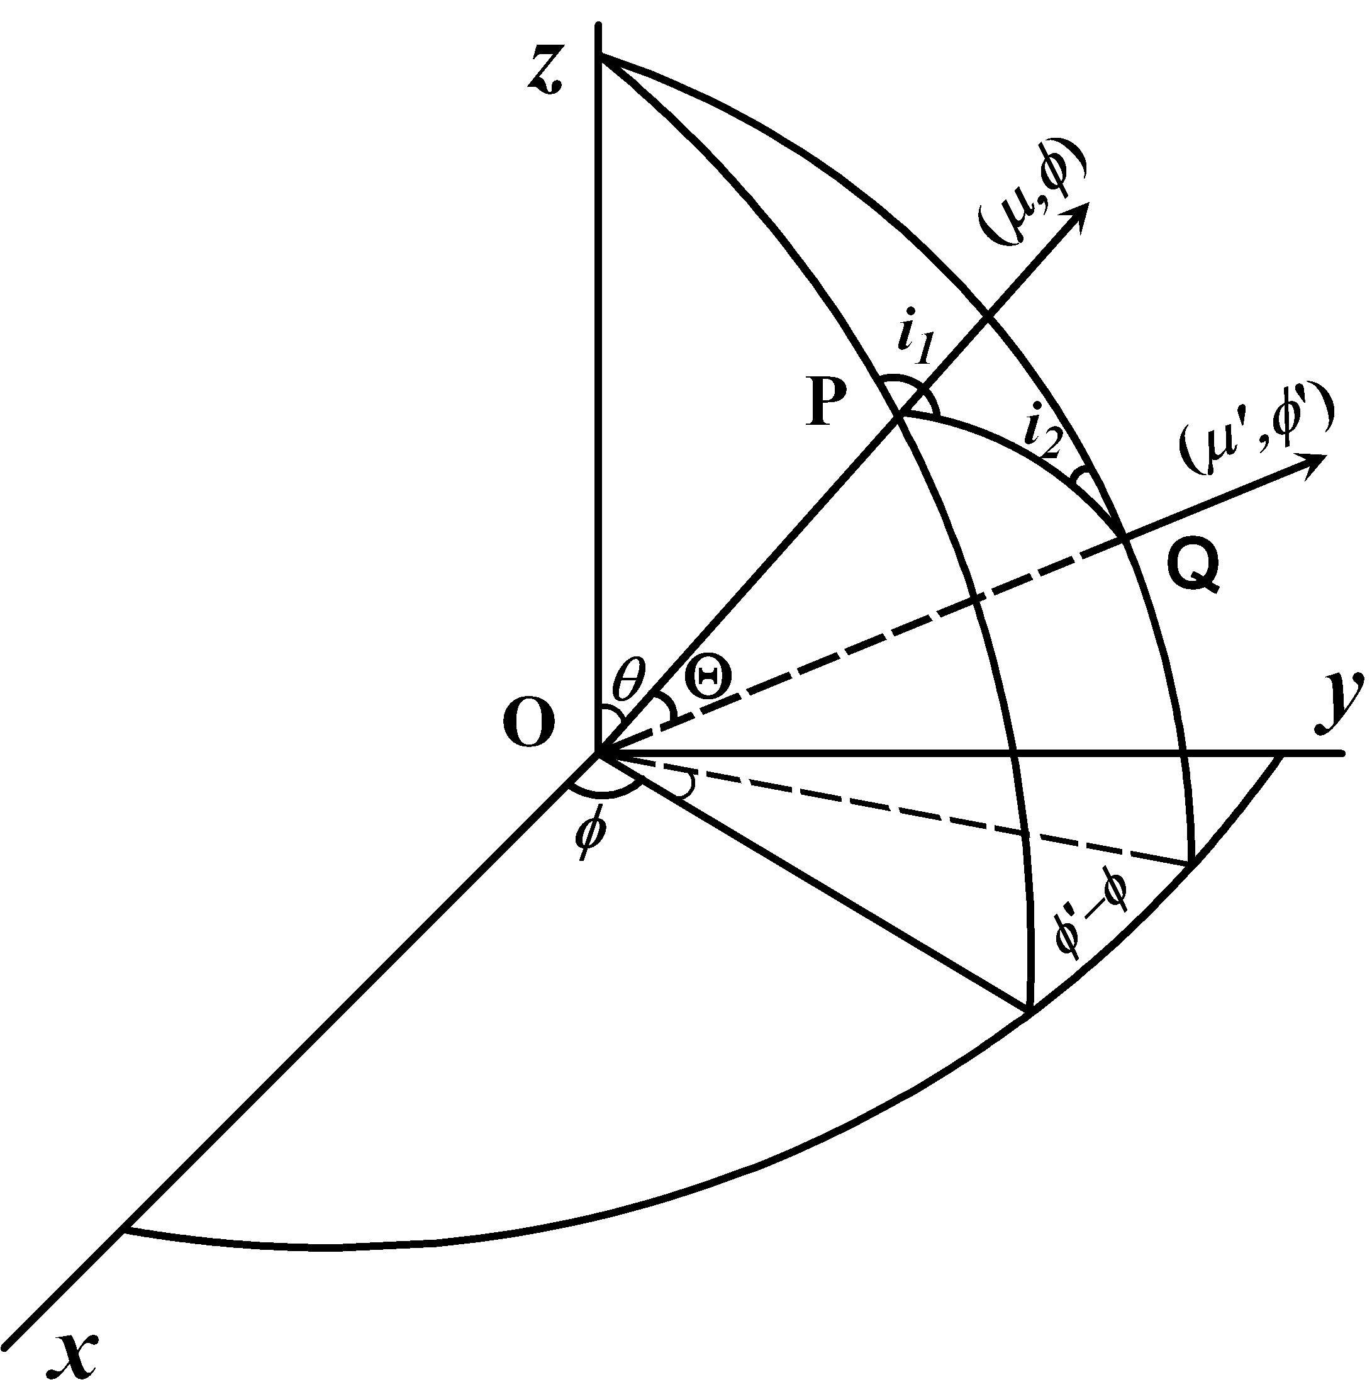
Vector Radiative Transfer Model
Advanced Double and Adding (ADA)
Polarization Two Stream Approximation (P2S)
Line by Line Radiative Transfer Model (LBLRTM)
Vector DISORT (VDISORT)
The scattering phase matrix (or Mueller matrix), S is defined in the scattering plan (POQ). But the incoming and outgoing radiations are defined in POZ and QOZ plans respectively.
5

Slide 6
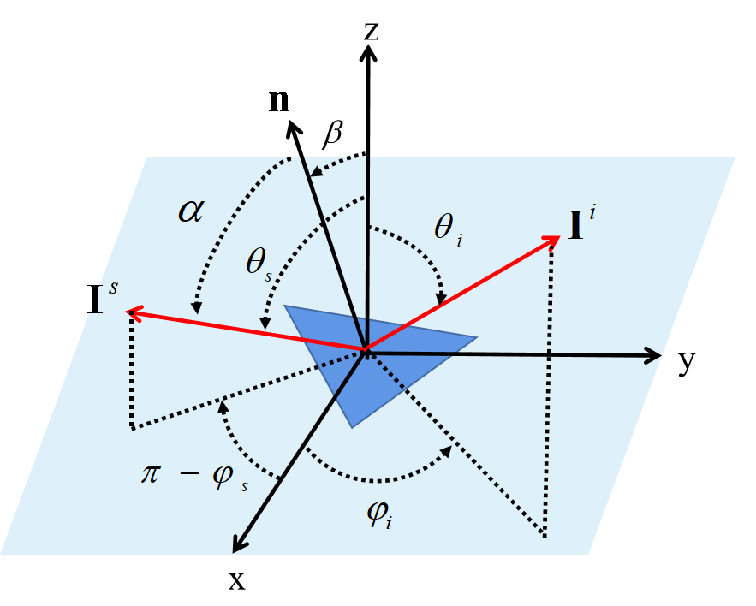
Radiative Transfer Lower Boundary Conditions
polarized BRDF matrix:
Stokes Emissivity Vector:
6

Slide 7
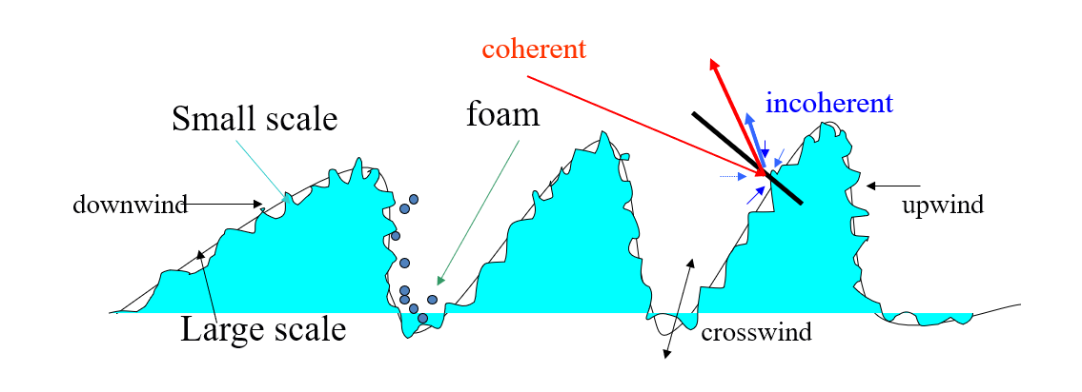
Two-Scale ocean Roughness Model (TSRM)
Radiometer
Reflectometer
Scatterometer
5GHz
37GHz
,
1GHz
12GHz
89GHz
The large-scale roughness is generated by gravity waves and whereas small irregularities are affected by capillary waves. There are coherent reflection and incoherent scattering associated with the waves in both scales. The coherent scattering for the large scale based on geometric optics. The small-scale roughness has both coherent and incoherent scattering and can be simulated by small perturbation model (SPM). In general, TSRM is valid for small to medium incident angles and a wide range of wind speeds.
Ocean Spectrum: Modified Durden Vessecky (1991)
Permittivity: Liu and Weng:(2011)
Cutoff wavenumber :Guissad (1987）
Foam: Monaha (1986)
Foam Emissivity: Stogryn Foam (1972)
Hydrodynamic modulation, Reece (1978)
7
Notes:
双尺度粗糙度理论将洋面模拟为由大尺度和小尺度的波组成，小尺度波叠加在大尺度波上。大尺度波的散射使用几何光学进行模拟，小尺度波的散射使用Bragg散射模拟。选择双尺度粗糙度理论是因为我们想要发展一个具有较宽微波适用频段的洋面BRDF，以实现不同星载仪器的应用。

Slide 8
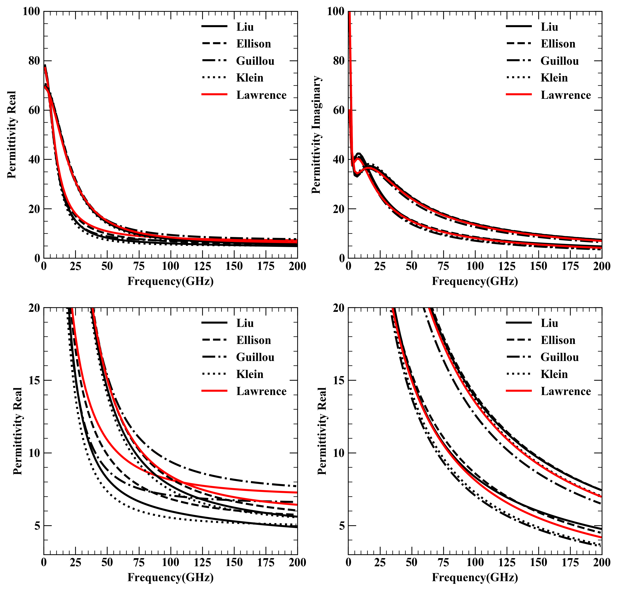
Ocean Permittivity Models
Single Debye Model（<10GHz）
Double Debye Model（>10GHz）
Klein model works well at lower frequencies (<10 Ghz)
Liu and Klein models are closer at lower frequencies
8

Slide 9
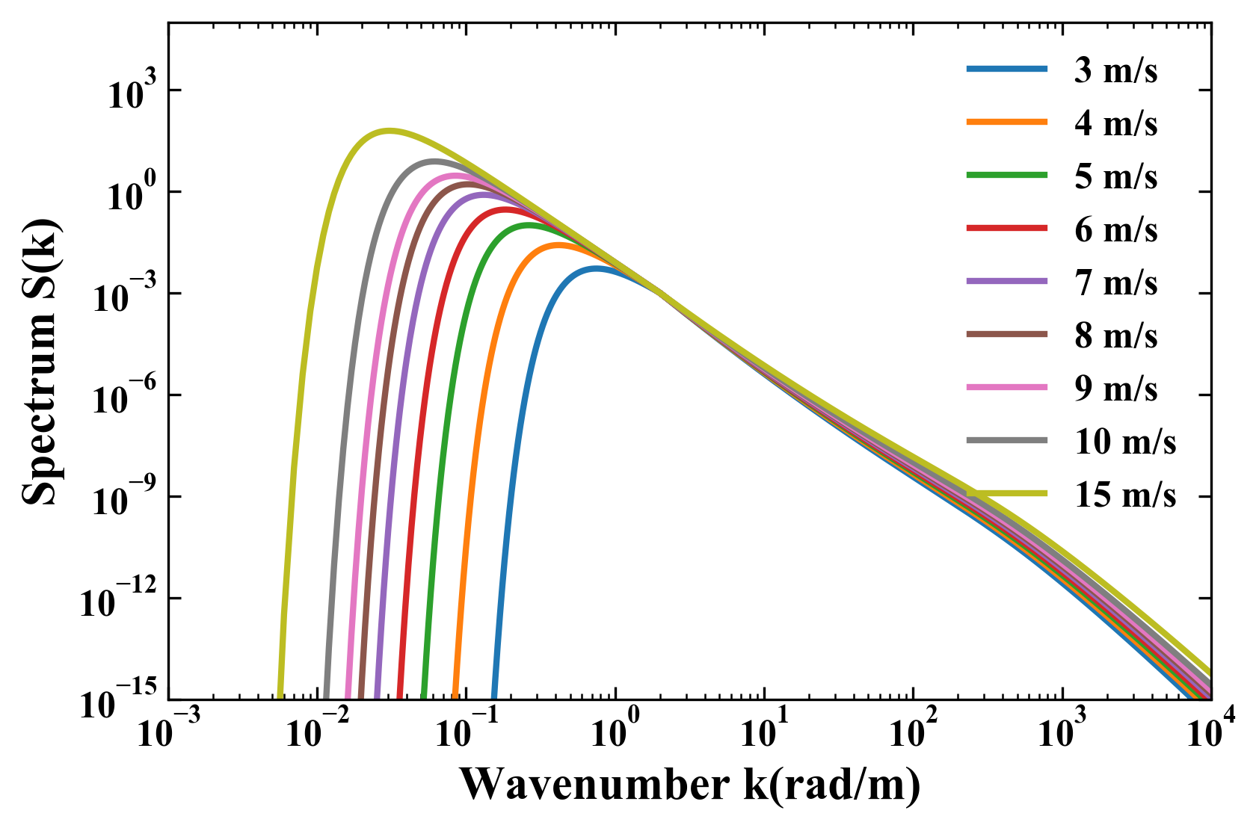
Modified Durden-Vesecky Ocean Roughness Spectrum
The scattering theory from Durden-Vesecky (DV) Spectrum combined with two-scale model is valid for incidence angle of 0-70 degree. Its derived backscatter cross-section agrees well with airborne scatterometer data (Durden,1985)
DV spectrum amplitude is modfied from 0.004 to 0.008, which is referred as Modified- DV. (Yueh, 1997)
Full spectrum
Azimuthal dependent angle
K < K_{j}
K >K_{j}
9

Slide 10
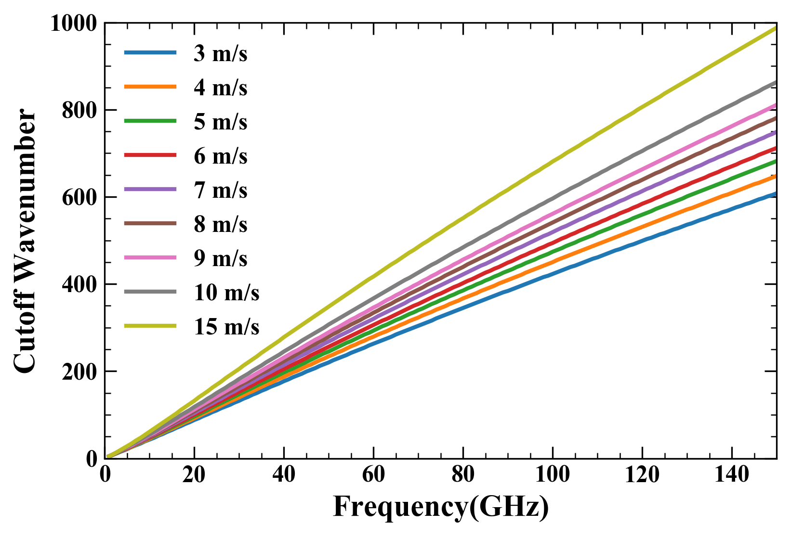
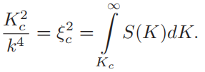
Cut-Off Wavenumber and Hydraulic Modulation
Cut-off Wavenumber
Guissad and Sobieski(1987)
Hydraulic Modulation:
Large-scale waves modulates small scales and result in
small-scale waves more concentrated on downwind sides
Cut-off wavenumber is derived from S(k) as a function of wind speed
It is a also a function of frequency
10

Slide 11
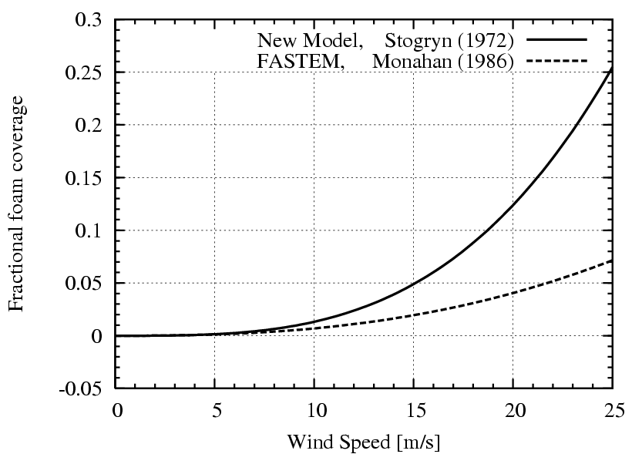
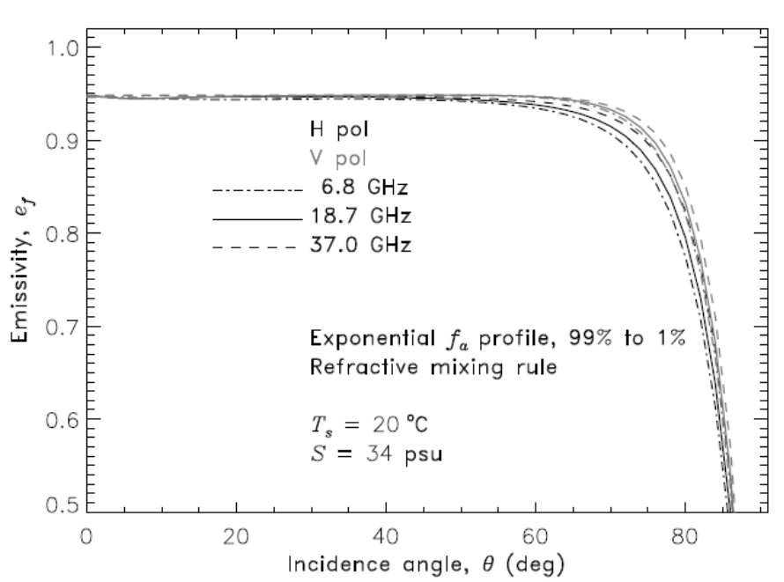
Foam Coverage and Emissivity
Foam Coverage
Foam is a mixture of air and water, and has a higher
emissivity
Stogryn, 1972
Monahan, 1986
Foam Emissivity
Foams have low emission but when they are
embedded in sea water, their volumetric
scattering enhances the overall emission
11

Slide 12
Foam Coverage and Emissivity
Foam Coverage
Foam is a mixture of air and water, and has a higher
emissivity
Stogryn, 1972
Monahan, 1986
Foam Emissivity
Foams have low emission but when they are
embedded in sea water, their volumetric
scattering enhances the overall emission
12

Slide 13
Polarized Bidirectional Reflectivity Distribution Function (pBRDF)
Cox-Munk Probability Distribution Function for large scale facets
Fact slopes at upwind and crosswind directions
Slope standard deviation at upwind and crosswind directions
13

Slide 14
Polarized Bidirectional Reflectivity Distribution Function (pBRDF)
14

Slide 15
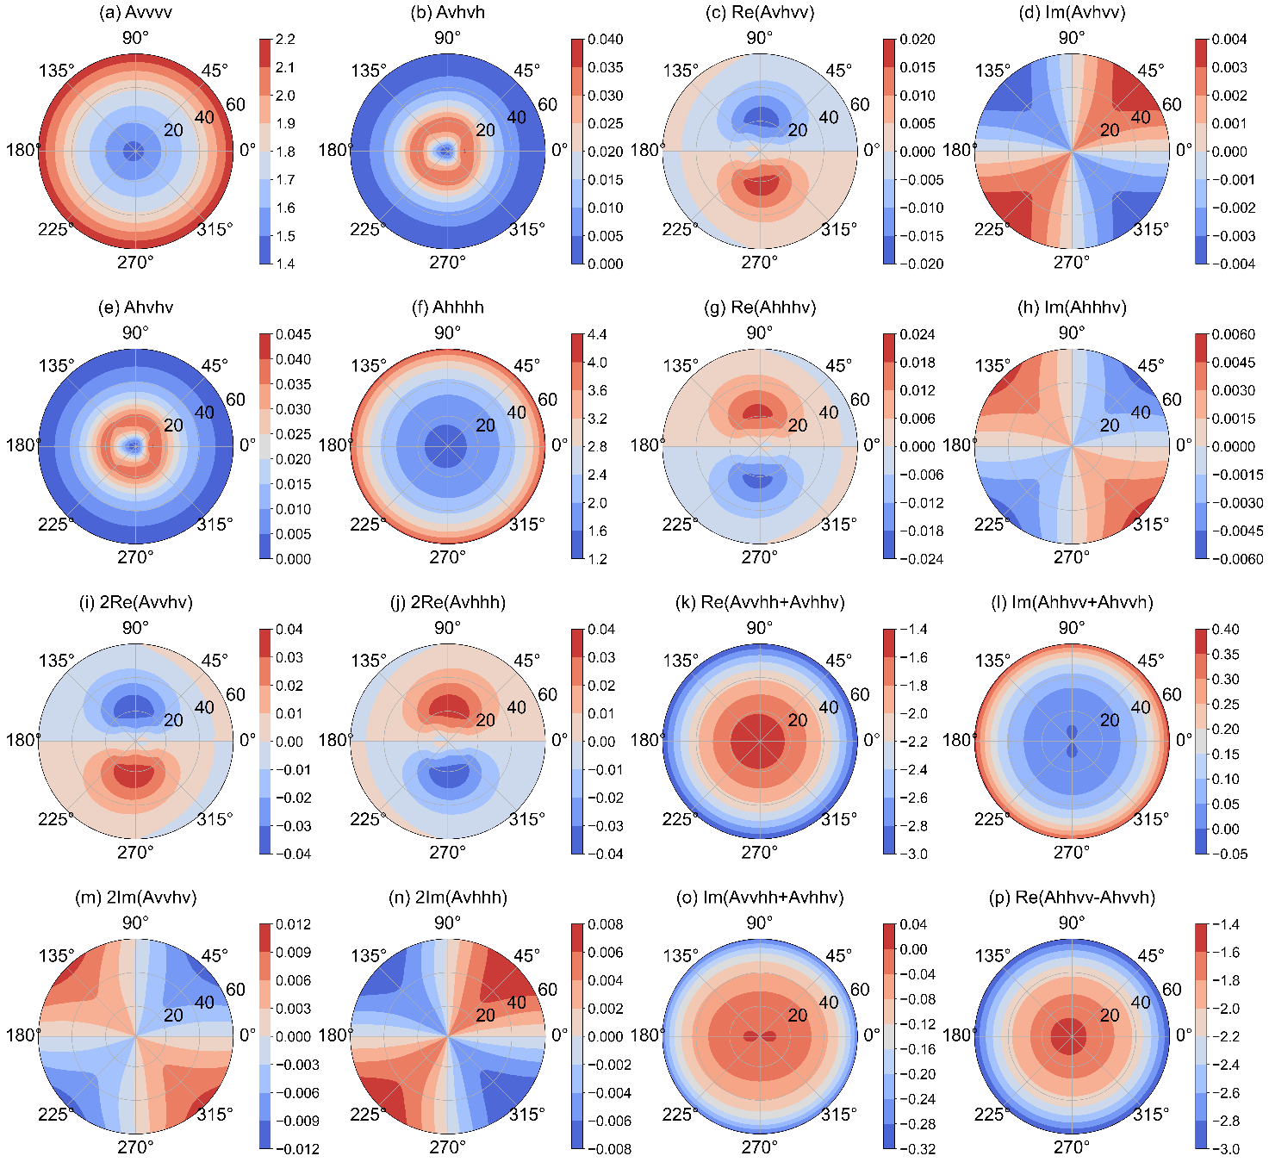
pBRDF Matrix (A) Distribution
For a specific geometry
Frequency = 1.58GHz
Windspeed = 10m/s
SST = 285K
SSS = 35‰
All elements are with obvious symmetry structure about wind direction (even symmetry, odd symmetry)
All elements change with azimuth angle and zenith angle, and the influence of zenith angle is more significant.
All elements decrease with increasing frequency.
15

Slide 16
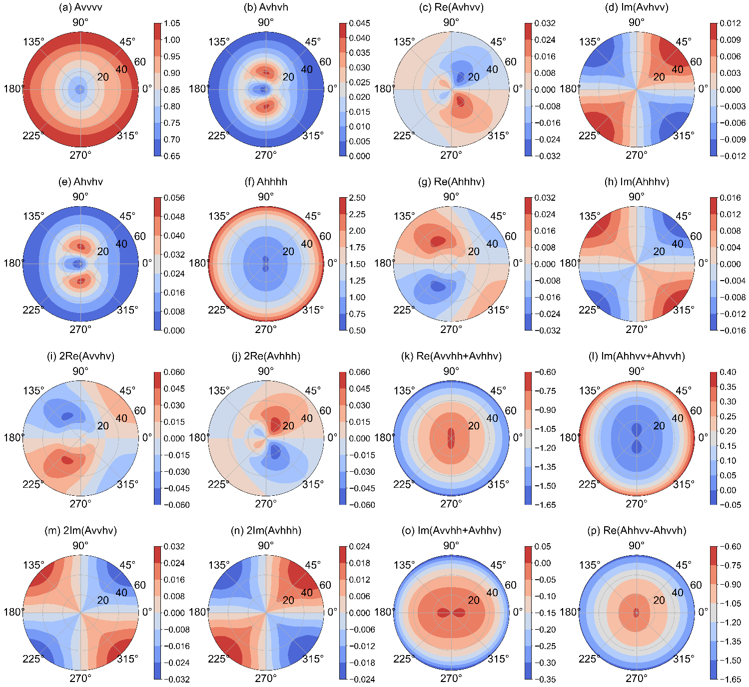
pBRDF Matrix (A) Distribution
For a specific geometry
Frequency = 19 GHz
Windspeed = 10m/s
SST = 285K
SSS = 35‰
All elements are with obvious symmetry structure about wind direction (even symmetry, odd symmetry)
All elements change with azimuth angle and zenith angle, and the influence of zenith angle is more significant.
All elements decrease with increasing frequency.
16

Slide 17
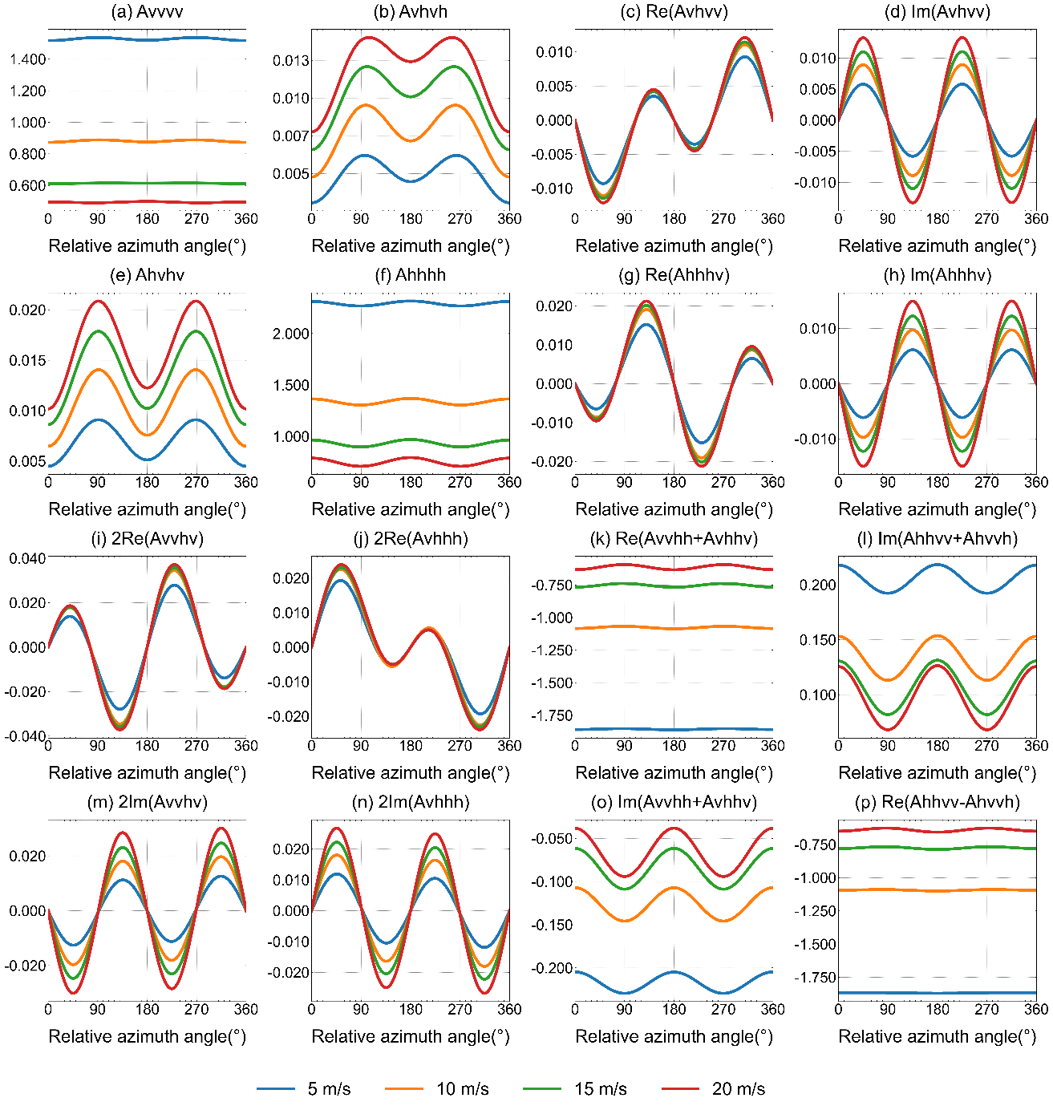
Windspeed Dependance of pBRDF (A) Matrix
For a specific geometry
Frequency = 37GHz
Zenith angle = 45°
SST = 285K
SSS = 35‰
pBDRF elements can have a unit of inverse solid angle (sr⁻¹)
Thus, the magnitudes can be greater than 1
As wind speed increases, the harmonic amplitudes of some elements increases significantly
17

Slide 18
Impacts of pBRDF on Reflected Brightness Temperature
v_pol
h_pol
Reflected Tb (K)
Frequency = 23.8GHz, windspeed = 10 m/s, SST = 285K, SSS = 35‰, relative azimuth angle = 45°
US standard profile
Reflected Tb (K)
3rd
4th
Reflected Tb increases with zenith angle
The coherent reflection from the geometric optics and small scale roughness (GO+SPM2) is the lowest
Geometric reflection does not produce the 3rd and 4th components
18

Slide 19
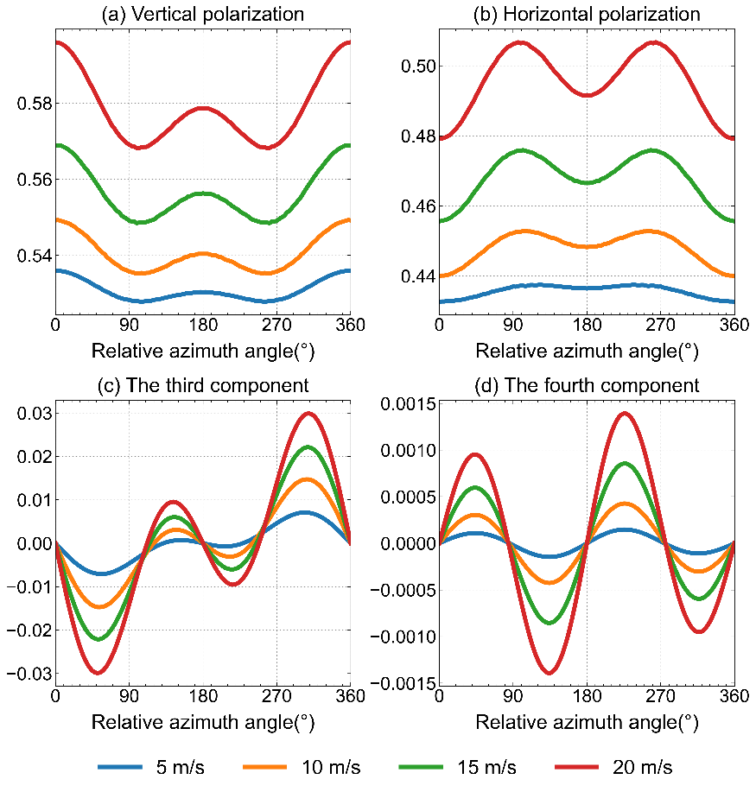
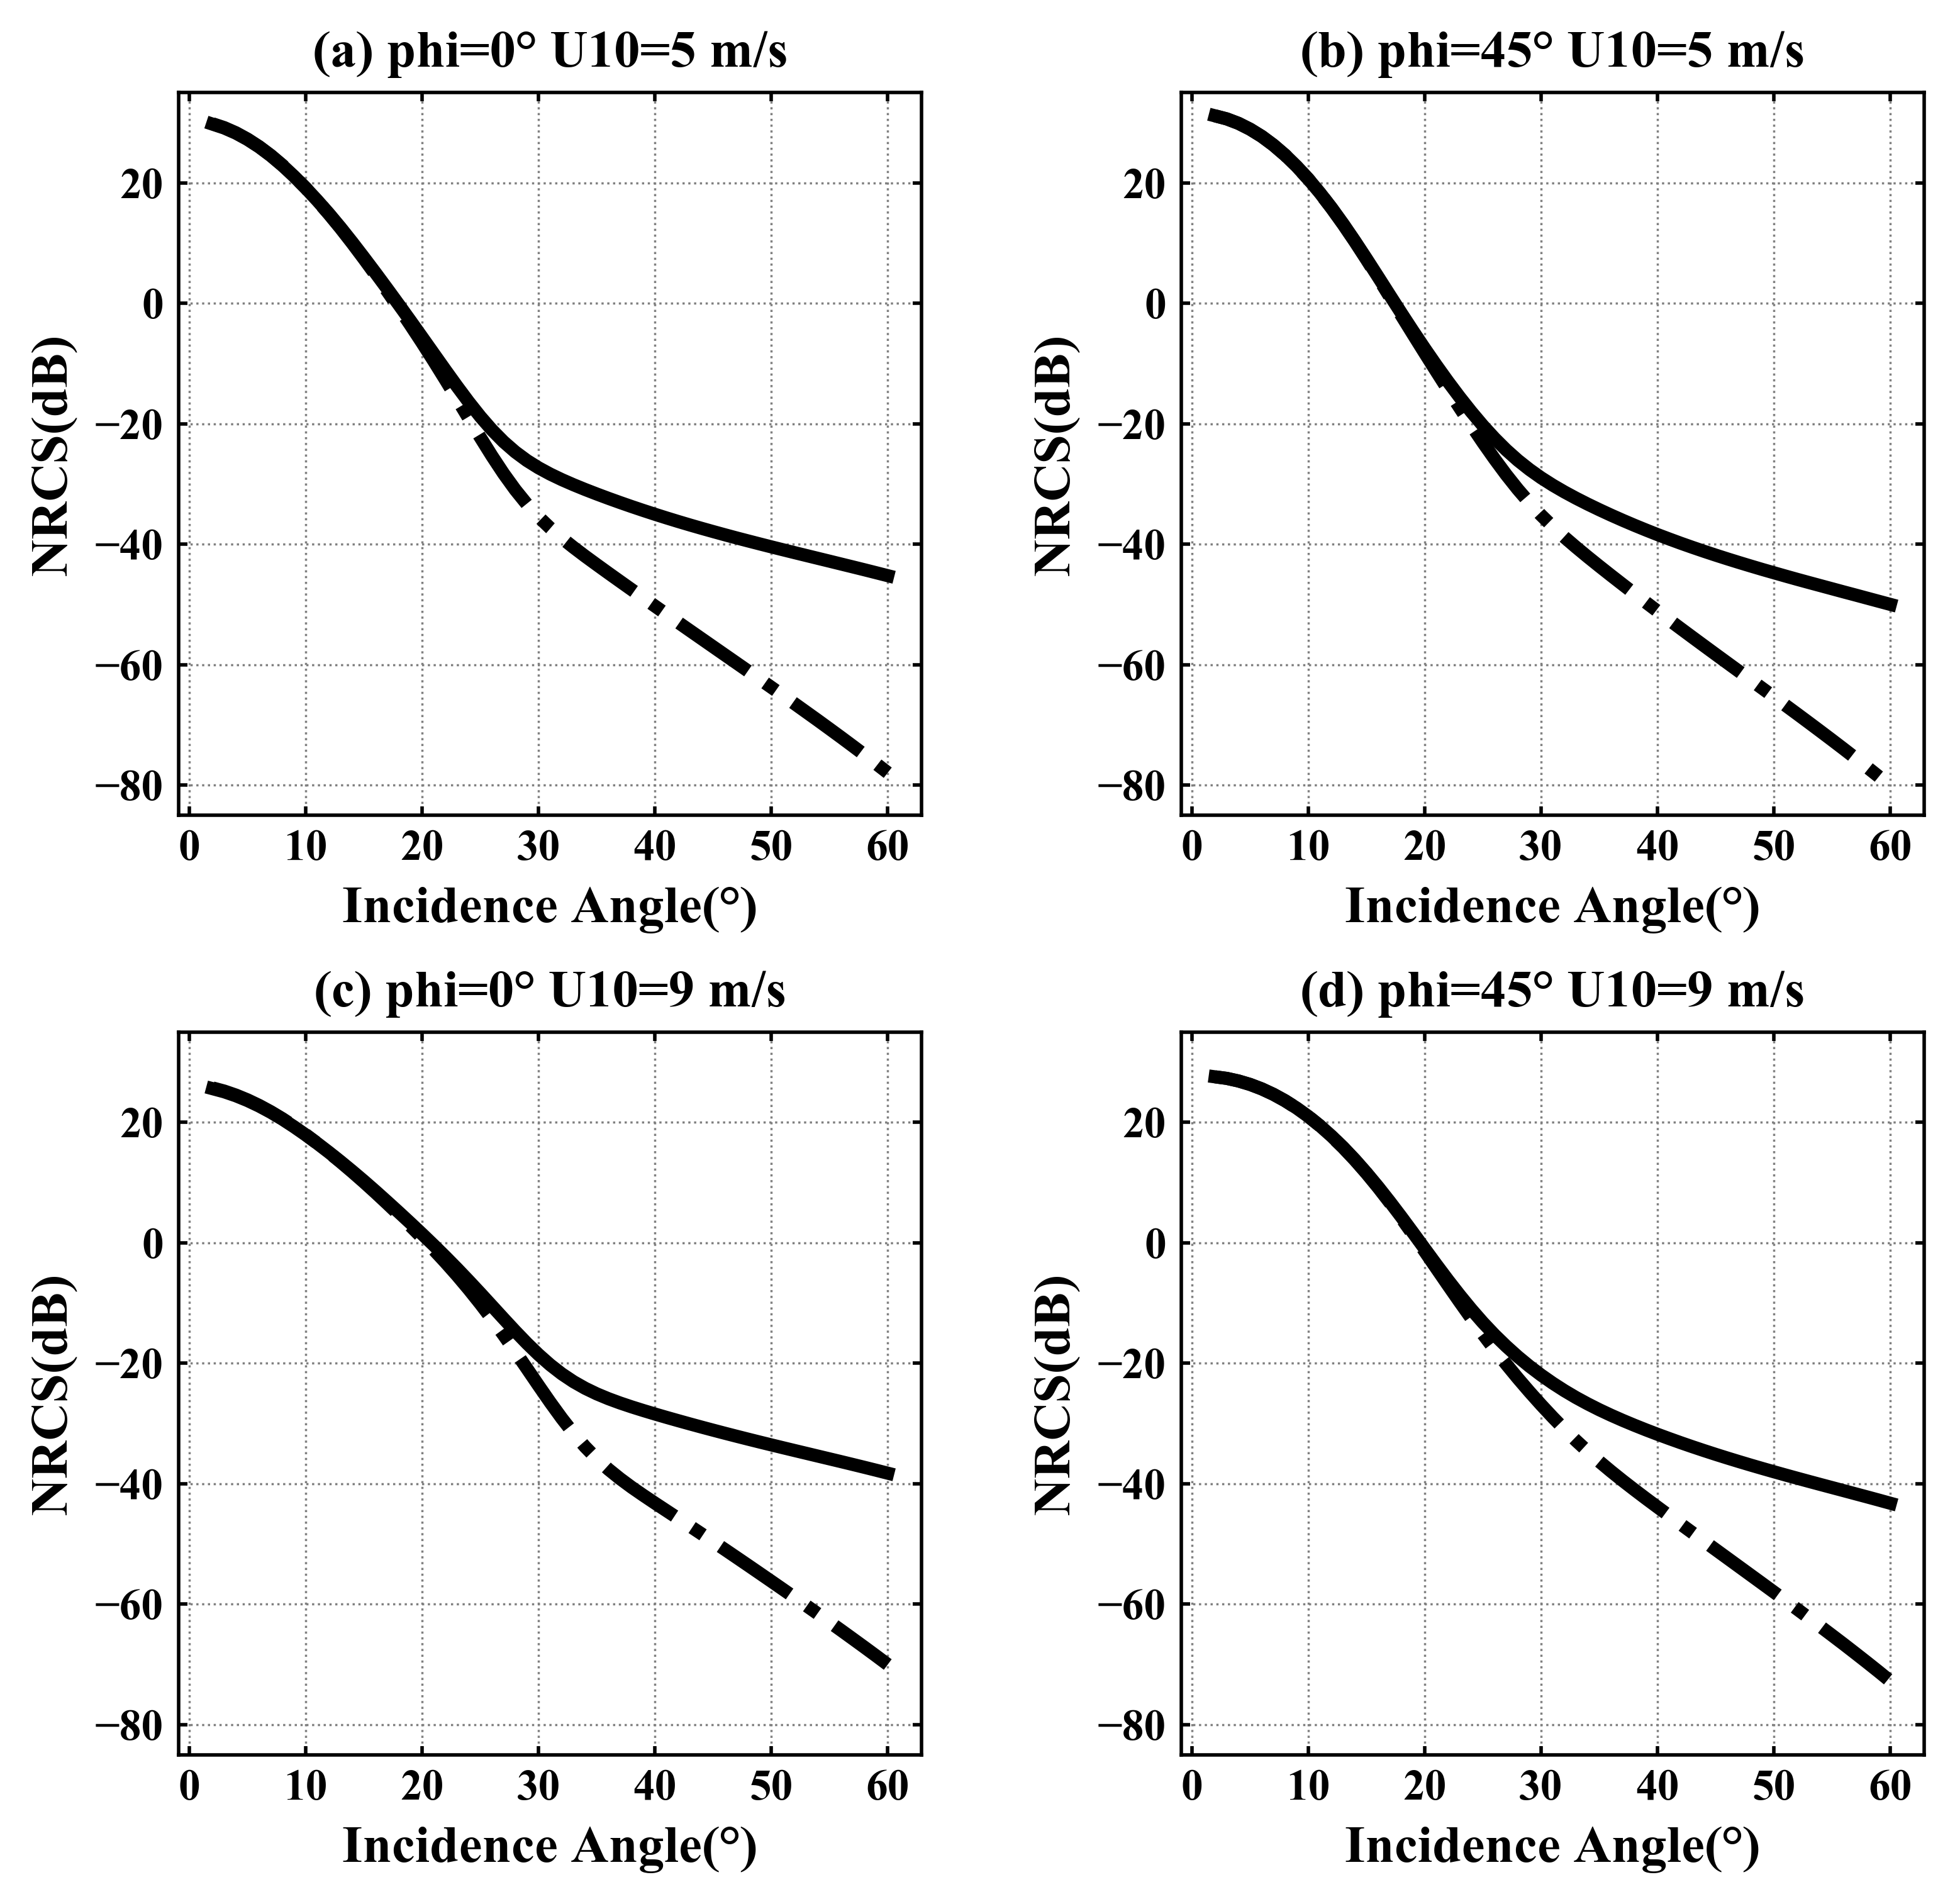
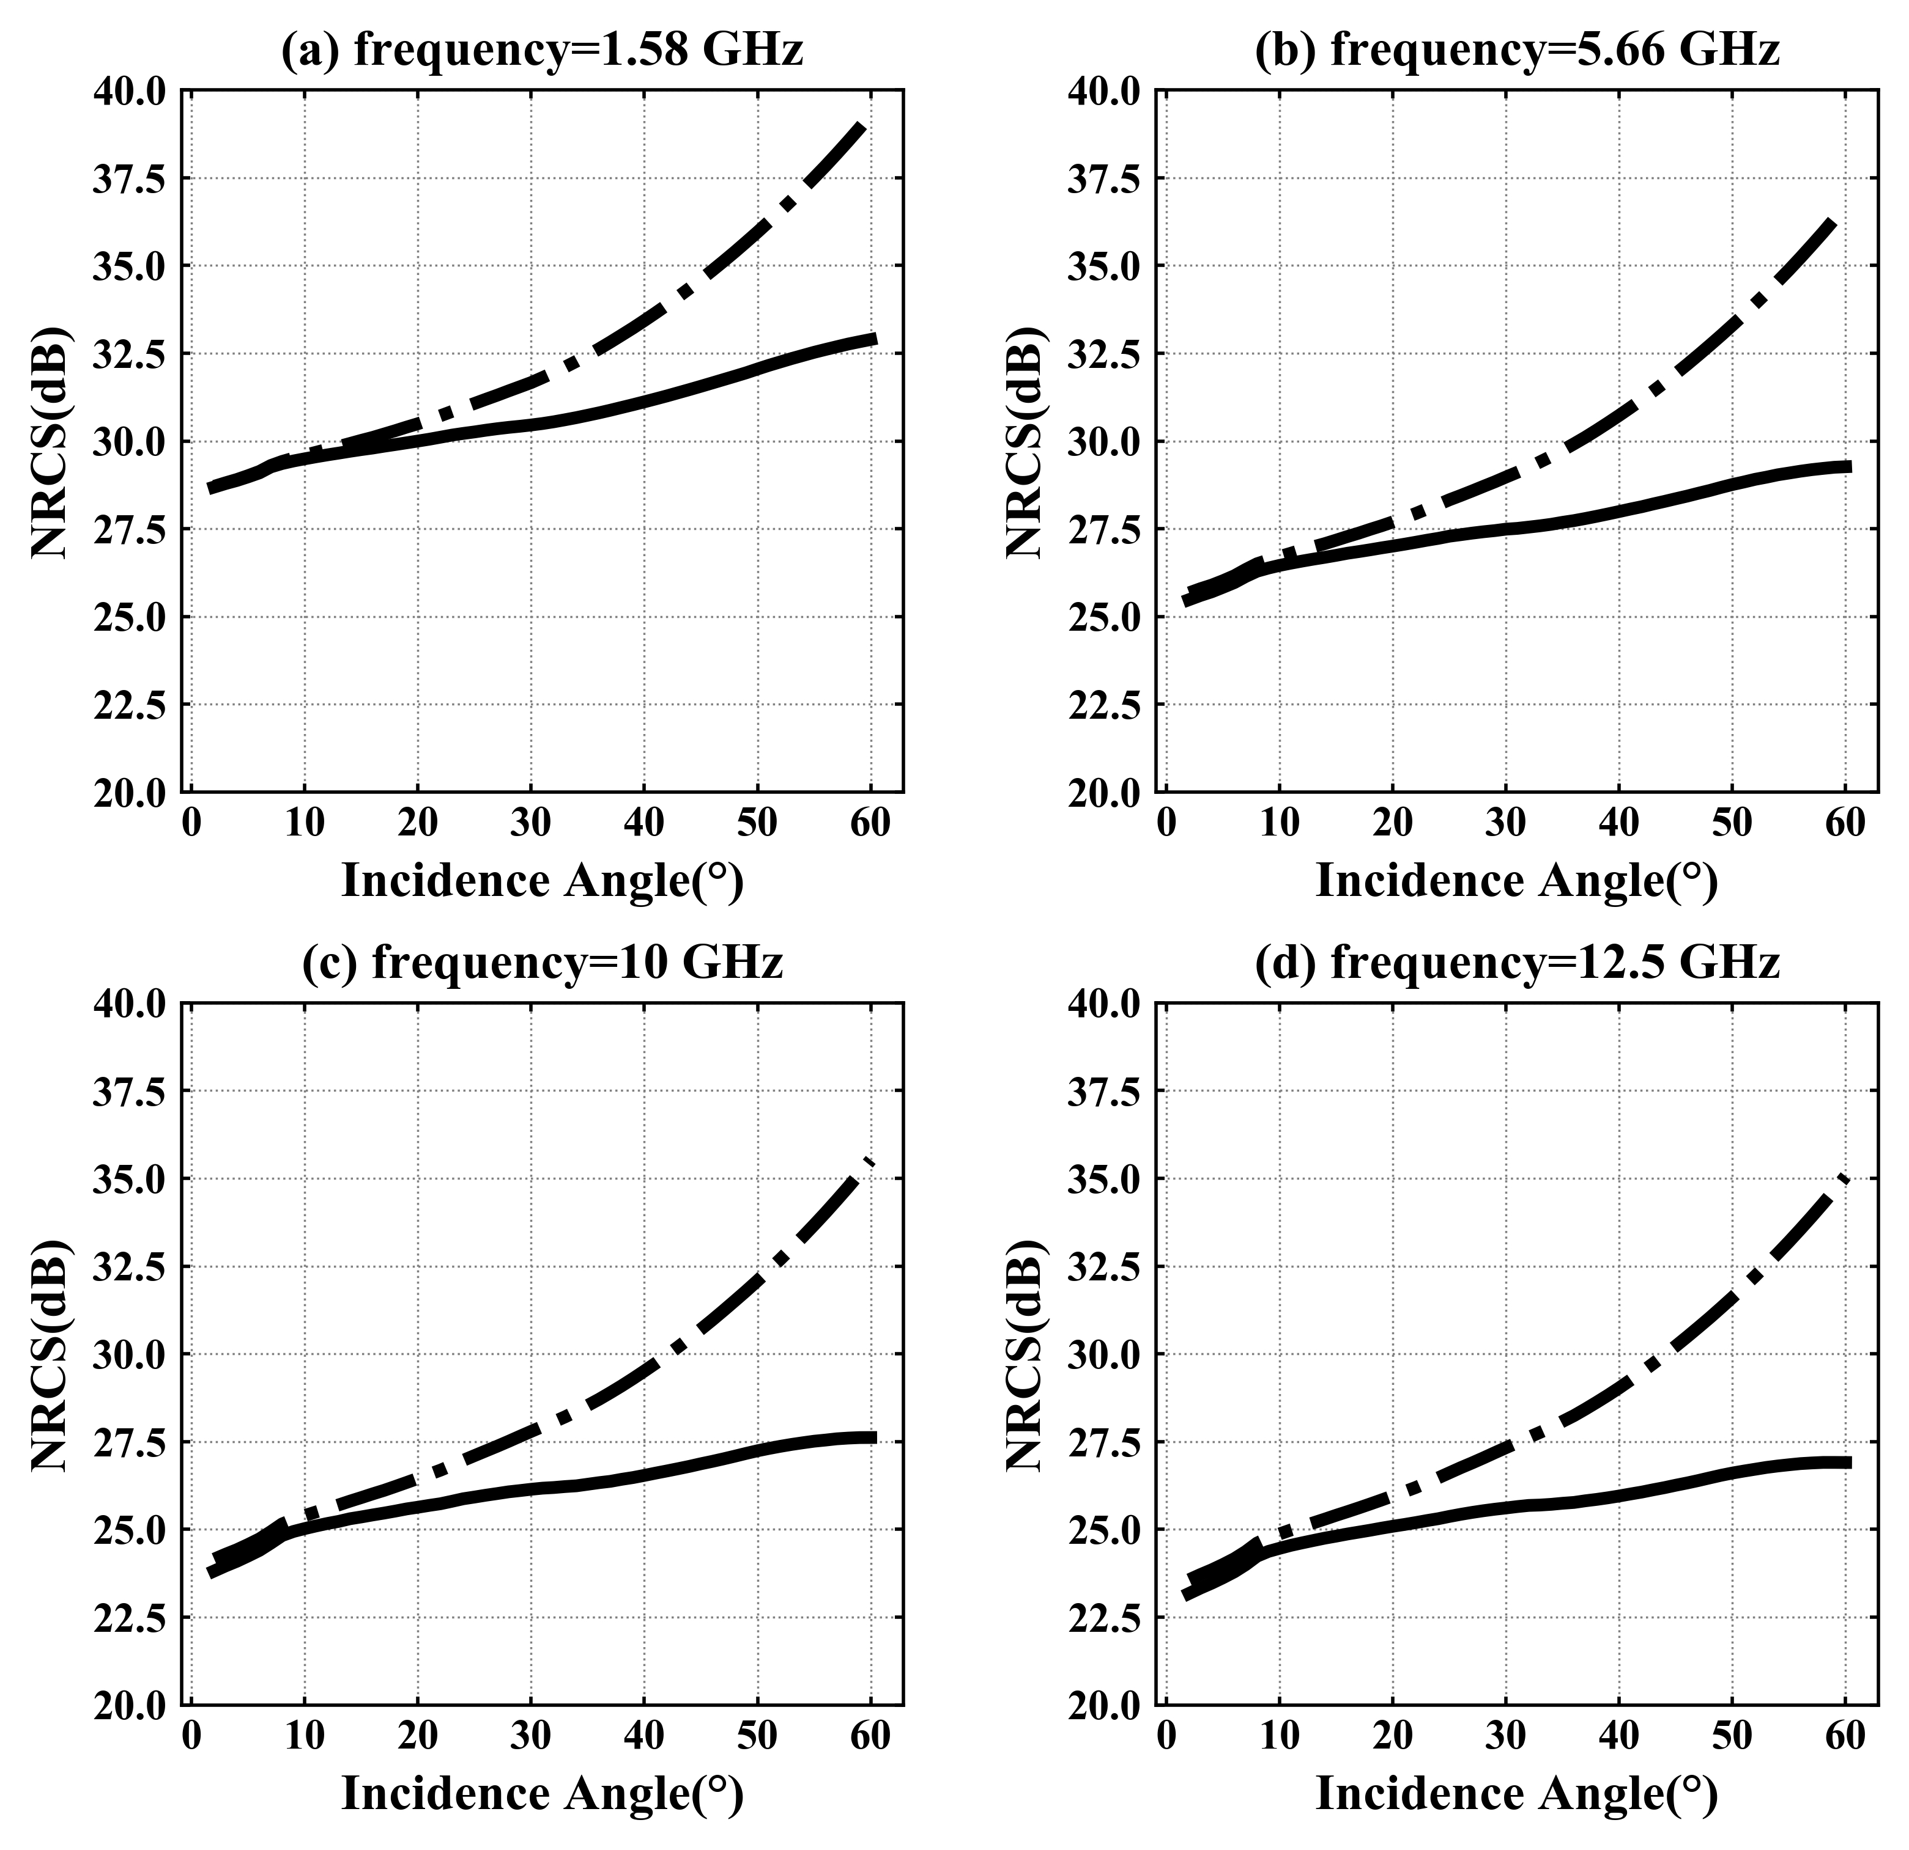
Major Applications of pBDRF Derived from TSRM
Passive
Active：monostatic
Active：bistatic
SST= 285K, SSS= 35‰, frequency=37GHz, $θ_{s}$ =30°
X band
Wind Speed 10m/s
19

Slide 20
Comparison of TSEM with PARMIO
EMISSIVITY
 | TSEM | PARMIO
Cutoff wavenumber | $$ξ_{c}^{2}=\int_{K_{c}}^{∞}{S\left(K\right)dK}$$ | $$2∗π/wavelength/4$$
Permittivity model | Liu | Meissner
Sea spectrum | Modified DV spectrum
Foam fraction | Monahan (86)
Foam emissivity | Stogryn | M-Du-E1
output | 360 azimuth angle(exclude atmosphere effect / include foam effect) | harmonic coefficients(exclude atmosphere effect / include foam effect)
*NRCS setting is same. But the NRCS results of PARMIO exclude foam effect.
PARMIO process:
PARMIO's program originally calculated brightness temperature, but I removed the multiplied SST during data processing, so that PARMIO's calculation output is emissivity.
The azimuthal variation of PARMIO’s emissivity is calculated from
$e_{v}=v0+v1cosφ+v2cos2φ$
$$e_{h}=h0+h1cosφ+h2cos2φ$$
$$e_{3}=U1sinφ+U2sin2φ$$
$$e_{4}=V1sinφ+V2sin2φ$$
20

Slide 21
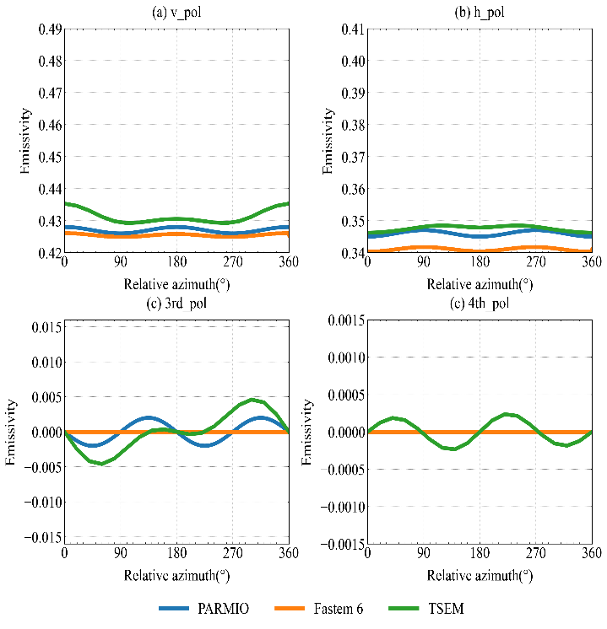
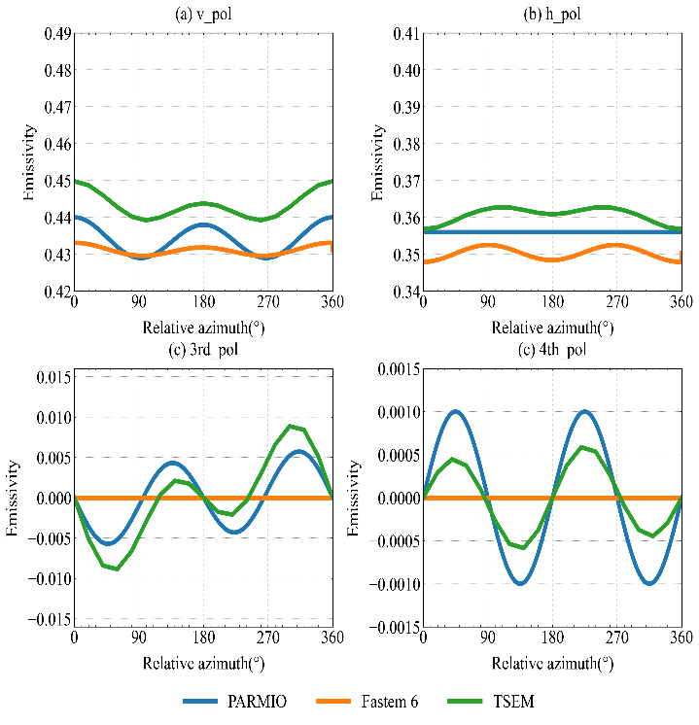
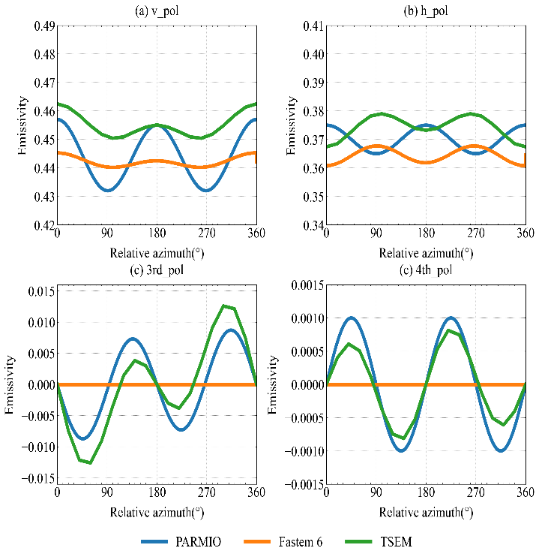
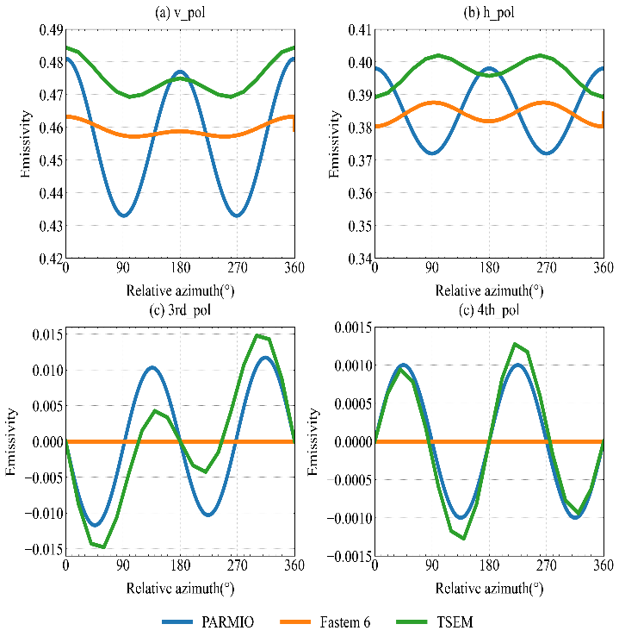
Comparison of TSEM with PARMIO at 10 GHz
5m/s
10m/s
15 m/s
20 m/s
10.65 GHz, 285K, observation zenith angle 30°, salinity 35‰
TSEM has azimuthal variations similar to PARMIO
In lower wind speeds, both TSEM and PARMIO have emissivity higher than FASTEM
FASTEM does not have the 3rd and 4th components.
21

Slide 22
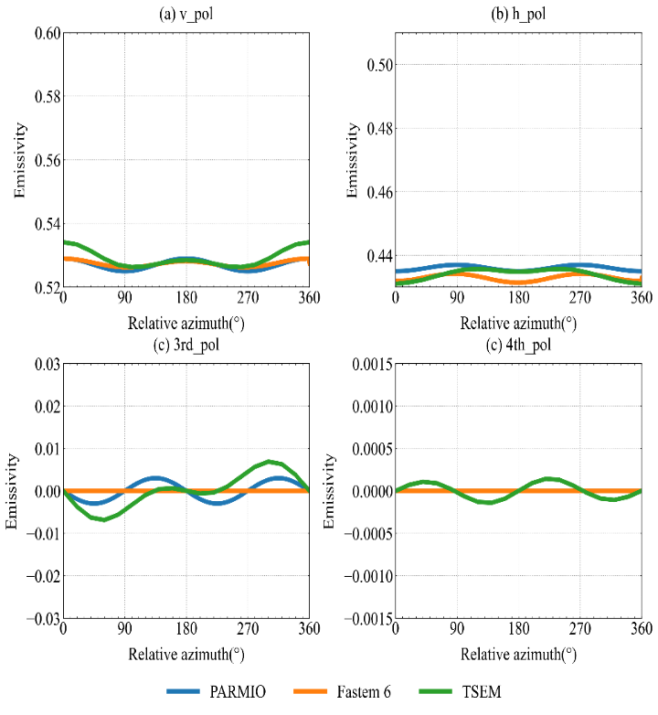
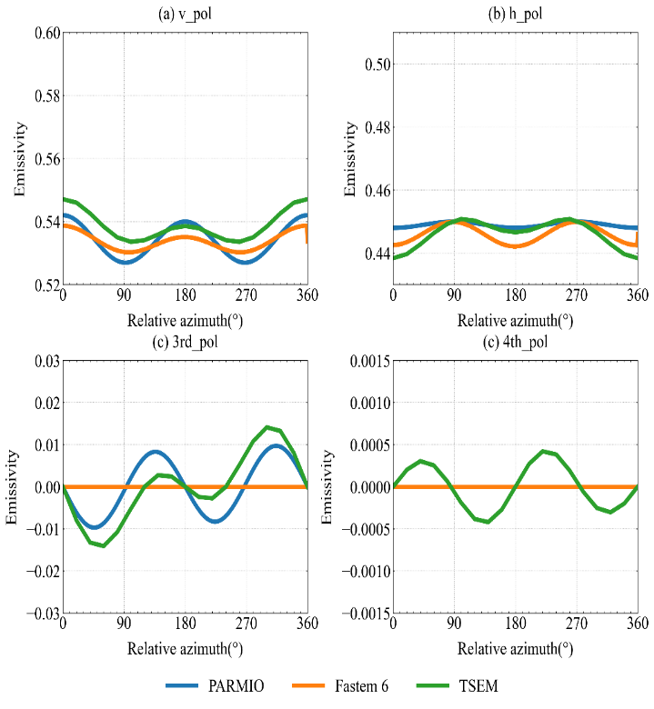
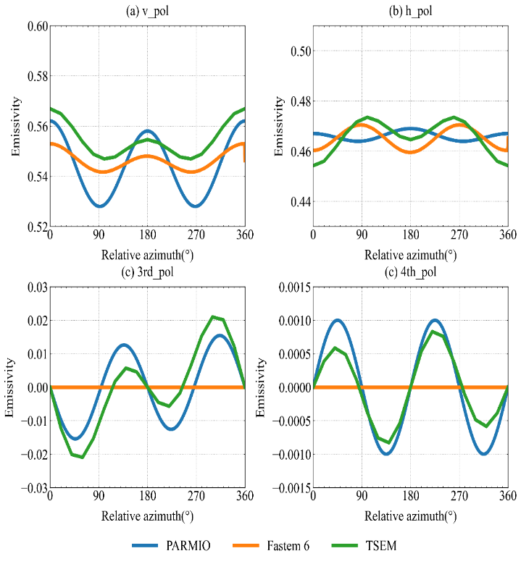
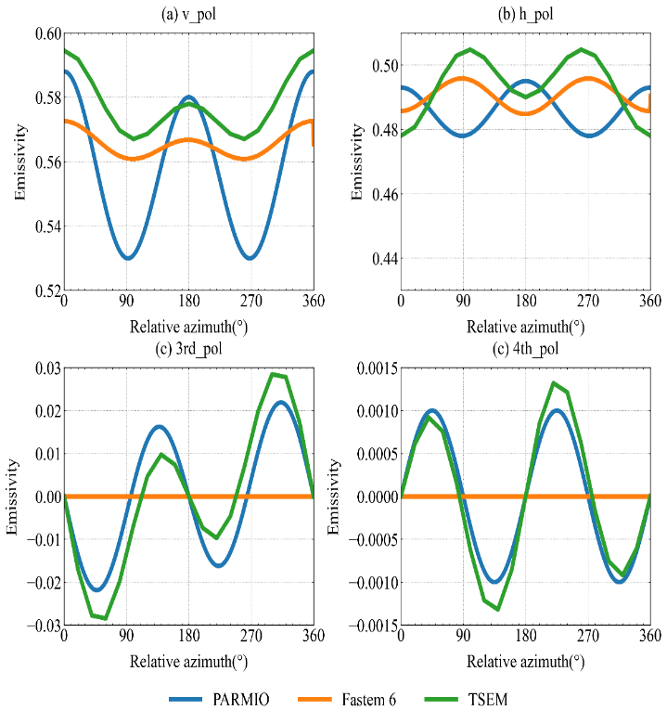
Comparison of TSEM with PARMIO at 37 GHz
5m/s
10m/s
15 m/s
20 m/s
37 GHz, 285K, observation zenith angle 30°, salinity 35‰
PARMIO can not predict the fourth Stokes component at 5 m/s and 10 m/s windspeed.
PARMIO have the opposite phases to TSEM and FASTEM in horizontal polarization at 15 and 20 m/s.
The results at 37GH are similar to those at 10.65GHz, but the differences between TSEM and FASTEM are smaller in both vertical and horizontal polarization.
22

Slide 23
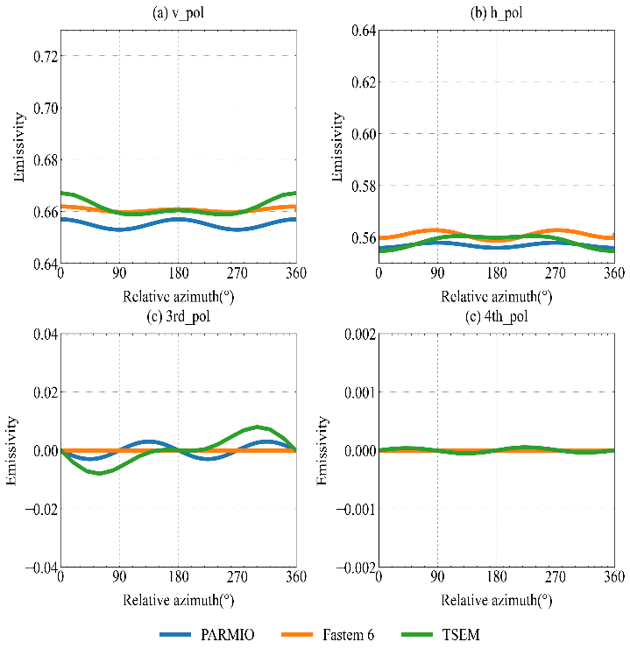
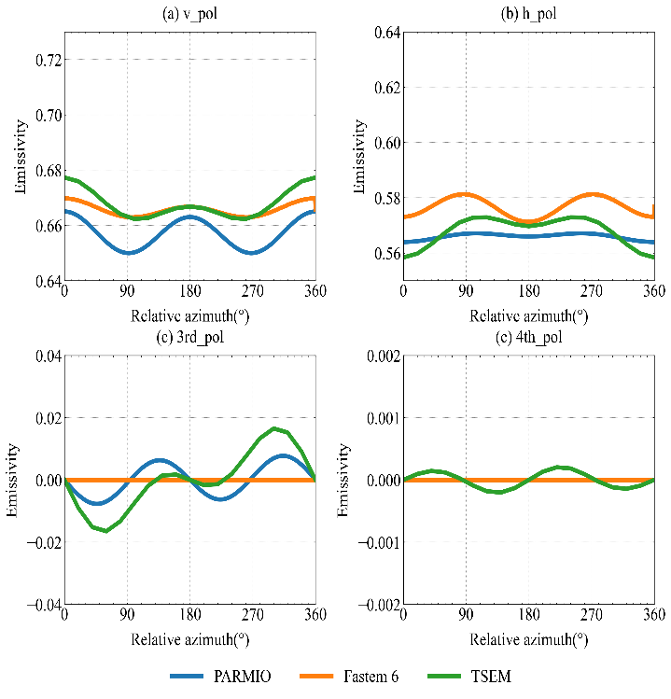
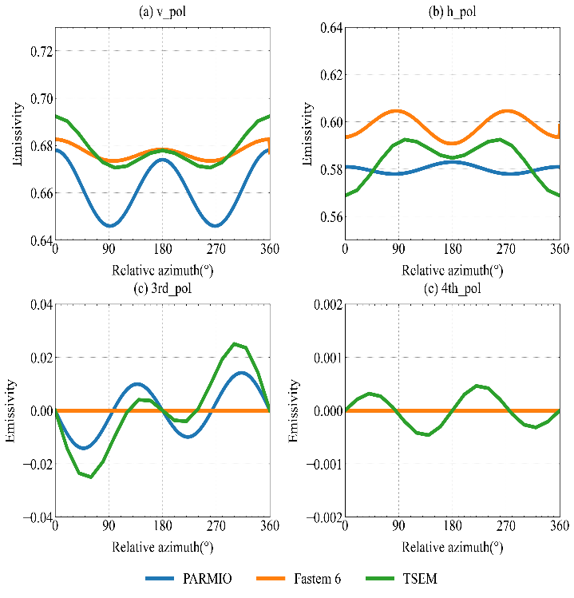
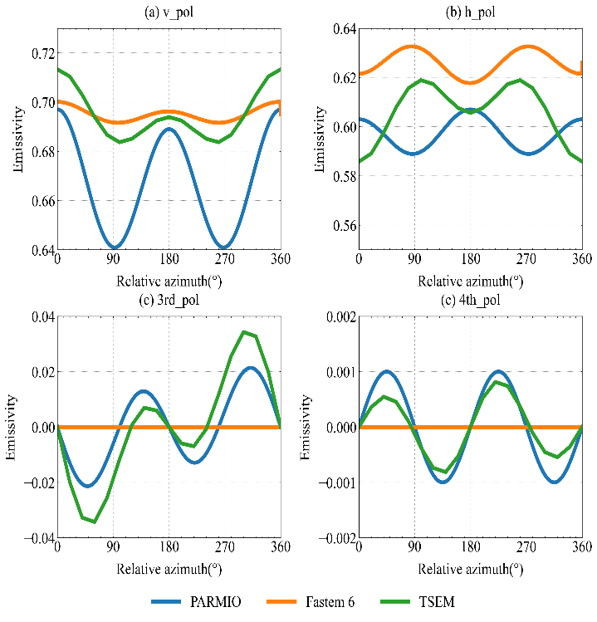
Comparison of TSEM with PARMIO at 89 GHz
5m/s
10m/s
15 m/s
20 m/s
89 GHz, 285K, observation zenith angle 30°, salinity 35‰
PARMIO can not predict the fourth Stokes component at 5, 10 and 15 m/s windspeed.
PARMIO has the opposite phase to TSEM and FASTEM in horizontal polarization at 15 and 20 m/s.
The difference between TSEM and FASTEM is smaller in vertical polarization but is larger in horizontal polarization compared with 37 GHz.
The differences between PARMIO and FASTEM are larger in both vertical and horizontal polarization compared with 37 GHz.
23

Slide 24
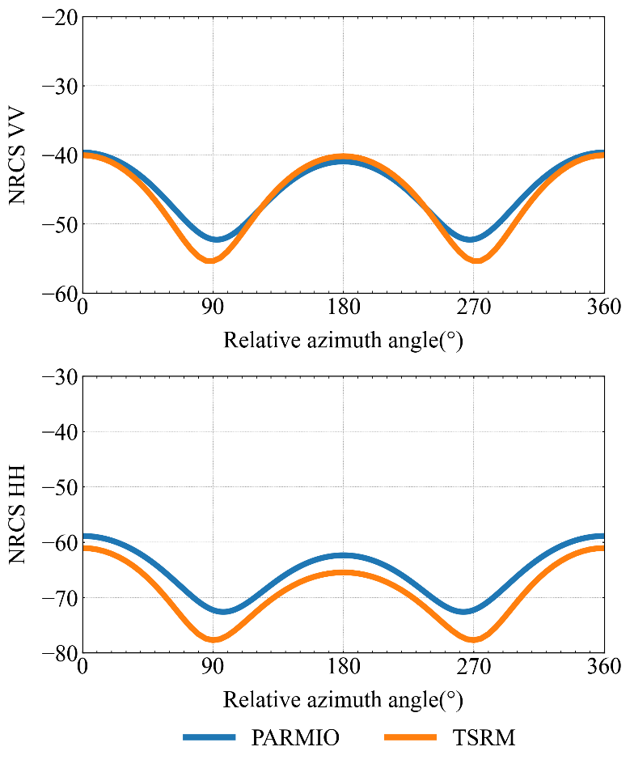
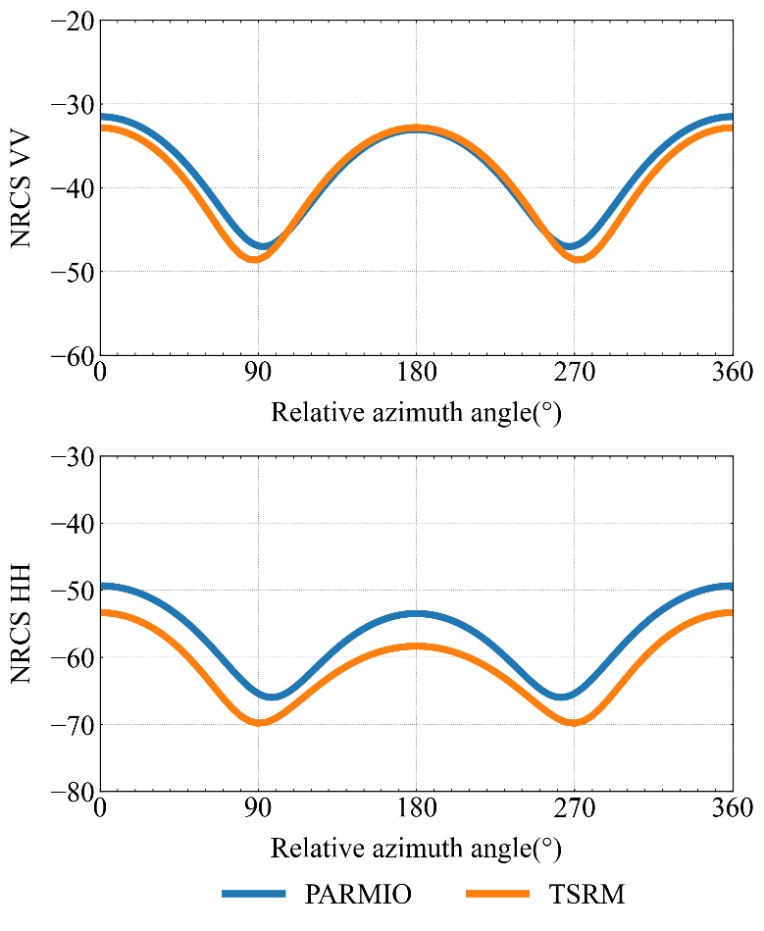
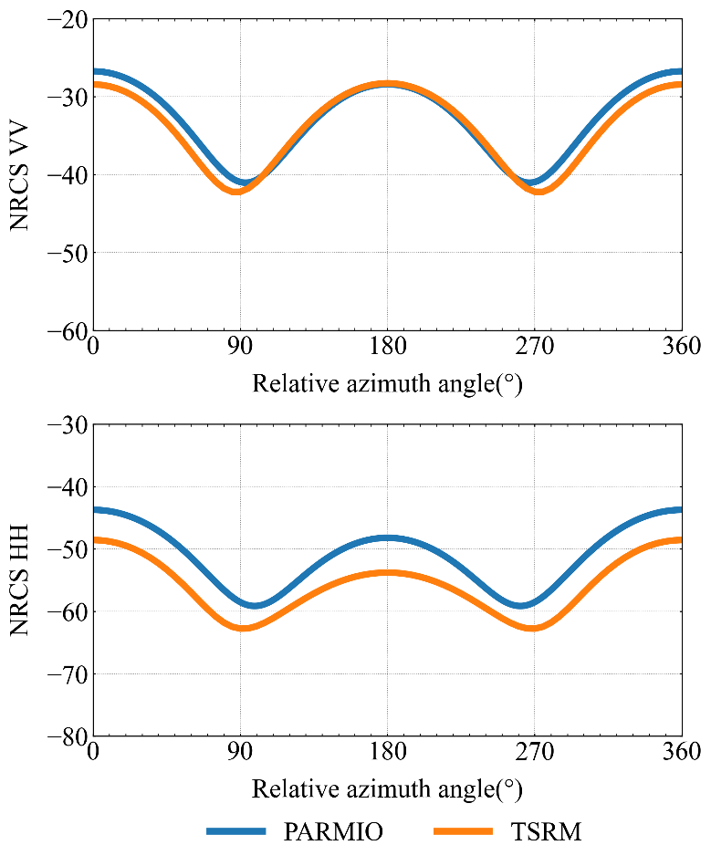
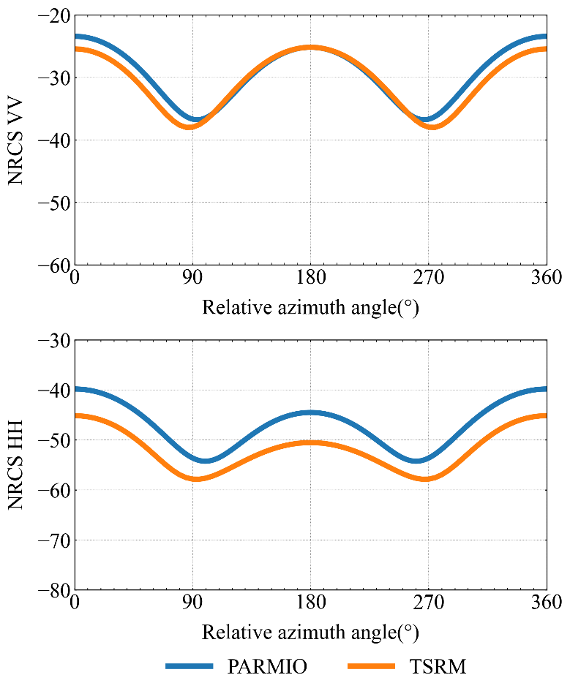
Normalized Radar Cross Section NRCS at C-Band
5m/s
10m/s
15m/s
20m/s
SST=285K, zenith angle = 50⁰, SSS = 35‰, C band
In VV NRCS, the smallest difference appears in the downwind direction.
VV NRCS is more consistent than HH NRCS.
The azimuth variations of the two model are similar.
24

Slide 25
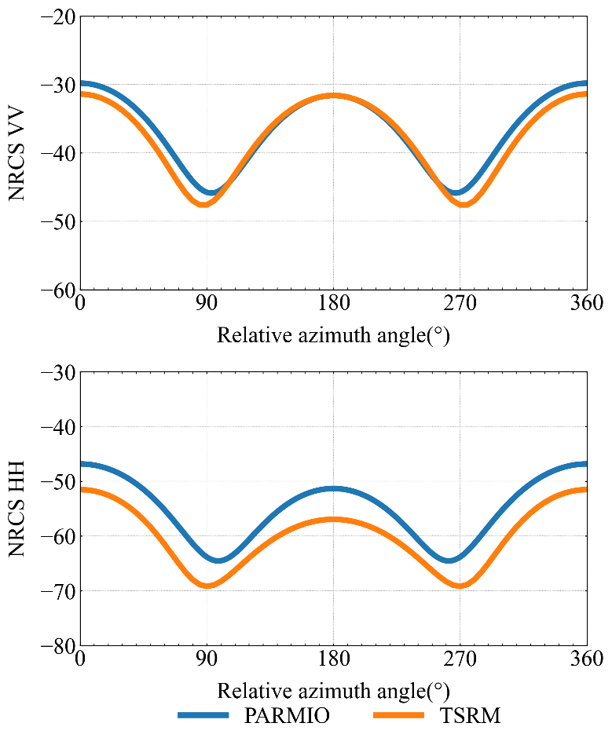
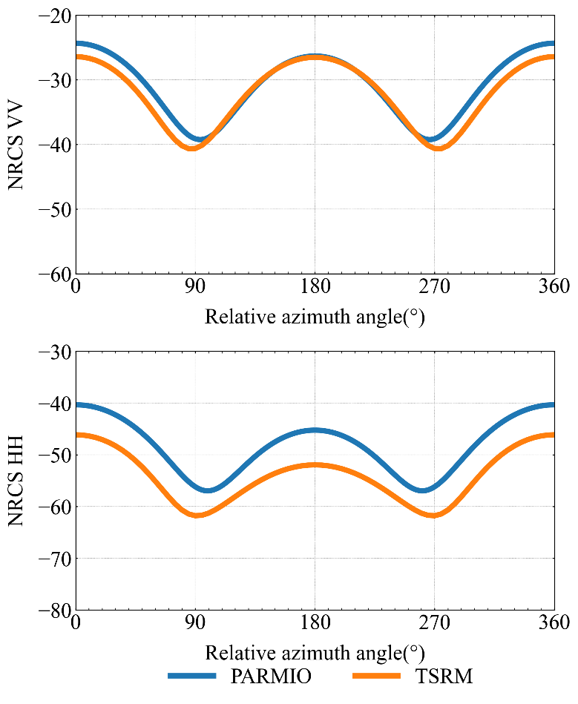
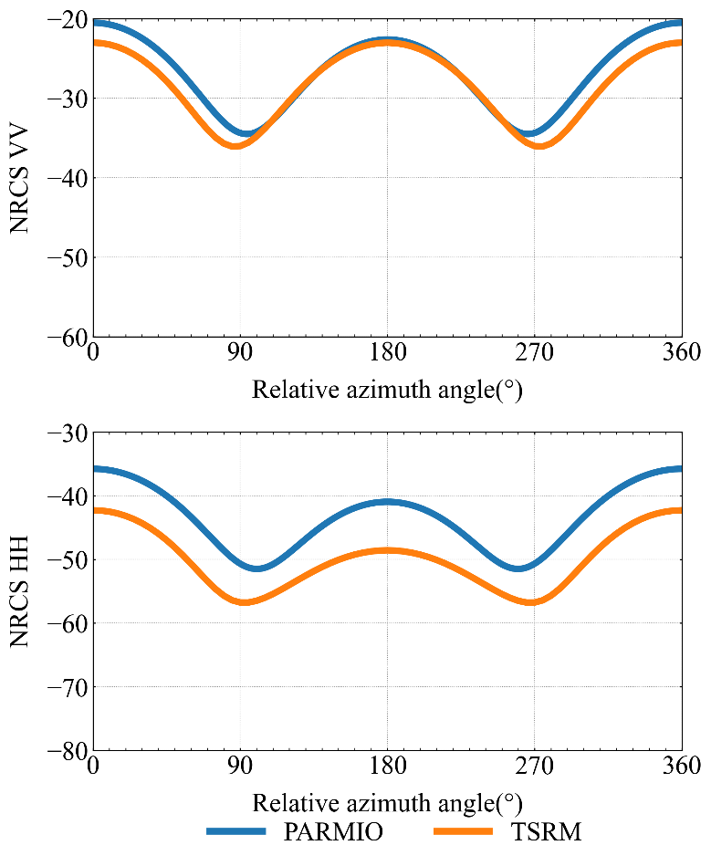
Normalized Radar Cross Section NRCS at X Band
5m/s
10m/s
15m/s
20m/s
SST=285K, zenith angle = 50⁰, SSS = 35‰, X band
25

Slide 26
Summary and Conclusions
ARMS is updated with the new ocean polarized BDRF matrix derived from two-scale reflection model (TSRM) and is supporting operational and research missions for satellite data assimilation as well as many other applications.
Polarized BRDF allows for better simulations of surface reflection in vector radiative transfer model.
Polarized BRDF allows for computing the surface Stokes emissivity vector, monostatic normalized radar cross section (NRCS) and bistatic NRCS.
Comparing with PARMIO and FASTEM, the surface emissivity vector derived pBDRF matrix produces reasonable distributions.
The azimuthal variations in backscattering NRCS also agree well with PARMIO, especially in vertical polarization.

