Slide 1
Scherrer & Gough (2019)
Takashi Sekii
NAOJ/Sokendai

Slide 2
This brief presentation is about
Introducing Scherrer & Gough (2019)
Submitted to ApJ
Entitled ‘How fast is the Sun spinning?’

Slide 3
Structure of the paper
In response to the inference made by Fossat et al (2017)[F17]
Their assumed detection of l=1 modes leads to inconsistency with GOLF data
Maybe these were l=2 except...
Actually, l=1 modes should not be detected anyway
A few datasets were analysed following the same procedure, with no robust detection

Slide 4
Comment on the inference made by F17
F17 say:
The 3 peaks at 210 nHz, 630 nHz and 1260 nHz are due to dipole and quadrupole modes
Assuming that the envelope (‘p-mode’) rotation rate is 433.5 nHz, the core rate is 1277 nHz

Slide 5
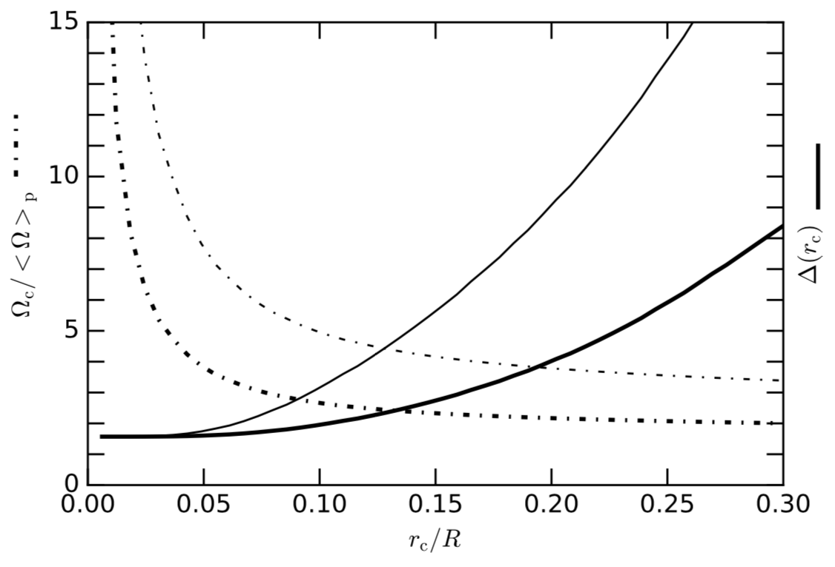
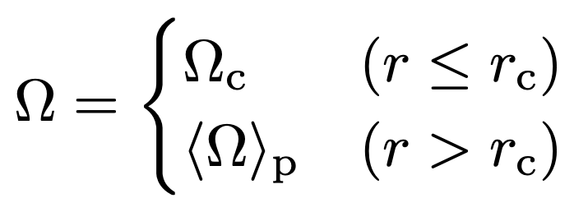
Comment on the inference made by F17
Scherrer & Gough say:
Their core rate is highly inconsistent with the GOLF(!) p-mode splitting data
If the lowest detected modes are l=2, the core rate would be 789 nHz which is more consistent

Slide 6
Comment on the inference made by F17
Scherrer & Gough say:
Their core rate is highly inconsistent with the GOLF(!) p-mode splitting data
If the lowest detected modes are l=2, the core rate would be 789 nHz which is more consistent
Maybe 394 nHz is possible too
If the 210 nHz peak corresponds to (l,m)=(2,2)?
Even these explains the 210 nHz peak only, not the remaining two peaks

Slide 7
More evidence against F17
Elsworth et al (1995)
The core of the Sun rotates no faster than the rest of the radiative interior
Etc, etc

Slide 8
Detection of dipole g modes?
Gough (1993), often referred to as ‘Les Houches note’, discusses aspherical perturbation theory
Keneddy, Jeferies & Hill (1993) pointed out, based on Gough (1993), that
Even-degree g modes produce p-mode frequency modulation
But not odd-degree g modes, to the leading order
So, F17 could not have detected dipole modes

Slide 9
Detection of dipole g modes?
Appendix of Scherrer & Gough
Does not seem to have the right parity

Slide 10
Detection of dipole g modes?
I decided to try to reproduce (A9)
In the hope that I will be able to say
At the time of writing, there are multiple discrepancies between (A9) and my formula
However
All the terms in my formula have the right parity
There is one term very similar to the last term in (A9), but with the right parity

Slide 11
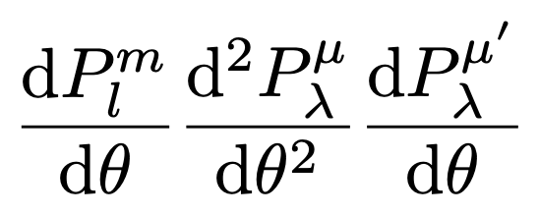
Detection of dipole g modes?
Appendix of Scherrer & Gough

Slide 12
Detection of dipole g modes?
I decided to try to reproduce (A9)
At the time of writing, there are multiple discrepancies between (A9) and my formula
However
All the terms in my formula have the right parity
There is one term very similar to the suspected term, but with the right parity
I am reasonably convinced that the conclusion is right

Slide 13
Analyses following F17
GOLF data
Analysis with a better cadence told a different story
Sensitive also to the start times of data and the window size (the canonical is 4 hours)
MDI, HMI, GONG, BiSON
Peaks are seen, but ‘not robust’
80-sec cadence GOLF data
60-sec cadence GOLF data

Slide 14
Analyses following F17
GOLF data
Analysis with a better cadence told a different story
Sensitive also to the start times of data and the window size (the canonical is 4 hours)
MDI, HMI, GONG, BiSON
Peaks are seen, but ‘not robust’

Slide 15
Conclusion by Scherrer & Gough
...the conclusions of Fossat et al. are premature

