Slide 1
g-mode detection: collapsogramme, models, extremes and all that
T. Appourchaux
Institut d’Astrophysique Spatiale, Orsay

Slide 2
Outline
Patterns: what are the g-mode detection schemes?
Where are the g modes...in theory?
How can we do a collapsogramme?
Detection in a collapsogramme...to what extreme?
Conclusion

Slide 3
Asymptotic periods
After Provost and Berthomieu (1986)
If you don't know the periods, we can rewrite the above for solving it for :

Slide 4
Patterns: What are the g-mode detection schemes?
Examples using the rotational splitting frequencies:
Collapsogramme using the 2l+1 signals (Appourchaux et al., 2000)
Overlapogramme using the l+1 signals (Salabert and Garcia, 2008)
Multiplets (Chaplin et al., 2002; Turck-Chièze et al., 2004)
Examples using the asymptotic period sequencing:
Exact Fraction Technique (van der Raay, 1986): échelle-diagram like but in periods Δν being replaced by
Coherence (Fröhlich and Delache, 1984; Fröhlich and Andersen, 1995)
Periodogram of the Fourier spectrum expressed in time (periodogram of the periodogram) (Garcia et al., 2007)
Guided search (Broomhall et al., 2007)

Slide 5
Collapsogramme for g modes (I)
Collapsogramme for p modes: use the splitting pattern
Collapsogramme for g modes: use of the asymptotic period pattern (not really new but...)
Select n orders with theoretical frequencies (includes splitting)
Use a window of so-many bins around the frequency
Cut the power spectrum in n chunks (normalize)
Co-add the n windows
Detect using a χ² with 2n d.o.f statistics

Slide 6
Collapsogramme for g modes (II)
Difficulties with this approach:
with a resolution of 1.4 nHz, modes if restricted to one bin are easy to be missed
mode lifetimes are supposed to be over several decades (or so...)
exact frequencies not known (this is the goal...)
Possible solutions:
smoothing over some bins (See Fossat et al., 2017) with a known statistics
optimize location of the theoretical frequencies (dithering) with a statistics to be derived...

Slide 7
Frequency spread vs model # (l=1)
n=1...30
1-24 JCD
25 Provost
26 Provost_86
27-28 Buldgen
29-30 Mathur
31 Bigot
32-34 Lebreton

Slide 8
Frequency spread vs model # (l=2)
n=1...30
1-24 JCD
25 Provost
26 Provost_86
27-28 Buldgen
29-30 Mathur
31 Bigot
32-34 Lebreton

Slide 9
Frequency spread vs frequency (l=1)
n=1...30

Slide 10
Frequency spread vs frequency (l=2)
n=1...30

Slide 11
Asymptotic periods
After Provost and Berthomieu (1986)
If you don't know the periods, we can rewrite the above for solving it for :

Slide 12
P₀ for various model (l=1,2)
n=10...27
Borexino constrained
0
-3σ
1-24 JCD
25 Provost
26 Provost_86
27-28 Buldgen
29-30 Mathur
31 Bigot
32-34 Lebreton

Slide 13
V_{l} for various model (l=1,2)
n=10...27
1-24 JCD
25 Provost
26 Provost_86
27-28 Buldgen
29-30 Mathur
31 Bigot
32-34 Lebreton

Slide 14
θ for various models (l=1,2)
n=10...27
1-24 JCD
25 Provost
26 Provost_86
27-28 Buldgen
29-30 Mathur
31 Bigot
32-34 Lebreton

Slide 15
Model comparison: conclusion
For recent models, frequencies can differ by ± 1.5%
For recent models, P₀ can differ by ±3% (1% is 1800 bins at 260 μHz for 22 years...)
What are the sources of differences?
How can we detect the modes by looking around these theoretical frequencies?
Summation by dithering the central frequency and optimisation of the maximum by looking for the maximum in the window...
...which brings the next subject: the statistics of extreme

Slide 16
Why the statistics of extreme?
Searching for the maximum in a window of n bins for each order, then sum over k orders.
What is the statistics of the maximum in a window? Case of 2 d.o.f
Searching for the maximum in a window of n bins summed over k orders.
What is the statistics of the maximum in a window? Case of 2k d.o.f
Searching for the maximum in a window of n bins smoothed over p bins summed over k orders (homework...)

Slide 17
Extreme value theory
Nature:
Extreme floods; The size of freak waves
Tornado outbreaks
Large wildfires
Earthquakes
Biology:
Mutational events during evolution
Side effects of drugs
Performances in athletic disciplines.
Economy:
The amounts of large insurance losses
Equity risks; Day to day market risk

Slide 18
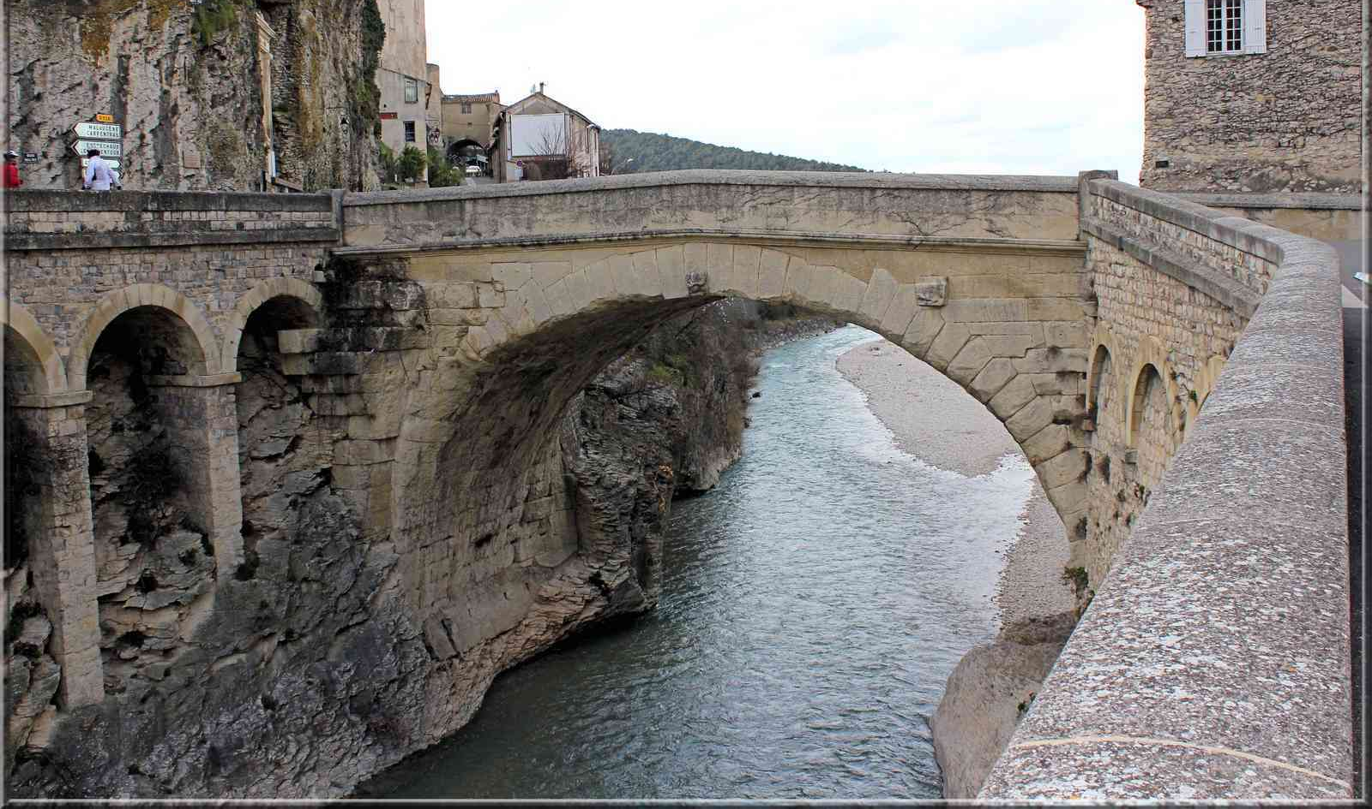
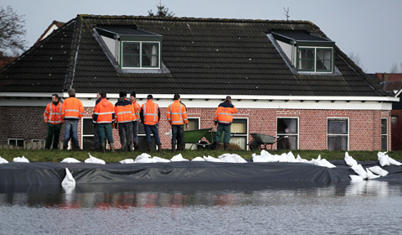
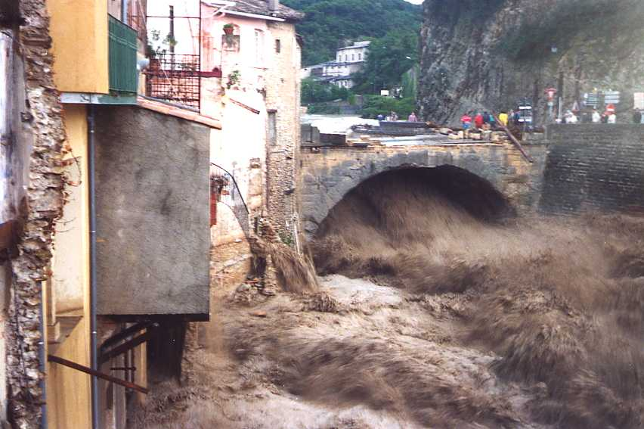
Floods
Vaison la Romaine
Nederlandse dijken

Slide 19
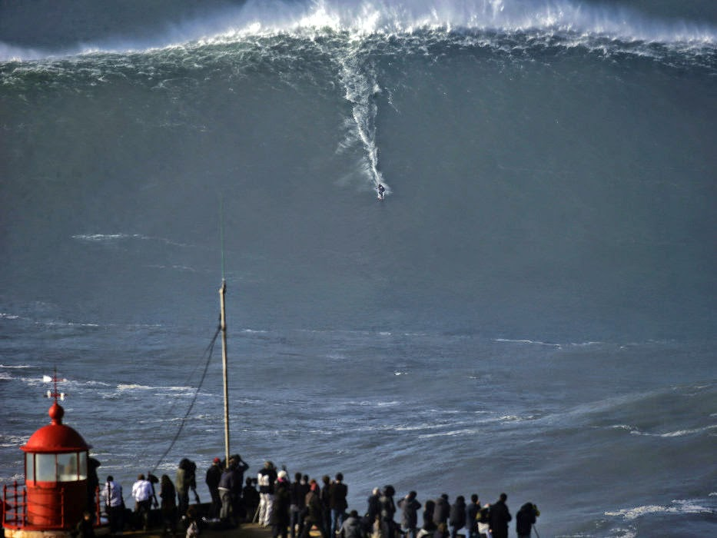
Waves

Slide 20
Statistics of the maximum
Let be a sequence of i.i.d random variables,
and
Let be the cumulative distribution function (cdf) of the
then the cdf of is :
What are the mean and rms of ?
Mr Tippett to the rescue....who worked on the problem of yarn
breakage rates in weaving (Shewart medal, 1961)

Slide 21
Fisher–Tippett–Gnedenko theorem
Let be a sequence of i.i.d random variables,
and
If a sequence of pairs of real numbers exists such
that and the the cdf of is:
where is a non degenerate function, then the limit distribution belongs to either the Gumbel, the Fréchet or the Weibull family.

Slide 22
Convergence conditions
Depending on the cdf function of the random variables the limiting cdf function can differ. For the Gumbel family, the convergence condition is:
with the Gumbel function given as:
where and
von Mises, R. (1936) in Revue mathématique de l'Union Interbalkanique, 1, 141
Gumbel, E.J. (1954), Statistical theory in extremes and practical applications, in Applied Mathematics Series, 33

Slide 23
Case of χ² with 2 d.o.f
For a χ² with 2 d.o.f, we have:
From the convergence condition, it belongs to the Gumbel family
Therefore we have and
Knowing the Gumbel distribution, we can derive that the mean value of the maximum and its sigma are given by:
wher is the Euler-Mascheroni constant
Fisher, R.A. and Tippett, L.H.C. (1928) in Proc. of the Cambridge Philosophical Society, 24, 180

Slide 24
Case of χ² with p d.o.f
For a χ² with p d.o.f we have from the convergence condition, it belongs to the Gumbel family
Black (dof=2), Green (dof=10), Orange (dof=100)

Slide 25
Question...
What is the probability that the maximum of an ensemble of n i.i.d with χ² with 2 d.o.f go over the 10% and 1% probability levels set for a single bin?
For 10 bins, 65% of the times, it is over the 10% level, while it is 10% of the times for the 1% level.

Slide 26
Conclusion
Models are available for making a collapsogramme (folding in rotational splitting)
Typical relative frequency variation is a few % (1% is 1800 bins at 260 μHz for 22 years...)
Statistics for collpasogramme using "fixed" theoretical frequencies is known (χ² with whatever dof...)
Statistics for collpasogramme for "dithered" theoretical frequencies is known (maximum of n χ² with whatever dof..., n being not too large...) (dithering cannot be large...10...)

