Slide 1
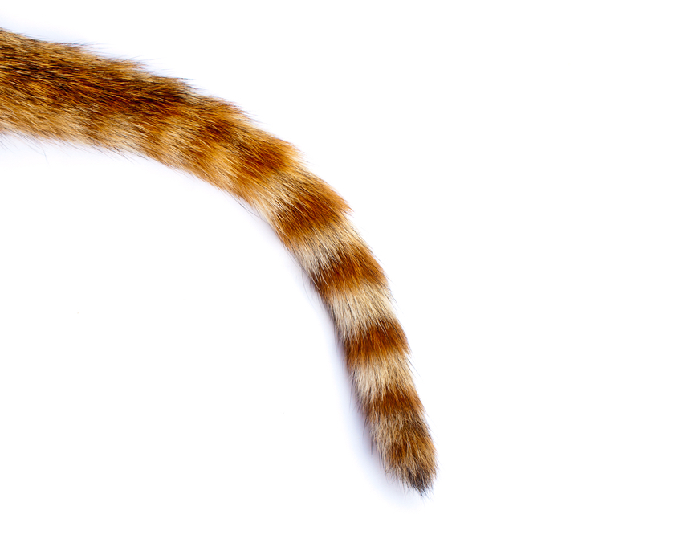
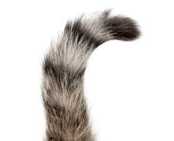
g-mode detection: the tale of two tails
T. Appourchaux
Institut d’Astrophysique Spatiale, Orsay

Slide 2
Outline
Reproduction of Fossat et al (2017) (Paper I)
What to conclude from Paper I?
Reproduction of Fossat and Schmider (2018) (Paper II)
What to conclude from Paper II?
Conclusion

Slide 3
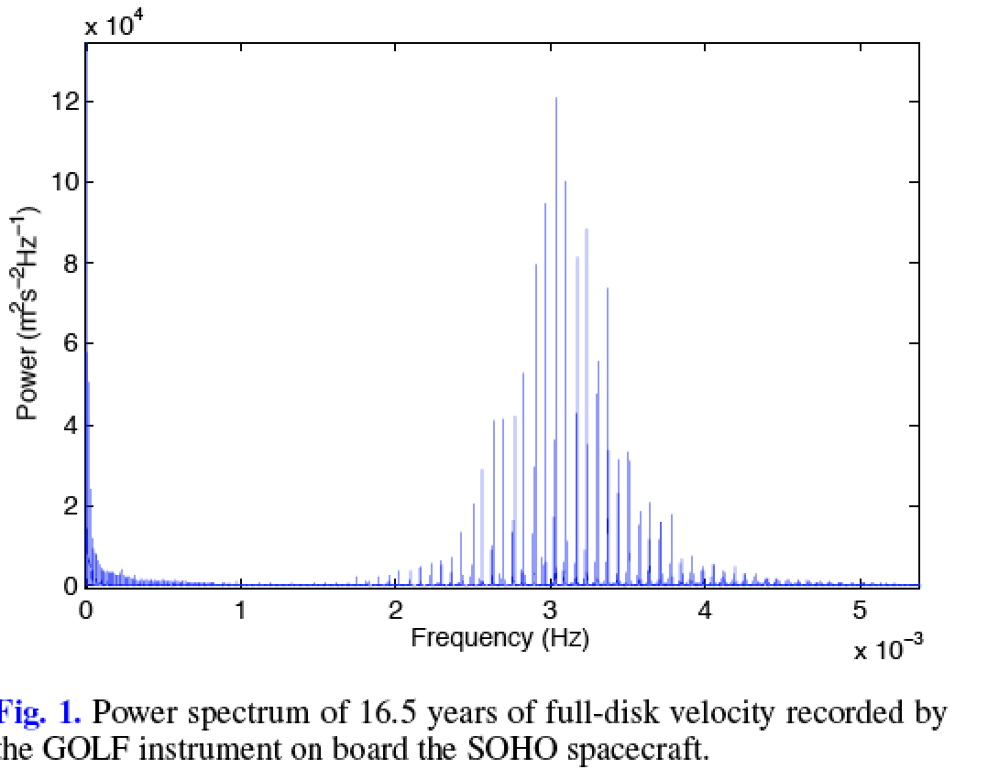
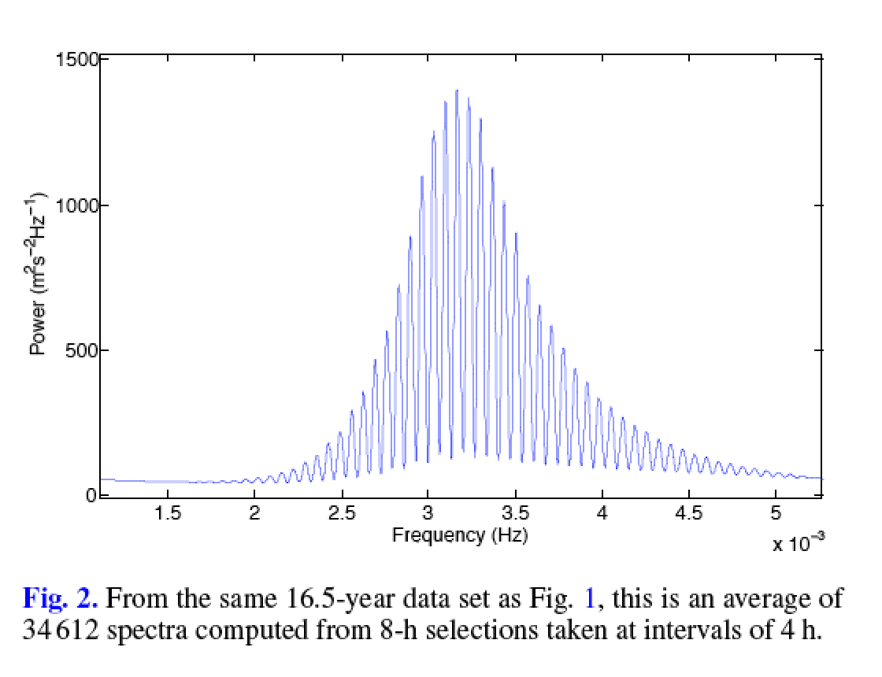
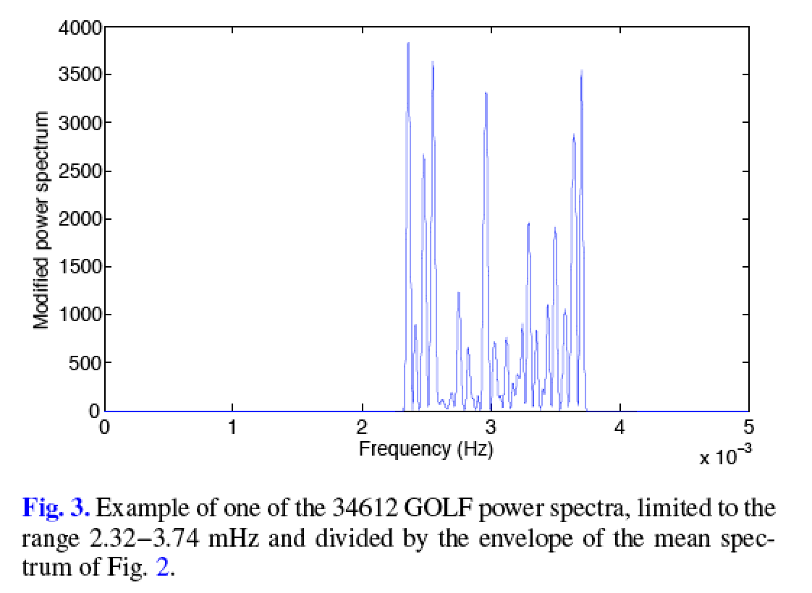
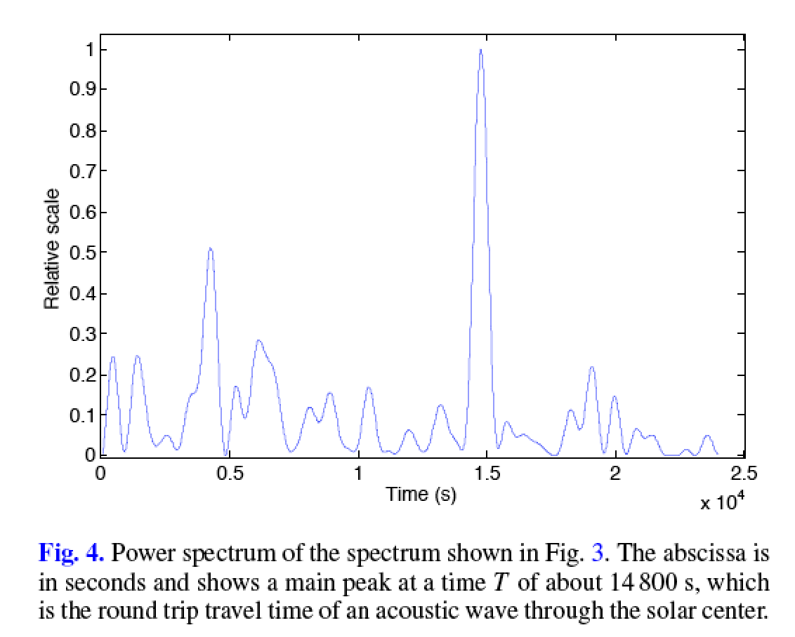
The method of Fossat et al. (2017)
Mean power spectrum
Power spectrum
Normalized and windowed
power spectrum
Fourier transform
Time travel of p-mode wave packet

Slide 4
The method of Fossat et al. (2017)
Take a time series, say GOLF
Take sub-series of 8 hours, each successive sub-series overlapping by 4 hours
Oversample each sub-series by filling it with zeroes (resolution of 1 μHz)
Compute power spectrum for each sub-series
Select a window in that power spectrum [2320, 3740] μHz (p-mode range)
Normalize the p-mode enveloppe by dividing by a Gaussian function
Oversample the windowed/normalized spectrum by filling it with zeroes up to 125 mHz (resolution of 8 sec)
Take power spectrum again (now we are in time space)
Measure location of the peak at roughly 4 h (=136/2 μHz) by fitting a 2nd order polynomial for each sub-series (gives a time in s)
Take the power spectrum of times, and select a window [5.5,34.7] μHz
Take autocorrelation of that window (Fig. 10 of Fossat et al, 2017)

Slide 5
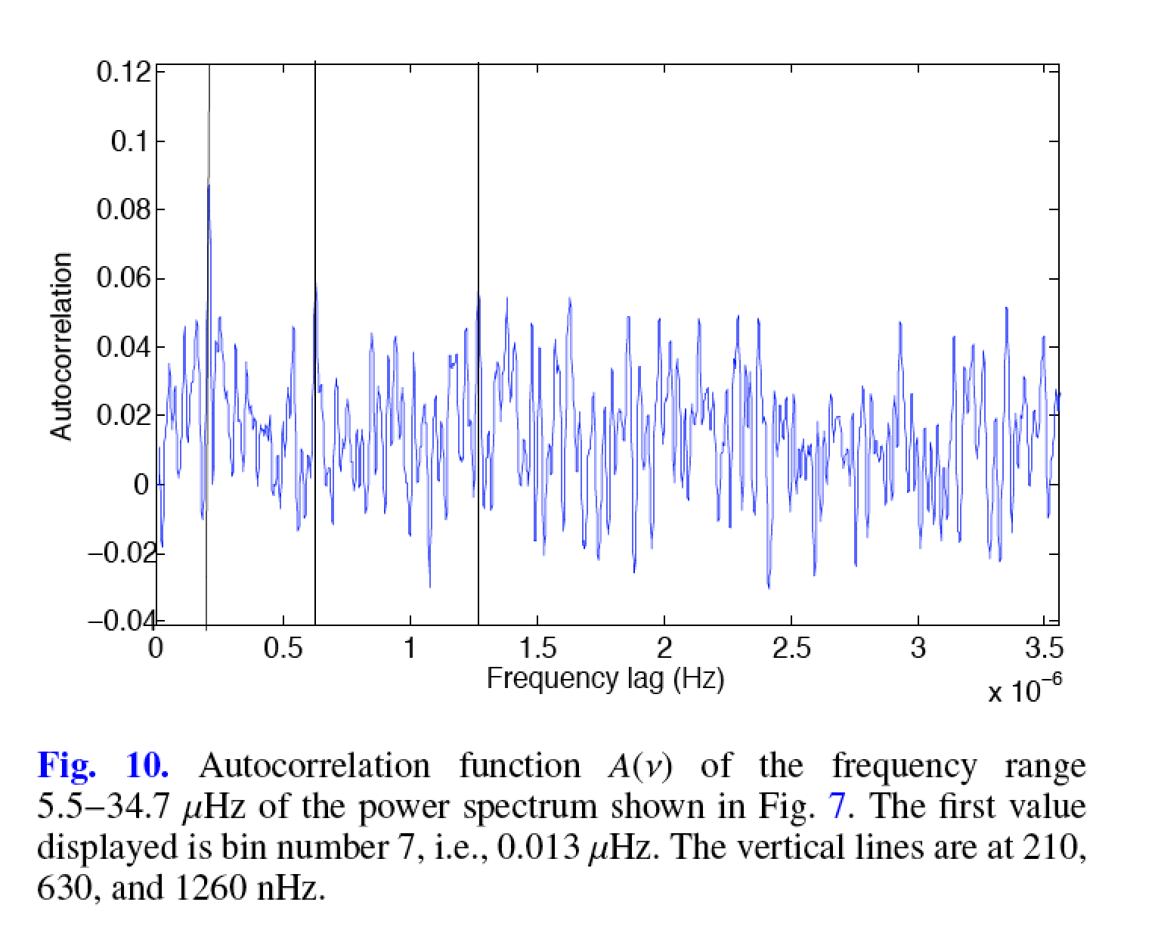
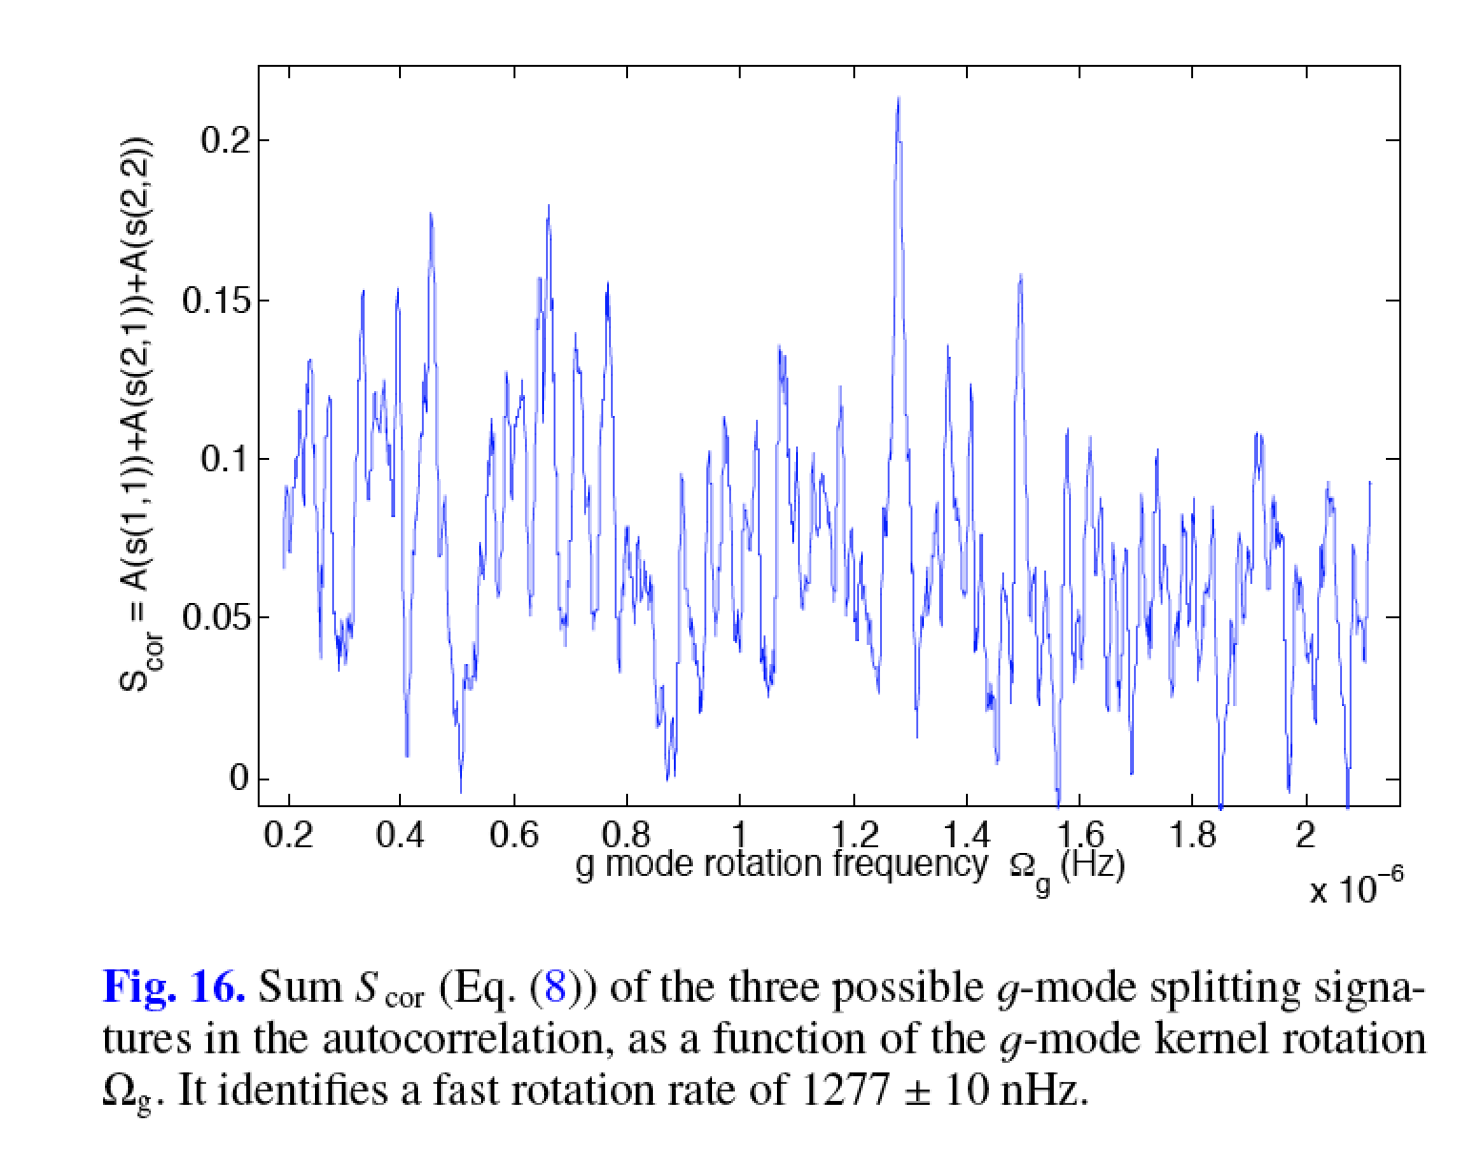
The results of Fossat et al (2017)

Slide 6
Fig. 10 The derivation of g-mode splitting
Data from the new GOLF calibration (Appourchaux et al, 2018)
Splitting for g modes seen by the p modes
0.210 μHz
0.630 μHz
1.260 μHz
is the rotation rate seen by the g modes
is the rotation rate seen by the p modes
Since the p modes rotate with the Sun, the splitting is seen in a rotating frame (hence minus )
Take sum of s(1,1)+s(2,1)+s(2,2) as a function of for = 0.432 μHz for producing Fig. 16

Slide 7
Fig. 16 The g-mode splitting
Data from the new GOLF calibration (Appourchaux et al, 2018)
Splitting for g modes seen by the p modes
1.277 μHz
is the rotation rate seen by the g modes
is the rotation rate seen by the p modes
Since the p modes rotate with the Sun, the splitting is seen in a rotating frame (hence minus )
Take sum of s(1,1)+s(2,1)+s(2,2) as a function of for = 0.432 μHz for producing Fig. 16

Slide 8
Old GOLF vs. New GOLF (80 s)
Old GOLF
0.210 μHz
New GOLF
0.630 μHz
1.260 μHz

Slide 9
New GOLF: 20 s vs 80 s
20 sec
80 sec

Slide 10
New GOLF: 20 s vs 60 s
20 sec
60 sec

Slide 11
New GOLF: PM1 vs. average
PM1
Average

Slide 12
New GOLF: PM1 vs. PM2
PM1
PM2

Slide 13
Start: unshifted vs. shifted by 2 hours
Shifted by 2 hours
New GOLF
Unshifted
New GOLF

Slide 14
New GOLF: 16.5 years vs. 22 years
22 years
New GOLF
16.5 years
New GOLF

Slide 15
New GOLF: Subseries of 11 years
First 11 years
Last 11 years

Slide 16
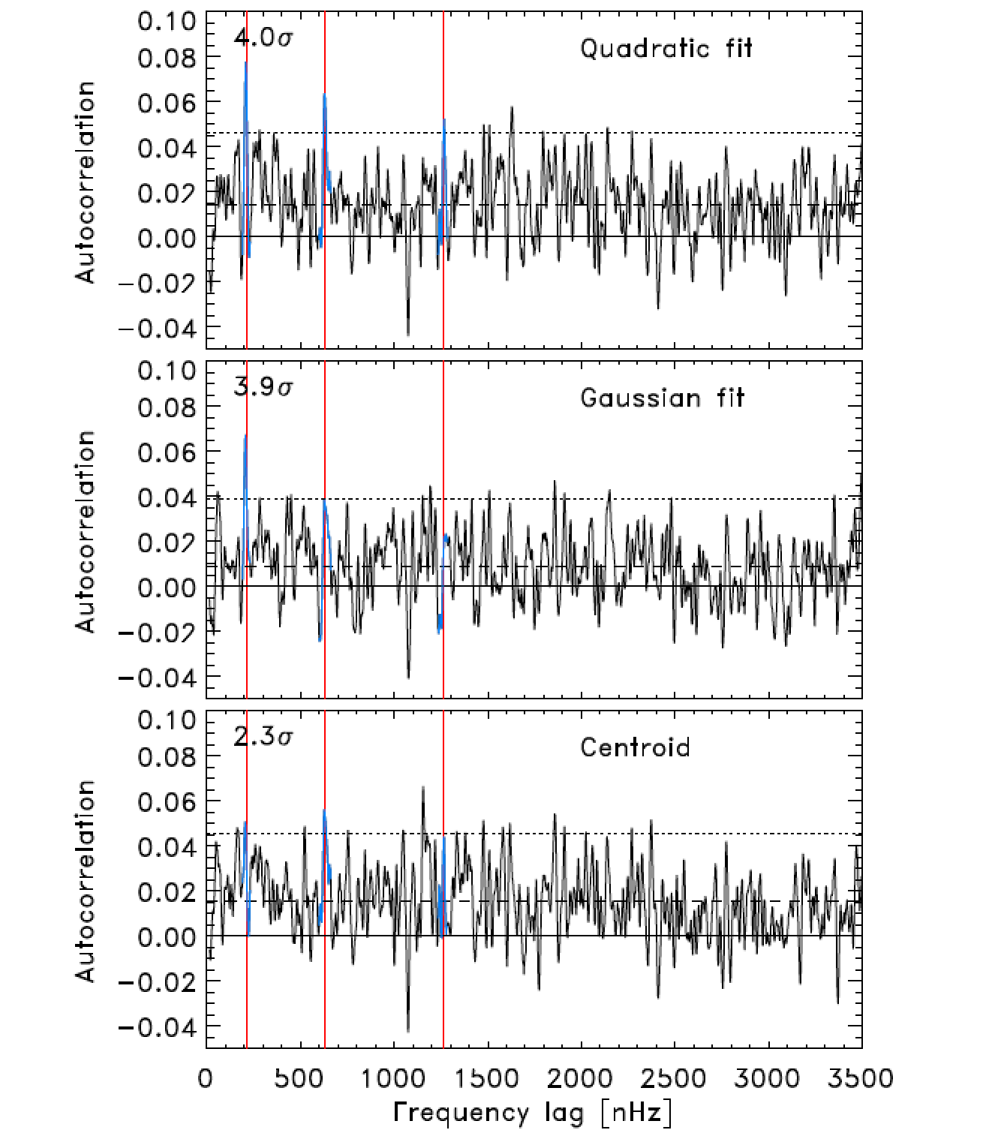
Findings of Schunker et al (2018)

Slide 17
Conclusion on Paper I
Sampling: Might or might not affect detection, to be debated..:
Heights of the three peaks depend on sampling
Rotation peak height (1280 nHz) less dependent on sampling
Photomultipliers: no confirmed detection (any sampling)
Sub series of 11 years: no confirmed detection
Longer time series: no confirmed detection. Rotation peak appears elsewhere at 0.9 μHz
Shifted start time by 2 hours: no confirmed detection (as in Schunker et al., 2018)
Cadence different to 4 h: no confirmed detection (Schunker et al., 2018)
Different function for peak fit / Smoothing: no confirmed detection (Schunker et al., 2018)

Slide 18
The method of Fossat and Schmider (2018)
Get data power spectrum using Steps 1 to 10 (Slide 4)
Make model spectrum using asymptotic g-mode periods as:
n is the order, P₀ the asymptotic separation, ν_{s} the rotational splitting
Use range n=[22,94] for l=1, and n=[36,144] for l=2
Smooth both spectra using this filter: [0.25, 0.5, 0.25]
Compute correlation of model spectrum with the power spectrum for l=1 and l=2

Slide 19
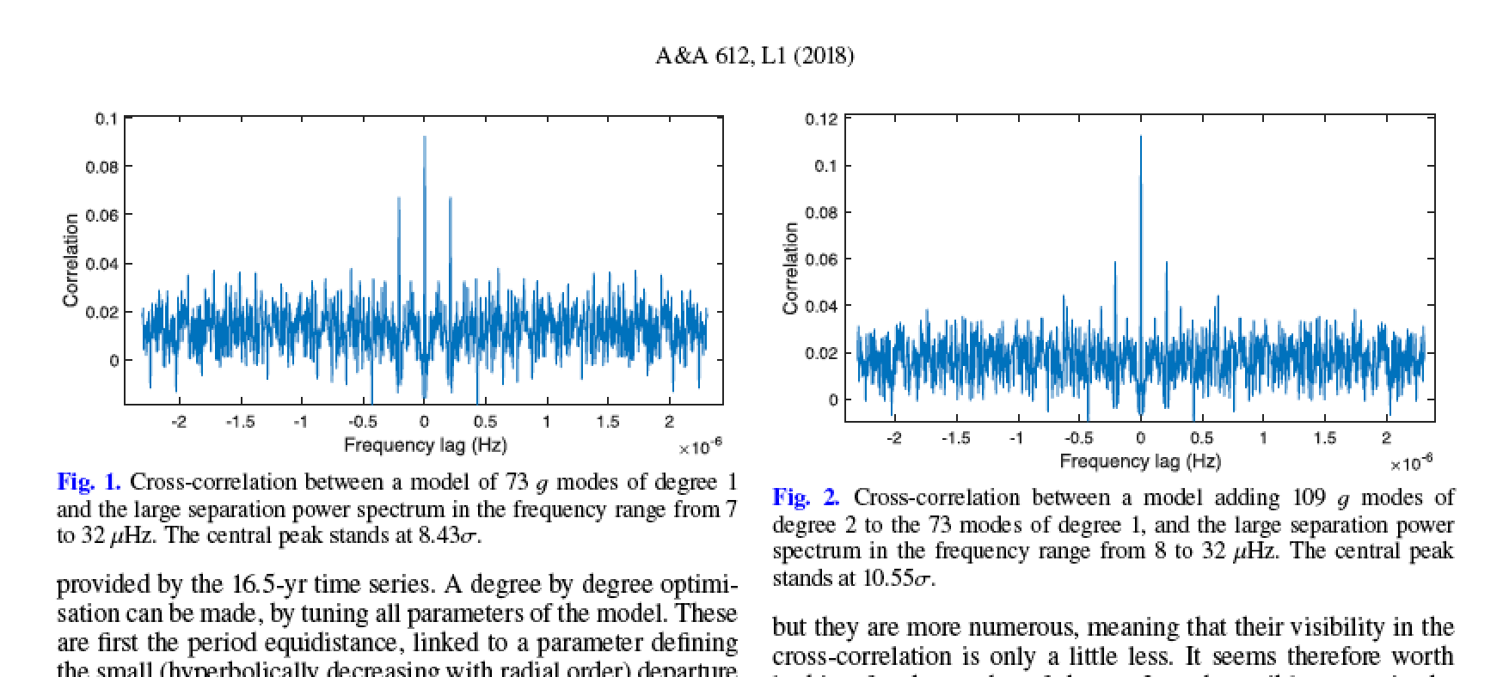
The results of Fossat and Schmider (2018)

Slide 20
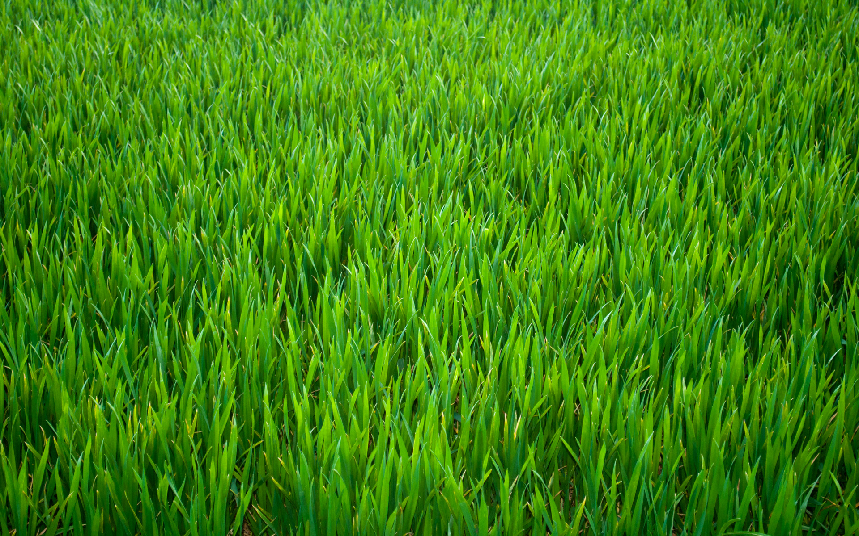
Optimisation of correlation (I)
5 parameters to be optimized for l=1 (6 for l=2)
Regular optimization code fails (see the grass...)

Slide 21
Optimisation of correlation (II)
Shoot 5 millions times at random the 5 (6) parameters within a given hypersphere
Compute the sum of the correlations at lag=0 and at lag=ν_{s}
Keep shooting until the maximum is reduced by 0.5% (make sure you shoot at least 100000 times). Reduce hypersphere by 10% when a lower value is found during the shooting
Do it a thousand times for the simulation...(one time for the data)
Simulation is a flat χ² with 2 d.o.f
Maximum
lag=0
Median
lag=0
lag=ν_{s}
lag=ν_{s}
In green: the un-optimized correlation for l=1
In black: the optimized correlation for l=1

Slide 22
Simulation: P₀ and P_{init} (n=22)
2041.86 s
33252 s
Start guess indicated
2039.94 s
31884 s

Slide 23
Simulation: ν_{s} and α
0.209 μHz
1338.73 s
Start guess indicated
0.628 μHz
1319.44 s

Slide 24
Simulation: a tale of two tails...
Histogram of correlation for lag ≠ 0
[0.055-0.145]
Normalized Histogram of correlation
[3.89-8.66]

Slide 25
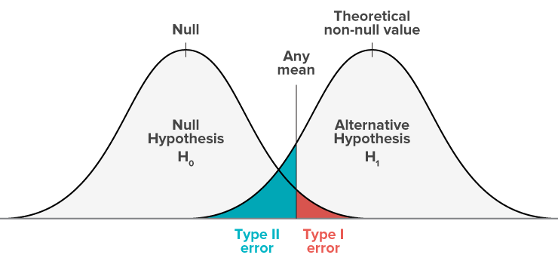
Two tails or two tales?
 | H₀ is true | H₀ is false
H₀ rejected | Type I error | Correct decision
H₀ accepted | Correct decision | Type II error

Slide 26
Where is the H₀ hypothesis?
The statistics at lag=0 are not comparable with the statistics at lag ≠ 0
The problem is the same as the statistics of the maximum of a random variable:
For lag≠0, this is the regular statistics of the sum of N random variable with a given statistics
For lag=0, this is the statistics of the sum of the maximum of N random variable with the same given statistics

Slide 27
Statistics of the maximum
The Probability Distribution Function (PDF) of the maximum Y of n random variable X with the same PDF is given by:
where CDF is the Cumulative Distribution Function, very clearly:
The statistics at lag=0 are not comparable with the statistics at lag ≠ 0

Slide 28
Statistics of the maximum: an example for χ² with 2 d.o.f.
Sum of 73 peaks at random summed over
m=0 and m=±1 (weights=0.6)
Sum of 73 maximum peaks taken from 73 windows of 26 bins
(simulating splitting)

Slide 29
Statistics of the maximum: an example for χ² with 2 d.o.f.

Slide 30
Data: same parameters as Fossat and Schmider (2018)
Large hypersphere

Slide 31
Data: same parameters as Fossat and Schmider (2018)
Small hypersphere

Slide 32
Data: different parameters from Fossat and Schmider (2018)
P_{init} shifted by 700 s (l=1) and 420 s (l=2)

Slide 33
Data: different parameters from Fossat and Schmider (2018)
P₀ increased by 25%

Slide 34
Data: different parameters from Fossat and Schmider (2018)
P₀ increased by 50%

Slide 35
Summary
The detection of Fossat et al (2017) is reproduced with the same sampling (80 s) and duration (16.5 y); and with 20 s; with the new and old GOLF time series
The detection of Fossat and Schmider (2018) is not reproduced with different series (PM, longer, shifted, subseries) or with the 60-s sampling; with the new GOLF time series. (See also Schunker et al, 2018 for the old GOLF time series)
The detection of Fossat and Schmider (2018) is reproduced for the same parameters (P₀, P_{init}, ν_{s}, α); with the old GOLF time series
But for a correlation, the statistics at lag=0 are different from those of at lag≠0
The detection of Fossat and Schmider (2018) is also reproduced for very different parameters (P₀ + 25%, P₀ + 50%, P_{init}+ΔP); with the old GOLF time series
The detection of Fossat and Schmider (2018) is also reproduced for noise simulation (χ² with 2 d.o.f, flat)

Slide 36
Conclusion
The detection of Fossat et al (2017) is not confirmed, most likely the fragility as coined by Schunker et al. (2018) is due to the noise playing with our nerves
The detection of Fossat and Schmider (2018) is not confirmed. The detection of degrees: 1, 2, 3 and 4 is an artefact of the correlation between hundreds of peaks and the signal (statistics of the maximum)

