Slide 1
Oscillatory Reconnection: wave-generating, periodic reconnection
James McLaughlin
Northumbria University
(Newcastle upon Tyne, United Kingdom)

Slide 2
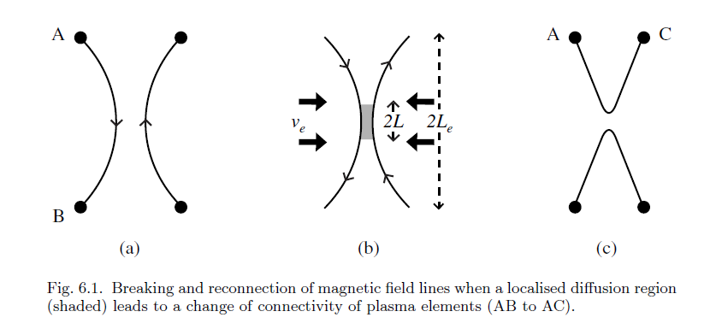
Introduction: Reconnection
Reconnection is a fundamental process in a plasma:
    Changes the topology
    Converts magnetic energy to heat/K.E
    Accelerates fast particles
Responsible for many phenomena in the solar atmosphere, e.g. Solar flares, CMEs, heating the Corona, ...

Slide 3
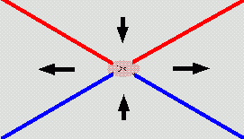
Introduction: Reconnection

Slide 4
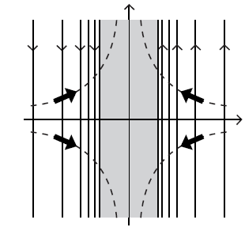
2D steady-state Reconnection theory well developed
    If magnetic field is brought in by a flow:
(v_{x} , v_{y} ) = (- Ux/a , Uy/a)
then a steady balance can be set up

Slide 5
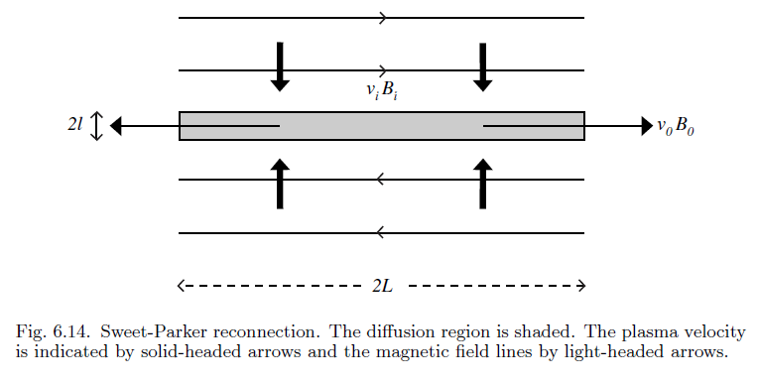
Sweet-Parker mechanism (1958)

Slide 6
Sweet-Parker mechanism (1958)
    Simple current sheet
    with uniform inflow

Slide 7
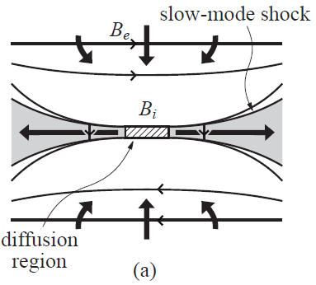
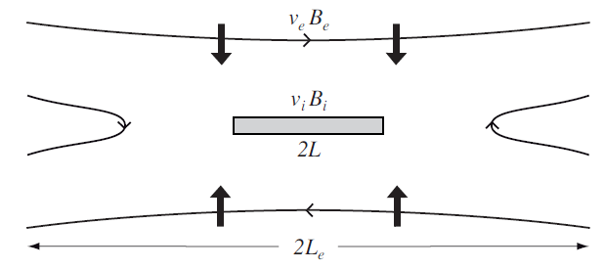
Petschek mechanism (1964)
Sheet bifurcates – pairs of Slow MA shocks form : energy conversion occurs at these standing shocks (shocks accelerate &heat)
Reconnection can now occur at a faster rate: any rate up to maximum:

Slide 8
But... aperiodic motions lead to periodic motions?
How? What is the generation mechanism?
2D steady-state Reconnection theory well developed

Slide 9
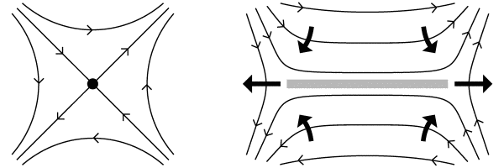
Introduction: Reconnection
    In 2D, reconnection can only occur at X-points (X-points are localised breakdown of the frozen-field condition)
    X-point collapses to a singular current sheet
Current very large => ohmic heating
(Ohmic) dissipation allows field-lines to break => change connectivity and diffuse through plasma

Slide 10
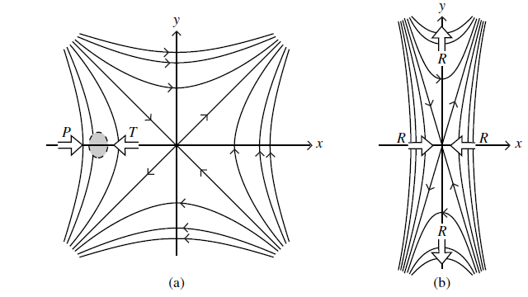
Introduction: X-point Collapse
An X-type neutral point tends to be locally unstable, provided the sources are free
to move
(Dungey 1953)
Figure: Fieldlines near X-type neutral point:
In equilibrium, no current, showing plasma element acted on by magnetic pressure force (P) and magnetic tension (T)
Away from equilibrium with resultant force R
(Priest & Forbes 2000)

Slide 11
General Idea
Consider wave propagation near to equilibrium magnetic field – simple 2D X-point.
Idea is to send in wave pulse from top boundary, and see (and explain!) what happens.

Slide 12
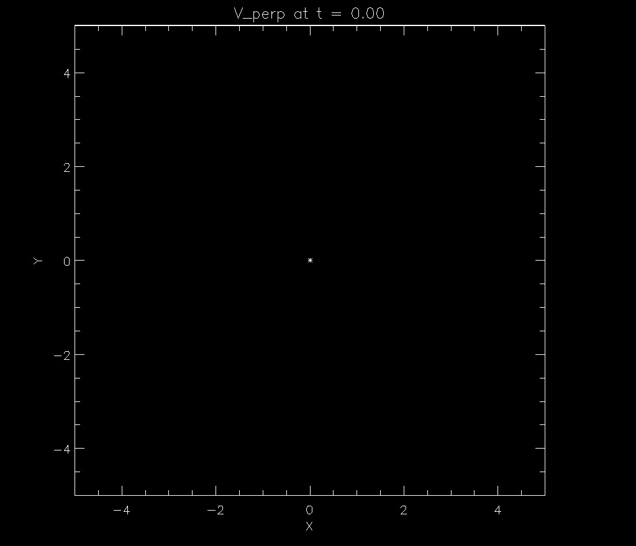
Linear, Cold Fast Wave (Numerical + WKB)

Slide 13
MHD Equations
Solve with LARE2D code: LAgrangian REmap code, second order accurate in space and time.
Code ideally suited to shock calculations.

Slide 14
MHD Equations
Solve with LARE2D code: LAgrangian REmap code, second order accurate in space and time.
Code ideally suited to shock calculations.

Slide 15
Linear, Cold Plasma
Linearise about equilibrium [0], Perturbed [1]
Ideal and β=0 (magnetically dominated)
Natural variable of the system:
σ
Related to the perpendicular velocity

Slide 16
Linear, Cold Plasma
Equations reduce to:

Slide 17
Linear, Cold Plasma
Equations reduce to:
Results:
Linear, fast MA wave travels towards the vicinity of the X-point and
bends around it.
Alfvén speed spatially varying:
travels faster further away from the null.
Wave demonstrates refraction – wraps wave around null
Key feature of fast wave propagation (linear + cold plasma).

Slide 18
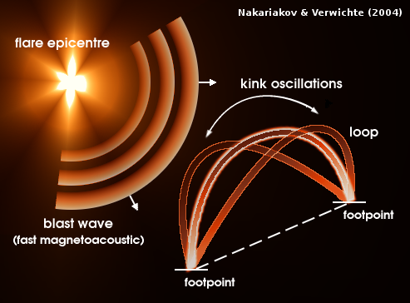

Slide 19
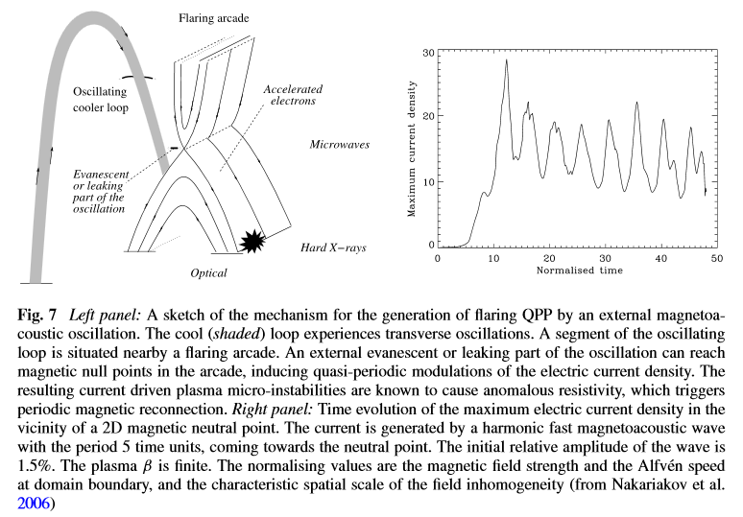
Modulation of the Energy Release Rate by External Oscillations
MHD waves and oscillations can produce QPP by changing physical conditions not only in the emitting plasma, but also by affecting the processes of the energy release, electron acceleration and injection in the flare site. It can be achieved by either modulation of energy release rates or triggering the energy releases. As the thickness of the reconnection site is believed to be very small, even weak oscillations can produce the required modulation. Nakariakov et al. (2006) developed a model which explains coupling of transverse, e.g. kink or sausage, MHD oscillations in an external loop with flaring QPP.

Slide 20
Modulation of the Energy Release Rate by External Oscillations
MHD waves and oscillations can produce QPP by changing physical conditions not only in the emitting plasma, but also by affecting the processes of the energy release, electron acceleration and injection in the flare site. It can be achieved by either modulation of energy release rates or triggering the energy releases. As the thickness of the reconnection site is believed to be very small, even weak oscillations can produce the required modulation. Nakariakov et al. (2006) developed a model which explains coupling of transverse, e.g. kink or sausage, MHD oscillations in an external loop with flaring QPP.
  A possible mechanism is the generation of anomalous resistivity by current-driven instabilities in current density spikes produced by magneto-acoustic waves in the vicinity of reconnection sites, which triggers magnetic reconnection.

Slide 21
Linear, Cold Fast Wave (Circular IC)
Obvious that plays vital role.
Natural to consider polar coordinates / circular pulse.
Similar experiment, but now with circular initial condition.
Pulse set up around r = 5.
Initial pulse splits into two waves;
travelling different directions.
Concentrate on incoming wave.
Along radial lines, solution
of the form:

Slide 22
Extension to Nonlinear: Key questions
Now look at the properties and behaviour of nonlinear MHD waves in the neighbourhood of 2D null point.
Does the fast wave now steepen to form shocks and can these now propagate across or escape the null?
Can the refraction effect drag enough magnetic field into the null point to initiate X-point collapse or reconnection?
Has the rate of current density
accumulation changed, and is
the null still the preferential
location of wave heating?

Slide 23
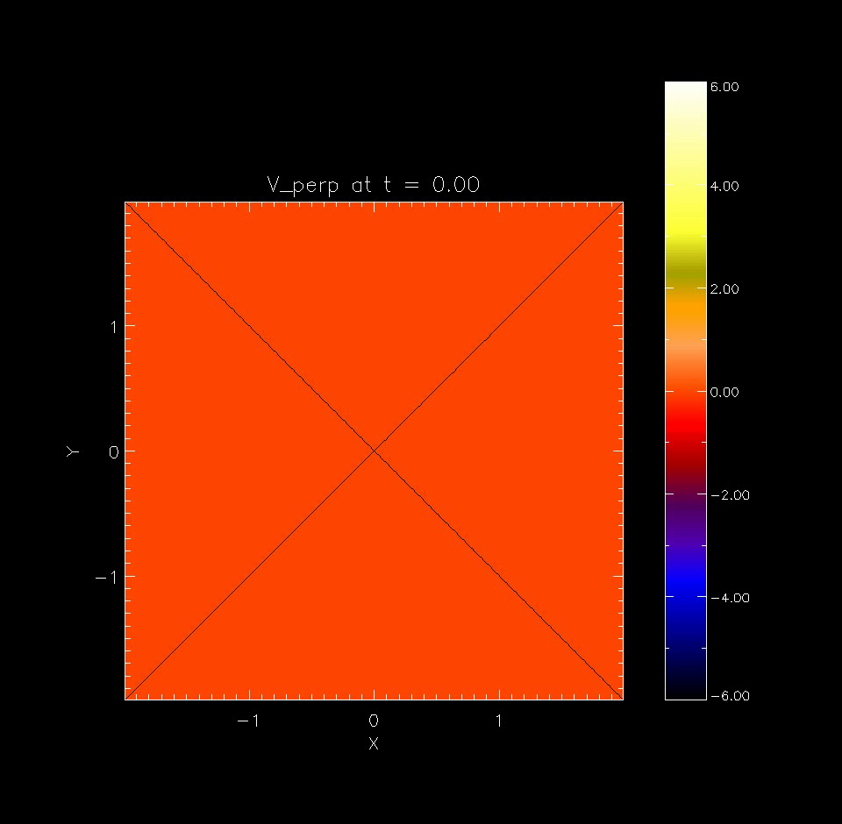

Slide 70
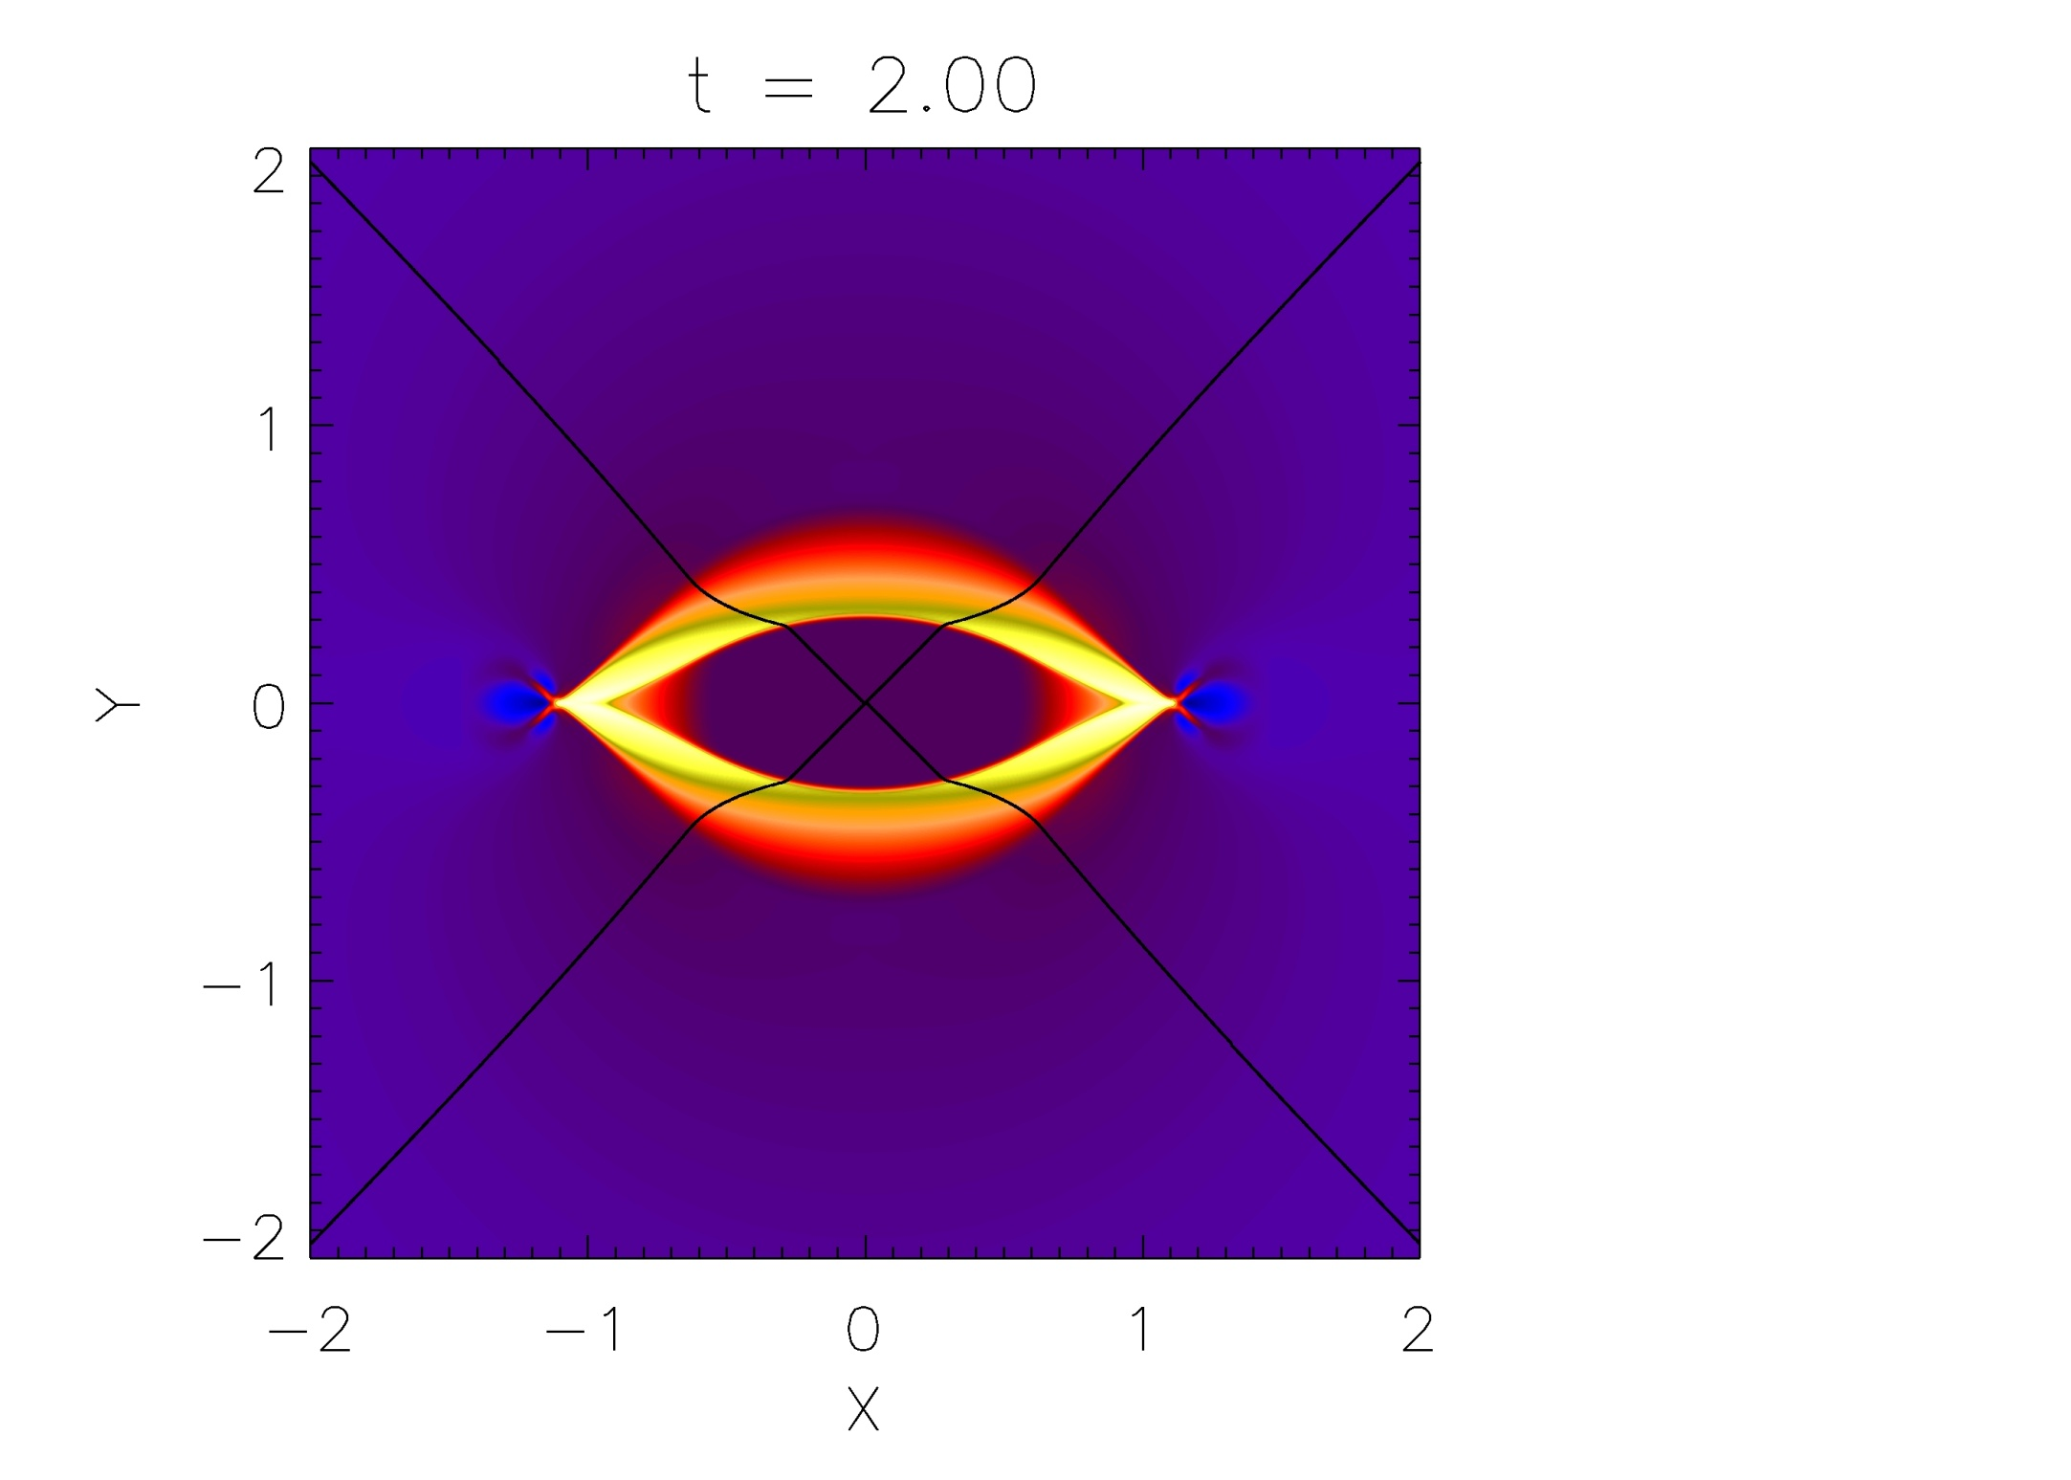
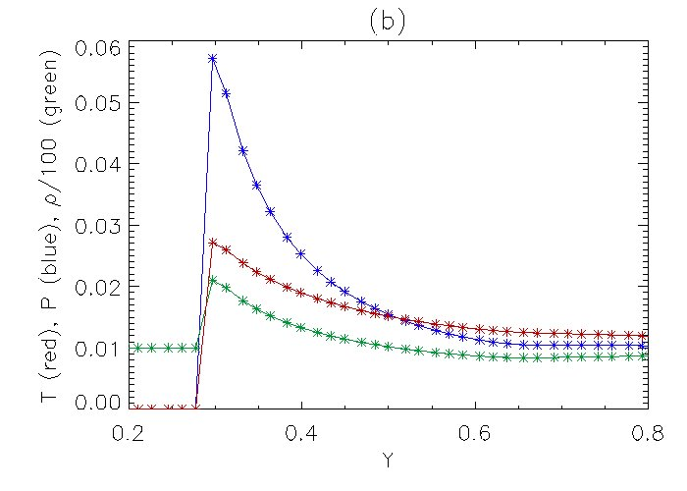

Slide 71
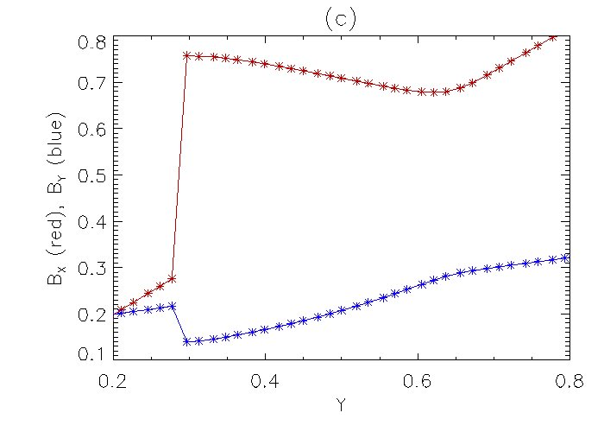

Slide 72
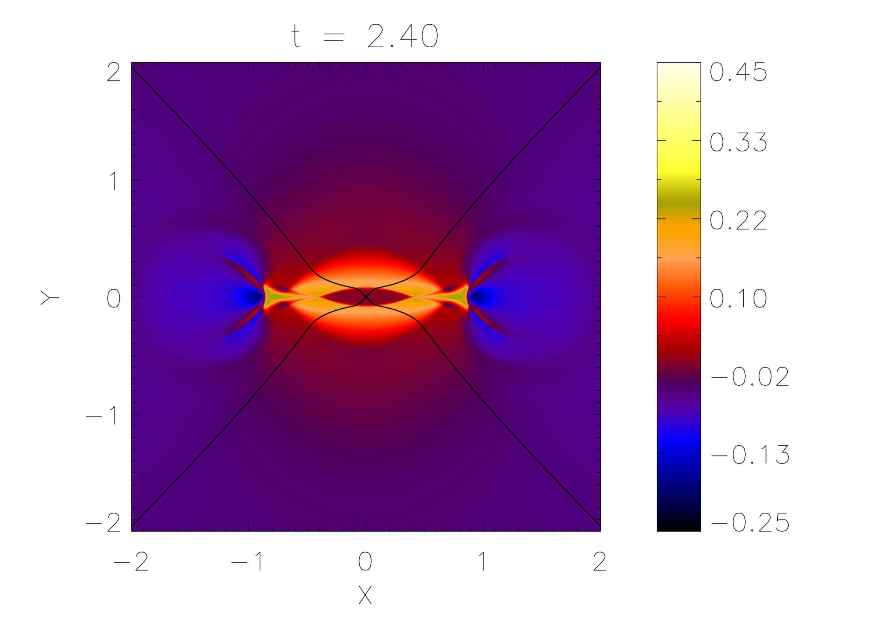

Slide 74
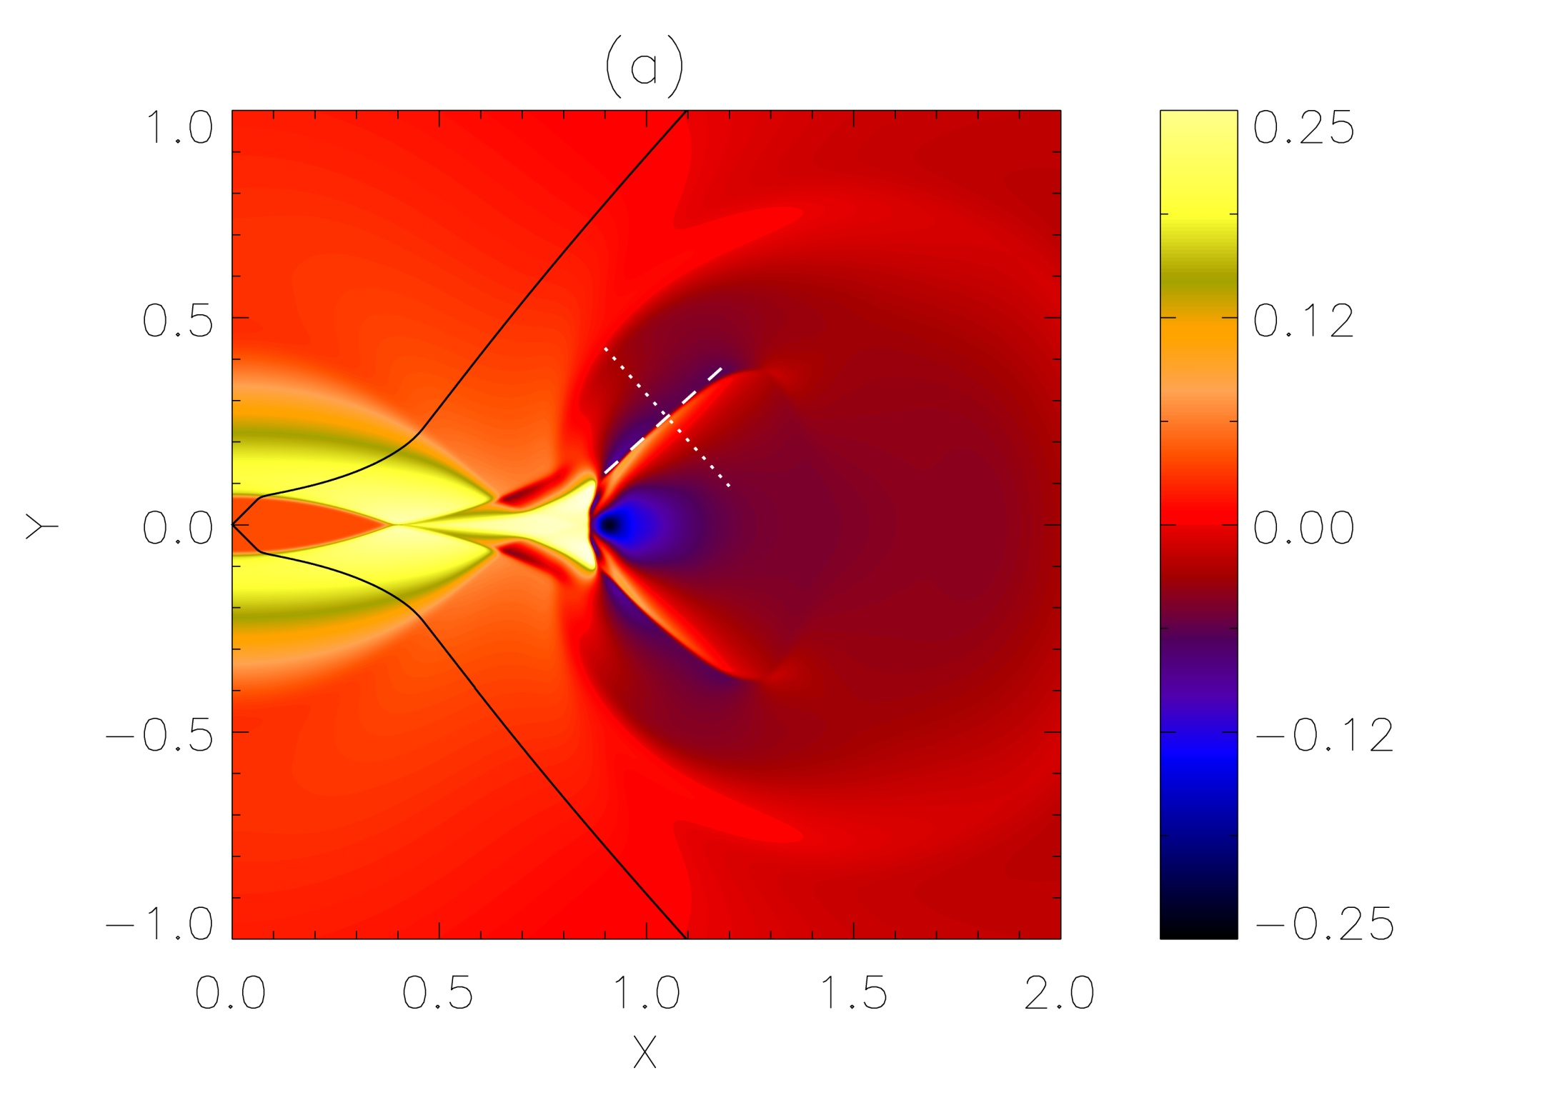

Slide 75
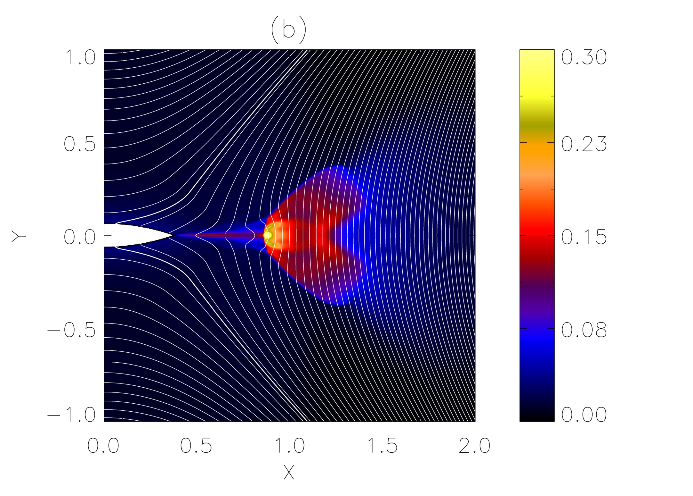

Slide 77
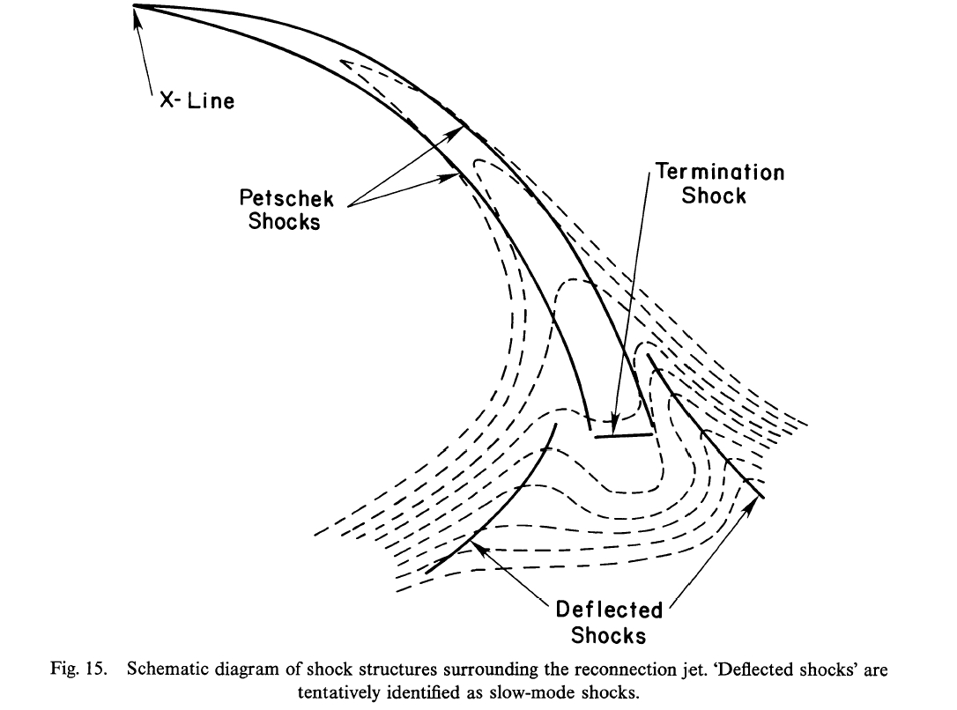
Forbes, T. (1988), Sol. Phys, 117, 97

Slide 80
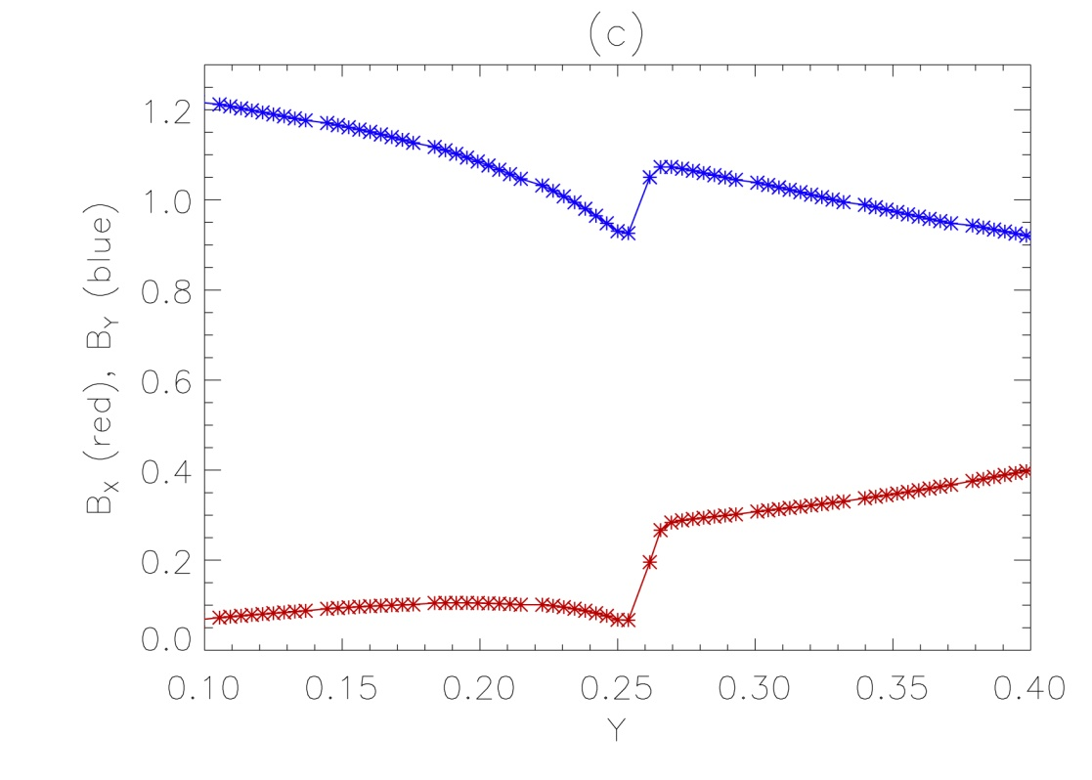

Slide 81
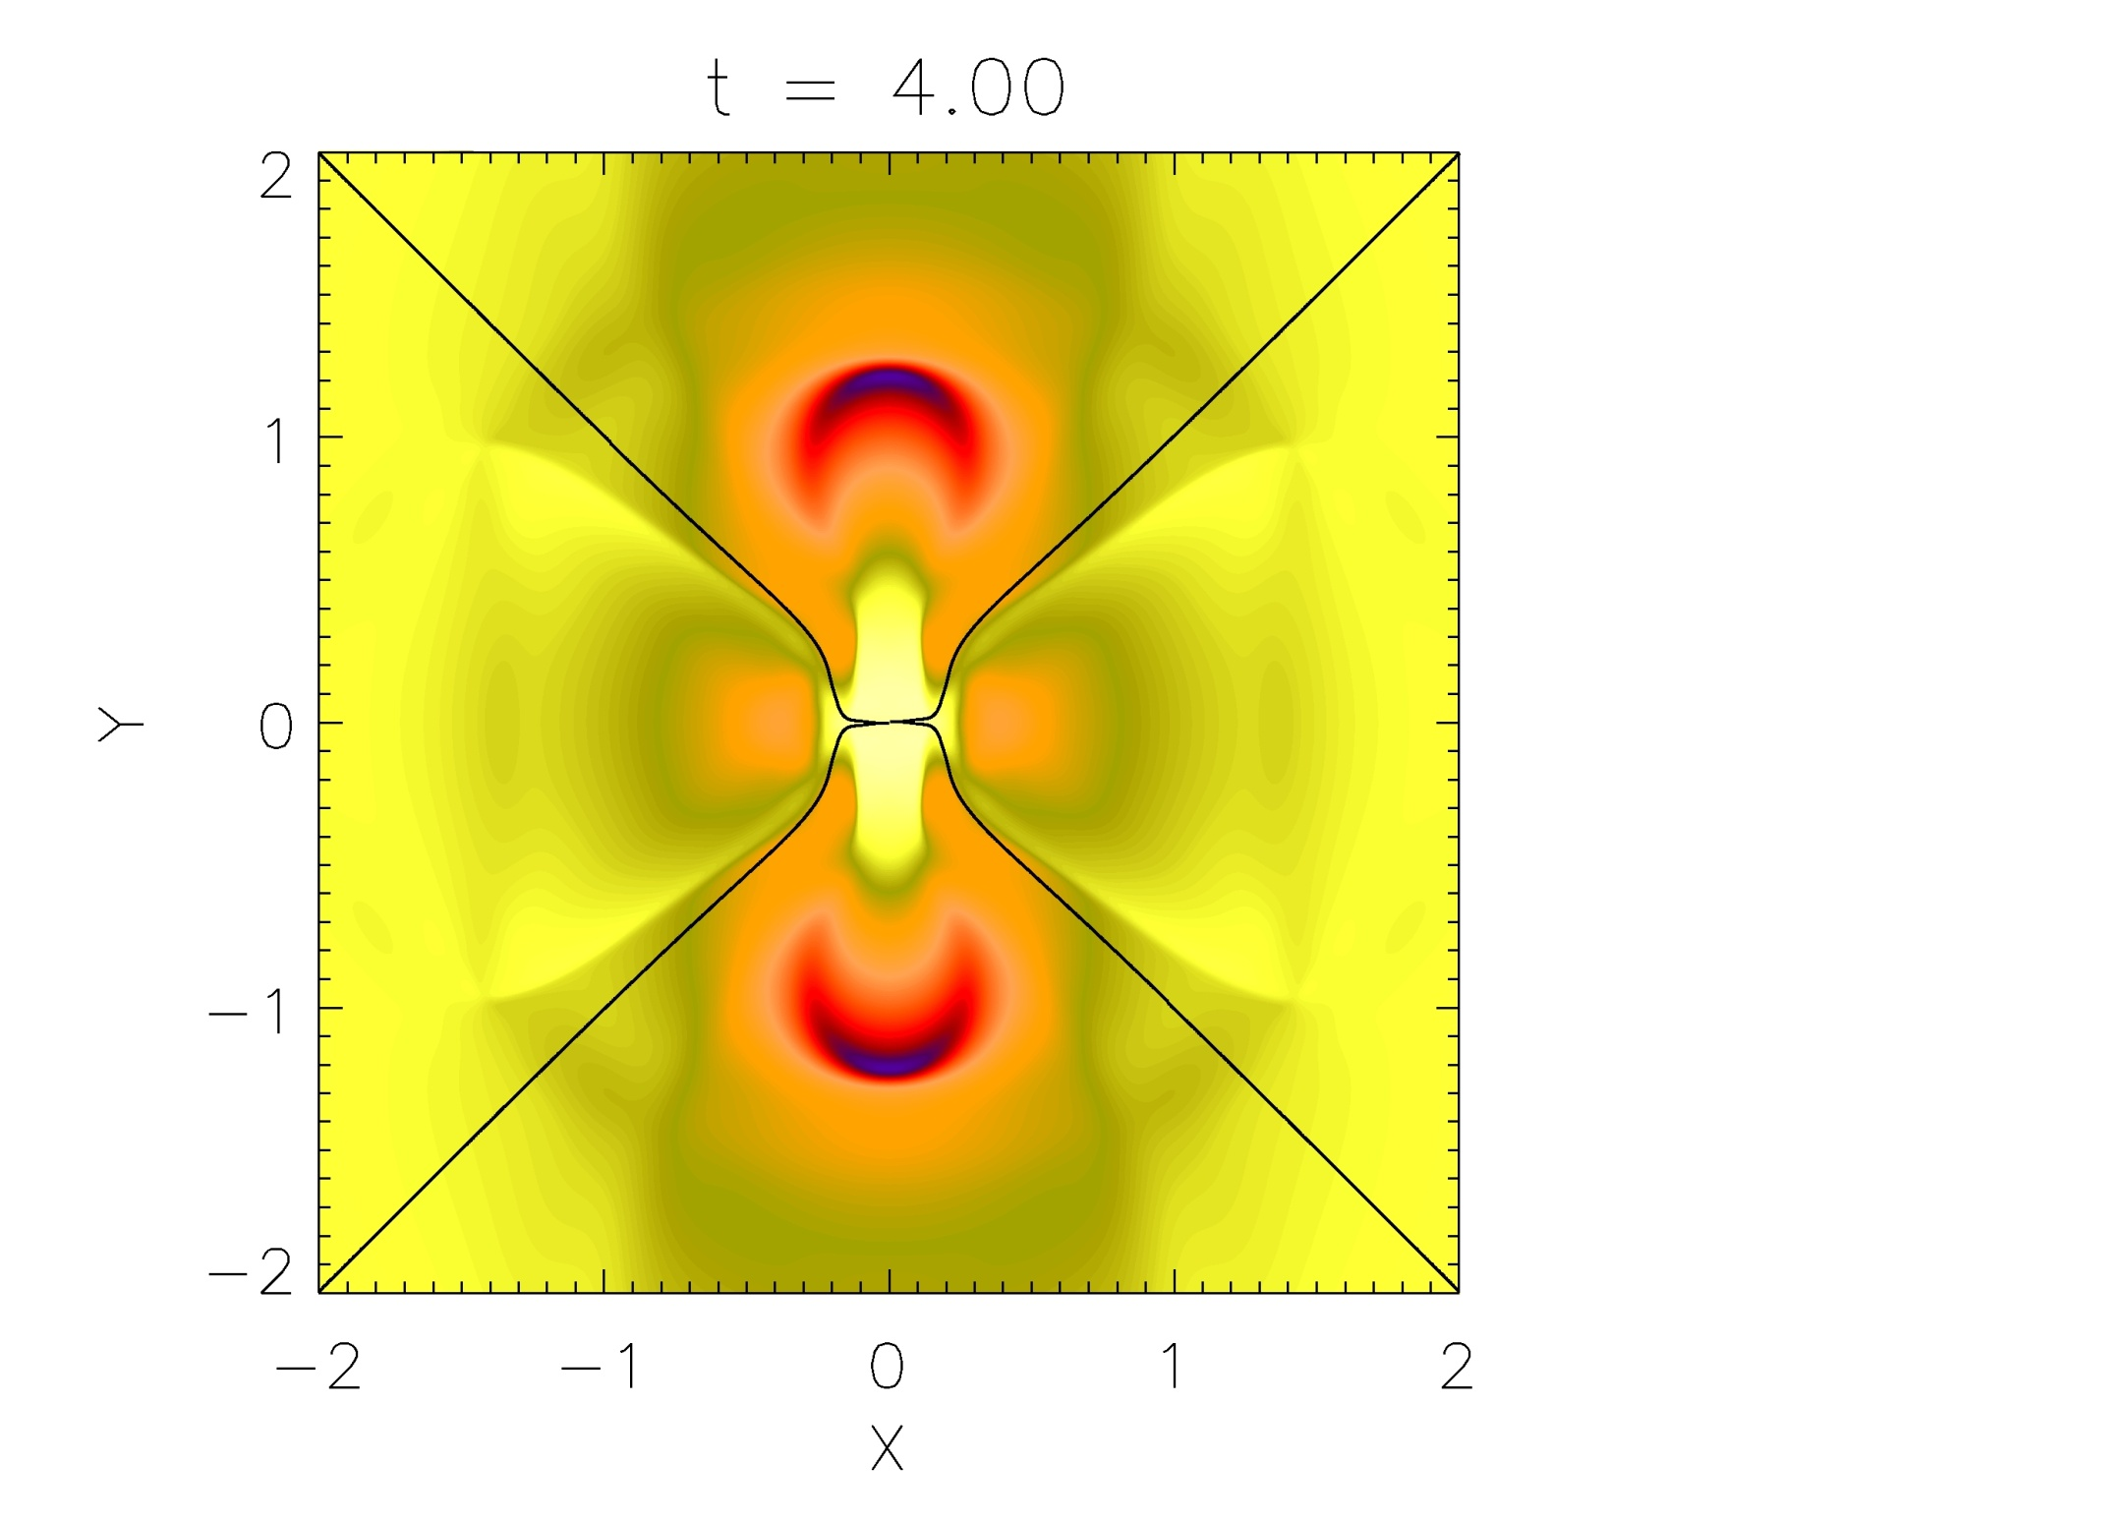

Slide 82
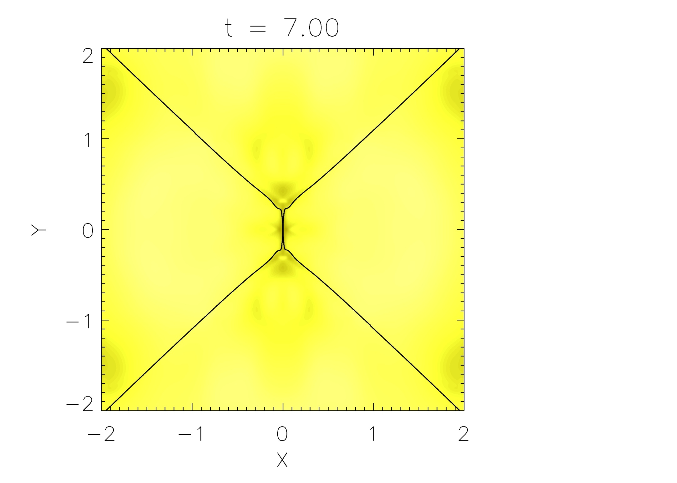

Slide 83
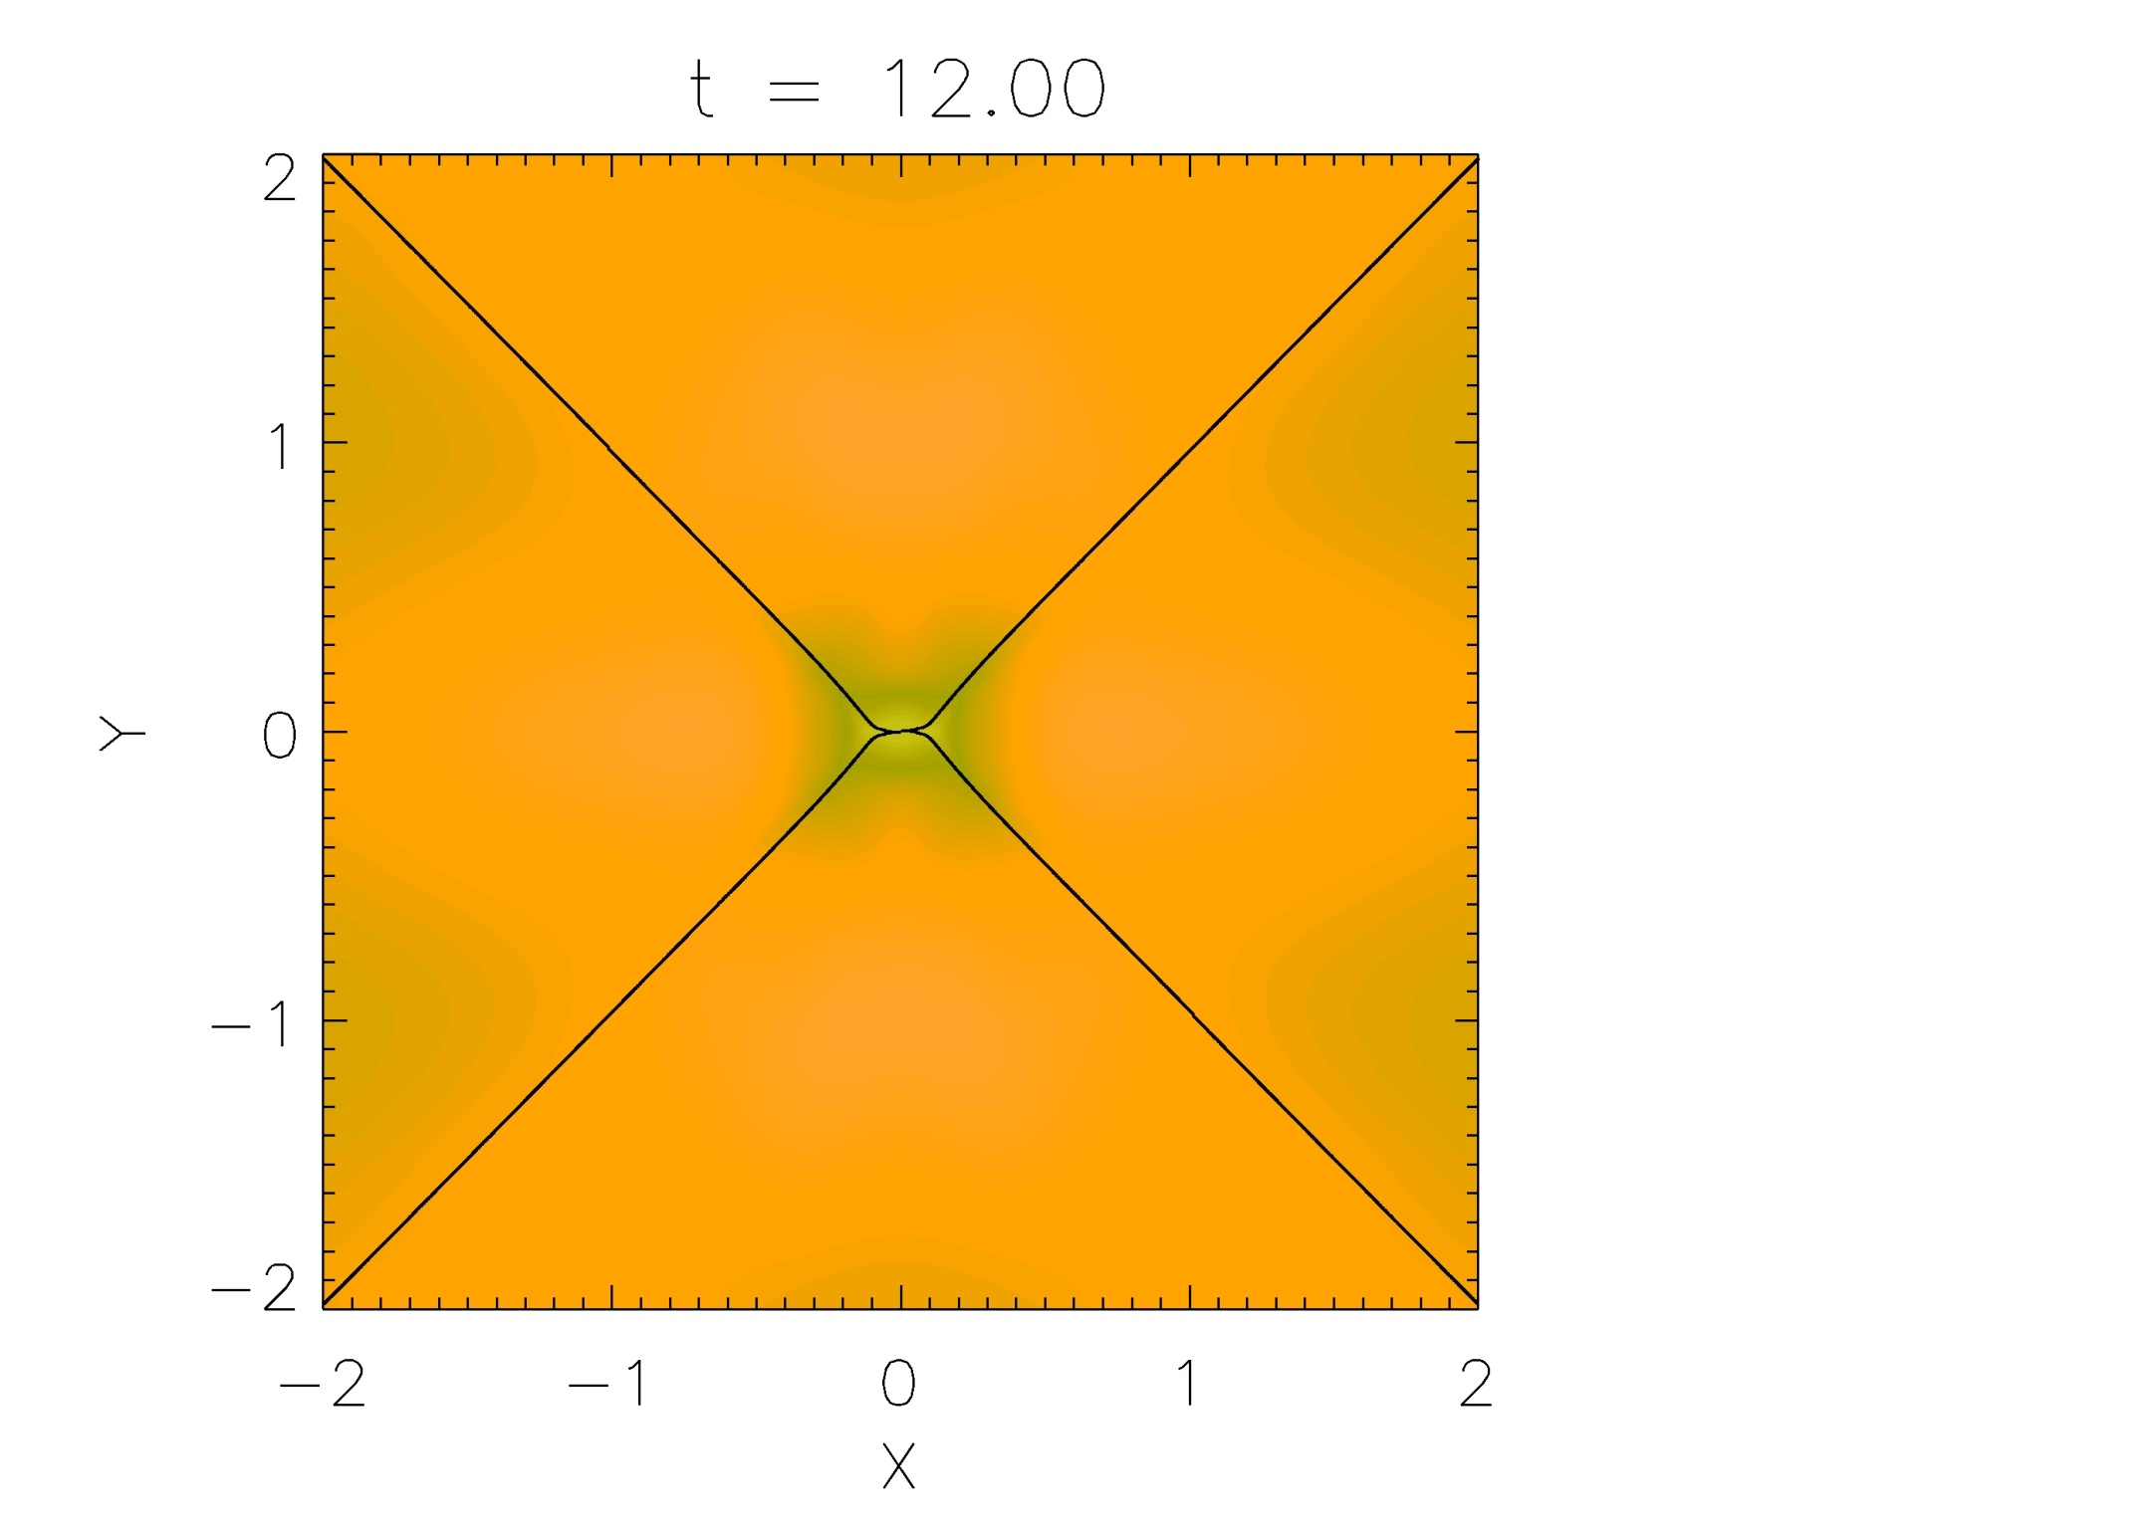

Slide 84
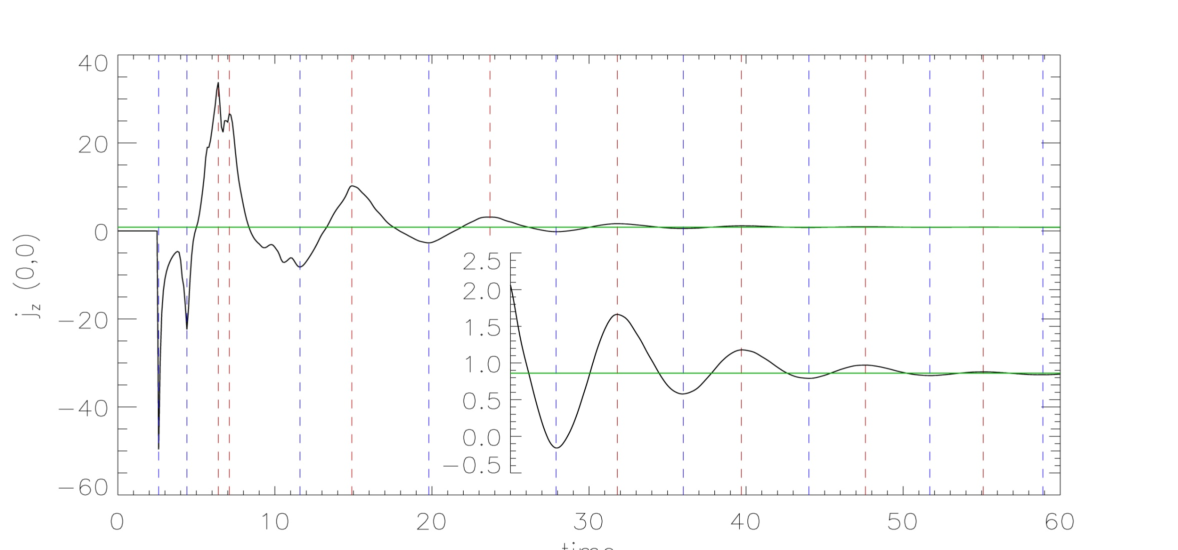
time

Slide 85
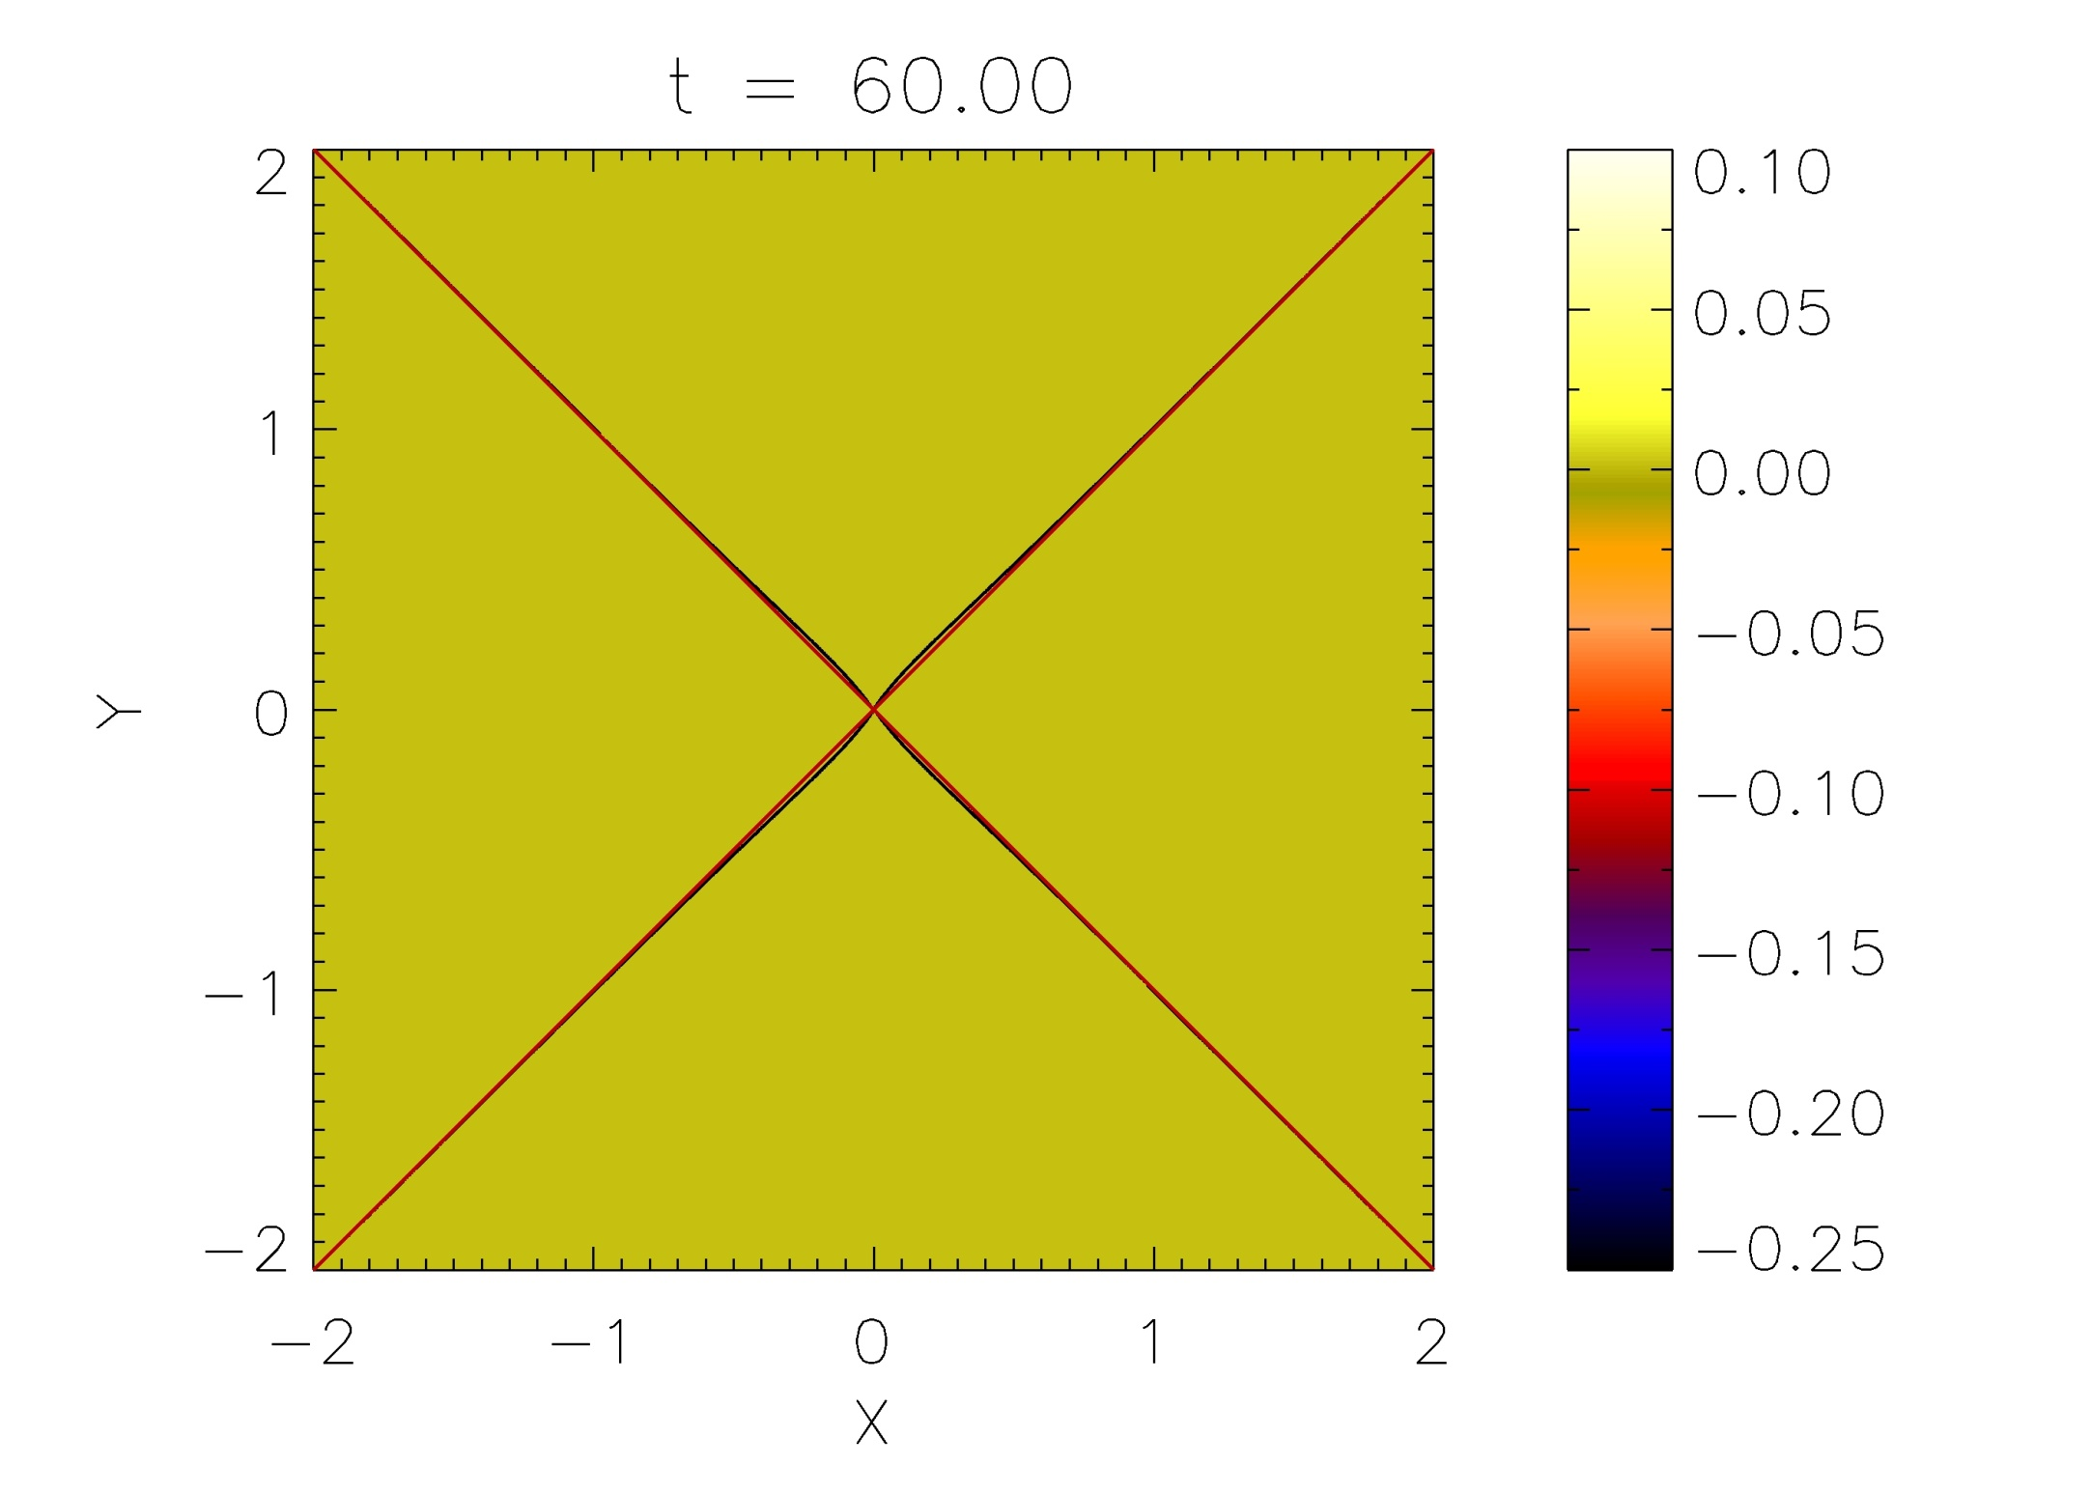

Slide 86
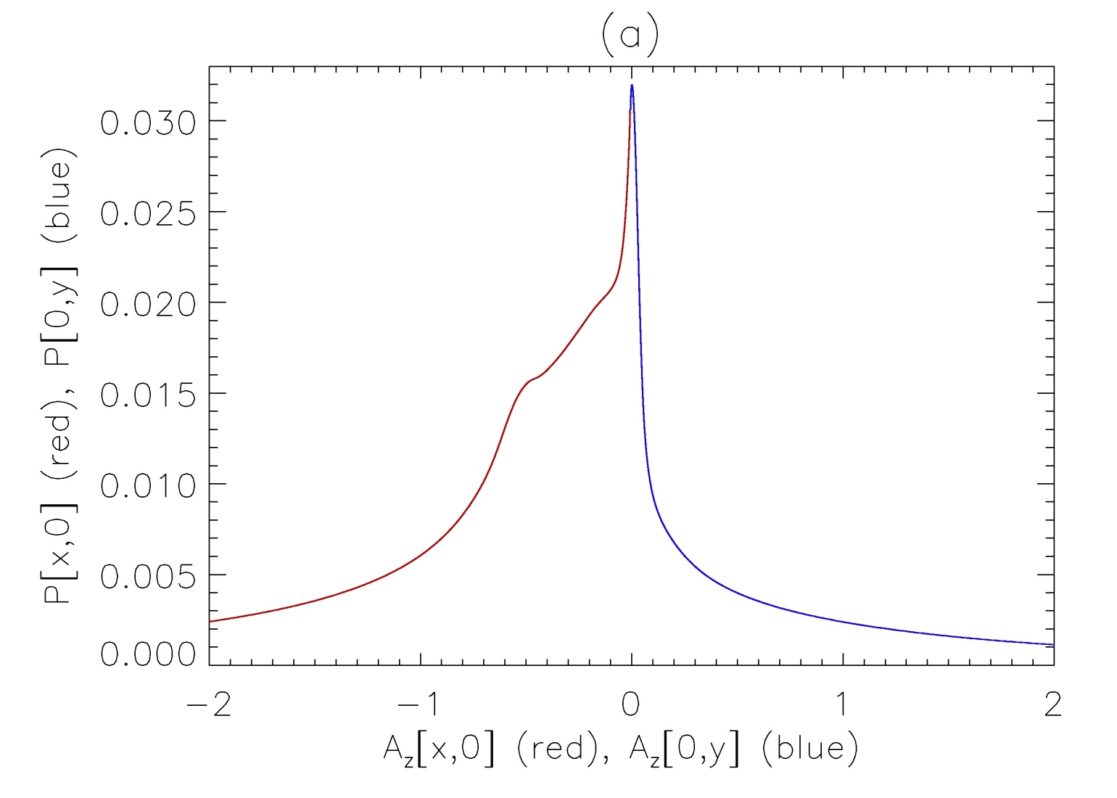
If final state is in force balance, we expect pressure to be a function of A_{z}, i.e. Plasma pressure should lie on contours of A_{z} if P=P(A_{z}).
Here, yields single curve.

Slide 87
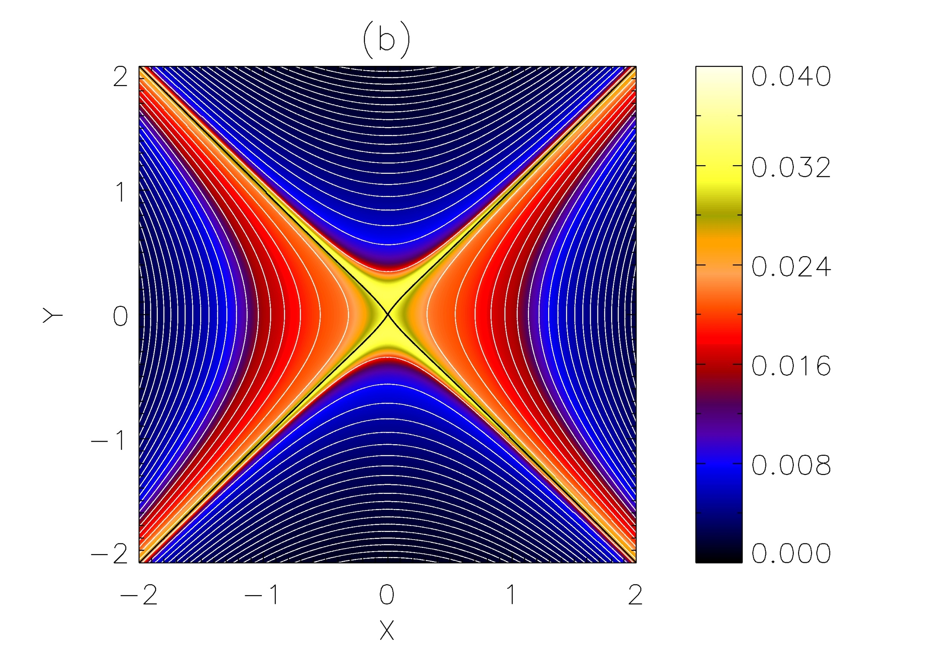

Slide 88
Reconnection?
It is clear we have oscillatory behaviour, but do we have reconnection?
Two pieces of evidence:
  Qualitative
  Quantitative

Slide 89
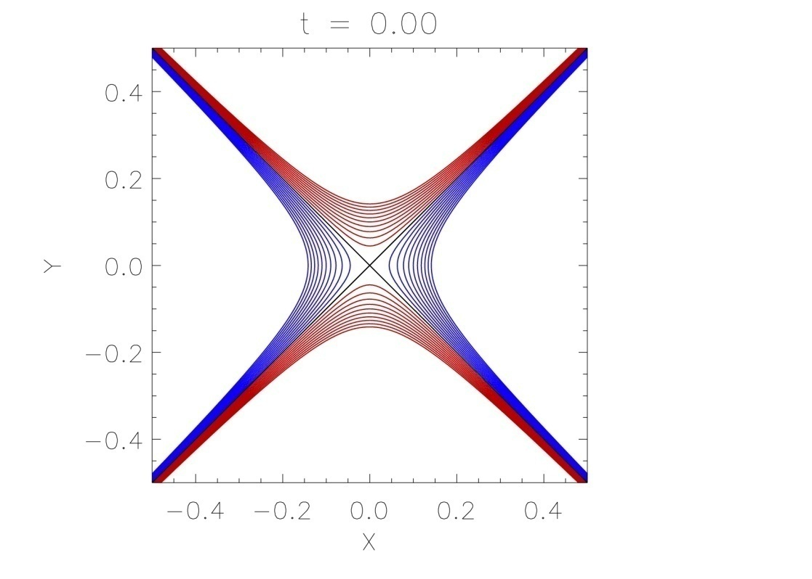
Qualitative Evidence
Plot selection of (same) fieldlines at different times.
Change in connectivity => red/blue fieldline cross (evolving) separatrices.
We have reflecting boundary conditions, and A_{z} on the boundaries does not change with time, we can be confident we are always plotting
the same fieldlines.

Slide 90
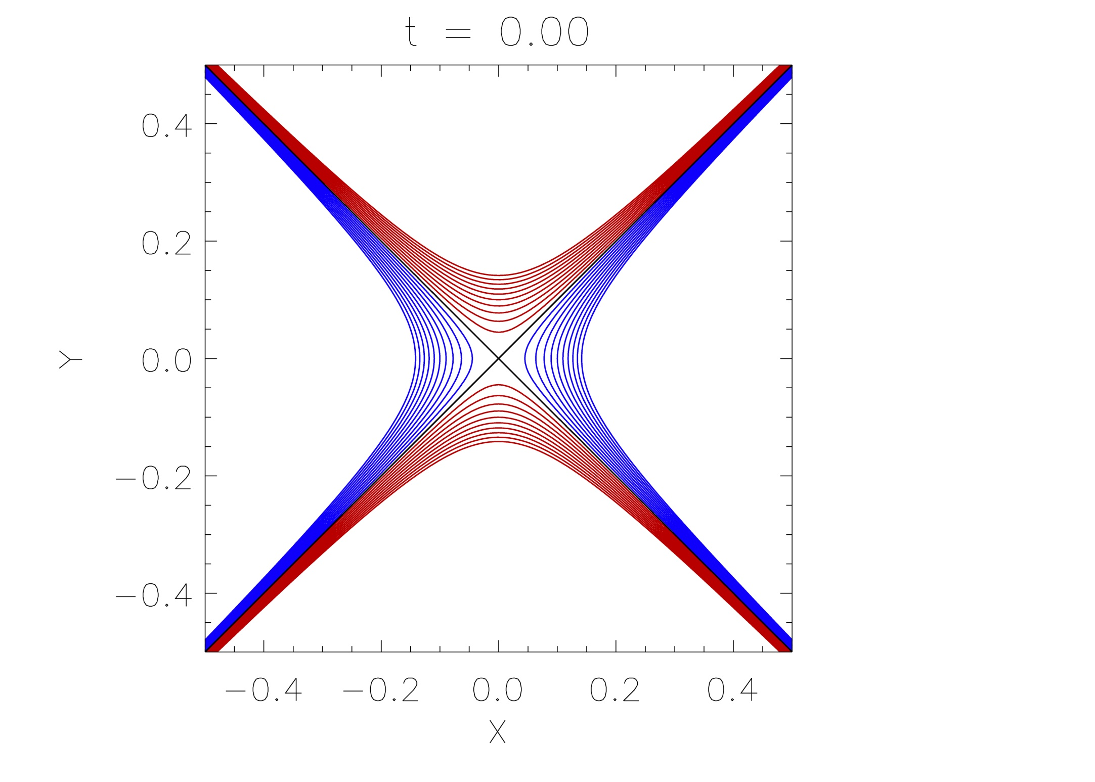

Slide 91
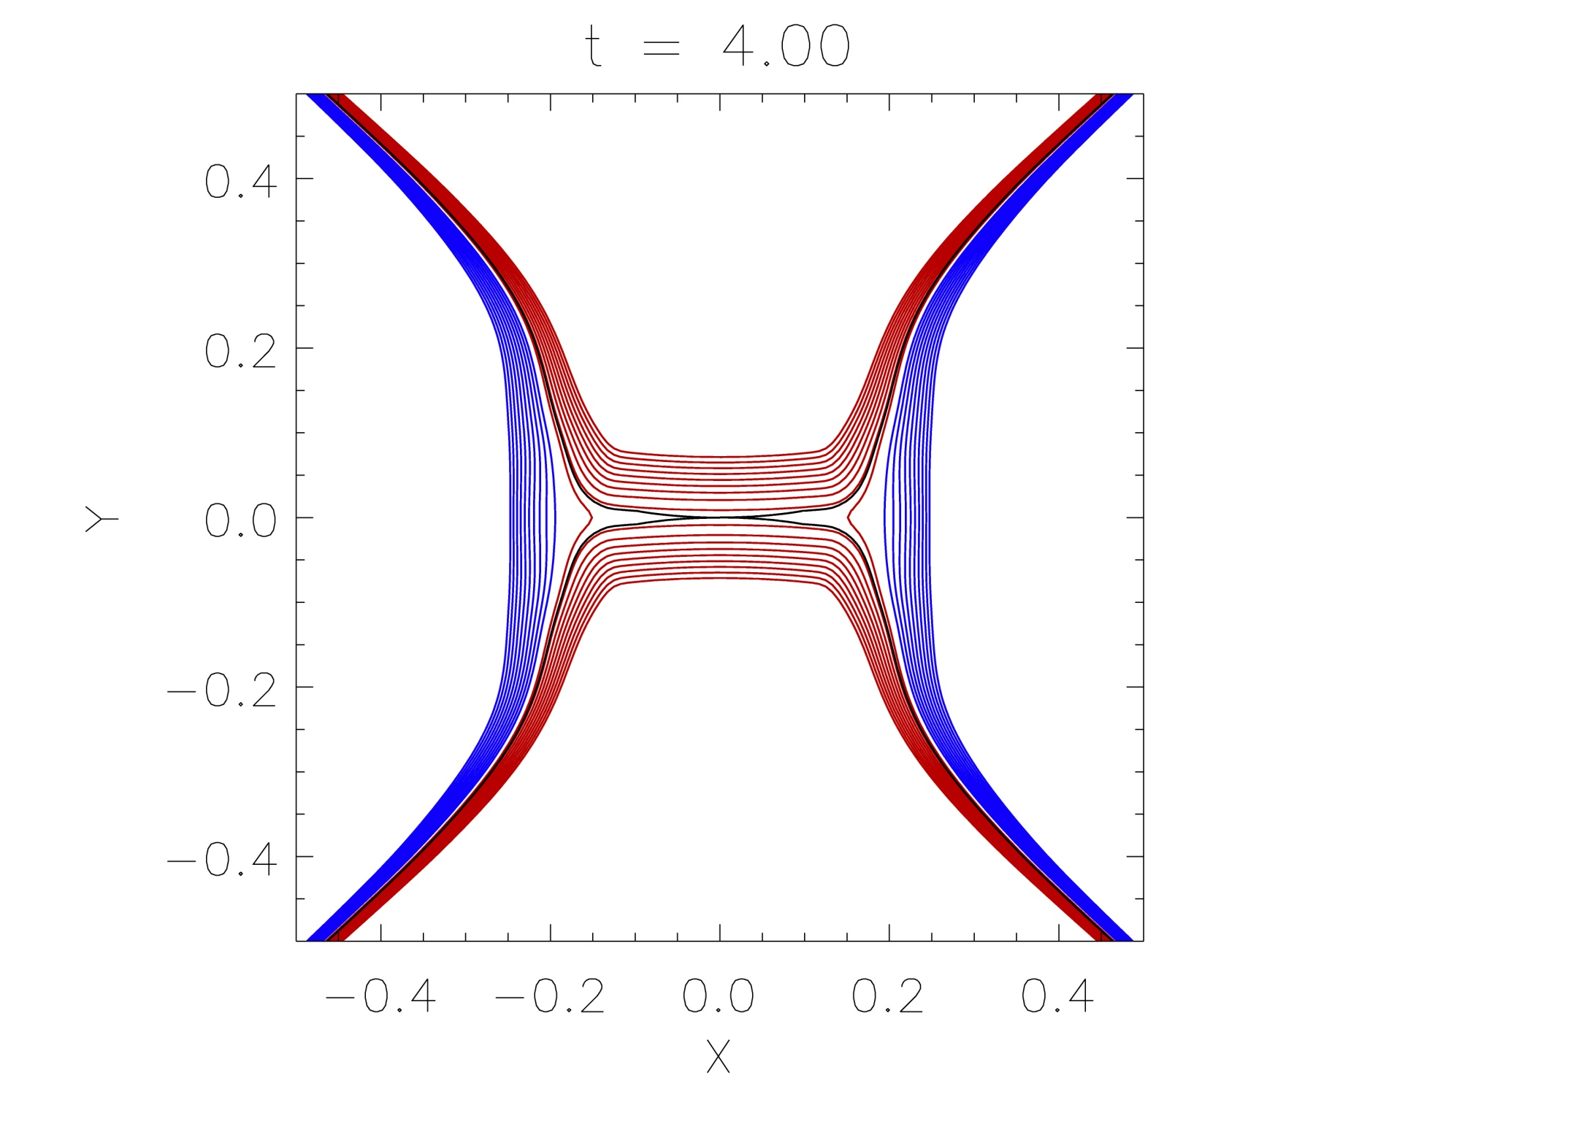

Slide 92
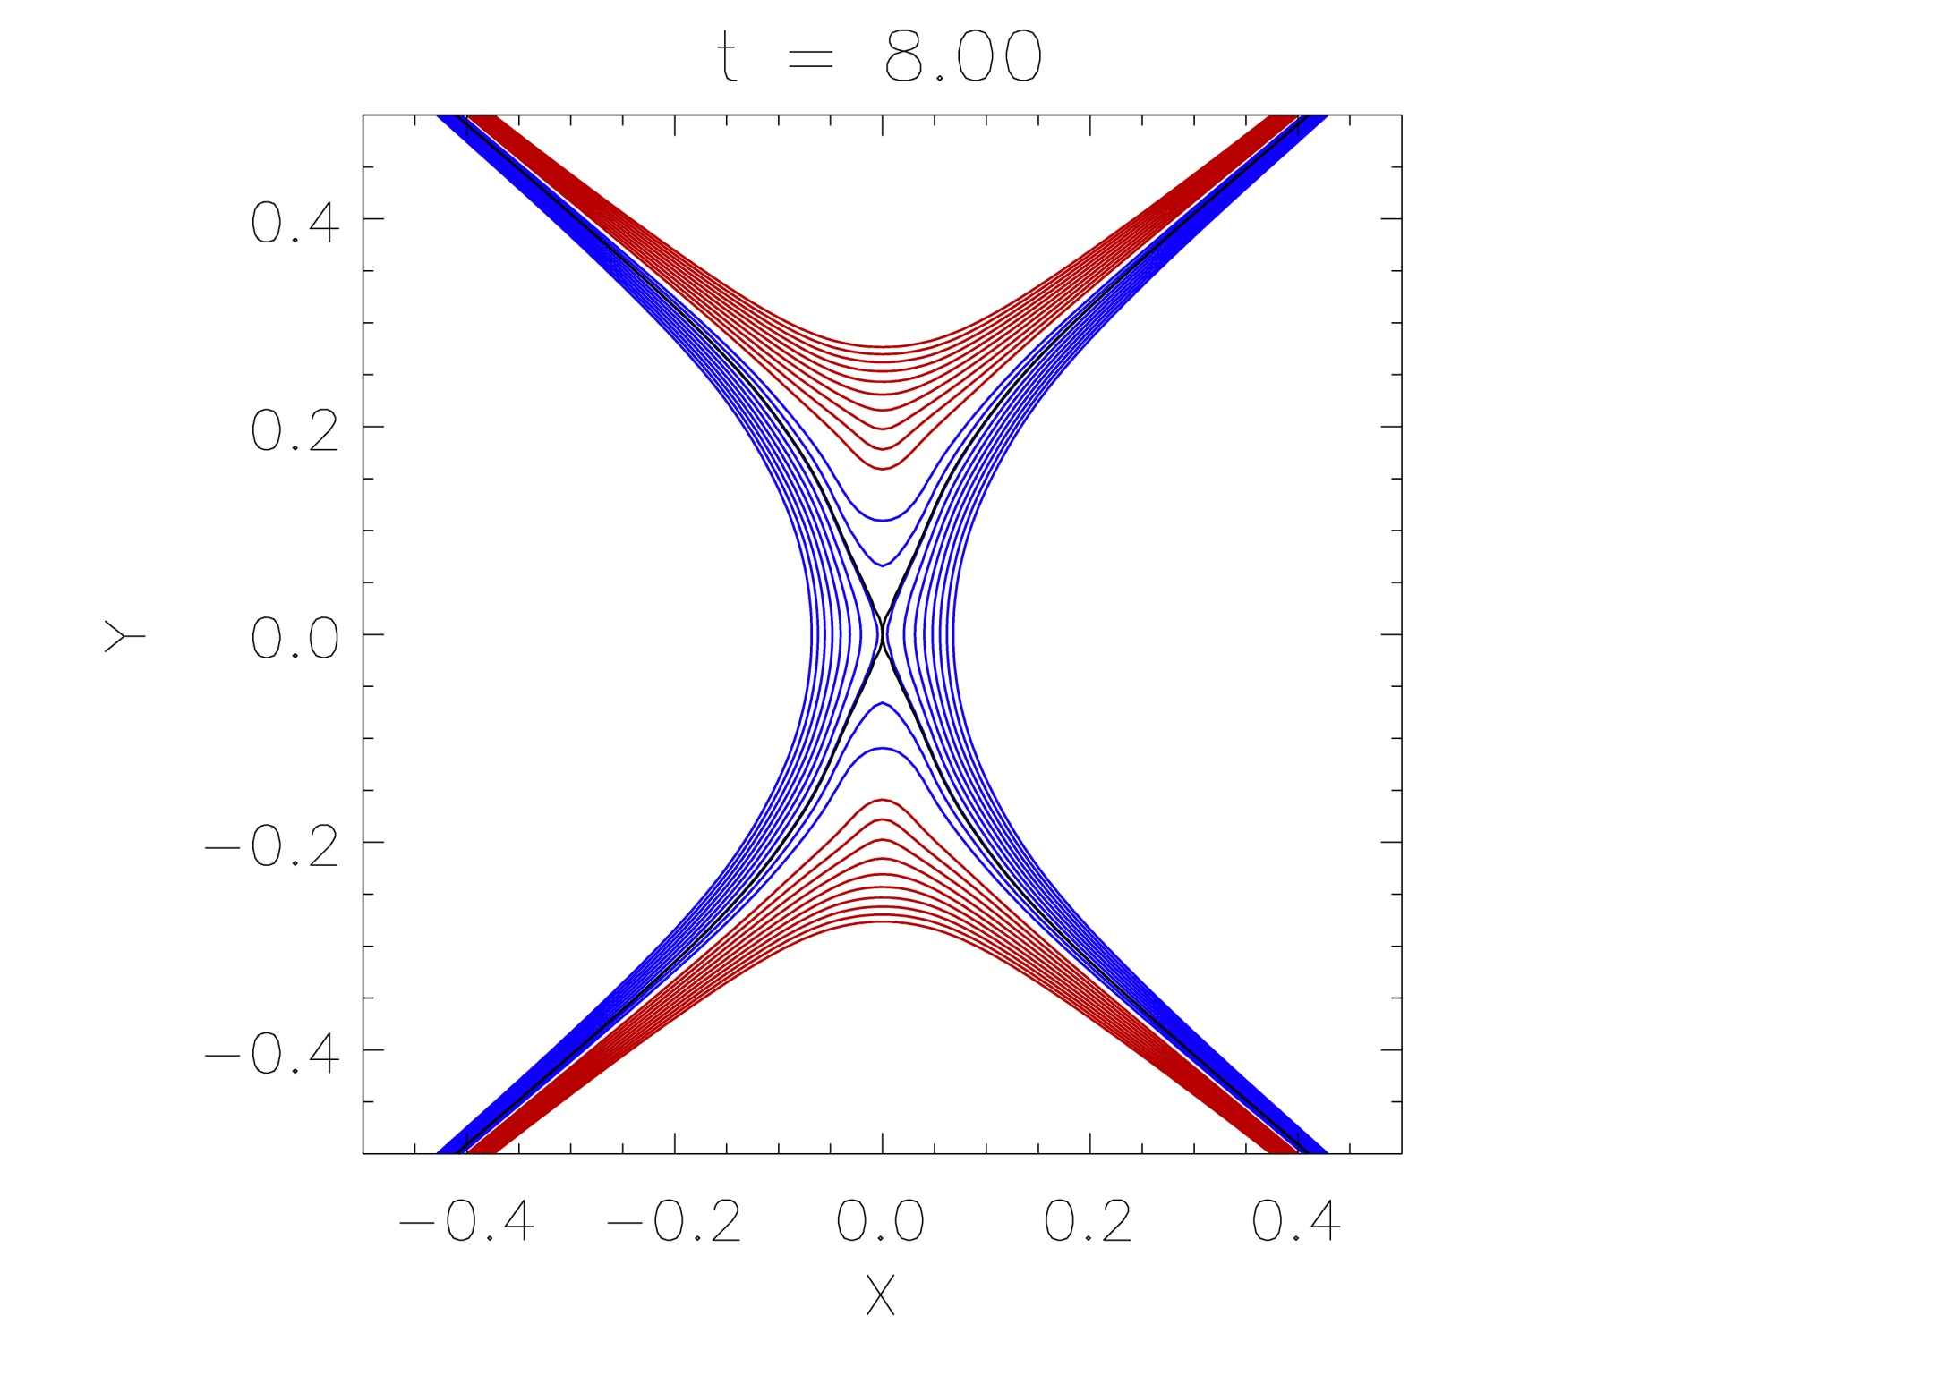

Slide 93
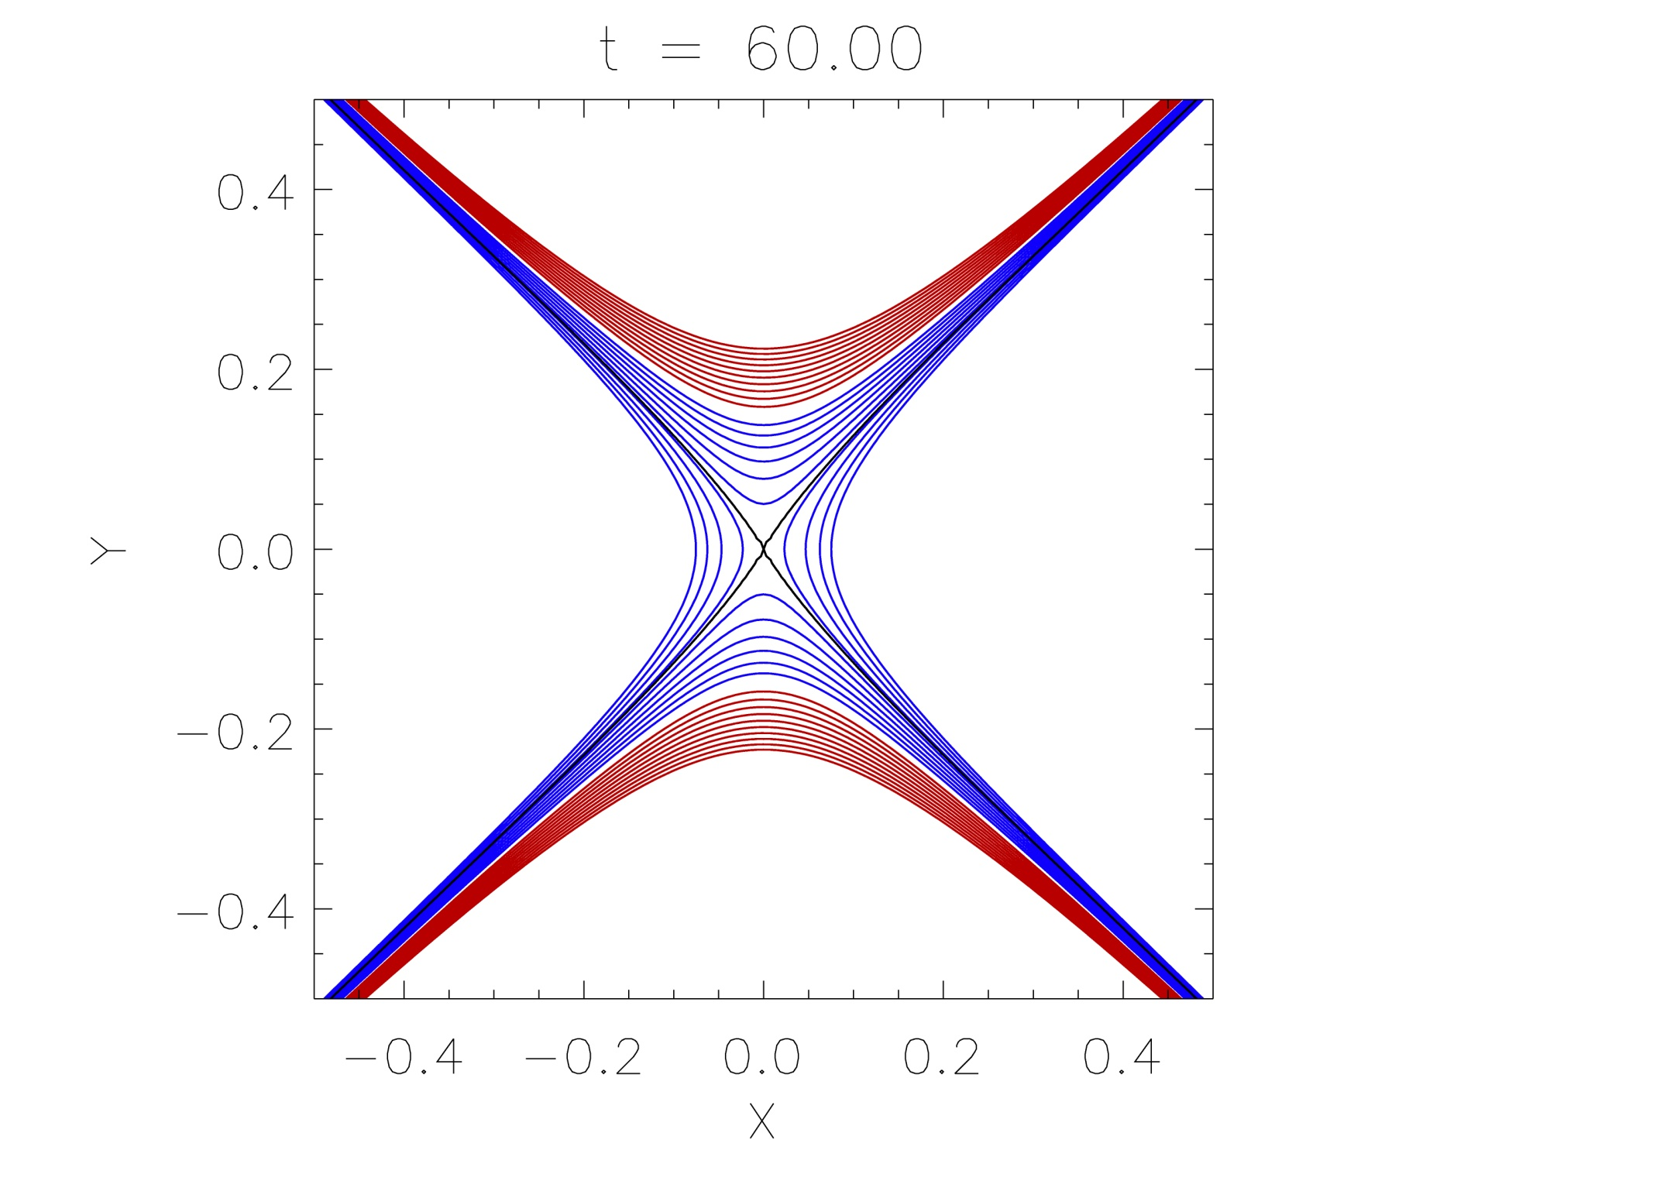

Slide 94
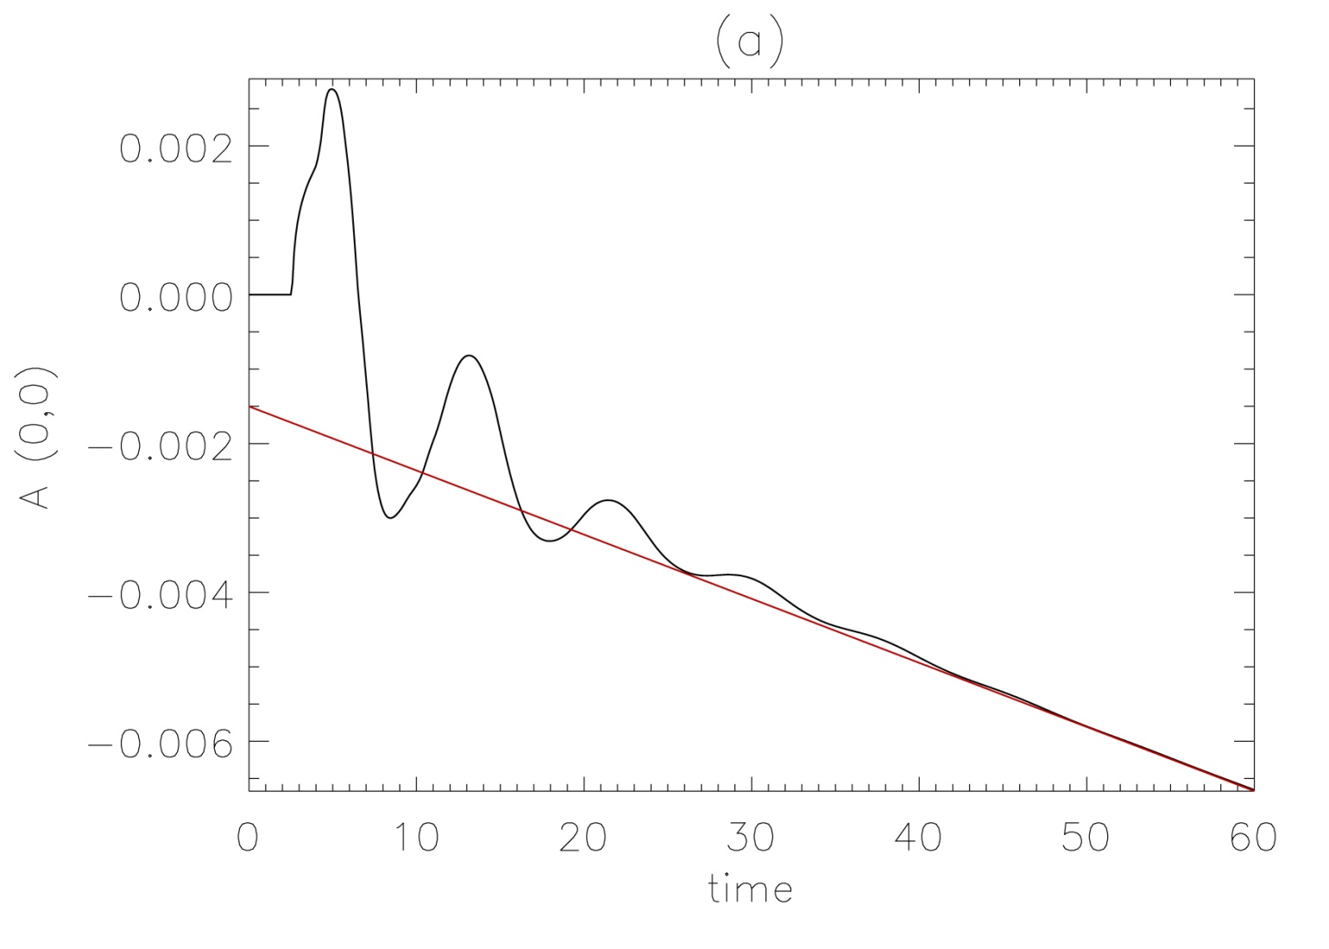
Quantitative Evidence
Plot time evolution of A_{z} (0,0)
Changes in the vector potential at the origin indicate changes in connectivity.

Slide 95
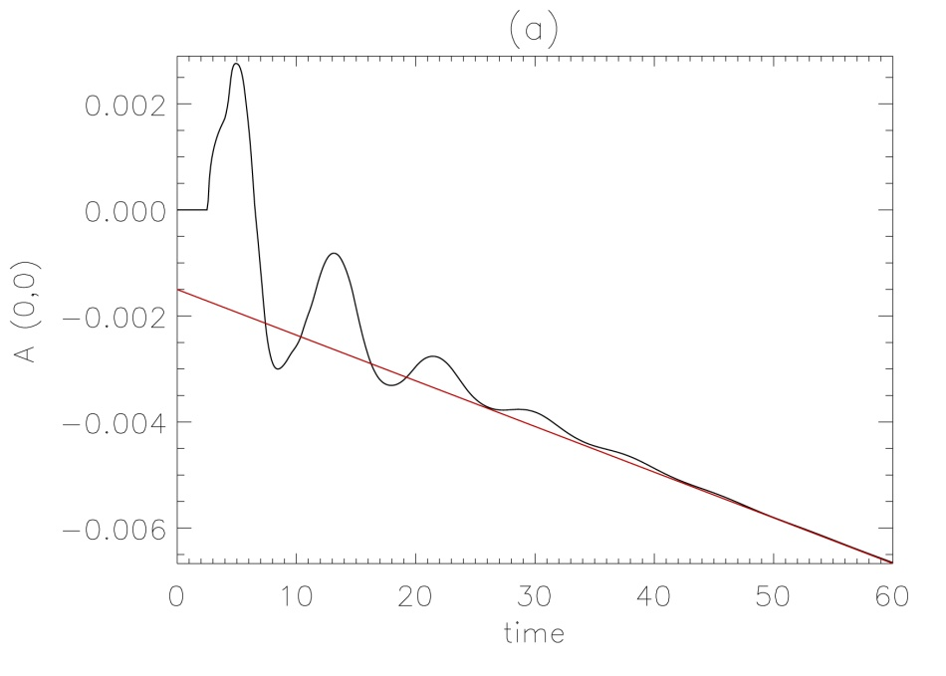
Quantitative Evidence
Before t=2.6, no change
After this, oscillates and displays clear downwards trend,
Tends to straight line:
This straight line is associated with the (final) current density remaining in the system:
Hence, if our final state contains
constant current density, then we
expect A_{z} to change linearly in time.
Integrating and comparing to the
straight line gives final current
density of 0.8615, in agreement
with current.

Slide 96
time

Slide 97
Quantitative Evidence
Plot time evolution of A_{z} (0,0)
Changes in the vector potential at the origin indicate changes in connectivity.

Slide 98
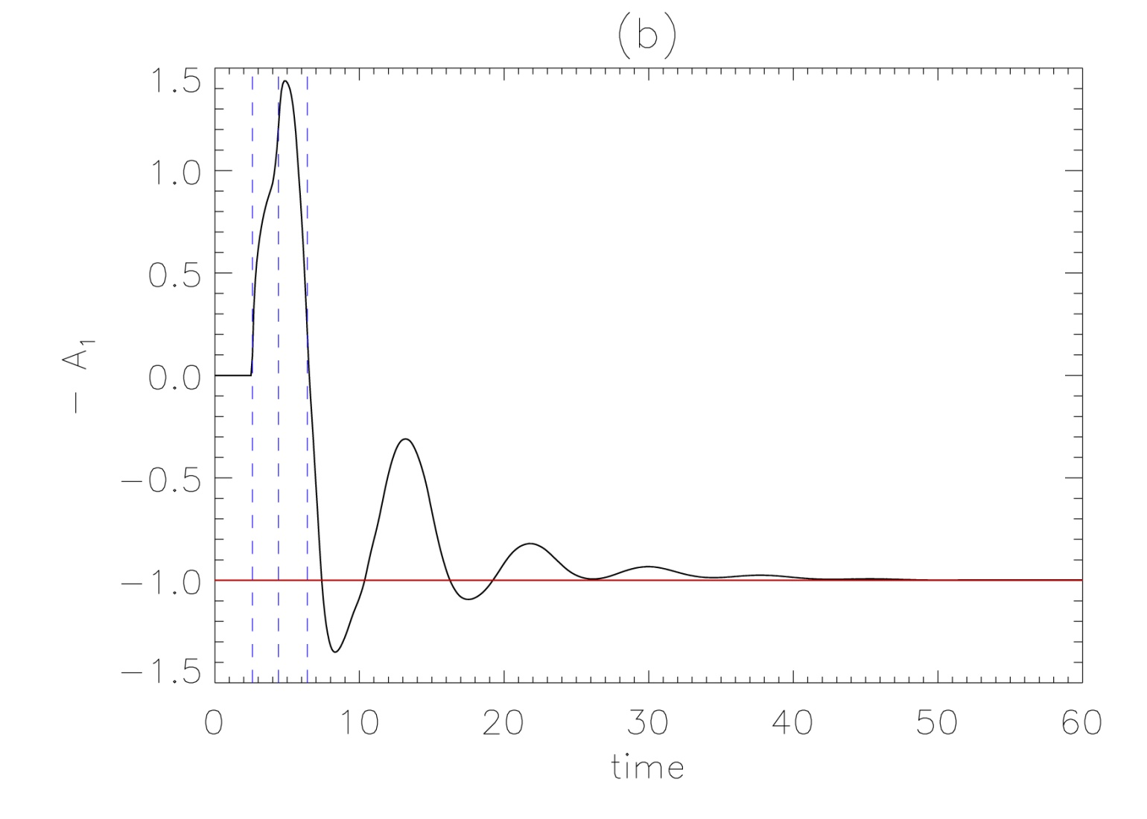
Quantitative Evidence
Remove straight line trend:
Can clearly see oscillatory nature of system

Slide 99

Quantitative Evidence
Remove straight line trend:
Can clearly see oscillatory nature of system, and tends towards constant value (confidence in straight line fit).
A_{z} continuously changing as tends to -1 => reconnection is continuously occurring.
Whenever oscillates through -1,
we are increasing or decreasing
flux on one side or the other of
the final state.

Slide 100
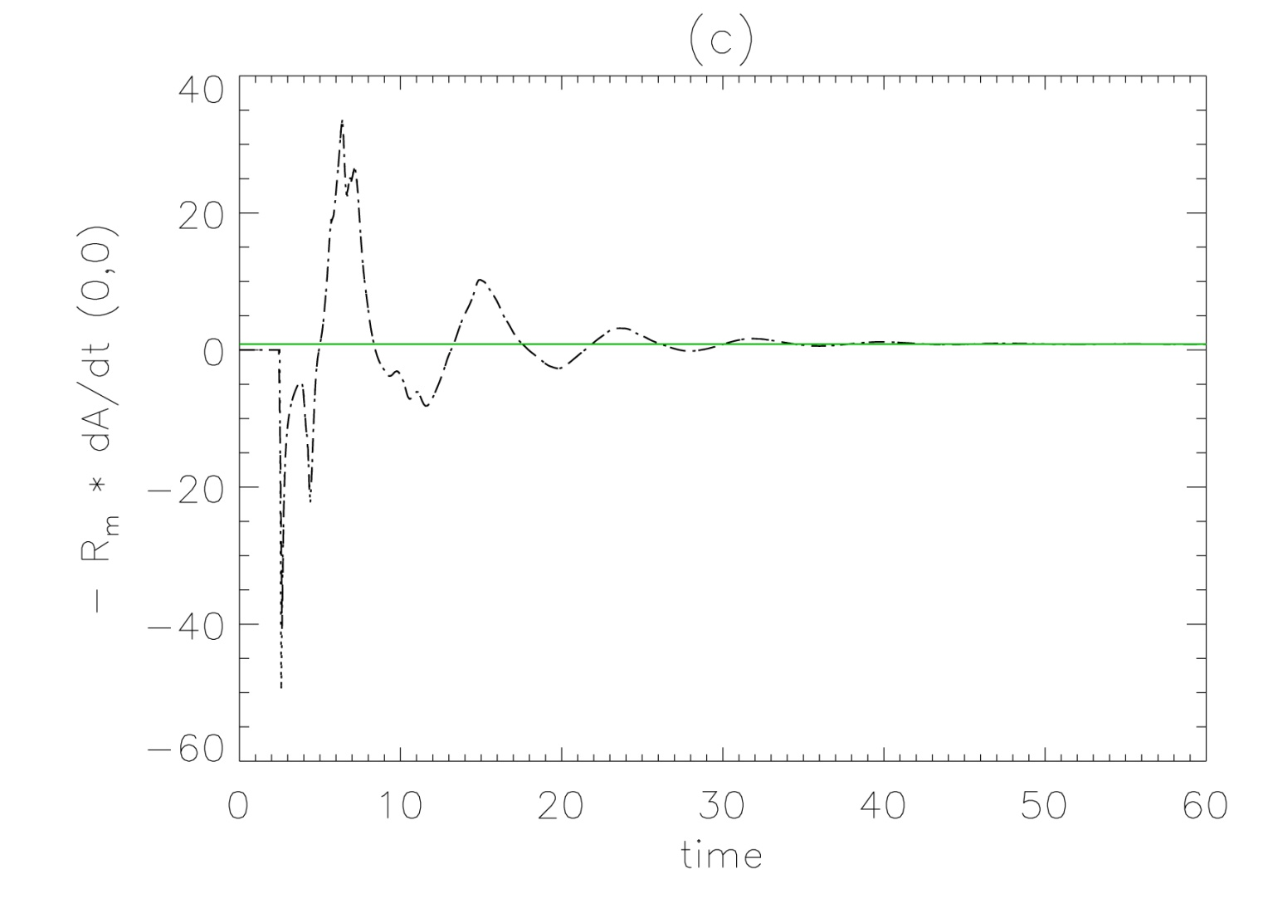
Quantitative Evidence
Can calculate reconnection rate in system, defined as:
Reconnection rate varies, tends towards constant

Slide 101
Answers to key questions
1) Does the fast wave now steepen to form shocks and can these now propagate across or escape the null?
Yes, nonlinear behaviour is completely different to linear case.
Fast and slow shocks form and cross null.
Shocks intersect & (asymmetrically) heat plasma via jets (β≠0).
Can the refraction effect drag enough magnetic field into the null
point to initiate X-point collapse?
Nonlinear wave deforms X-point. Oscillatory reconnection:
* Cycle of horizontal and vertical current sheets.
* Changes in vector potential at origin indicate changes in connectivity.
Final state in force-balance, but non-potential.
Has the rate of current density accumulation changed, and is the
null still the preferential location of wave heating?
Current density now forms in many locations: current sheets, shock fronts.
Neutral point no longer preferential location for heating.
  [linear] McLaughlin & Hood (2004) A&A, 420, 1129
  [nonlinear] McLaughlin, De Moortel, Hood & Brady (2009) A&A, 493, 227
  [Review paper] McLaughlin, Hood & De Moortel (2011), SSR, 158, 205

Slide 102
End of introduction...

Slide 103
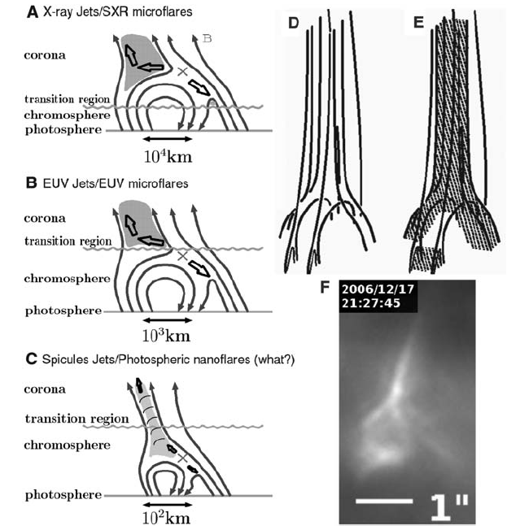
Shibata et al.
(2007),Science
Chromospheric anemone jets observed in
Ca II H with Hinode/SOT
“Inverted Y-shape”
Where is reconnection seen on the Sun?
Everywhere and Nowhere...

Slide 104
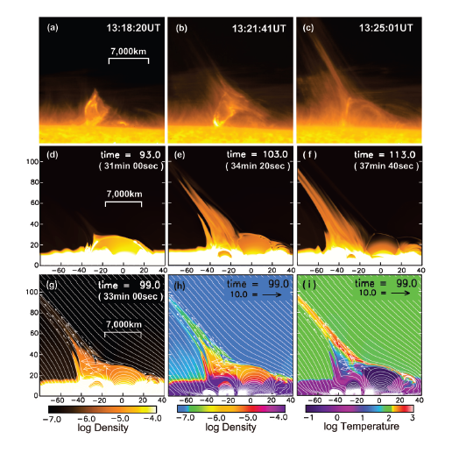
Nishizuka et al
(2008), ApJL
Evidence of propagating
Alfven Waves and
Magnetic simulations
SOT, XRT, TRACE
Where is reconnection seen on the Sun?
Everywhere and Nowhere...

Slide 105
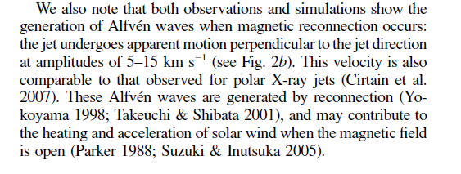
Nishizuka et al
(2008), ApJL
Evidence of propagating
Alfven Waves and
Magnetic simulations
SOT, XRT, TRACE
Where is reconnection seen on the Sun?
Everywhere and Nowhere...

Slide 106
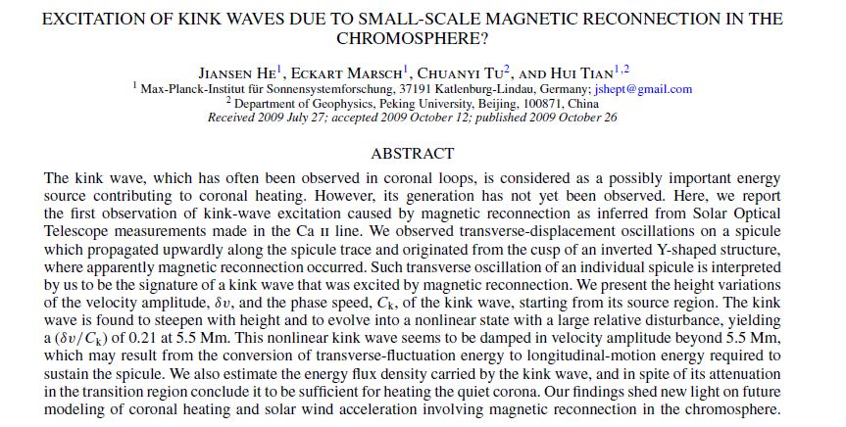
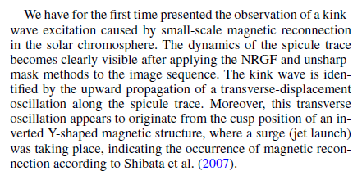

Slide 107
Flux emergence
Magnetic field is continuously emerging on the Sun over a range of scales.
Magnetic flux tubes (tachocline) rise buoyantly through CZ.
At photosphere, buoyant rise ends.
Magnetic buoyancy instability allows flux to penetrate into atmosphere.
Subsequent evolution: properties initial tube, environment, pre-exist field.
(short-term) evolution well described in literature.
Buried flux tube set in radial force balance and thermal equilibrium.
Thus, a density difference exists and so tube is buoyant relative to
surroundings (at start, will rise bodily upwards).

Slide 108
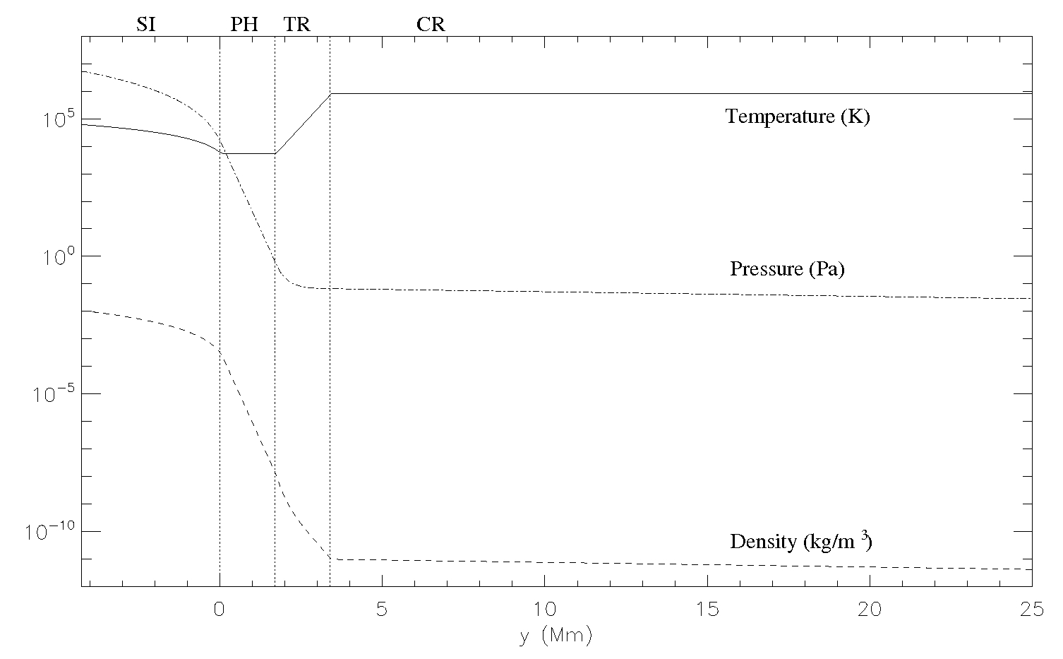

Slide 109
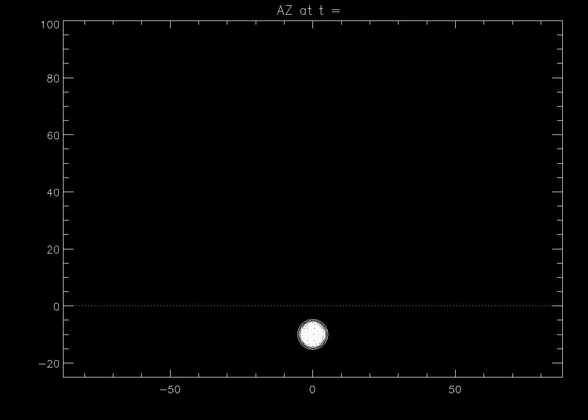

Slide 110
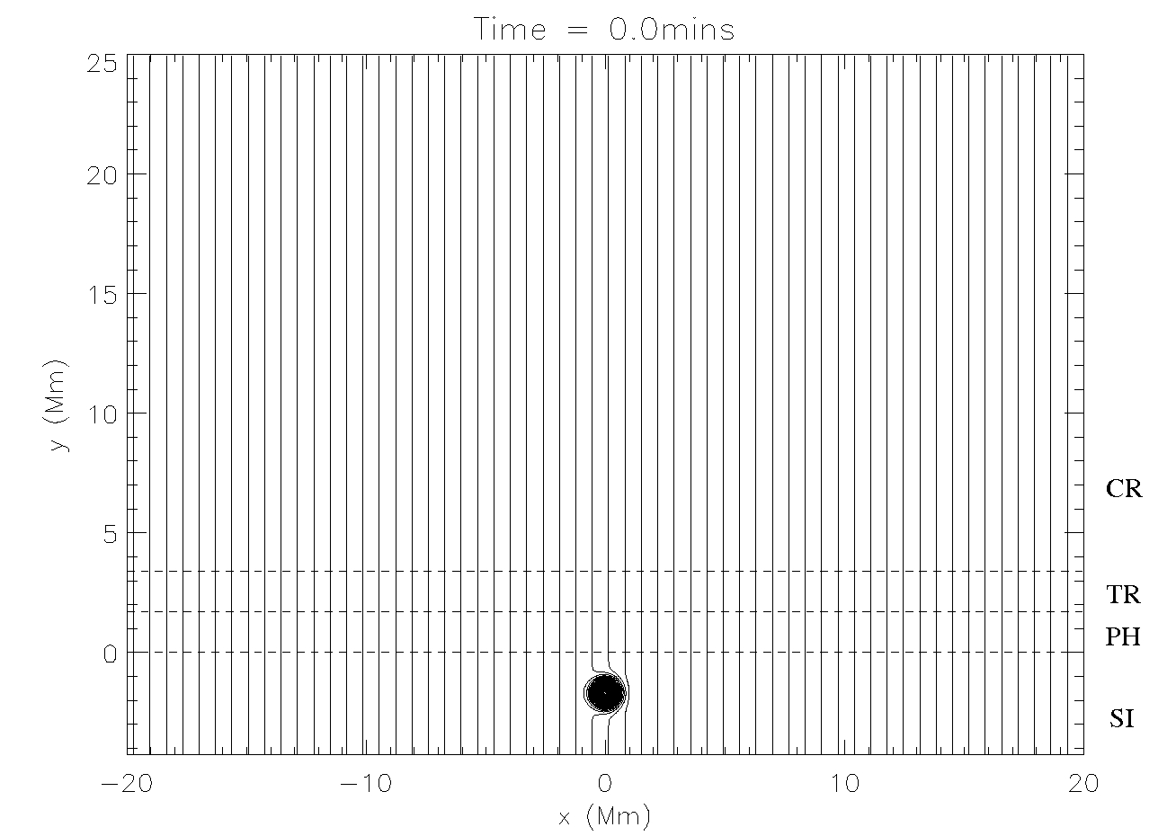
Pre-existing field & Murray et al. (2009)

Slide 111
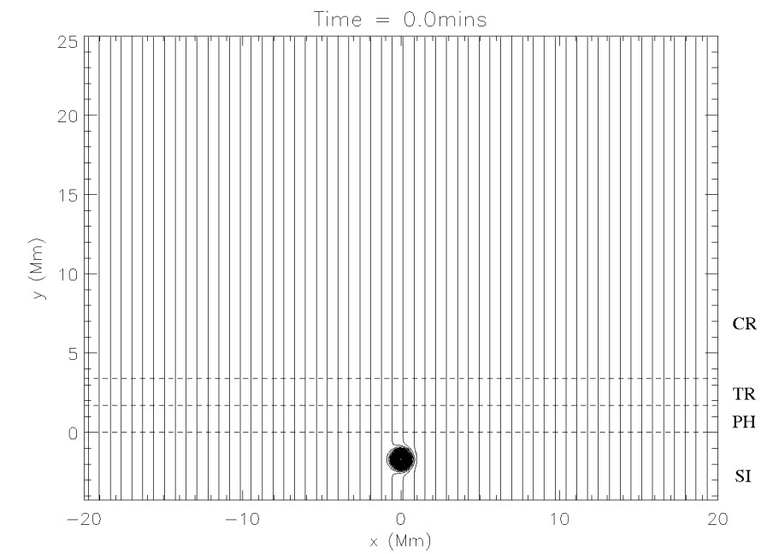
Pre-existing field & Murray et al. (2009)
Values taken from Murray et al (2009)
Pre-existing field = 19.5 G; Zhang et al (2007)
Initial flux tube:
Where B₀=3.25 x 10³ G
(B₀ *=2.5)

Slide 112
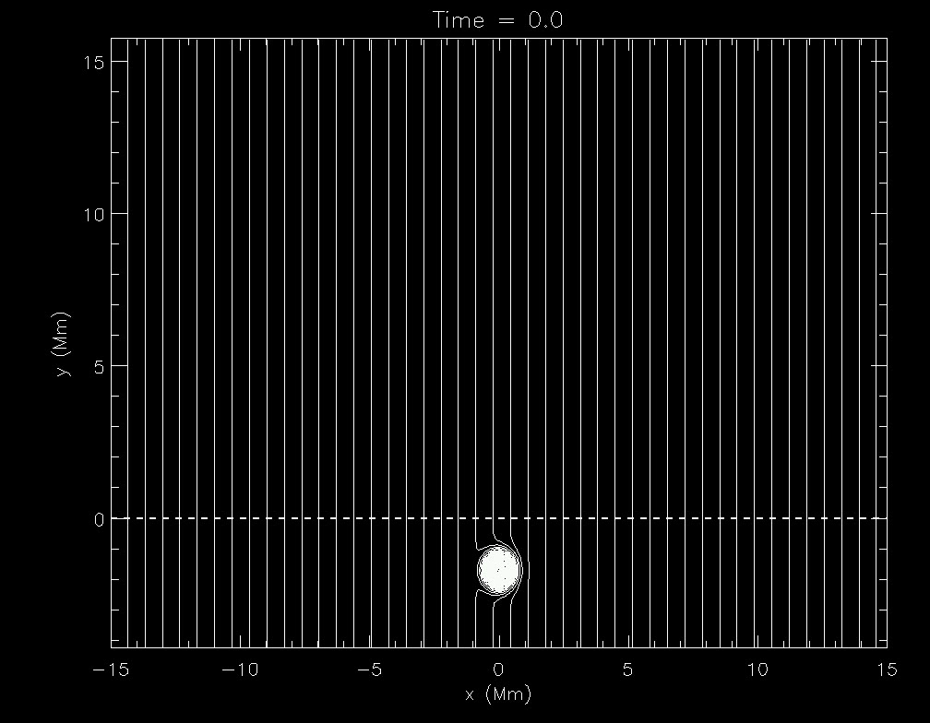

Slide 113
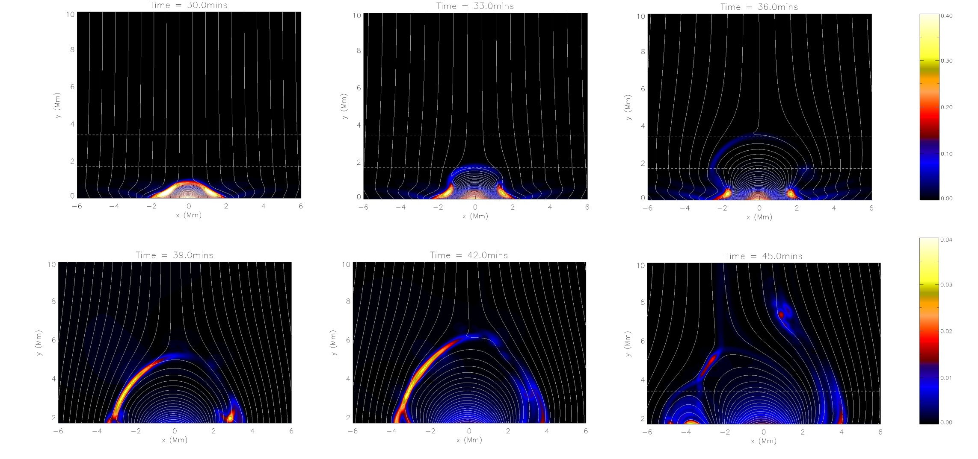
Emerging flux compresses pre-existing field, current sheet formation
Contours of current density overlaid with a selection of fieldlines

Slide 114
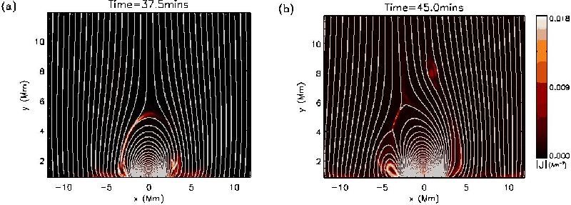
Murray et al. (2009)
Contours of current density overlaid with a selection of fieldlines

Slide 115
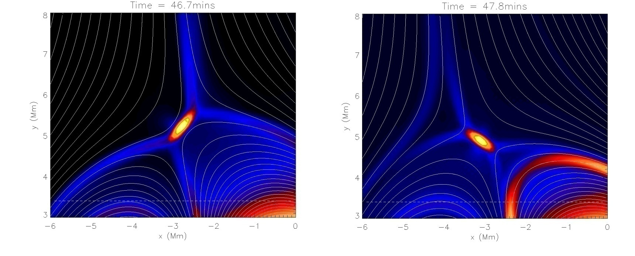
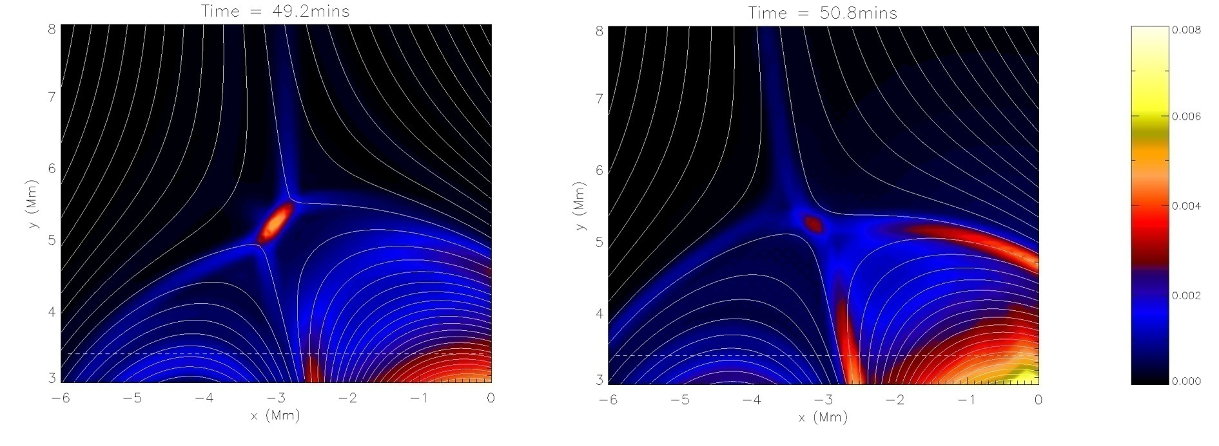
Oscillatory Reconnection (searching for equilibrium)

Slide 116

$$|j_{z}|$$

Slide 117

Murray et al. (2009)
Contours of current density overlaid with velocity arrows

Slide 118

Murray et al. (2009)
Open fieldlines passing from left (dashed) to right (solid) of
the emerged loops over time as a fraction of the total number
of open fieldlines traced.

Slide 119

Murray et al. (2009)
Reconnection rate given by the inflow Alfven mach number
Maximum current in the current sheet (dashed) and length of
current sheet (solid)

Slide 120

(top) Contours of gas pressure (arrows indicate direction and magnitude
of gas pressure gradient
(bottom) Contours of magnetic pressure (arrows indicate direction and
magnitude of Lorentz force)

Slide 121

Contours of VX and VY
Jets from lower end of CS => (periodically) negatively-directed VX and VY
Jets from upper end of CS => (periodically) positively-directed VX and VY

Slide 122

Measure VX at fixed point ( -2.5 Mm,7 Mm)
Central axis of jet horizontally-displaced periodically as CS contracts and
lengthens => characteristic transverse / swaying behaviour !
Specific to Oscillatory Reconnection, absent in steady-state.
For t<47mins, vx>0 due to initial formation/flux emergence.

Slide 123

Measure VY at fixed point ( -2.5 Mm,7 Mm)
Can clearly see oscillatory behaviour, and outflow changes.
For t>50 mins, signal much weaker (bulk of OR over)
Fit damped envelope: for v_{y}>0 and for v_{y}<0 (red)
Stronger positive v_{y} than negative, i.e. Evidence of upflow (blue=average)

Slide 124

Measure A_{Z} to obtain quantitative measure of the oscillations (period)
Track the centre of the (moving) current sheet, measure A_{Z}
Changes in A_{Z} indicate changes in connectivity (reconnection).

Slide 125
Measure A_{Z} to obtain quantitative measure of the oscillations (period)
Measure a period of
195 seconds = 3.25 mins
Track the centre of the (moving) current sheet, measure A_{Z}
Changes in A_{Z} indicate changes in connectivity (reconnection).

Slide 126

Now vary B₀ => robustness, limitations, period changes,
Eight values of B₀* => oscillatory reconnection present in all

Slide 127

Periods : 105 – 212.5 seconds => 1.75 – 3.5 minutes
Eight values of B₀* => oscillatory reconnection present in all

Slide 128
Periods : 105 – 212.5 seconds => 1.75 – 3.5 minutes
stronger => longer
Eight values of B₀* => oscillatory reconnection present in all

Slide 129

Location of X-point at t = 100 mins
Final/resting location is displaced both higher and further to the left for stronger B₀* (intuitive: stronger B₀* tubes have larger emergence
velocities and thus greater momenta => higher and farther).

Slide 130

Other B₀* explored => fundamentally different behaviour
Failed emergence (below buoyancy instability criterion)
Similar but, now plasmoid ejection
(flux leaves, so different regime)

Slide 131
Observational interest...
Recently, great deal of interest in transverse oscillations and flows:
Tomczyk et al (2007) – CoMP – ubiquitous, transverse disturbances propagating along magnetic field lines. Authors do not report on how these waves are generated.
De Pontieu et al (2007) – Hinode/SOT – transverse waves in chromosphere with amplitudes 10-30 km/s periods 100-500 seconds (dynamic spicules/jet-like extrusions).
De Pontieu et al (2011) – link between chromospheric spicules/jets and coronal spicules/jets – authors report there are currently no models for what drives and heats the observed jets.
McIntosh et al (2011) – SDO – transition region observations of transverse oscillations, outwardly propagating, amplitudes 20km/s, period 100-500 seconds – authors not that the challenge remains to understand how and where these waves are generated in the solar atmosphere.
De Pontieu & McIntosh (2010) – Hinode/EIS – quasi-periodic upflows (50-150 km/s line-of-sight)
Thus, clear need for a better understanding of the physical generation mechanism for these ubiquitous, transverse, propagating motions (oscillations and flows kept in mind). Oscillatory wake from CME, periodic reconnection.

Slide 132
Conclusions
We have presented numerical simulations that naturally generate quasi-periodic flows with a characteristic swaying/transverse aspect.
Self- consistent => no period driver (aperiodic) but physical mechanism gives rise to periodic behaviour.
Mechanism generates both v_{x} and v_{y} together, and are (generated) exponentially damped => measured signals decaying not due to damping, but due to generation mechanism itself
(not surprising, finite amount FE energy in, finite duration outputs).

Slide 133
Conclusions
We investigate the long-term evolution of an initially buoyant magnetic flux tube emerging into a gravitationally-stratified coronal hole environment and report on the resulting oscillations and outflows. We perform 2.5D nonlinear numerical simulations, generalizing the models of McLaughlin et al. (2009) and Murray et al. (2009).
We find that the physical mechanism of oscillatory reconnection naturally generates quasi-periodic vertical outflows, with a transverse/swaying aspect. The vertical outflows consist of both a periodic aspect and evidence of a positively-directed flow. The speed of the vertical outflow (20 − 60 km/s) is comparable to those reported in the observational literature.
We also perform a parametric study varying the magnetic strength of the buoyant flux tube and find a range of associated periodicities: 1.75 − 3.5 min. Thus, the mechanism of oscillatory reconnection may provide a physical explanation to some of the high-speed, quasi-periodic, transverse outflows/jets recently reported by a multitude of authors and instruments.

Slide 134
References
[linear wave about X-point]
McLaughlin & Hood (2004) A&A, 420, 1129
[nonlinear wave about X-point]
McLaughlin, De Moortel, Hood & Brady (2009) A&A, 493, 227
[first paper on oscillatory reconnection]
Craig & McClymont (1991) ApJ, 371, L41
[flux emergence & oscillatory reconnection]
Murray, van Driel-Gesztelyi & Baker(2009) A&A, 494, 329
[generated outflows/waves and periods : flux emergence & oscillatory reconnection] McLaughlin, Verth, Fedun & Erdelyi (2012) ApJ

