Slide 1
Evaluating the risk of a solar super flare
Christoffer Karoff

Slide 2
Karoff et al. 2016

Slide 3
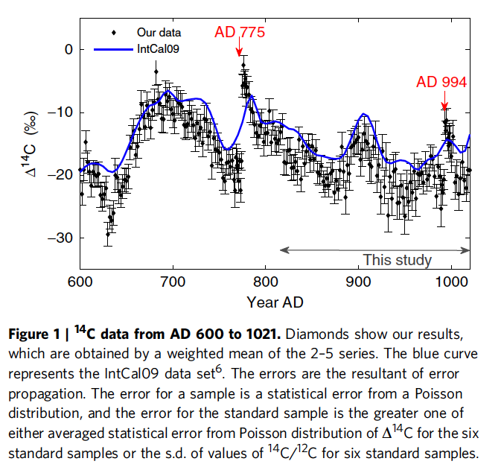
Miyake et al. 2013

Slide 4
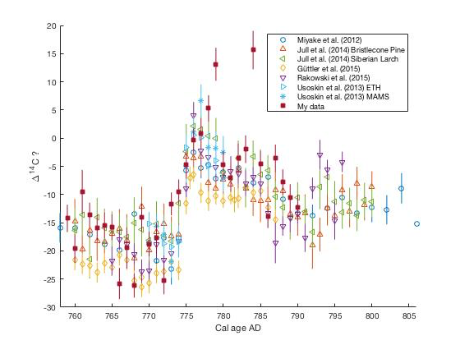

Slide 5
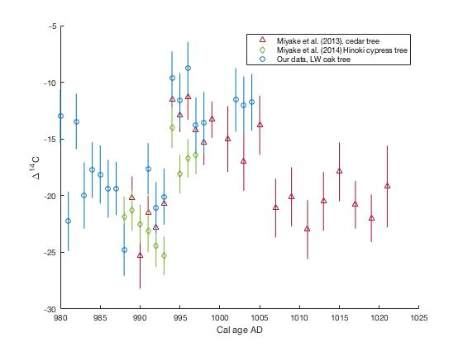

Slide 6
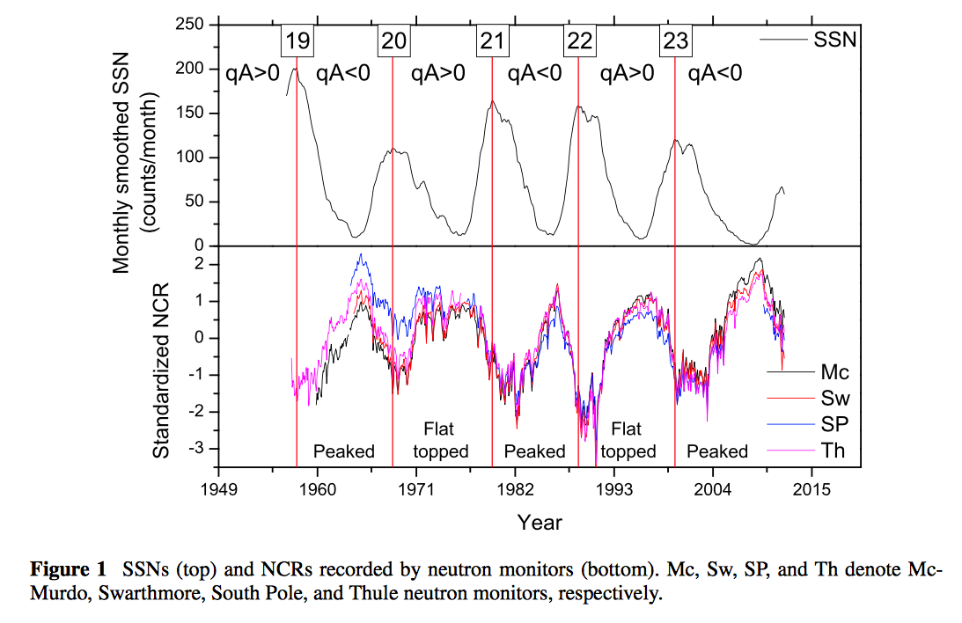
Inceoglu et al. 2014

Slide 7
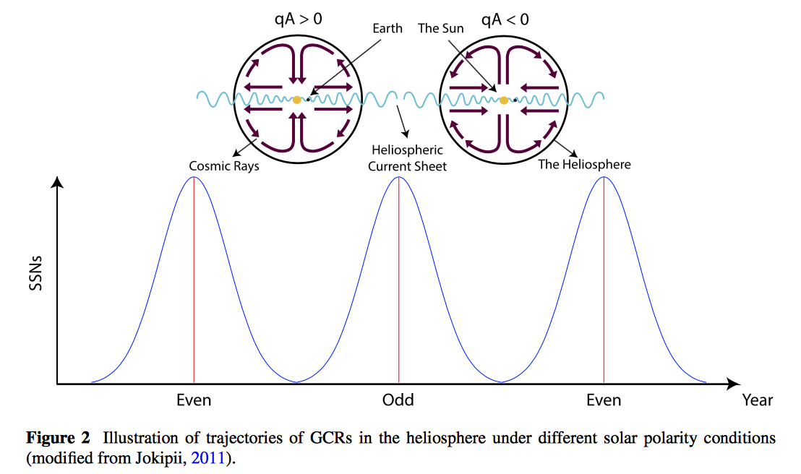
Inceoglu et al. 2014

Slide 8
Cycle 4b
Karoff et al. 2014

