Slide 1
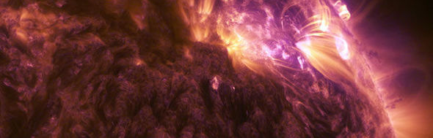
Hare and Hounds exercise via Empirical Mode Decomposition
Tishtrya Mehta
University of Warwick
Supervisor: Prof. Valery Nakariakov Secondary supervisor: Dr. Dmitrii Kolotkov

Slide 2
Identifying flares
Sudden increase in intensity, slow drop off.
Three distinct phases:
X6.9, August 9th 2011

Slide 3
Identifying quasi-periodic pulsations
QPPs: small scale oscillations, often seen during the rise and decay flaring phase.
Can be both stationary and non stationary
Found in almost all flares
Obscured by (coloured) noise
Irregular periodicities
Simulated Flare, Broomhill 2017

Slide 4
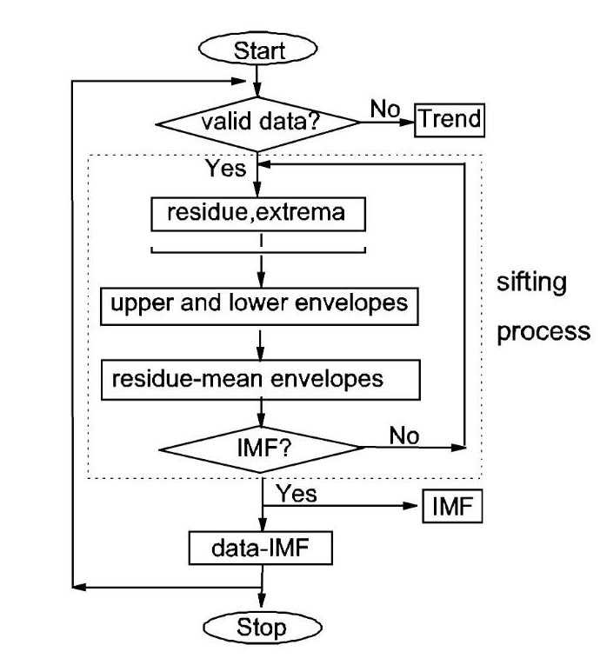
Empirical Mode Decomposition
Technique that decomposes a signal into several ‘intrinsic mode functions’.
Some of these mode functions can be attributed to random/coloured noise
Those above a confidence interval may be evidence of QPPs.
G. Wang et al,
“On intrinsic mode functions”
Notes:
EMD is adaptive and highly efficient.^{[6]} Since the decomposition is based on the local characteristic time scale of the data, it can be applied to nonlinear and nonstationary processes.^{[6]}
Unlike Fourier which cant deal with non stationary data

Slide 5
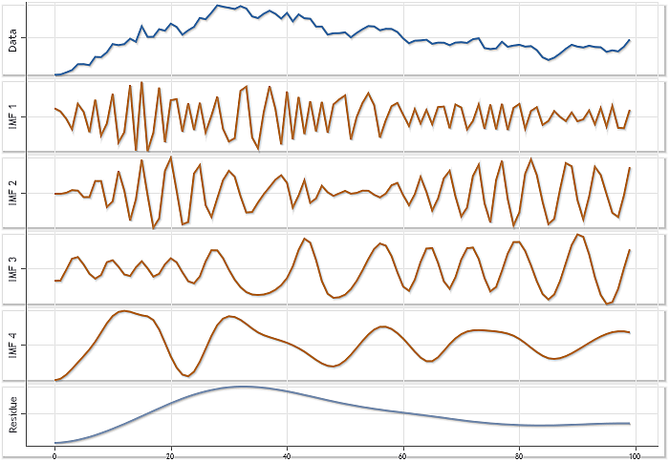
Empirical Mode Decomposition: IMFs
Criteria for an Intrinsic Mode Functions:
The number of zero crossings and the number of IMF extrema should differ by no more than one.
At any point of an IMF the mean envelope should equal zero.
www.mql5.com/en/articles/439
Notes:
Stopping criteria

Slide 6
Empirical Mode Decomposition: IMFs
From Kolotkov .et al (2017), Long-period quasi-periodic oscillations of a small-scale magnetic structure on the Sun
Notes:
Non stationary ( not shown in Fourier)

Slide 7
Empirical Mode Decomposition: Sifting
Sifting process:
Find extrema of data
Construct upper and lower envelopes
Find the mean envelope
Subtract the mean from the initial data
Check whether this produces an IMF, repeat if not.
Subtract the IMF from data and repeat until stopping criteria is fulfilled.
Local maxima
Local minima
Envelope
Mean envelope

Slide 8
Confidence intervals: Noise
Noise can be described by a parameter alpha:
α= 0 : White noise, not correlated, dominates over short periods/high frequency.
α > 0: Coloured noise, the larger the value of alpha the stronger the dependence on previous data values, dominates on longer (redder) frequencies.

Slide 9
Confidence intervals: Fourier Power Spectrum
Frequency = 1/Period
S$(f^{\text{α}})=C$
Log[S]$−\text{α} Log[P]=K$
From Kolotkov et al, 2016.
Log[Power]
Y$− \text{m} X=C$
Gradient = $\text{α}$
Log[Period]
Notes:
Power spectral density S of coloured noises as a function of frequency, f can be written as S = C/ f α

Slide 10
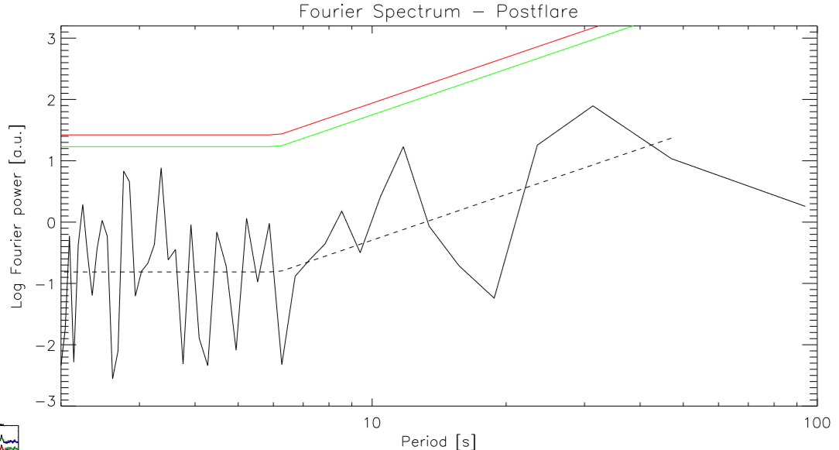
Confidence intervals: Fourier Power Spectrum
$\text{α}$ = $0$
White noise
$\text{α}$ > $0$
Coloured noise
Log[Power]
Log[Period]
Notes:
Mention detrednind to find bp, etc tec
Power spectral density S of coloured noises as a function of frequency, f can be written as S = C/ f α

Slide 11
Confidence intervals: Fourier Power Spectrum
Log[Power]
Log[Period]
Notes:
Power spectral density S of coloured noises as a function of frequency, f can be written as S = C/ f α

Slide 12
Confidence intervals: EMD Spectrum
${\overline{E}}_{m}\left(α\right)$ is the average total energy of mode ‘m’.
$k_{m}\left(α\right)$ represents the number of degrees of freedom.
From Kolotkov .et al (2016), EMD analysis of random processes in the solar atmosphere
Notes:
Power spectral density S of coloured noises as a function of frequency, f can be written as S = C/ f α

Slide 13
Confidence intervals: EMD Spectrum
$E(P^{1−\text{α}})=C′$
$Log[E]−(\text{α}\text{−1)} Log[P]=K′$
From Kolotkov et al, 2016.
Y$− \text{m} X=C$
Log[Mean Modal Energy]
Gradient =
$\text{α}\text{−1}$
Log[Period]
Notes:
Power spectral density S of coloured noises as a function of frequency, f can be written as S = C/ f α

Slide 14
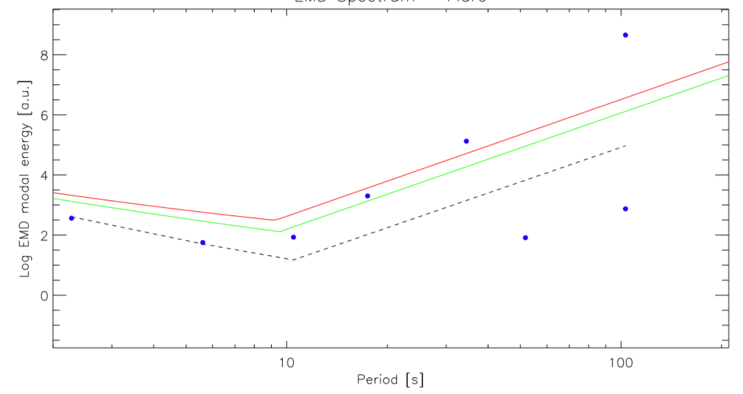
Confidence intervals: EMD Spectrum
Log[Mean Modal Energy]
$\text{α}$ = $0$
White noise
$\text{α}$ > $0$
Coloured noise
Log[Period]
Notes:
Power spectral density S of coloured noises as a function of frequency, f can be written as S = C/ f α

Slide 15
Confidence intervals: EMD Spectrum
$\text{α}$ = $0$
White noise
$\text{α}$ > $0$
Coloured noise
15

Slide 16
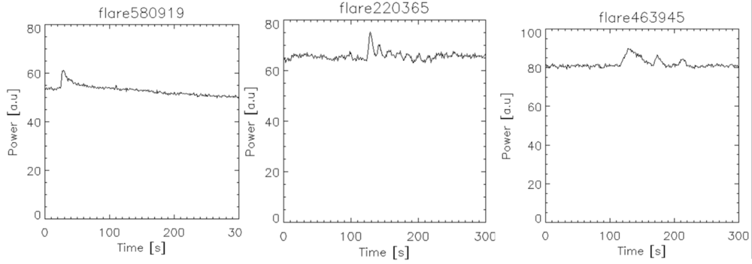
Simulated Flares
1. Solitary flare event
2. Overlapping events (Evidence of QPPs?)
3. Separated events
4. More exotic behaviour
Above lightcurves, and all data to follow is from A.M. Broomhall

Slide 17
Flare 58469: Profile

Slide 18
Flare 58469: Spectra

Slide 19
Flare 62351: Profile

Slide 20
Flare 62351: Spectra
Notes:
Rebiining could how fft

Slide 21
Flare 375344: Profile
Notes:
Deaying oscill

Slide 22
Flare 375344: Spectra

Slide 23
Flare 629040: Profile

Slide 24
Flare 629040: Spectra

Slide 25
Flare 801580: Profile

Slide 26
Flare 801580: Spectra (Flare Phase only)

Slide 27
Main issues with EMD
As is the case with wavelet analysis and other methods, the ‘Shift factor’ is an external variable which greatly affects results.
Mode leakage can occur
Computationally intensive to carry out.
Notes:
We only care about mode leaking for sig

Slide 28
Future work
Work on improving the usability of the program.
Possibly employ Laura’s method of splitting ‘Flare phase’ into impulsive and decay for observed light curves
Work with ISSI team to optimise accuracy.
‘EMD Manual’ to be completed, and source code to be made available on GitHub.

Slide 29
Results against input model: 58618
Raw signal
Initial EMD mode input model
Retuned EMD mode
input model

Slide 30
Results against input model: 58618
Edits from Initial to Final EMD:
Removed 2nd mode
Shiftfactor changed from 0.030 to 0.035

Slide 31
Results against input model: 641968
Raw signal
Initial EMD mode input model
Retuned EMD mode
input model

Slide 32
Results against input model: 641968
Edits from Initial to Final EMD:
Shiftfactor changed from 0.146 to 0.430

Slide 33
Results against input model: 754456
Raw signal
Initial EMD mode input model
Retuned EMD mode
input model

Slide 34
Results against input model: 754456
Edits from Initial to Final EMD:
Shiftfactor changed from 0.002 to 0.011

Slide 35
Results against input model: 801580
Raw signal
Initial EMD mode input model
Retuned EMD mode
input model

Slide 36
Results against input model: 801580
Edits from Initial to Final EMD:
Changed ‘end point’ of flare
Shiftfactor changed from 0.08 to 0.26 (But SF would have to be entirely changed due to change in boundaries)

