Slide 1
Modelling Quasi-periodic Pulsations in Solar and Stellar Flares
J.A. McLaughlin, V.M. Nakariakov, M. Dominique, P. Jelínek & S. Takasao
McLaughlin et al. (2018) Space Science Reviews, 214, 45

Slide 2
Solar flare emission is detected in all EM bands and variations in flux density of solar energetic particles. Often the EM radiation generated in solar and stellar flares shows a pronounced oscillatory pattern, with characteristic periods ranging from a fraction of a second to several minutes. These oscillations are referred to as quasi-periodic pulsations (QPPs), to emphasise that they often contain apparent amplitude and period modulation. We review the current understanding of QPPs in solar and stellar flares. In particular, we focus on the possible physical mechanisms, with an emphasis on the underlying physics that generates the resultant range of periodicities. These physical mechanisms include MHD oscillations, self-oscillatory mechanisms, oscillatory reconnection / reconnection reversal, wave-driven reconnection, two loop coalescence, MHD flow over-stability, the equivalent LCR-contour mechanism, and thermal-dynamical cycles. We also provide a histogram of all QPP events published in the literature at this time. The occurrence of QPPs puts additional constraints on the interpretation and understanding of the fundamental processes operating in flares, e.g. particle acceleration and magnetic energy liberation. Therefore, a full understanding of QPPs is essential in order to work towards an integrated model of solar and stellar flares.

Slide 3
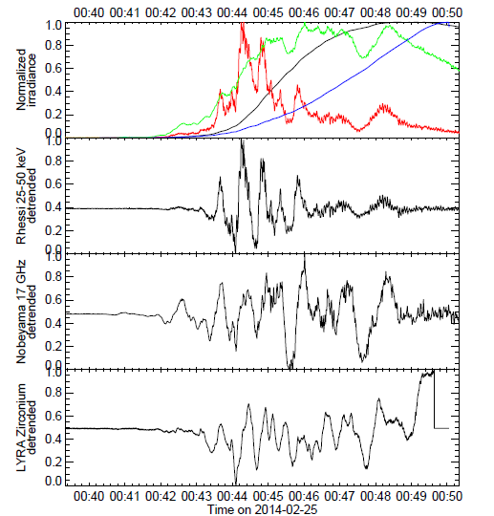
Solar flare emission is detected in all EM bands and variations in flux density of solar energetic particles.
Often the EM radiation generated in solar and stellar flares shows a pronounced oscillatory pattern, with characteristic periods ranging from a fraction of a second to several minutes.
  radio (Nobeyama)
  EUV (PROBA-2/Lyra)
  HXR ranges (RHESSI)
Despite the very different ranges of energy considered, the oscillations are remarkably synchronous.
Notes:
Fig. 1 Example of QPPs for the X4.9 flare of 25 February 2014. Top panel: the normalised
flare time series from GOES 0.1–0.8 nm (black), Lyra 1–20 nm (blue), RHESSI 50–100 keV
(red) and Nobeyama 17 GHz. Second, third and fourth panels: the same time series for
respectively RHESSI, Lyra, and Nobeyama, detrended with a 50 s window. The QPPs
appear to be remarkably synchronous. The data gap in the Lyra time series from 00:50 UT
onwards is caused by a spacecraft manoeuvre.

Slide 4
http://www2.warwick.ac.uk/fac/sci/physics/research/cfsa/people/valery/research/qpp/
Catalogue that contains information about QPPs in solar flares, detected in various bands and with various instruments, based on the information provided in already published papers by various authors, is continuously updated, and at the moment contains 278 QPP events reported in the literature.
Can create a histogram of the detected QPPs in time and by the periods.
thermal emission
We attribute an event to a QPP in the thermal emission if it was detected
in EUV and/or soft X-rays
Non-thermal emission
QPPs in radio, microwave, visible light and white light, hard X-ray and
gamma-ray bands
This separation is rather artificial, but may be useful for the choice of appropriate instrumentation for further studies of this phenomenon.
We have attributed QPPs detected in visible light as non-thermal emission, but certain types of visible light could be classed as either thermal or non-thermal emission.

Slide 5
Increase in number of QPPs detected simultaneously in both thermal & non-thermal emission reflects growing interest in multi-instrumental studies of the QPP phenomenon (necessary for the exclusion of instrumental artefacts).
Statistics of QPP detections clearly correlates with solar cycle (not a surprise, as frequency of flares depends on the phase of the cycle).
The recent increase in the detection of QPPs in thermal emission is explained in the availability of EUV and soft X-ray instruments.

Slide 6
Physical mechanisms underpinning QPP generation
MHD oscillations
QPPs periodically triggered by external waves
Oscillatory reconnection (Reconnection Reversal)
Thermal over-stability
MHD flow over-stability
Waves and plasmoids in a current sheet (dispersive wave trains)
“Magnetic tuning fork” oscillation driven by reconnection outflow
Wave-driven reconnection in the Taylor problem
Two loop coalescence
Equivalent LCR contour
Autowave processes in flares

Slide 7
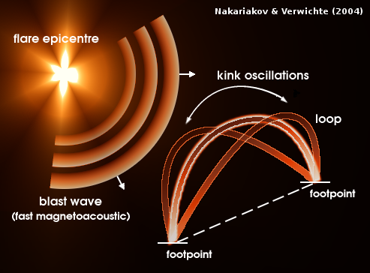
1) MHD oscillations
QPP periods coincide with the order of magnitude of MHD waves / oscillations that are abundantly detected in the corona (and well resolved both spatially and temporally).
Flare is invoked as a justification for energy provider, but once the finite-duration internal/external excitation occurs, we will get free MHD oscillations of the emitting plasma. Variation of macroscopic parameters (mass & current densities, temperature, gas pressure, bulk flow, magnetic field) in the vicinity of flare site can affect flaring emission.
Thus, we are now within the field of coronal seismology, so observed parameters tell us diagnostic information about the medium/local conditions in flaring region / the oscillating structure, rather than the flare itself (driver).
period will be independent of the flare energy.

Slide 8
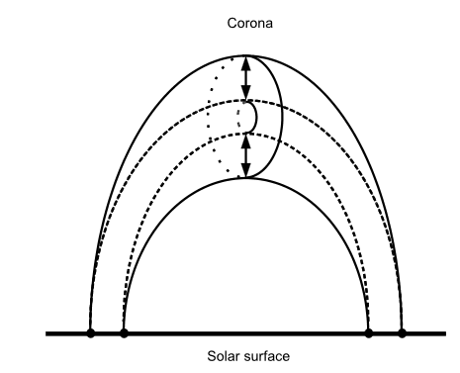
1) MHD oscillations
QPP periods coincide with the order of magnitude of MHD waves / oscillations that are abundantly detected in the corona (and well resolved both spatially and temporally).
Flare is invoked as a justification for energy provider, but once the finite-duration internal/external excitation occurs, we will get free MHD oscillations of the emitting plasma. Variation of macroscopic parameters (mass & current densities, temperature, gas pressure, bulk flow, magnetic field) in the vicinity of flare site can affect flaring emission.
Thus, we are now within the field of coronal seismology, so observed parameters tell us diagnostic information about the medium/local conditions in flaring region / the oscillating structure, rather than the flare itself (driver).
period will be independent of the flare energy.
Sausage mode

Slide 9
1) MHD oscillations
QPP periods coincide with the order of magnitude of MHD waves / oscillations that are abundantly detected in the corona (and well resolved both spatially and temporally).
Flare is invoked as a justification for energy provider, but once the finite-duration internal/external excitation occurs, we will get free MHD oscillations of the emitting plasma. Variation of macroscopic parameters (mass & current densities, temperature, gas pressure, bulk flow, magnetic field) in the vicinity of flare site can affect flaring emission.
Thus, we are now within the field of coronal seismology, so observed parameters tell us diagnostic information about the medium/local conditions in flaring region / the oscillating structure, rather than the flare itself (driver).
Sausage mode

Slide 10
1) MHD oscillations
QPP periods coincide with the order of magnitude of MHD waves / oscillations that are abundantly detected in the corona (and well resolved both spatially and temporally).
Flare is invoked as a justification for energy provider, but once the finite-duration internal/external excitation occurs, we will get free MHD oscillations of the emitting plasma. Variation of macroscopic parameters (mass & current densities, temperature, gas pressure, bulk flow, magnetic field) in the vicinity of flare site can affect flaring emission.
Thus, we are now within the field of coronal seismology, so observed parameters tell us diagnostic information about the medium/local conditions in flaring region / the oscillating structure, rather than the flare itself (driver).
period will be independent of the flare energy.
Sausage mode

Slide 11
1) MHD oscillations
Light curves of the soft X-ray emission (black and red lines) and hard X-ray emission (blue and green lines) at different photon energy bands (see the inset legend).
A few post-flare oscillations are visible in the soft X-ray light curves.
Pinto et al. (2016)
Pinto et al. (2016) developed a model of the thermal & non-thermal emission produced during evolution of kink-unstable twisted coronal loops in a flare. Modelling showed post-flare oscillations in the soft X-ray emission, which could be interpreted as QPPs.

Slide 12
2) QPPs periodically triggered by external waves
In the previous subsection, the flare is invoked as an impulsive forcing term, hence the periodicity comes from the global parameters of the oscillating loop, not from the driver. However, in some cases MHD waves and oscillations may affect, or back-react on, the flaring process.
Pre-flare stage, i.e. before the primary energy release (the impulsive phase), is one of energy storage. By definition, flares are the rapid release of energy stored previously in the magnetic field. Reconnection must be at the heart of this energy release.
The CSHKP standard flare model which has a null point — a location where the magnetic field, and hence the Alfvén speed, is zero, at least in a certain plane — as part of its magnetic topology.
Here, we focus specifically on the triggering of flares by MHD waves.

Slide 13
ASIDE: (McLaughlin & Hood 2004)
Consider wave propagation near to equilibrium magnetic field – simple 2D X-point.
Idea is to send in wave pulse from top boundary, and see (and explain!) what happens.

Slide 14
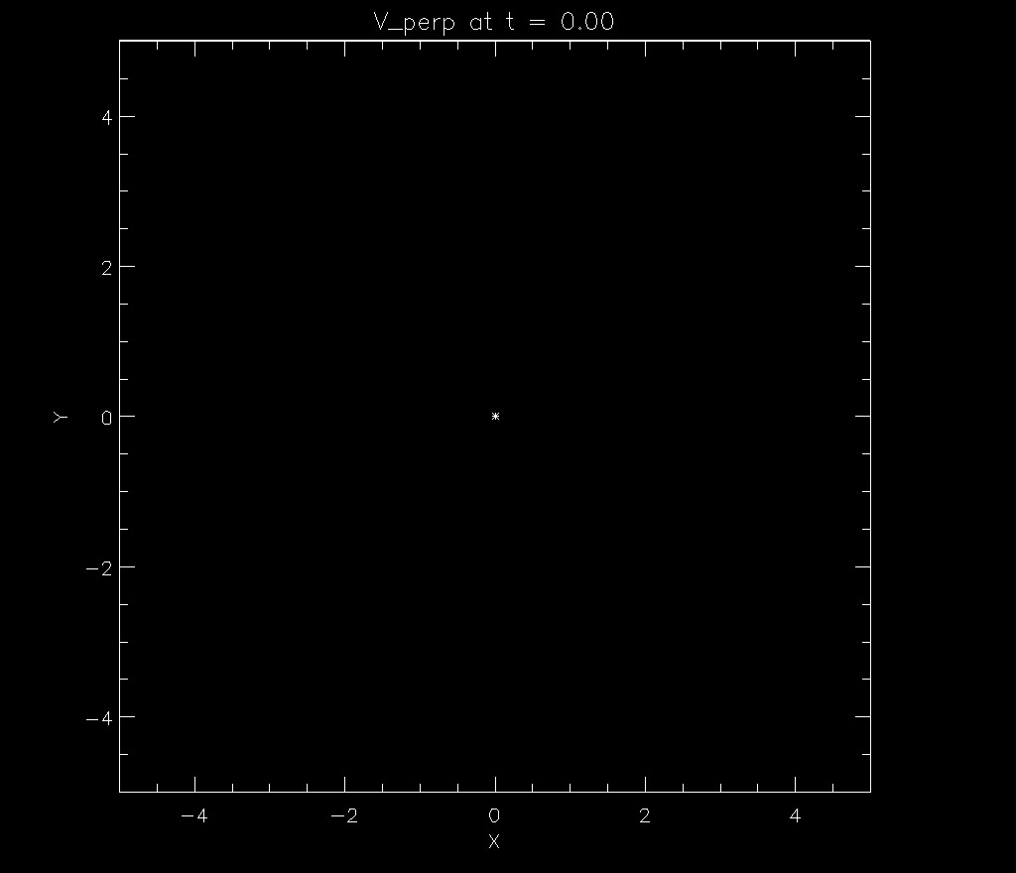
Linear, Cold Fast Wave (Numerical + WKB)

Slide 15
ASIDE: (McLaughlin & Hood 2004)
Equations reduce to:
Results:
Linear, fast MA wave travels towards the vicinity of the X-point and
bends around it.
Alfvén speed spatially varying:
travels faster further away from the null.
Wave demonstrates refraction – wraps wave around null
Key feature of fast wave propagation (linear + cold plasma).

Slide 16
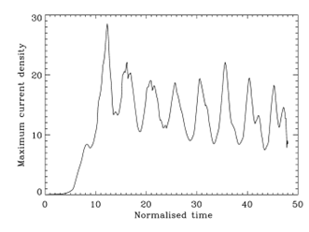
2) QPPs periodically triggered by external waves
Nakariakov et al. (2006) : The cool (shaded) loop experiences fast magnetoacoustic oscillations (e.g. kink or sausage mode). A segment of the oscillating loop is situated nearby a flaring arcade.

Slide 17
2) QPPs periodically triggered by external waves
Nakariakov et al. (2006) : The cool (shaded) loop experiences fast magnetoacoustic oscillations (e.g. kink or sausage mode). A segment of the oscillating loop is situated nearby a flaring arcade.
An external evanescent or leaking part of the oscillation can reach the null point(s) in the arcade, inducing quasi-periodic modulations of the electric current density.

Slide 18
2) QPPs periodically triggered by external waves
Nakariakov et al. (2006) : The cool (shaded) loop experiences fast magnetoacoustic oscillations (e.g. kink or sausage mode). A segment of the oscillating loop is situated nearby a flaring arcade.
An external evanescent or leaking part of the oscillation can reach the null point(s) in the arcade, inducing quasi-periodic modulations of the electric current density.
Via plasma microinstabilities this cause anomalous resistivity which triggers reconnection. This then accelerates particles periodically, which follow the field lines and precipitate in the dense atmosphere, causing quasi-periodic emission in radio, optical and X-ray bands.

Slide 19
2) QPPs periodically triggered by external waves
Nakariakov et al. (2006) : The cool (shaded) loop experiences fast magnetoacoustic oscillations (e.g. kink or sausage mode). A segment of the oscillating loop is situated nearby a flaring arcade.
An external evanescent or leaking part of the oscillation can reach the null point(s) in the arcade, inducing quasi-periodic modulations of the electric current density.
Via plasma microinstabilities this cause anomalous resistivity which triggers reconnection. This then accelerates particles periodically, which follow the field lines and precipitate in the dense atmosphere, causing quasi-periodic emission in radio, optical and X-ray bands.
Here, the period is determined by the period of the oscillating loop.

Slide 20
2) QPPs periodically triggered by external waves
Chen and Priest (2006) performed MHD simulations of transition-region explosive events driven by five-minute solar p-mode oscillations. The authors considered an anti-parallel magnetic field with a stratified atmosphere. Five minute oscillations are imposed at the photospheric base and this leads to periodically triggered reconnection.
Specifically, it was found that density variations in the vicinity of the reconnection site result in a periodic variation in the electron drift speed, which switches on/off anomalous resistivity, and thus accelerates the process of reconnection periodically.
Thus the reconnection rate is modulated with a period of approximately five minutes. The corresponding UV light curve indicates impulsive bursty behaviour, which each spiky burst lasting for approximately one minute (for the parameters considered).
Thus, this is an example of the periodic triggering of reconnection due to MHD

Slide 21
3) Oscillatory reconnection (Reconnection Reversal)
Above (#2) we considered periodic flare triggering via MHD oscillations, but alternatively the reconnection itself can be repetitive and even periodic.

Slide 22
3) Oscillatory reconnection (Reconnection Reversal)
Above (#2) we considered periodic flare triggering via MHD oscillations, but alternatively the reconnection itself can be repetitive and even periodic.
Oscillatory Reconnection: Time-dependent magnetic reconnection mechanism that naturally produces periodic outputs from aperiodic drivers.
Adapted from McLaughlin et al. (2009).

Slide 23
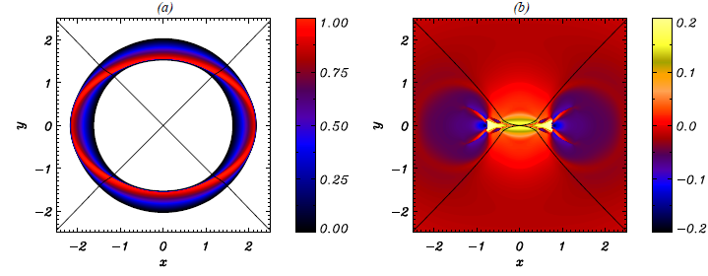
3) Oscillatory reconnection (Reconnection Reversal)
Above (#2) we considered periodic flare triggering via MHD oscillations, but alternatively the reconnection itself can be repetitive and even periodic.
Oscillatory Reconnection: Time-dependent magnetic reconnection mechanism that naturally produces periodic outputs from aperiodic drivers.
Adapted from McLaughlin et al. (2009).

Slide 24
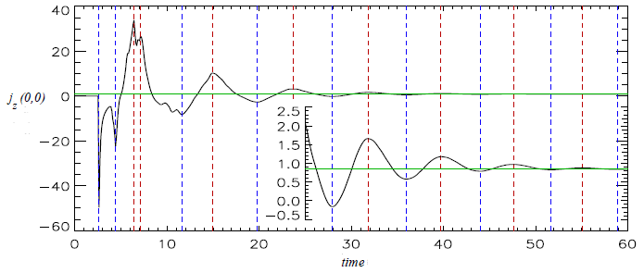
3) Oscillatory reconnection (Reconnection Reversal)
Above (#2) we considered periodic flare triggering via MHD oscillations, but alternatively the reconnection itself can be repetitive and even periodic.
Oscillatory Reconnection: Time-dependent magnetic reconnection mechanism that naturally produces periodic outputs from aperiodic drivers.
Adapted from McLaughlin et al. (2009).

Slide 25
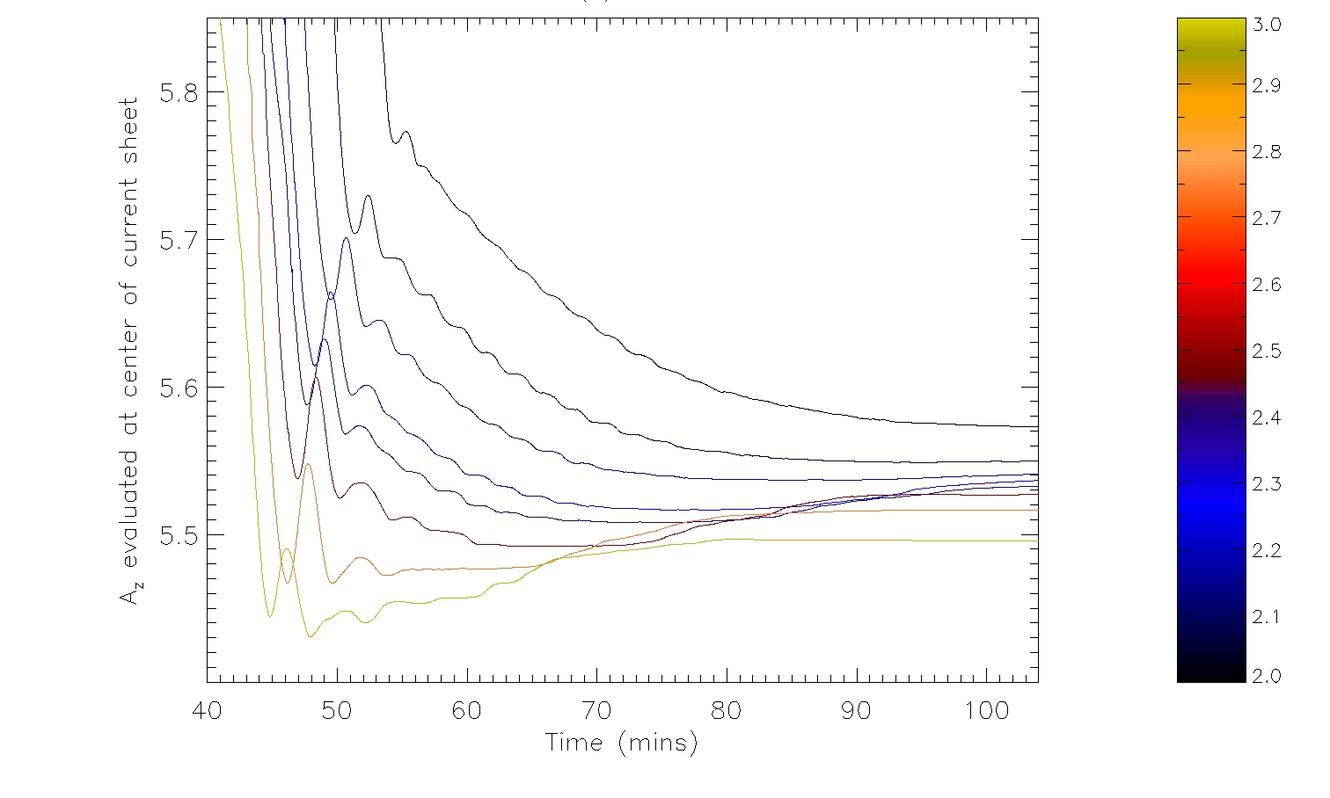
Flux Emergence: vary B₀ => robustness, limitations, period changes,
Periods : 105 – 212.5 seconds
Eight values of B₀* => oscillatory reconnection present in all

Slide 26
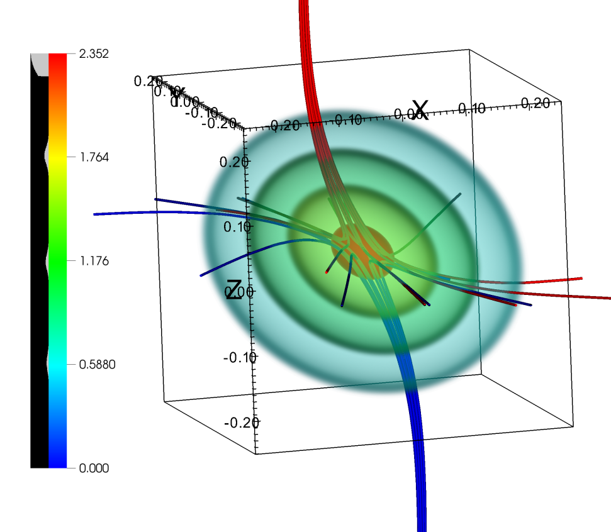
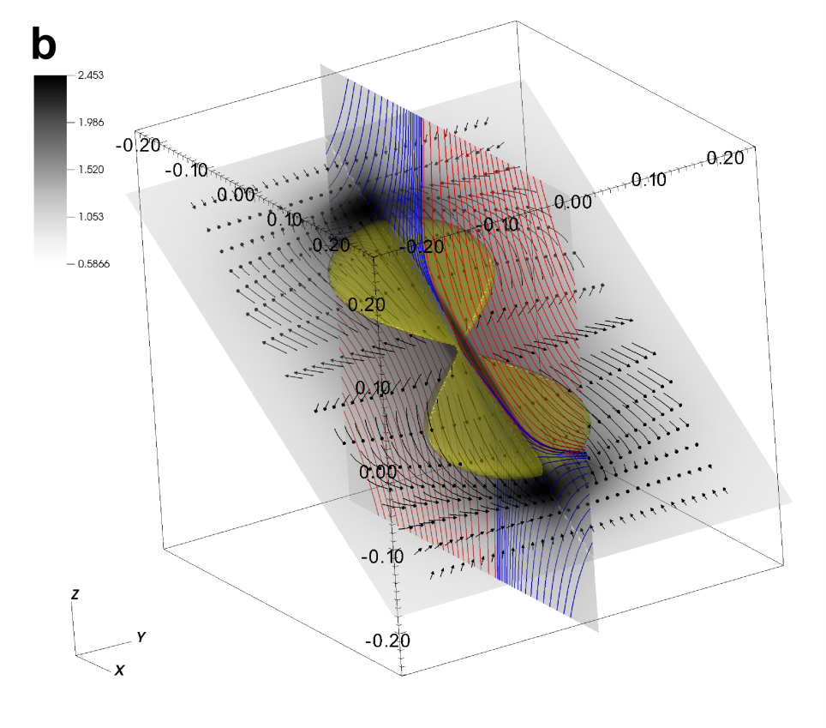
3) Oscillatory reconnection (Reconnection Reversal)
Thurgood, Pontin & McLaughlin (2017) ApJ, 844, 1
Three-dimensional oscillatory magnetic reconnection
Diminished Field Fronts Stall
Enhanced Field Fronts Accelerate

Slide 27
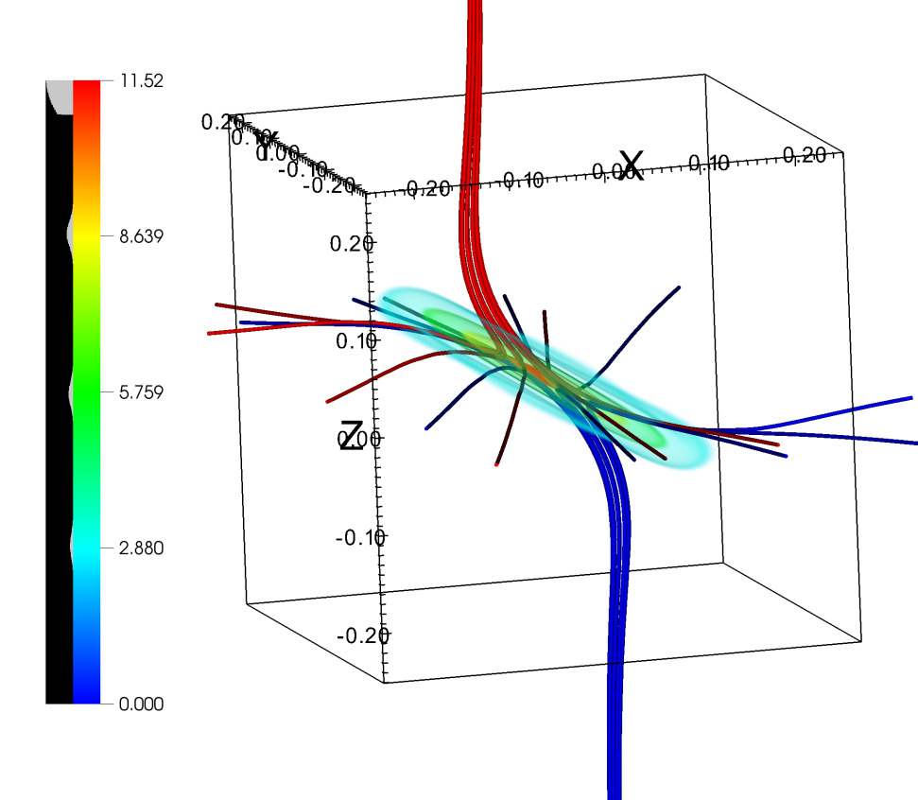
3) Oscillatory reconnection (Reconnection Reversal)
Thurgood, Pontin & McLaughlin (2017) ApJ, 844, 1
Three-dimensional oscillatory magnetic reconnection
Diminished Field Fronts Stall
Enhanced Field Fronts Accelerate

Slide 28
4) Thermal over-stability
In corona, there is a continuous competition between radiative losses & energy supply (heating)
Misbalance can lead to the appearance of oscillatory regime of thermal instability.
Decaying linear oscillation,
no radiative cooling, no heating
Undamped oscillation,
with radiative and dissipative losses compensated by heating
Over-damped oscillation
=> Saturation effect due to nonlinearity
Growing oscillation, due to heating
Notes:
Different regimes of the evolution of the fundamental acoustic oscillation of a coronal loop, determined by the misbalance of radiative cooling and plasma heating

Slide 29
4) Thermal over-stability
In corona, there is a continuous competition between radiative losses & energy supply (heating)
Misbalance can lead to the appearance of oscillatory regime of thermal instability.
Decaying linear oscillation,
no radiative cooling, no heating
Undamped oscillation,
with radiative and dissipative losses compensated by heating
Over-damped oscillation
=> Saturation effect due to nonlinearity
Growing oscillation, due to heating
Notes:
Different regimes of the evolution of the fundamental acoustic oscillation of a coronal loop, determined by the misbalance of radiative cooling and plasma heating

Slide 30
4) Thermal over-stability
In corona, there is a continuous competition between radiative losses & energy supply (heating)
Misbalance can lead to the appearance of oscillatory regime of thermal instability.
Decaying linear oscillation,
no radiative cooling, no heating
Undamped oscillation,
with radiative and dissipative losses compensated by heating
Over-damped oscillation
=> Saturation effect due to nonlinearity
Growing oscillation, due to heating
Notes:
Different regimes of the evolution of the fundamental acoustic oscillation of a coronal loop, determined by the misbalance of radiative cooling and plasma heating

Slide 31
4) Thermal over-stability
In corona, there is a continuous competition between radiative losses & energy supply (heating)
Misbalance can lead to the appearance of oscillatory regime of thermal instability.
Decaying linear oscillation,
no radiative cooling, no heating
Undamped oscillation,
with radiative and dissipative losses compensated by heating
Over-damped oscillation
=> Saturation effect due to nonlinearity
Growing oscillation, due to heating
Notes:
Different regimes of the evolution of the fundamental acoustic oscillation of a coronal loop, determined by the misbalance of radiative cooling and plasma heating

Slide 32
4) Thermal over-stability
In corona, there is a continuous competition between radiative losses & energy supply (heating)
Misbalance can lead to the appearance of oscillatory regime of thermal instability.
Decaying linear oscillation,
no radiative cooling, no heating
Undamped oscillation,
with radiative and dissipative losses compensated by heating
Over-damped oscillation
=> Saturation effect due to nonlinearity
Growing oscillation, due to heating
Notes:
Different regimes of the evolution of the fundamental acoustic oscillation of a coronal loop, determined by the misbalance of radiative cooling and plasma heating

Slide 33
5) MHD flow over-stability
Similar to 4) Thermal over-stability, the energy supply can come from plasma flow.
Ofman & Sui (2006) reconnection in a CS with a steady plasma flow.

Slide 34
5) MHD flow over-stability
Similar to 4) Thermal over-stability, the energy supply can come from plasma flow.
Ofman & Sui (2006) reconnection in a CS with a steady plasma flow.
For approx Alfvén speed flow, the configuration was unstable to Kelvin-Helmholtz instability and Tearing instability.
This gave rise to over-stable (i.e. oscillating) modes.

Slide 35
5) MHD flow over-stability
Similar to 4) Thermal over-stability, the energy supply can come from plasma flow.
Ofman & Sui (2006) reconnection in a CS with a steady plasma flow.
For approx Alfvén speed flow, the configuration was unstable to Kelvin-Helmholtz instability and Tearing instability.
This gave rise to over-stable (i.e. oscillating) modes.
Variation of integrated Ohmic heating rate.
Dotted = case without flow.
Dashed = case where flow = Alfvén speed.
Solid = where flow = 1.5*Alfvén speed.

Slide 36
5) MHD flow over-stability
Mechanism can produce QPPs of thermal emission via variations in plasma heating rate.
Over-stability produces plasmoids, so there is strong oscillating E. This can periodically accelerate non-thermal electrons (so also non-thermal emission).
Variation of integrated Ohmic heating rate.
Dotted = case without flow.
Dashed = case where flow = Alfvén speed.
Solid = where flow = 1.5*Alfvén speed.

Slide 37
6) Waves and plasmoids in a current sheet (dispersive wave trains)
Owing to their enhanced density, neutral CS (key ingredient) can guide several types of MHD waves. Exact nature of mode determines its dispersion, i.e. dependence of phase/group speed on wavenumber.

Slide 38
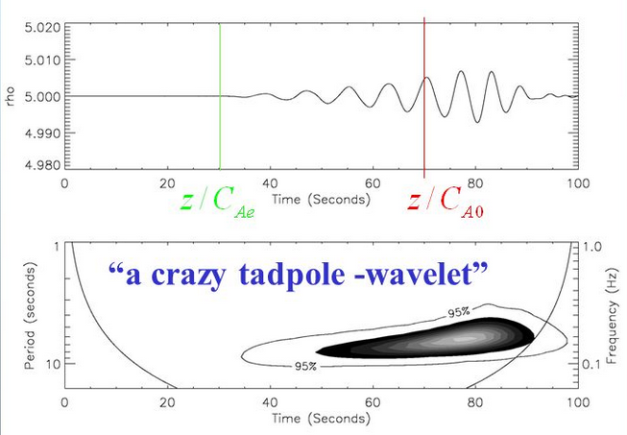
6) Waves and plasmoids in a current sheet (dispersive wave trains)
Owing to their enhanced density, neutral CS (key ingredient) can guide several types of MHD waves. Exact nature of mode determines its dispersion, i.e. dependence of phase/group speed on wavenumber.
MHD waves in CS can be excited by various processes, e.g. impulsive energy release in a flare. An initially-broadband perturbation evolves into a quasi-periodic signal. In turn, these oscillations, e.g. the quasi-periodic signals appearing because of the dispersion, can be the sources of QPPs.

Slide 39
6) Waves and plasmoids in a current sheet (dispersive wave trains)
Owing to their enhanced density, neutral CS (key ingredient) can guide several types of MHD waves. Exact nature of mode determines its dispersion, i.e. dependence of phase/group speed on wavenumber.
MHD waves in CS can be excited by various processes, e.g. impulsive energy release in a flare. An initially-broadband perturbation evolves into a quasi-periodic signal. In turn, these oscillations, e.g. the quasi-periodic signals appearing because of the dispersion, can be the sources of QPPs.

Slide 40
6) Waves and plasmoids in a current sheet (dispersive wave trains)
Owing to their enhanced density, neutral CS (key ingredient) can guide several types of MHD waves. Exact nature of mode determines its dispersion, i.e. dependence of phase/group speed on wavenumber.
MHD waves in CS can be excited by various processes, e.g. impulsive energy release in a flare. An initially-broadband perturbation evolves into a quasi-periodic signal. In turn, these oscillations, e.g. the quasi-periodic signals appearing because of the dispersion, can be the sources of QPPs.
The analysis of group speeds of the guided modes shows that the long wavelength spectral components propagate faster than the medium- and short wavelength ones (higher frequencies propagate slower). The signal can have pronounced amplitude modulation, since initially different spectral components have different energy.
Nakariakov et al. (2004) simulated the formation of a quasi-periodic wave train in fast MA waveguides. The dispersive evolution of fast wave trains leads to the appearance of characteristic “crazy” tadpole wavelet signatures.

Slide 41
6) Waves and plasmoids in a current sheet (dispersive wave trains)
Owing to their enhanced density, neutral CS (key ingredient) can guide several types of MHD waves. Exact nature of mode determines its dispersion, i.e. dependence of phase/group speed on wavenumber.
MHD waves in CS can be excited by various processes, e.g. impulsive energy release in a flare. An initially-broadband perturbation evolves into a quasi-periodic signal. In turn, these oscillations, e.g. the quasi-periodic signals appearing because of the dispersion, can be the sources of QPPs.
The analysis of group speeds of the guided modes shows that the long wavelength spectral components propagate faster than the medium- and short wavelength ones (higher frequencies propagate slower). The signal can have pronounced amplitude modulation, since initially different spectral components have different energy.
Nakariakov et al. (2004) simulated the formation of a quasi-periodic wave train in fast MA waveguides. The dispersive evolution of fast wave trains leads to the appearance of characteristic “crazy” tadpole wavelet signatures.

Slide 42
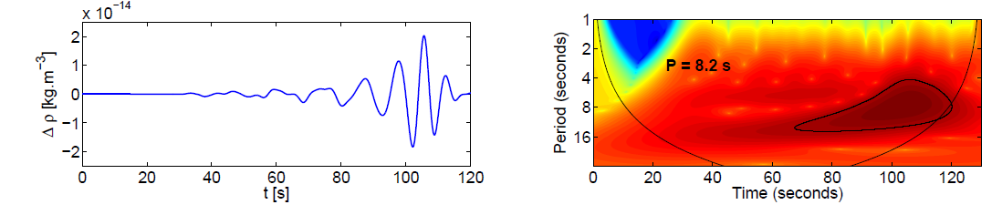

6) Waves and plasmoids in a current sheet (dispersive wave trains)
Jelínek & Karlický (2012) studied propagating fast sausage waves in a CS.
Period can be expressed as
(width of Harris CS, external Alfvén speed).
Assumes that fast MA wave train modulate the (radio or UV) fluxes, e.g. modulate the radio emission produced by non-thermal electrons trapped in a loop/CS.
impulsively excited propagating MHD perturbations develop into quasi-periodic wave trains

Slide 43
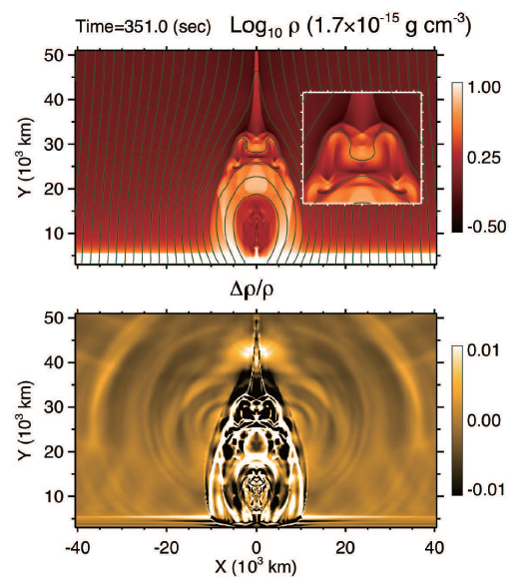
7) “Magnetic tuning fork” oscillation driven by reconnection outflow
Reconnection, the central engine of solar flares, can drive supersonic Alfvénic flows.
Such fast reconnection outflows can be an exciter of oscillations through collision with the ambient plasma.
However, the oscillation process will be highly nonlinear, because the supersonic reconnection outflows will form nonlinear waves and shocks (Takasao & Shibata 2016).

Slide 44
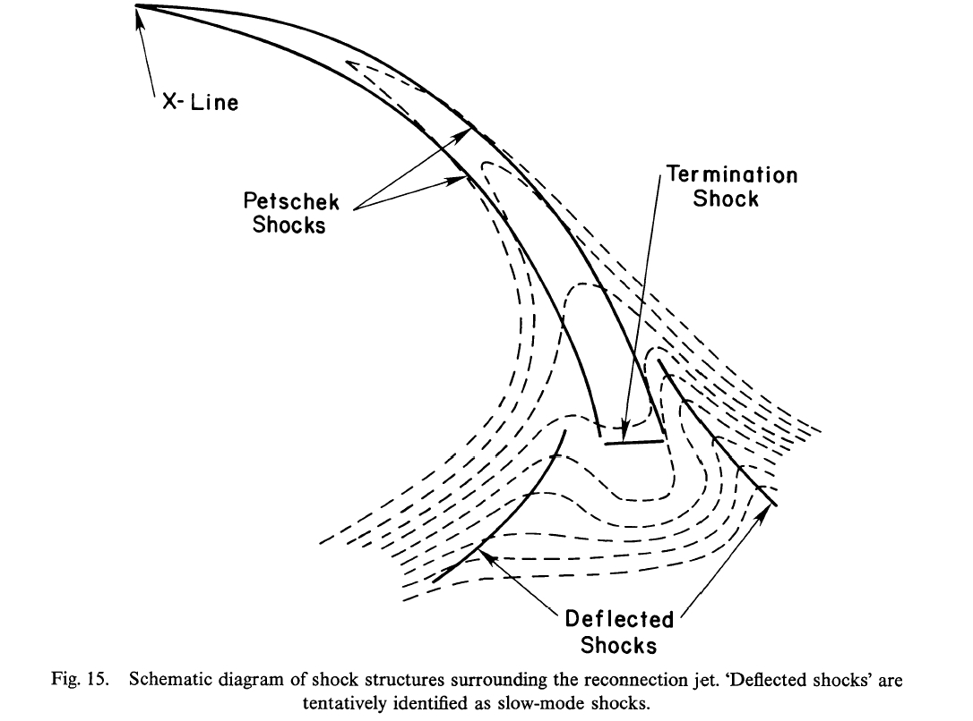
Forbes, T. (1988), Sol. Phys, 117, 97

Slide 45
7) “Magnetic tuning fork” oscillation driven by reconnection outflow

Slide 46
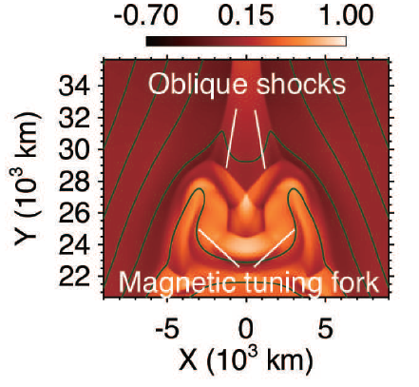
7) “Magnetic tuning fork” oscillation driven by reconnection outflow

Slide 47
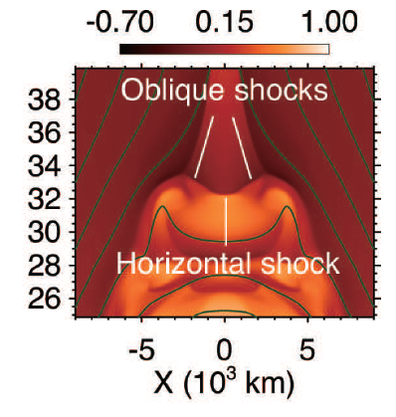
7) “Magnetic tuning fork” oscillation driven by reconnection outflow

Slide 48
7) “Magnetic tuning fork” oscillation driven by reconnection outflow

Slide 49
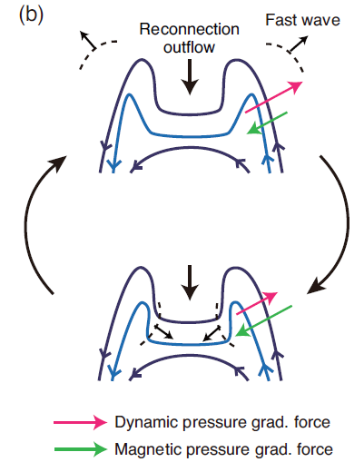
7) “Magnetic tuning fork” oscillation driven by reconnection outflow

Slide 50
7) “Magnetic tuning fork” oscillation driven by reconnection outflow
This movement periodically (40 sec) compresses the magnetic field around the two arms, generating outwardly-propagating fast-mode waves.
Analogous to generation of sound waves by an externally-driven tuning fork, hence “Magnetic tuning fork”.

Slide 51

7) “Magnetic tuning fork” oscillation driven by reconnection outflow
The mechanism generates quasi-periodic oscillations in termination shock strength.
It has been argued that termination shocks are promising sites for particle acceleration.
Thus, perhaps the quasi- periodic oscillations of the termination shock lead to QPPs in non-thermal emission (through the quasi-periodic variation of the efficiency of particle acceleration.
From Takasao & Shibata (2016):

Slide 52
8) Wave-driven reconnection in the Taylor problem
Magnetic reconnection can be broadly classified into two types:
  Free / spontaneous - caused by an intrinsic instability which taps into the magnetic free energy stored within the equilibrium topology,
  Forced - driven by perturbations (e.g. from a boundary) that induce a change in connectivity to an equilibrium or a sudden increase in the anomalous resistivity in the reconnection site.
An interesting forced, impulsive mechanism has been investigated with regards to the so-called ‘Taylor’ problem, which was proposed by J. B. Taylor in a private communication to Hahm and Kulsrud (1985) who then carried out the analysis themselves.

Slide 53
8) Wave-driven reconnection in the Taylor problem
Consider a slab plasma equilibrium that is suddenly subjected to imposed, small-amplitude boundary perturbations such as to drive magnetic reconnection at the centre of the slab.

Slide 54
8) Wave-driven reconnection in the Taylor problem
Consider a slab plasma equilibrium that is suddenly subjected to imposed, small-amplitude boundary perturbations such as to drive magnetic reconnection at the centre of the slab.
The two pulses then subsequently bounce back and forth several times.
The arrival time of the pulses at x = 0 correlates with the spikes in the reconnection rate.
Each time these wave-pulses cross x=0, they generate a transient surge in the reconnection rate.
The evolution of the current density is dominated by a series of spikes in the reconnection rate.

Slide 55
8) Wave-driven reconnection in the Taylor problem
Consider a slab plasma equilibrium that is suddenly subjected to imposed, small-amplitude boundary perturbations such as to drive magnetic reconnection at the centre of the slab.
The two pulses then subsequently bounce back and forth several times.
The arrival time of the pulses at x = 0 correlates with the spikes in the reconnection rate.
Each time these wave-pulses cross x=0, they generate a transient surge in the reconnection rate.
The evolution of the current density is dominated by a series of spikes in the reconnection rate.
Evolution of the magnetic reconnection rate, J(t).

Slide 56
8) Wave-driven reconnection in the Taylor problem
Consider a slab plasma equilibrium that is suddenly subjected to imposed, small-amplitude boundary perturbations such as to drive magnetic reconnection at the centre of the slab.
The authors conclude that the strong spikes in J(t), represent reconnection driven by fast MA waves which are excited by the sudden onset of the wall perturbation.
Physical mechanism as to why is not reported (we speculate that this is related to an increase in gradients of B and therefore ∇ × B as the wave passes through x=0.
Evolution of the magnetic reconnection rate, J(t).

Slide 57
8) Wave-driven reconnection in the Taylor problem
Consider a slab plasma equilibrium that is suddenly subjected to imposed, small-amplitude boundary perturbations such as to drive magnetic reconnection at the centre of the slab.
Period is governed by the fast MA speed and the distance between walls, i.e. the (reflection) travel time.
Periodicity is based on reflections between opposing solid boundaries. Applicability to solar/stellar atmospheres is unclear...
Gao et al. (2008) reported on a periodicity in the flaring rate of binary star YY Gem and proposed that reconnection is modulated by fast MA waves which are trapped between the surfaces of the two stars, so that the reconnection rate presents a periodic behaviour.

Slide 58
9) Two loop coalescence
It is understood that a CS with a high (> 10⁴) Lundquist number is subject to fragmentation (Shibata and Takasao 2016). This instability is called the plasmoid instability and leads to the formation of plasmoids (magnetically-confined plasma).
Plasmoids will contain electric current in the same direction as each other - therefore an attracting Lorentz force will operate between them (which will lead to coalescence of plasmoids - known as the coalescence instability).

Slide 59
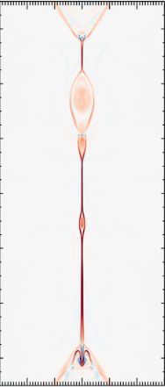
9) Two loop coalescence
It is understood that a CS with a high (> 10⁴) Lundquist number is subject to fragmentation (Shibata and Takasao 2016). This instability is called the plasmoid instability and leads to the formation of plasmoids (magnetically-confined plasma).
Plasmoids will contain electric current in the same direction as each other - therefore an attracting Lorentz force will operate between them (which will lead to coalescence of plasmoids - known as the coalescence instability).

Slide 60
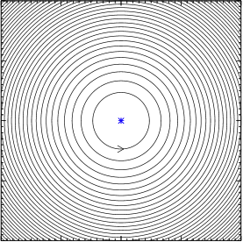
9) Two loop coalescence
It is understood that a CS with a high (> 10⁴) Lundquist number is subject to fragmentation (Shibata and Takasao 2016). This instability is called the plasmoid instability and leads to the formation of plasmoids (magnetically-confined plasma).
Plasmoids will contain electric current in the same direction as each other - therefore an attracting Lorentz force will operate between them (which will lead to coalescence of plasmoids - known as the coalescence instability).

Slide 61
9) Two loop coalescence
It is understood that a CS with a high (> 10⁴) Lundquist number is subject to fragmentation (Shibata and Takasao 2016). This instability is called the plasmoid instability and leads to the formation of plasmoids (magnetically-confined plasma).
Plasmoids will contain electric current in the same direction as each other - therefore an attracting Lorentz force will operate between them (which will lead to coalescence of plasmoids - known as the coalescence instability).

Slide 62
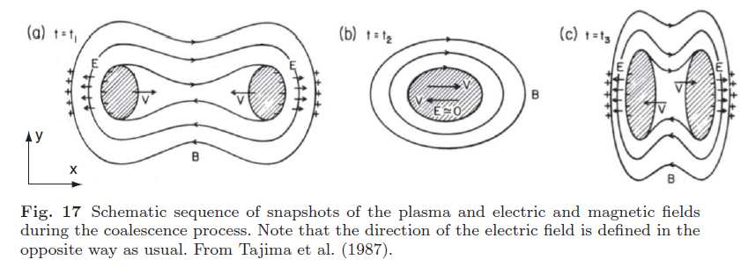
9) Two loop coalescence
When the coalescence starts, a strong acceleration of ions by the Lorentz force takes place.
At t = t₁, the acceleration reaches a maximum, leading to a strong compression at the far sides of the two plasma blobs. This compression causes the first temperature peak. In addition, the difference in inertia between ions and electrons results in charge separation at the compressed regions. The charge separation generates the electrostatic field E. The E × B force accelerates high-energy particles in the z-direction.
At time t = t₂ when two plasma blobs totally merge, the electric field (v × B) vanishes. The direction of the acceleration of electrons and ions along the z-direction is reversed at this moment.
At time t = t₃, the overshooting plasma blob motions result in the generation of the reverse electrostatic field. The temperature again reaches a maximum.

Slide 63
9) Two loop coalescence
When the coalescence starts, a strong acceleration of ions by the Lorentz force takes place.
At t = t₁, the acceleration reaches a maximum, leading to a strong compression at the far sides of the two plasma blobs. This compression causes the first temperature peak. In addition, the difference in inertia between ions and electrons results in charge separation at the compressed regions. The charge separation generates the electrostatic field E. The E × B force accelerates high-energy particles in the z-direction.
At time t = t₂ when two plasma blobs totally merge, the electric field (v × B) vanishes. The direction of the acceleration of electrons and ions along the z-direction is reversed at this moment.
At time t = t₃, the overshooting plasma blob motions result in the generation of the reverse electrostatic field. The temperature again reaches a maximum.

Slide 64
9) Two loop coalescence
When the coalescence starts, a strong acceleration of ions by the Lorentz force takes place.
At t = t₁, the acceleration reaches a maximum, leading to a strong compression at the far sides of the two plasma blobs. This compression causes the first temperature peak. In addition, the difference in inertia between ions and electrons results in charge separation at the compressed regions. The charge separation generates the electrostatic field E. The E × B force accelerates high-energy particles in the z-direction.
At time t = t₂ when two plasma blobs totally merge, the electric field (v × B) vanishes. The direction of the acceleration of electrons and ions along the z-direction is reversed at this moment.
At time t = t₃, the overshooting plasma blob motions result in the generation of the reverse electrostatic field. The temperature again reaches a maximum.

Slide 65
9) Two loop coalescence
When the coalescence starts, a strong acceleration of ions by the Lorentz force takes place.
At t = t₁, the acceleration reaches a maximum, leading to a strong compression at the far sides of the two plasma blobs. This compression causes the first temperature peak. In addition, the difference in inertia between ions and electrons results in charge separation at the compressed regions. The charge separation generates the electrostatic field E. The E × B force accelerates high-energy particles in the z-direction.
At time t = t₂ when two plasma blobs totally merge, the electric field (v × B) vanishes. The direction of the acceleration of electrons and ions along the z-direction is reversed at this moment.
At time t = t₃, the overshooting plasma blob motions result in the generation of the reverse electrostatic field. The temperature again reaches a maximum.

Slide 66
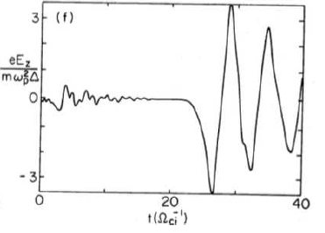
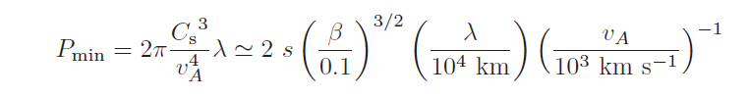
9) Two loop coalescence
Nonlinear simulations revealed that coalescing plasmoids show quasi-periodic oscillations in Electric field and other particle quantities.
Since particle acceleration is expected during the coalescence, QPPs seen in emissions originated from non-thermal, high-energy particles could be caused by the oscillations associated with the coalescence instability.

Slide 67
10) Equivalent LCR contour
Equivalent LCR (Inductance-Capacitance-Resistance) contour was proposed by Zaitsev et al. (1998). Model is based on the difference in the values of electrical conductivity in the coronal & chromospheric parts of the flaring region.
  In corona, parallel electrical conductivity is much higher than across the field, and J should go along B.
  In partly-ionised photospheric plasma, J could go across B.
Hence there appears a closed electrical circuit formed in a coronal loop by a field-aligned current, which goes from one footpoint to the other, and the cross-field current between the footpoints in the photosphere.

Slide 68
10) Equivalent LCR contour
Equivalent LCR (Inductance-Capacitance-Resistance) contour was proposed by Zaitsev et al. (1998). Model is based on the difference in the values of electrical conductivity in the coronal & chromospheric parts of the flaring region.
  In corona, parallel electrical conductivity is much higher than across the field, and J should go along B.
  In partly-ionised photospheric plasma, J could go across B.
Hence there appears a closed electrical circuit formed in a coronal loop by a field-aligned current, which goes from one footpoint to the other, and the cross-field current between the footpoints in the photosphere.

Slide 69
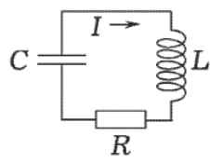
10) Equivalent LCR contour
Equivalent LCR (Inductance-Capacitance-Resistance) contour was proposed by Zaitsev et al. (1998). Model is based on the difference in the values of electrical conductivity in the coronal & chromospheric parts of the flaring region.
  In corona, parallel electrical conductivity is much higher than across the field, and J should go along B.
  In partly-ionised photospheric plasma, J could go across B.
Hence there appears a closed electrical circuit formed in a coronal loop by a field-aligned current, which goes from one footpoint to the other, and the cross-field current between the footpoints in the photosphere.

Slide 70
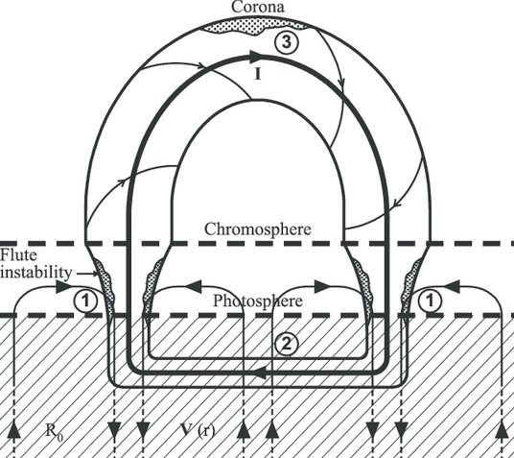
10) Equivalent LCR contour
Equivalent LCR (Inductance-Capacitance-Resistance) contour was proposed by Zaitsev et al. (1998). Model is based on the difference in the values of electrical conductivity in the coronal & chromospheric parts of the flaring region.
  In corona, parallel electrical conductivity is much higher than across the field, and J should go along B.
  In partly-ionised photospheric plasma, J could go across B.
Hence there appears a closed electrical circuit formed in a coronal loop by a field-aligned current, which goes from one footpoint to the other, and the cross-field current between the footpoints in the photosphere.

Slide 71

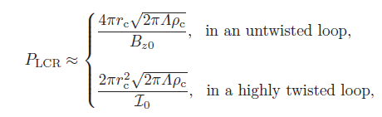

10) Equivalent LCR contour
Dynamics described by:
Can produce an alternating electric current with:
LCR oscillations can produce QPPs of both thermal and non-thermal emission:
  E.g. Microwave emission intensity (non-thermal) produced by the gyrosynchrotron mechanism is periodically modulated by alternating current
  e.g. Electric field may result in periodic acceleration of charged particles.

Slide 72
10) Equivalent LCR contour
Mechanism may also easily explain drifts of the QPP periods, that are often observed in flares. E.g. Dennis et al. (2017) detected high-quality oscillations of the time derivative of the soft X-ray emission of the decay phase of a flare, with the period increasing gradually from 25 s to 100 s.
If the detected QPPs are produced by the alternating current, a gradual decrease in the equilibrium current , caused by, e.g. Ohmic dissipation, would lead to the increase in the period.
Approach ignores the fact that changes in B and related electric current propagate at the Alfvén speed, assuming the instant changes of the electric current in the whole circuit. Therefore, this model describes adequately the oscillations and evolution with time scales longer than Alfvén travel time along the loop.

Slide 73


10) Equivalent LCR contour
Mechanism may also easily explain drifts of the QPP periods, that are often observed in flares. E.g. Dennis et al. (2017) detected high-quality oscillations of the time derivative of the soft X-ray emission of the decay phase of a flare, with the period increasing gradually from 25 s to 100 s.
If the detected QPPs are produced by the alternating current, a gradual decrease in the equilibrium current , caused by, e.g. Ohmic dissipation, would lead to the increase in the period.
Approach ignores the fact that changes in B and related electric current propagate at the Alfvén speed, assuming the instant changes of the electric current in the whole circuit. Therefore, this model describes adequately the oscillations and evolution with time scales longer than Alfvén travel time along the loop.

Slide 74
10) Equivalent LCR contour
Mechanism may also easily explain drifts of the QPP periods, that are often observed in flares. E.g. Dennis et al. (2017) detected high-quality oscillations of the time derivative of the soft X-ray emission of the decay phase of a flare, with the period increasing gradually from 25 s to 100 s.
If the detected QPPs are produced by the alternating current, a gradual decrease in the equilibrium current , caused by, e.g. Ohmic dissipation, would lead to the increase in the period.
Approach ignores the fact that changes in B and related electric current propagate at the Alfvén speed, assuming the instant changes of the electric current in the whole circuit. Therefore, this model describes adequately the oscillations and evolution with time scales longer than Alfvén travel time along the loop.

Slide 75

11) Autowave processes in flares
Autowaves can appear in active media, when the passage of the wave causes an energy release that reinforces the wave. E.g. A wave of flame (is an autowave). Perhaps “wave”of sympathetic flares: energy release in first flare ignites next, etc., i.e. “domino effect”.
The speed, amplitude and other parameters are determined by the properties of the medium.
The progression of the quasi-periodic energy release site along neutral line in a two-ribbon flare (hard X-ray and EUV brightenings) could also be produced by an autowave:
The medium could be considered as active if certain perturbations provoke the medium
to release energy

Slide 76
11) Autowave processes in flares
Autowaves can appear in active media, when the passage of the wave causes an energy release that reinforces the wave. E.g. A wave of flame (is an autowave). Perhaps “wave”of sympathetic flares: energy release in first flare ignites next, etc., i.e. “domino effect”.
The speed, amplitude and other parameters are determined by the properties of the medium.
The progression of the quasi-periodic energy release site along neutral line in a two-ribbon flare (hard X-ray and EUV brightenings) could also be produced by an autowave:
The medium could be considered as active if certain perturbations provoke the medium
to release energy

Slide 77
11) Autowave processes in flares
Autowaves can appear in active media, when the passage of the wave causes an energy release that reinforces the wave. E.g. A wave of flame (is an autowave). Perhaps “wave”of sympathetic flares: energy release in first flare ignites next, etc., i.e. “domino effect”.
The speed, amplitude and other parameters are determined by the properties of the medium.
The progression of the quasi-periodic energy release site along neutral line in a two-ribbon flare (hard X-ray and EUV brightenings) could also be produced by an autowave:
The medium could be considered as active if certain perturbations provoke the medium
to release energy

Slide 78
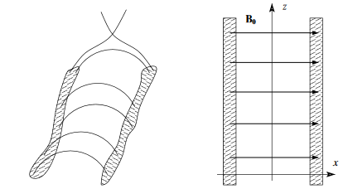
11) Autowave processes in flares
Primary energy release occurring somewhere above the neutral line, in the flaring arcade, excites a slow MA pulse that propagates downward.
Pulse gets reflected from chromosphere and returns back to the top of the flaring arcade, slightly offset from location of the primary energy release along the neutral line.
There wave triggers another energy release (QPPs triggered by external waves). Energy release excites another slow wave, causing the next cycle of this autowave mechanism.
Nakariakov & Zimovets (2011).
Magnetic arcade of a two-ribbon flare
Along the field, pulse propagates at a speed close to c_{s}
Across the field, group speed is 10–20% of c_{s}
(consistent with observed speed of brightening progression along neutral line).
Period determined by the acoustic travel time from the footpoints to the arcade top, e.g. 30–80 s for typical solar flares.

Slide 79
11) Autowave processes in flares
Primary energy release occurring somewhere above the neutral line, in the flaring arcade, excites a slow MA pulse that propagates downward.
Pulse gets reflected from chromosphere and returns back to the top of the flaring arcade, slightly offset from location of the primary energy release along the neutral line.
There wave triggers another energy release (QPPs triggered by external waves). Energy release excites another slow wave, causing the next cycle of this autowave mechanism.
Nakariakov & Zimovets (2011).
Magnetic arcade of a two-ribbon flare

Slide 80
11) Autowave processes in flares
Primary energy release occurring somewhere above the neutral line, in the flaring arcade, excites a slow MA pulse that propagates downward.
Pulse gets reflected from chromosphere and returns back to the top of the flaring arcade, slightly offset from location of the primary energy release along the neutral line.
There wave triggers another energy release (QPPs triggered by external waves). Energy release excites another slow wave, causing the next cycle of this autowave mechanism.
Nakariakov & Zimovets (2011).
Magnetic arcade of a two-ribbon flare

Slide 81
11) Autowave processes in flares
Primary energy release occurring somewhere above the neutral line, in the flaring arcade, excites a slow MA pulse that propagates downward.
Pulse gets reflected from chromosphere and returns back to the top of the flaring arcade, slightly offset from location of the primary energy release along the neutral line.
There wave triggers another energy release (QPPs triggered by external waves). Energy release excites another slow wave, causing the next cycle of this autowave mechanism.
Nakariakov & Zimovets (2011).
Magnetic arcade of a two-ribbon flare
Along the field, pulse propagates at a speed close to c_{s}
Across the field, group speed is 10–20% of c_{s}
(consistent with observed speed of brightening progression along neutral line).
Period determined by the acoustic travel time from the footpoints to the arcade top, e.g. 30–80 s for typical solar flares.

Slide 82
Summary
We have reviewed eleven potential physical mechanisms underpinning QPP generation.
These can be classed according to the nature of the underlying physical process:
Oscillatory processes of the emitting plasma:
Self-oscillatory processes, including the “load-unload” model:
We also considered autowave processes in flares. Properties of autowaves are independent or weakly-dependent on the initial excitation, and so they are determined only by the parameters of the system.

Slide 83
Summary
We have reviewed eleven potential physical mechanisms underpinning QPP generation.
These can be classed according to the nature of the underlying physical process:
Oscillatory processes of the emitting plasma:
MHD oscillations | QPPs triggered periodically by external waves | Dispersive wave trains | magnetic tuning fork | equivalent LCR contour
Self-oscillatory processes, including the “load-unload” model:
We also considered autowave processes in flares. Properties of autowaves are independent or weakly-dependent on the initial excitation, and so they are determined only by the parameters of the system.

Slide 84
Summary
We have reviewed eleven potential physical mechanisms underpinning QPP generation.
These can be classed according to the nature of the underlying physical process:
Oscillatory processes of the emitting plasma:
MHD oscillations | QPPs triggered periodically by external waves | Dispersive wave trains | magnetic tuning fork | equivalent LCR contour
Oscillations are (quasi-)periodic motions around an equilibrium, connected with the competition between inertia and an effective restoring force.
Properties of oscillations (spectrum, amplitudes, phases, etc) are prescribed by the initial perturbation.
Self-oscillatory processes, including the “load-unload” model:
We also considered autowave processes in flares. Properties of autowaves are independent or weakly-dependent on the initial excitation, and so they are determined only by the parameters of the system.

Slide 85
Summary
We have reviewed eleven potential physical mechanisms underpinning QPP generation.
These can be classed according to the nature of the underlying physical process:
Oscillatory processes of the emitting plasma:
MHD oscillations | QPPs triggered periodically by external waves | Dispersive wave trains | magnetic tuning fork | equivalent LCR contour
Oscillations are (quasi-)periodic motions around an equilibrium, connected with the competition between inertia and an effective restoring force.
Properties of oscillations (spectrum, amplitudes, phases, etc) are prescribed by the initial perturbation.
advantage of the MHD oscillation explanation is the observation of multiple periodicities
Self-oscillatory processes, including the “load-unload” model:
We also considered autowave processes in flares. Properties of autowaves are independent or weakly-dependent on the initial excitation, and so they are determined only by the parameters of the system.

Slide 86
Summary
We have reviewed eleven potential physical mechanisms underpinning QPP generation.
These can be classed according to the nature of the underlying physical process:
Oscillatory processes of the emitting plasma:
MHD oscillations | QPPs triggered periodically by external waves | Dispersive wave trains | magnetic tuning fork | equivalent LCR contour
Oscillations are (quasi-)periodic motions around an equilibrium, connected with the competition between inertia and an effective restoring force.
Properties of oscillations (spectrum, amplitudes, phases, etc) are prescribed by the initial perturbation.
advantage of the MHD oscillation explanation is the observation of multiple periodicities
Self-oscillatory processes, including the “load-unload” model:
periodic or repetitive spontaneous reconnection / oscillatory reconnection | thermal over-stabilities | wave-flow over-stabilities | wave-driven reconnection in Taylor problem | coalescence of two magnetic flux tubes
We also considered autowave processes in flares. Properties of autowaves are independent or weakly-dependent on the initial excitation, and so they are determined only by the parameters of the system.

Slide 87
Summary
We have reviewed eleven potential physical mechanisms underpinning QPP generation.
These can be classed according to the nature of the underlying physical process:
Oscillatory processes of the emitting plasma:
MHD oscillations | QPPs triggered periodically by external waves | Dispersive wave trains | magnetic tuning fork | equivalent LCR contour
Oscillations are (quasi-)periodic motions around an equilibrium, connected with the competition between inertia and an effective restoring force.
Properties of oscillations (spectrum, amplitudes, phases, etc) are prescribed by the initial perturbation.
advantage of the MHD oscillation explanation is the observation of multiple periodicities
Self-oscillatory processes, including the “load-unload” model:
periodic or repetitive spontaneous reconnection / oscillatory reconnection | thermal over-stabilities | wave-flow over-stabilities | wave-driven reconnection in Taylor problem | coalescence of two magnetic flux tubes
Usually self-oscillations have properties that are independent of the initial excitation and occur in essentially non-conservative systems. The self-oscillation period may depend upon the amplitude. The energy supply for self-oscillations comes from an essentially non-periodic source.
We also considered autowave processes in flares. Properties of autowaves are independent or weakly-dependent on the initial excitation, and so they are determined only by the parameters of the system.

Slide 88
Summary
We have reviewed eleven potential physical mechanisms underpinning QPP generation.
These can be classed according to the nature of the underlying physical process:
Oscillatory processes of the emitting plasma:
MHD oscillations | QPPs triggered periodically by external waves | Dispersive wave trains | magnetic tuning fork | equivalent LCR contour
Oscillations are (quasi-)periodic motions around an equilibrium, connected with the competition between inertia and an effective restoring force.
Properties of oscillations (spectrum, amplitudes, phases, etc) are prescribed by the initial perturbation.
advantage of the MHD oscillation explanation is the observation of multiple periodicities
Self-oscillatory processes, including the “load-unload” model:
periodic or repetitive spontaneous reconnection / oscillatory reconnection | thermal over-stabilities | wave-flow over-stabilities | wave-driven reconnection in Taylor problem | coalescence of two magnetic flux tubes
Usually self-oscillations have properties that are independent of the initial excitation and occur in essentially non-conservative systems. The self-oscillation period may depend upon the amplitude. The energy supply for self-oscillations comes from an essentially non-periodic source.
The advantage of time-dependent reconnection model is natural explanation of simultaneity of QPPs in different bands, as they are produced by the same cause: the time-varying rate of the electron acceleration.
We also considered autowave processes in flares. Properties of autowaves are independent or weakly-dependent on the initial excitation, and so they are determined only by the parameters of the system.

Slide 89
Key unanswered questions:
When reviewing the QPP physical mechanisms, we have emphasised (where possible):
[i] What range of periods can the mechanism generate?
[ii] What underlying physics determines these periodicities?
[iii] How much can this mechanism be proven/identified in observations?
There is currently no physical mechanism that can unambiguously explain all QPPs.
Conclusive proof will require identification of multiple characteristics in a single observed event with a favourable magnetic configuration.
Is there any statistical relationship between QPP parameters (periods, decay times, relative and absolute amplitudes, modulations, etc) with the parameters of the host flare?
Observed QPP periods coincide by the order of magnitude with MHD waves detected abundantly in the solar corona (and well resolved in time and space). These MHD oscillations/waves typically have a few percent relative amplitude. In contrast, QPPs can reach a modulation depth of up to 100%. If QPP are caused by MHD oscillations, how can the oscillatory signal be amplified?
Are QPPs detected in different phases of the flare fundamentally different?
Are QPPs detected in thermal and non-thermal emission different?
Can we distinguish between different classes of QPPs (if indeed there are different classes)?
Are QPPs detected in stellar superflares, that are much more powerful than the strongest detected solar flares, produced by the same mechanisms as in solar flares?

Slide 90
Key unanswered questions:
When reviewing the QPP physical mechanisms, we have emphasised (where possible):
[i] What range of periods can the mechanism generate?
[ii] What underlying physics determines these periodicities?
[iii] How much can this mechanism be proven/identified in observations?
There is currently no physical mechanism that can unambiguously explain all QPPs.
Conclusive proof will require identification of multiple characteristics in a single observed event with a favourable magnetic configuration.
Is there any statistical relationship between QPP parameters (periods, decay times, relative and absolute amplitudes, modulations, etc) with the parameters of the host flare?
Observed QPP periods coincide by the order of magnitude with MHD waves detected abundantly in the solar corona (and well resolved in time and space). These MHD oscillations/waves typically have a few percent relative amplitude. In contrast, QPPs can reach a modulation depth of up to 100%. If QPP are caused by MHD oscillations, how can the oscillatory signal be amplified?
Are QPPs detected in different phases of the flare fundamentally different?
Are QPPs detected in thermal and non-thermal emission different?
Can we distinguish between different classes of QPPs (if indeed there are different classes)?
Are QPPs detected in stellar superflares, that are much more powerful than the strongest detected solar flares, produced by the same mechanisms as in solar flares?

Slide 91
Key unanswered questions:
When reviewing the QPP physical mechanisms, we have emphasised (where possible):
[i] What range of periods can the mechanism generate?
[ii] What underlying physics determines these periodicities?
[iii] How much can this mechanism be proven/identified in observations?
There is currently no physical mechanism that can unambiguously explain all QPPs.
Conclusive proof will require identification of multiple characteristics in a single observed event with a favourable magnetic configuration.
Is there any statistical relationship between QPP parameters (periods, decay times, relative and absolute amplitudes, modulations, etc) with the parameters of the host flare?
Observed QPP periods coincide by the order of magnitude with MHD waves detected abundantly in the solar corona (and well resolved in time and space). These MHD oscillations/waves typically have a few percent relative amplitude. In contrast, QPPs can reach a modulation depth of up to 100%. If QPP are caused by MHD oscillations, how can the oscillatory signal be amplified?
Are QPPs detected in different phases of the flare fundamentally different?
Are QPPs detected in thermal and non-thermal emission different?
Can we distinguish between different classes of QPPs (if indeed there are different classes)?
Are QPPs detected in stellar superflares, that are much more powerful than the strongest detected solar flares, produced by the same mechanisms as in solar flares?

Slide 92
Key unanswered questions:
When reviewing the QPP physical mechanisms, we have emphasised (where possible):
[i] What range of periods can the mechanism generate?
[ii] What underlying physics determines these periodicities?
[iii] How much can this mechanism be proven/identified in observations?
There is currently no physical mechanism that can unambiguously explain all QPPs.
Conclusive proof will require identification of multiple characteristics in a single observed event with a favourable magnetic configuration.
Is there any statistical relationship between QPP parameters (periods, decay times, relative and absolute amplitudes, modulations, etc) with the parameters of the host flare?
Observed QPP periods coincide by the order of magnitude with MHD waves detected abundantly in the solar corona (and well resolved in time and space). These MHD oscillations/waves typically have a few percent relative amplitude. In contrast, QPPs can reach a modulation depth of up to 100%. If QPP are caused by MHD oscillations, how can the oscillatory signal be amplified?
Are QPPs detected in different phases of the flare fundamentally different?
Are QPPs detected in thermal and non-thermal emission different?
Can we distinguish between different classes of QPPs (if indeed there are different classes)?
Are QPPs detected in stellar superflares, that are much more powerful than the strongest detected solar flares, produced by the same mechanisms as in solar flares?

Slide 93
Key unanswered questions:
When reviewing the QPP physical mechanisms, we have emphasised (where possible):
[i] What range of periods can the mechanism generate?
[ii] What underlying physics determines these periodicities?
[iii] How much can this mechanism be proven/identified in observations?
There is currently no physical mechanism that can unambiguously explain all QPPs.
Conclusive proof will require identification of multiple characteristics in a single observed event with a favourable magnetic configuration.
Is there any statistical relationship between QPP parameters (periods, decay times, relative and absolute amplitudes, modulations, etc) with the parameters of the host flare?
Observed QPP periods coincide by the order of magnitude with MHD waves detected abundantly in the solar corona (and well resolved in time and space). These MHD oscillations/waves typically have a few percent relative amplitude. In contrast, QPPs can reach a modulation depth of up to 100%. If QPP are caused by MHD oscillations, how can the oscillatory signal be amplified?
Are QPPs detected in different phases of the flare fundamentally different?
Are QPPs detected in thermal and non-thermal emission different?
Can we distinguish between different classes of QPPs (if indeed there are different classes)?
Are QPPs detected in stellar superflares, that are much more powerful than the strongest detected solar flares, produced by the same mechanisms as in solar flares?

Slide 94
Key unanswered questions:
When reviewing the QPP physical mechanisms, we have emphasised (where possible):
[i] What range of periods can the mechanism generate?
[ii] What underlying physics determines these periodicities?
[iii] How much can this mechanism be proven/identified in observations?
There is currently no physical mechanism that can unambiguously explain all QPPs.
Conclusive proof will require identification of multiple characteristics in a single observed event with a favourable magnetic configuration.
Is there any statistical relationship between QPP parameters (periods, decay times, relative and absolute amplitudes, modulations, etc) with the parameters of the host flare?
Observed QPP periods coincide by the order of magnitude with MHD waves detected abundantly in the solar corona (and well resolved in time and space). These MHD oscillations/waves typically have a few percent relative amplitude. In contrast, QPPs can reach a modulation depth of up to 100%. If QPP are caused by MHD oscillations, how can the oscillatory signal be amplified?
Are QPPs detected in different phases of the flare fundamentally different?
Are QPPs detected in thermal and non-thermal emission different?
Can we distinguish between different classes of QPPs (if indeed there are different classes)?
Are QPPs detected in stellar superflares, that are much more powerful than the strongest detected solar flares, produced by the same mechanisms as in solar flares?

Slide 95
Key unanswered questions:
When reviewing the QPP physical mechanisms, we have emphasised (where possible):
[i] What range of periods can the mechanism generate?
[ii] What underlying physics determines these periodicities?
[iii] How much can this mechanism be proven/identified in observations?
There is currently no physical mechanism that can unambiguously explain all QPPs.
Conclusive proof will require identification of multiple characteristics in a single observed event with a favourable magnetic configuration.
Is there any statistical relationship between QPP parameters (periods, decay times, relative and absolute amplitudes, modulations, etc) with the parameters of the host flare?
Observed QPP periods coincide by the order of magnitude with MHD waves detected abundantly in the solar corona (and well resolved in time and space). These MHD oscillations/waves typically have a few percent relative amplitude. In contrast, QPPs can reach a modulation depth of up to 100%. If QPP are caused by MHD oscillations, how can the oscillatory signal be amplified?
Are QPPs detected in different phases of the flare fundamentally different?
Are QPPs detected in thermal and non-thermal emission different?
Can we distinguish between different classes of QPPs (if indeed there are different classes)?
Are QPPs detected in stellar superflares, that are much more powerful than the strongest detected solar flares, produced by the same mechanisms as in solar flares?

