Slide 1
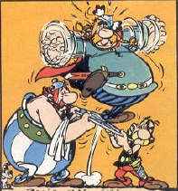
Rossby (Vorticity) Wave Instability
Eyal Heifetz,
Tel-Aviv University

Slide 2
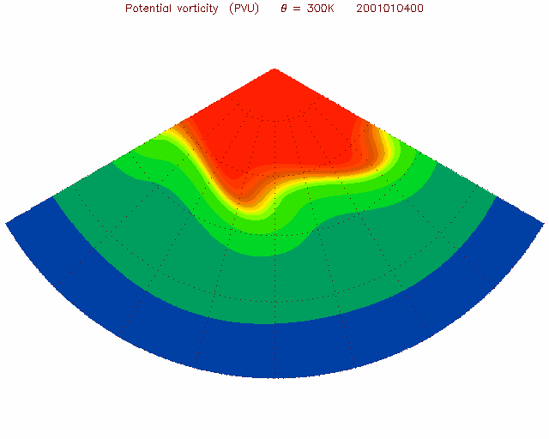
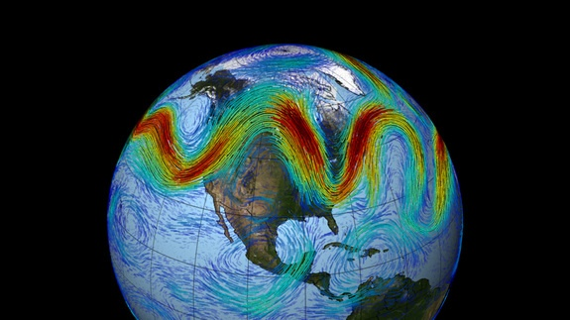
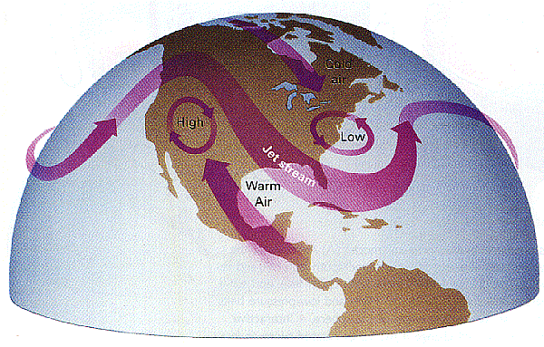
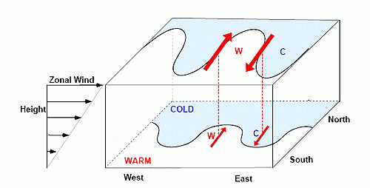
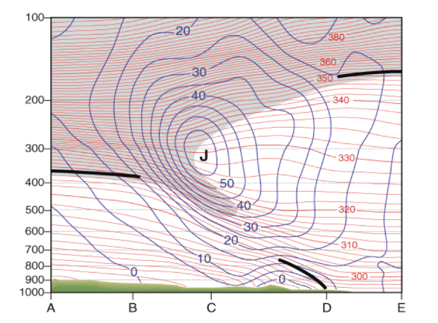
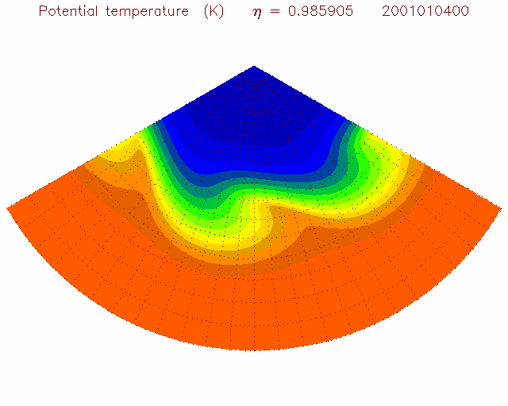
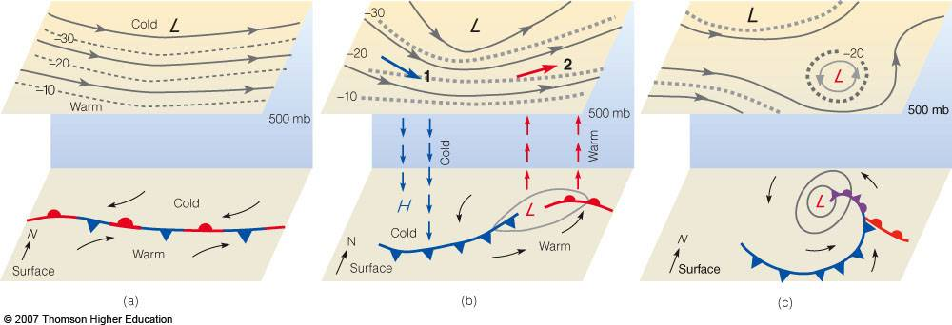
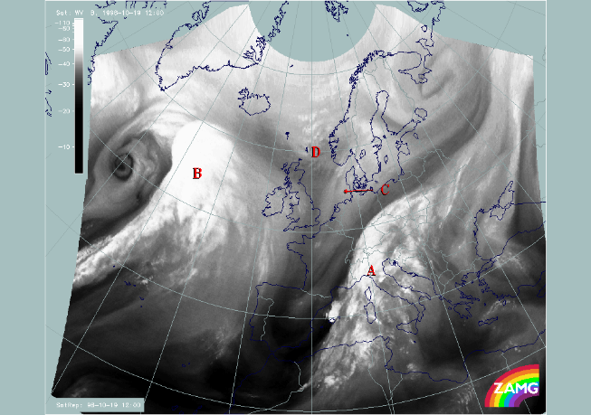
GFD: Baroclinic Instability
Rossby waves
Upper (PV)
Surface (temp)

Slide 3


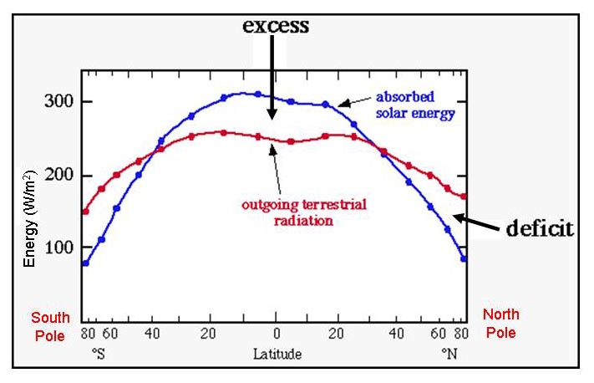
The basic problem of
atmospheric circulation
Differential heating
cold
warm
Observations indicate:
a poleward heat transfer
So how does heat get
transferred poleward?

Slide 4
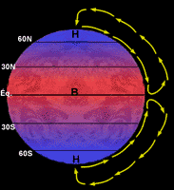
The Hadley cell (1735)

Slide 5
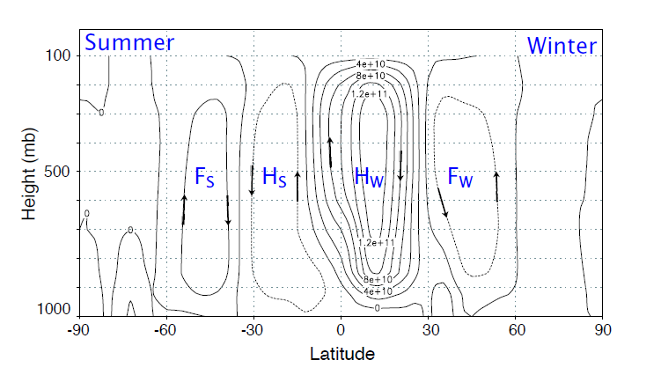
Hadley was only partly right
(for the tropics)

Slide 6
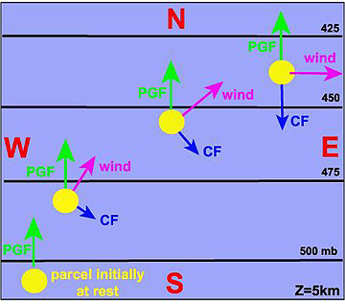
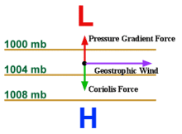
Geostrophic balance
L
H
L

Slide 7
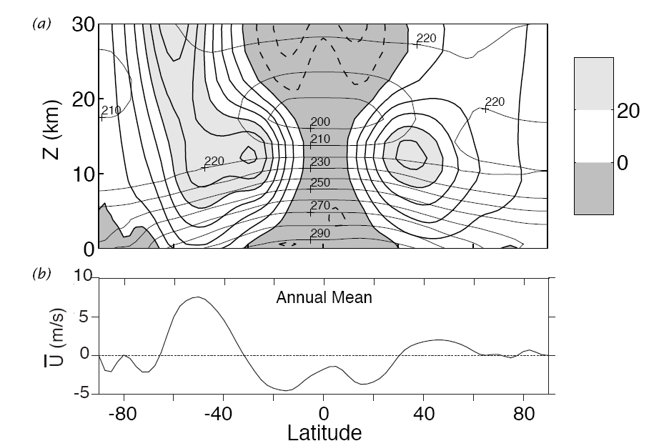
Annual zonal mean :
S
N

Slide 9
θ
strat
p
trop
trop

Slide 10
Baroclinic Instability:
The jet stream is unstable to small meanders.
The resulting eddies grow and mix heat between
pole and equator while
Shaping our weather
~5km height (PV)
Surface (temp)

Slide 11
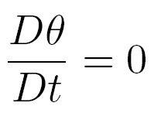
Potential temperature

Slide 12
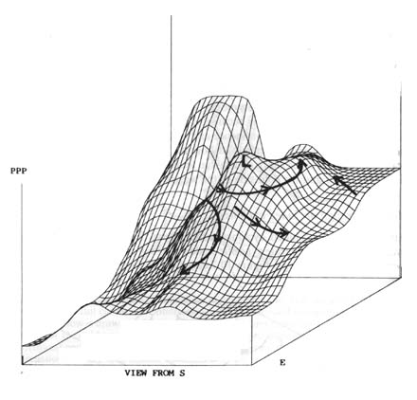
Isentropic surface
= const
PV

Slide 13
Isentropic surface
= const
PV

Slide 14
Isentropic surface
= const
PV

Slide 15
Γ
s
Z
Γ
T
T
d
Γ
T
-2
s
s
Τ
T
ϑ
10-
22-
7
60
48
12-
16-
6
48
44
14-
10-
5
36
40
8-
4-
4
32
36
2-
2
3
28
32
4
8
2
24
28
10
14
1
20
24
16
20
km
16
20

Slide 16
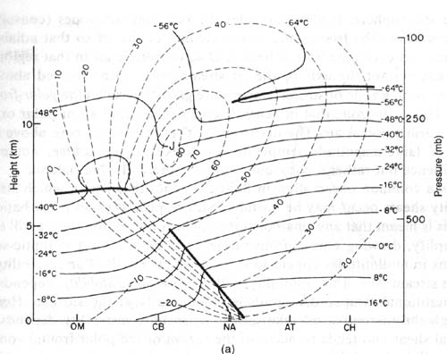
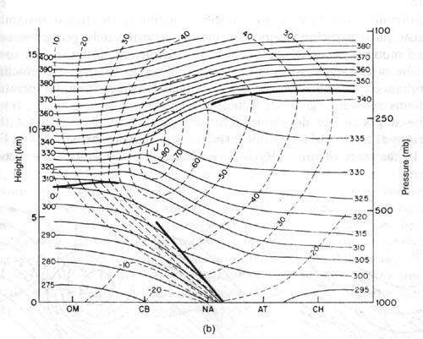
Jet maxima and tropopause slope
Τ
ϑ

Slide 17
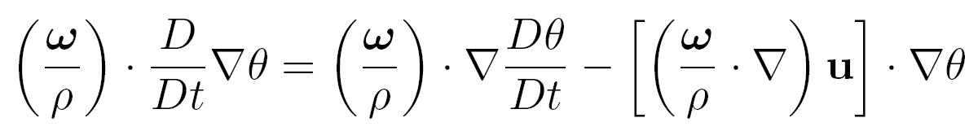
Ertel PV (1942)
0
+
0
Vorticity is
a vector
PV is
a scalar

Slide 18
PV – physical meaning

Slide 19

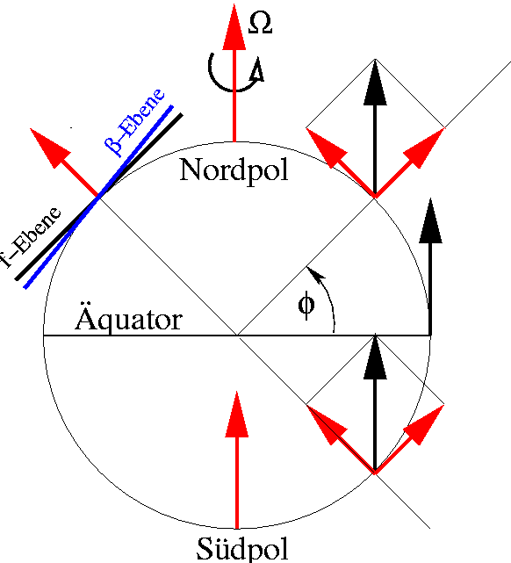
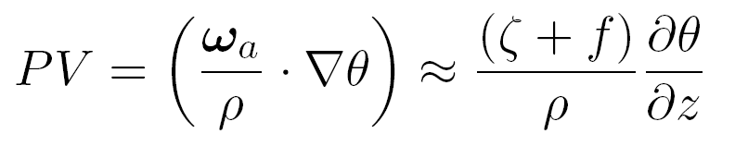
In a rotating frame like the Earth :
pole
equator

Slide 20
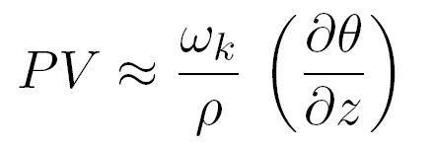
Since in the synoptic scale the main circulation
is Horizontal (the vorticity is vertical)
The stratification :
IPV – Isentropic Potential Vorticity
ϑ_{o}+Δϑ
ϑ_{o}+Δϑ
(stable)
<=
ΔZ
(less stable)
ΔZ
ϑ_{o}
ϑ_{o}

Slide 21
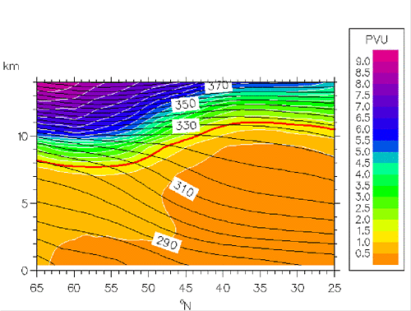
Zonal mean PV
high f, high static stab.
low f, low static stab.

Slide 22
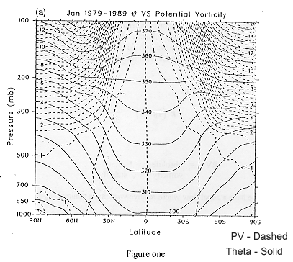

Thermal Rossby waves
upper
world
upper
world
middle world
Eady
lower
world

Slide 23
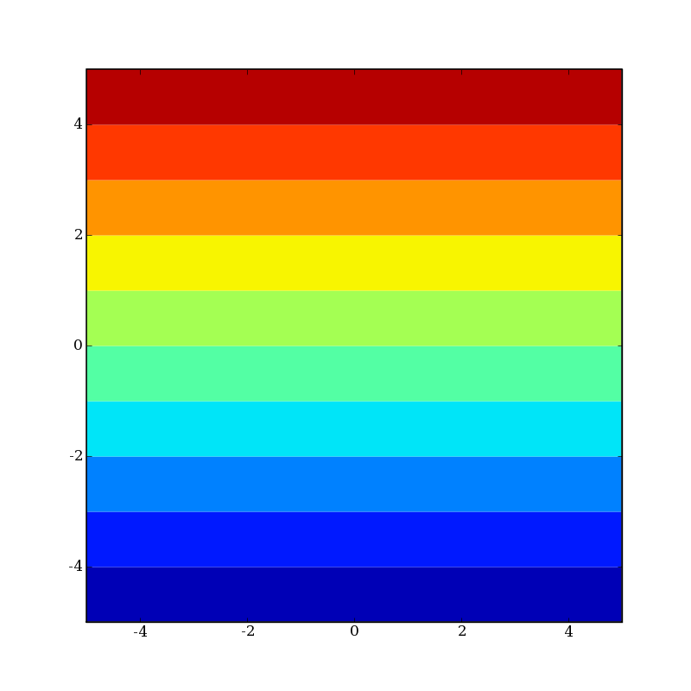
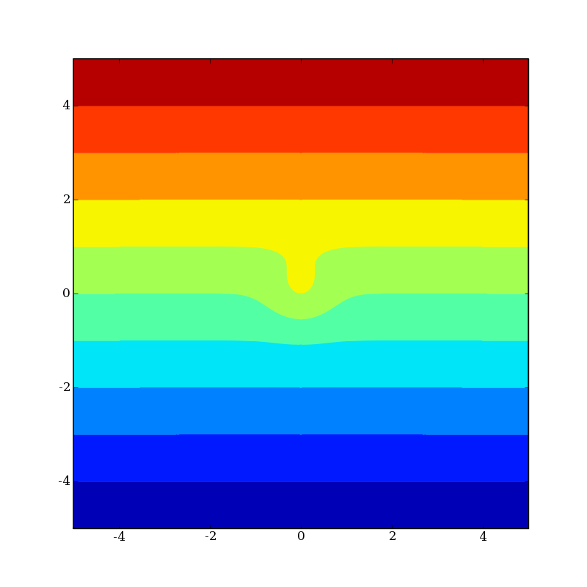
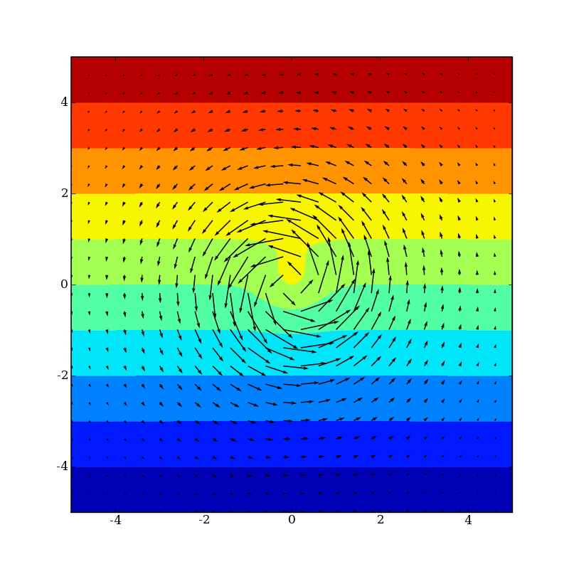
Generation of Rossby waves
+

Slide 24
Generation of Rossby waves
+q’
+
-q’

Slide 25
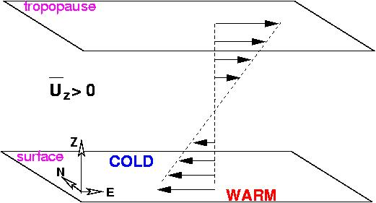
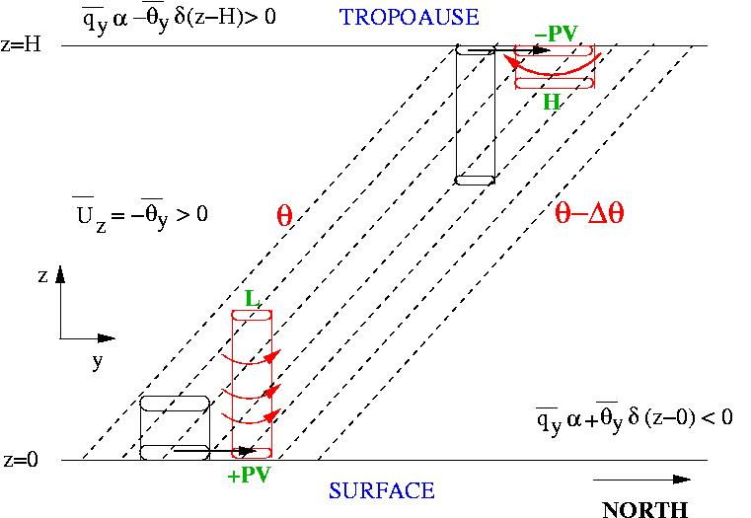
The symmetric f-plane
Eady model (1949)
Bretherton (1966) perspective:

Slide 26
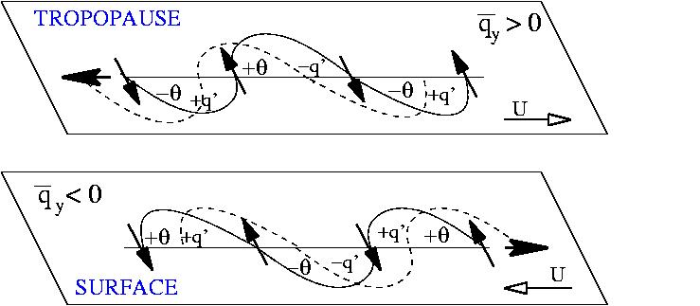
Eady edge wave propagation

Slide 27
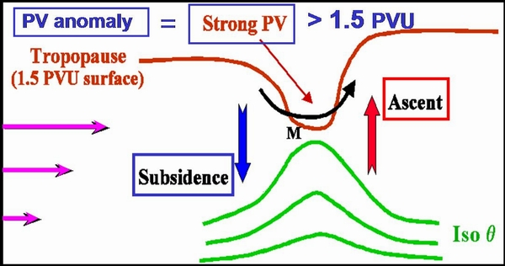
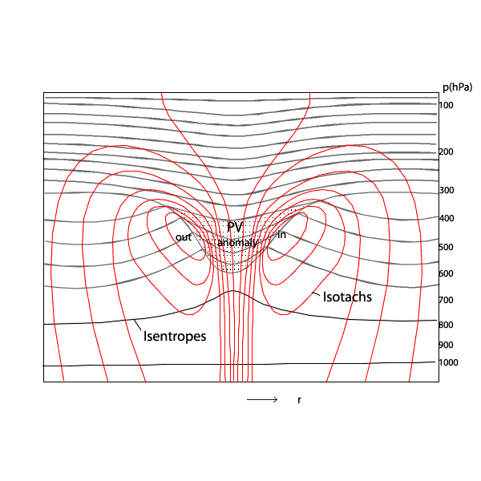
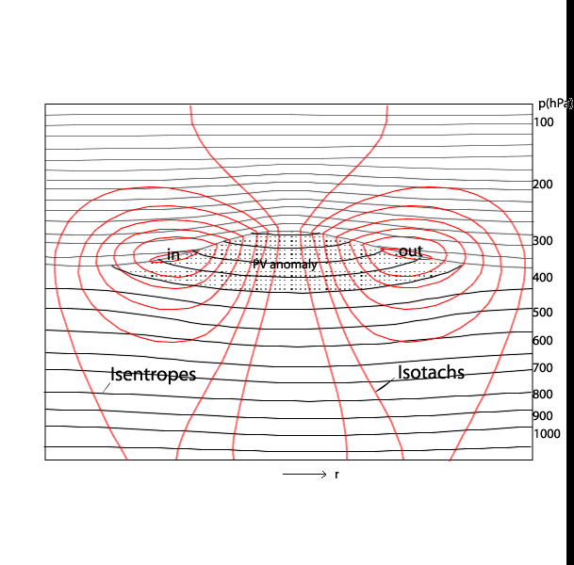

Slide 28
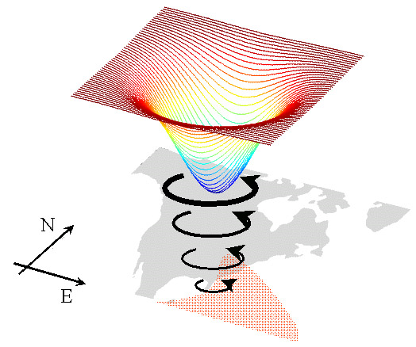

Slide 29
The symmetric f-plane
Eady model (1949)
Bretherton (1966) perspective:

Slide 30
Eady edge wave propagation

Slide 31
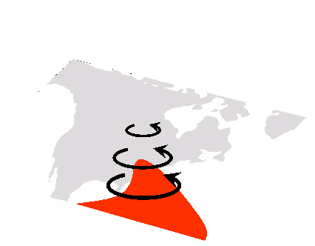
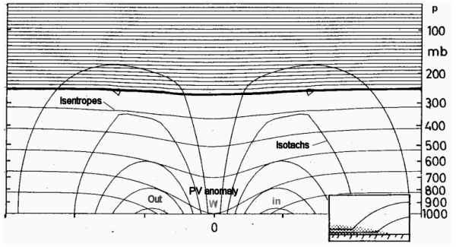

Slide 32
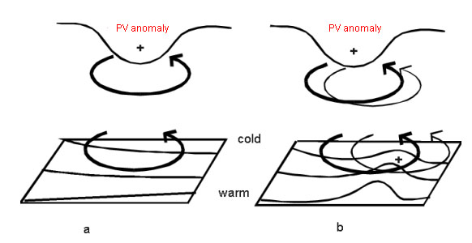

Slide 34
The Eady model (1949)

Slide 35
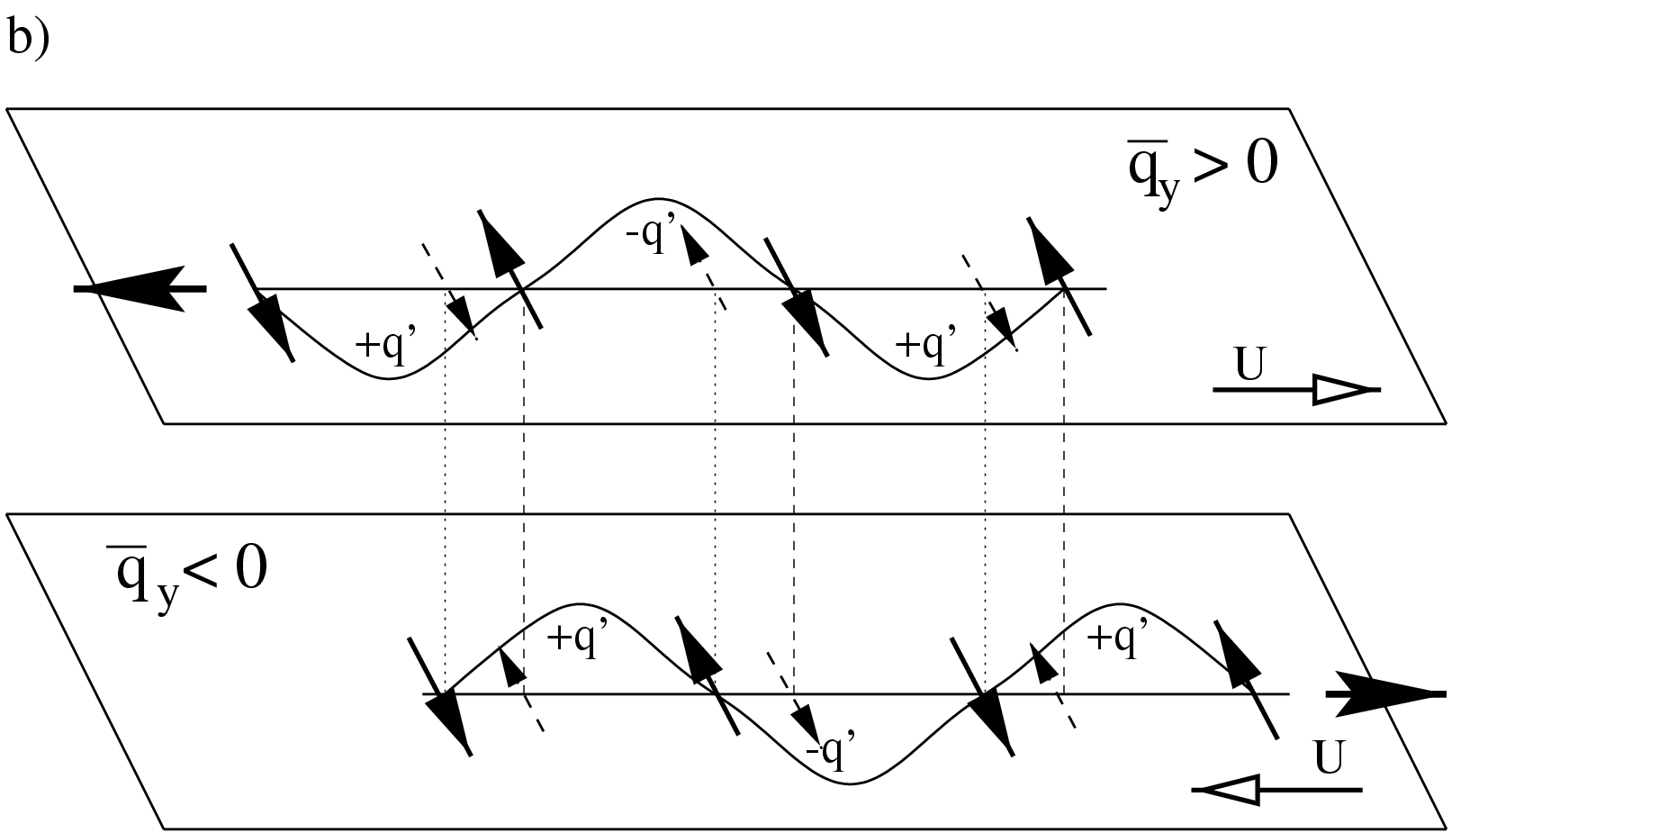
Essence of CRW approach to baroclinic instability :
Both the wave propagation speed of each wave, and its amount of evanescence are proportional to the wavelength (the Rossby height of deformation - Hr)
Under the right conditions unstable phase locked NM are obtained
C
shear
U
C
U
The necessary conditions for instability:
- Fjortoft: U and q_{y} positively correlated – to obtain CRW phase locking
- Charney and Stern: q_{y} change sign – to obtain mutual growth

Slide 36
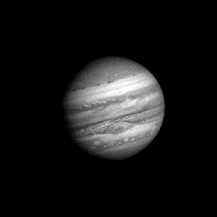
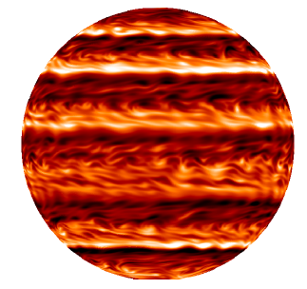
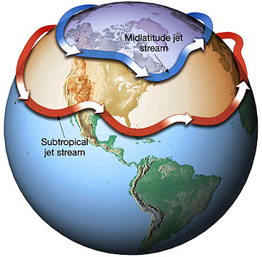
Jet sharpening

Slide 37
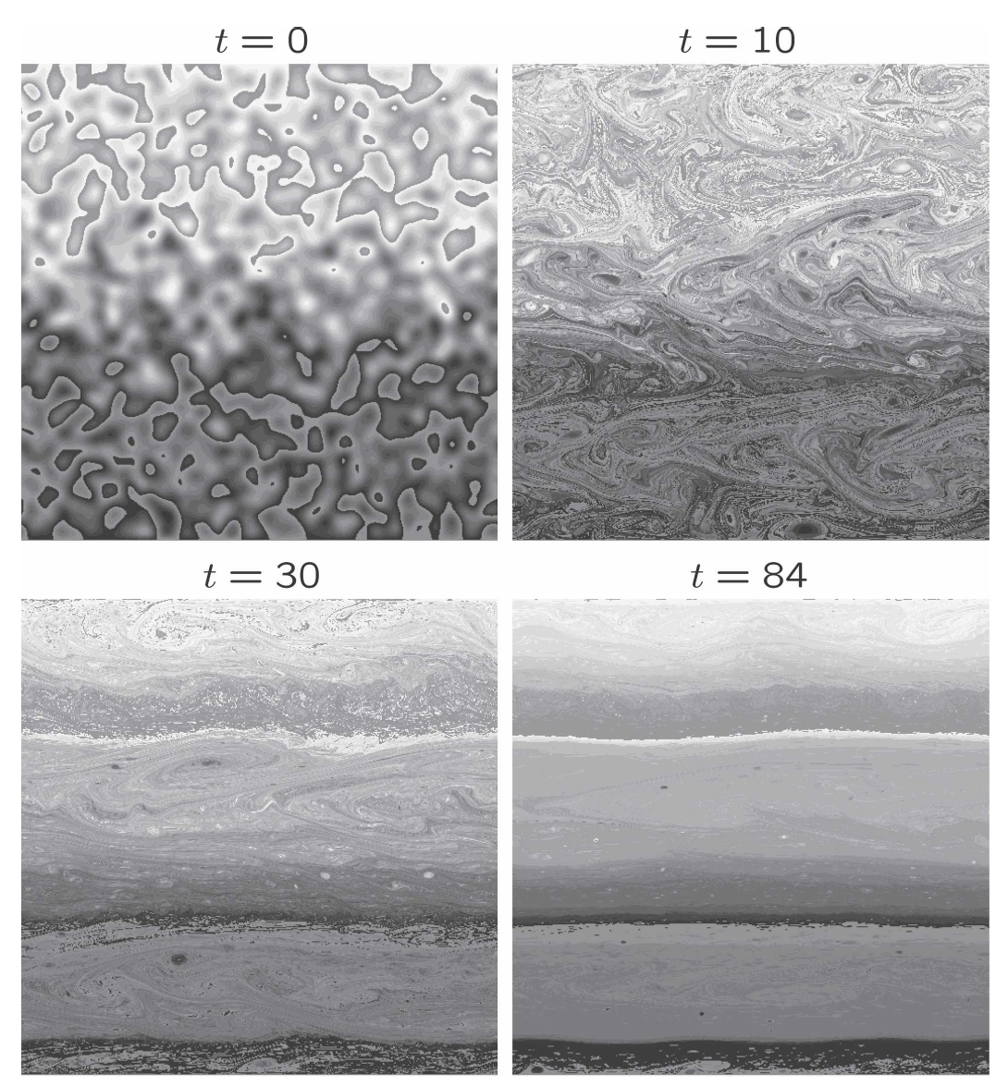

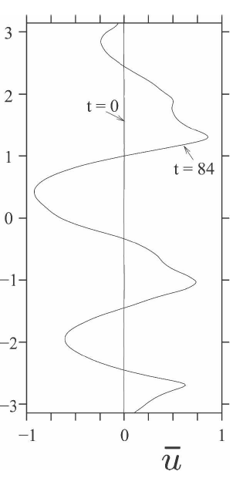
Dritschel & McIntyre
JAS (2007)
Rossby waves
jet
eddies
jet

Slide 38
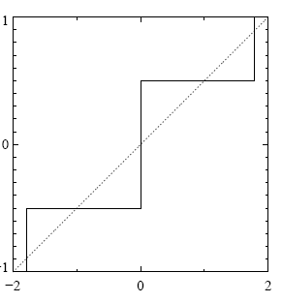
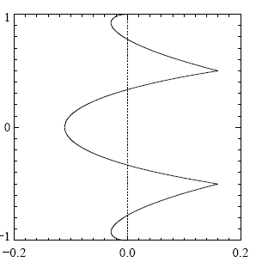
Jet sharpening &
(potential) vorticity “staircases”
potential vorticity
zonal velocity
PV stair
jet
latitude
turblent
mixing
Rossby waves
jet
PV stair

Slide 39
Momentum-wise in order to generate jets eddies should deposit zonal momentum to the mean flow and hence decay barotropically
(if not maintained by an external source)
zonal velocity
eddy momentum flux
jet

Slide 40
The baroclinic Eady model (1949)
is analogous to the Rayleigh
barotropic model (1880)

Slide 41
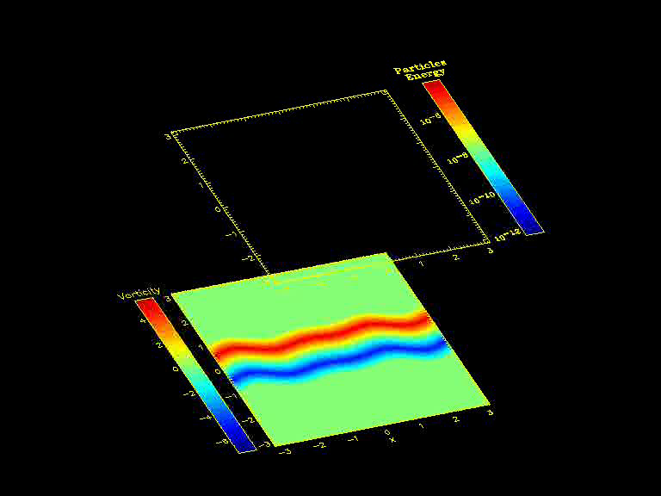


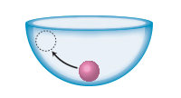
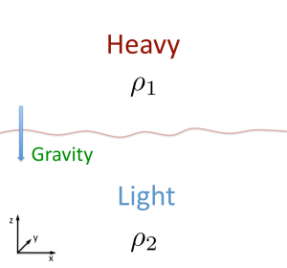

Shear instability versus
convective (gravitational) instability
unstable
stable
y
x

Slide 42
energy growth via Reynolds stress
(the Orr mechanism)

Slide 43
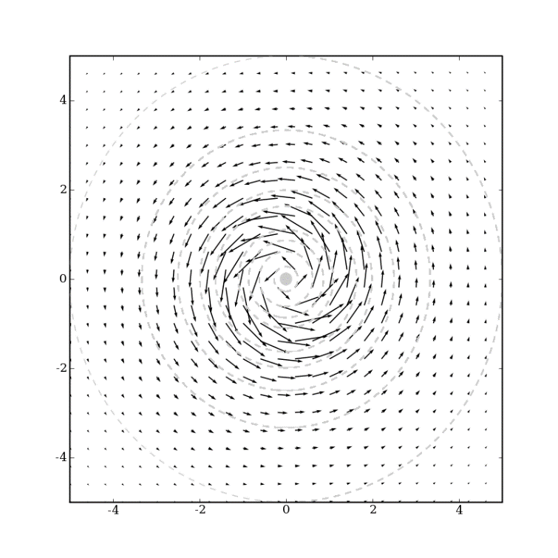



Why vorticity (PV) –
not only because it is materially conserved
but also because when localized it induces
far field velocity (vorticity inversion)
Curvature :
Shear :
4
1
3
1
2
4
2
3
4
3
1
3
2
4
2
1

Slide 44




Building blocks, action at a distance vorticity inversion (Green function)

Slide 45
Building blocks of vorticity waves
+vor
-vor
+vor
c

Slide 46
Vorticity-displacement (q,ζ) wave propagation:
1.displacement
+
ζ
+
ζ
ζ
-
ζ
-
vort’ and disp’ in phase
+
ζ
-
-
ζ
ζ
vort’ and disp’ in anti-phase

Slide 47
Vorticity-displacement (q,ζ) wave propagation:
2. vorticity – a. the Rossby mechanism

Slide 48
Vorticity-displacement (q,ζ) wave propagation:
2. vorticity – b. restoring force mechanism

Slide 49

Two vorticity-displacement wave building blocks
c
c

Slide 50
Instantaneous mutual amplification
not possible between the same build’ blocks
c
c
c
c

Slide 51
Instantaneous mutual amplification
possible between two different build’ blocks
qζ>0
qζ<0
c
c
c
c
qζ<0
qζ>0
expect <qζ> to be small

Slide 52
Counter-propagation – sustained growth
Uqζ<0
U
qζ<0
c
Uqζ<0
c
qζ>0
expect <Uqζ> to be negative

Slide 53
For Rossby waves – mutual instantaneous amplification
The Rayleigh condition (1883)
The mean flow must have an inflection point
(Qy = -Uyy = 0 Qy must change sign)
Qy > 0
c
qζ<0
Qy < 0
c
y
qζ>0
x

Slide 54
For Rossby waves – mutual instantaneous amplification
The Rayleigh condition (1883)
The mean flow must have an inflection point
(Qy = -Uyy = 0 Qy must change sign)
Qy < 0
c
c
y
Qy > 0
x

Slide 55
For Rossby waves – counter-propagation
The Fjortoft condition (1953)
The mean flow and the mean vorticity gradient
should be positively correlated (<UQy> >0)
UQy < 0
c
UQy < 0
c
y
x

Slide 56
For Rossby waves – counter-propagation
The Fjortoft condition (1953)
The mean flow and the mean vorticity gradient
should be positively correlated (<UQy> >0)
UQy > 0
c
UQy > 0
c
y
x

Slide 57
Pseudo-momentum and Pseudo-energy
(Boussinesq (x,z) stratified shear flow example)

Slide 58
Vorticity-displacement formulation
c

Slide 59
Pseudo-momentum conservation and the condition for instantaneous mutual amplification
qζ<0
c
Rayleigh
c
qζ>0
expect <qζ> to be small

Slide 60
Pseudo-energy and the condition for
Counter-propagation
Uqζ<0
U
qζ<0
c
Uqζ<0
c
qζ>0
expect <Uqζ> to be negative

Slide 61
Pseudo-energy and the condition for
Counter-propagation

Slide 62







H.M.R. (1985) –
The counter-propagating Rossby wave
view to barotropic/baroclinic instability
(vorticity)

Slide 63
Ensuring phase locking when (U – c) = 0
c
c
y
x

Slide 64
Ensuring phase locking when (U – c) > 0
c
c
y
x

Slide 65
Ensuring phase locking when (U – c) > 0
c
c
y
x

Slide 66
Ensuring phase locking when (U – c) < 0
c
c
y
x

Slide 67
Ensuring phase locking when (U – c) < 0
c
c
y
x

Slide 68
All roads lead to phase locking

Slide 69




“CRW phase diagram”
most unstable
mode

Slide 70
The simplest (symmetric) unstable
barotropic model (piecewise linear)

Slide 71
x

Slide 72

Non-modal growth

Slide 73

nature of optimal transient growth (SVD) :

Slide 74
All this can be formulated mathematically:

Slide 75
Generalization to an infinite number of kernel building blocks:
Look at how the kernel amplitude and phase positions change with time
shear
3
2
1

Slide 76



piecewise versus smooth profile
2 CRWs
infinite number
of KRWs

Slide 77


KRW Canonical Hamilton equations

Slide 78
KRW Canonical Hamilton equations

Slide 79


KRW Canonical Hamilton equations

Slide 80

Relation to over-reflection and
critical-layer emission
n^2 > 0
n^2 =
-m^2 < 0

Slide 81
Full reflection

Slide 82
Partial reflection

Slide 83
Over reflection

Slide 85



2 CRW schematic description of O-R
steady state
normal mode
The laser formula:

Slide 86
Unstable normal mode
|T| > 0
+
+
n² > 0
+
q_{y} > 0
U-c > 0
2
+
U-c
+
y₁
CL
-q
-q
-q
-q
n² < 0
q_{y}=β0
q_{y} > 0
U-c < 0
y₀
1
TL
+
+
+
+
q_{y} < 0
U-c < 0
+
Hbottom
+
+
q_{y}=- β0
+
+
n² > 0
+
+
TL
0
|R| > 1

Slide 87
How the presence of a background magnetic field alters the instability mechanism of hydrodynamic shear flows ?

Slide 88
MHD shear flow ambiguity:
Uniform magnetic field acts to stabilize shear flows (energetic argument – extra work has to be done to bend magnetic field-lines)
On the other hand - spatially varying magnetic field can destabilize shear flows which are otherwise stable in the hydrodynamic limit
Can we use the vorticity wave concept to go beyond energetic arguments and shed light on the (in)stability mechanism ?

Slide 89






Simplified 2D (x,y) MHD equations:
B =

Slide 90













Adding background magnetic field
y
x

Slide 91









vortical magnetic-shear perturbations

Slide 92




vortical magnetic-shear waves
Modified
Alfven
Alfven
Rossby

Slide 93

Rossby edge wave

Slide 94
vortical magnetic-shear waves
Modified
Alfven
Alfven
Rossby

Slide 95


“pure” Alfven wave
c
c

Slide 96
vortical magnetic-shear waves
Modified
Alfven
Alfven
Rossby

Slide 97

“modified” Alfven wave
c
c

Slide 98



Stabilizing HD shear flow by
constant magnetic field
B
U(y)
M = B/U
Alfven dynamics makes the
counter-propagating Rossby
waves to propagate too fast to
phase lock

Slide 99


Stabilizing HD shear flow by
constant magnetic field
B
U(y)
Critical level effect:
M = B/U
The “standing wave” at the
critical level acts to decay the
mutual edge wave amplification

Slide 100


Stabilizing HD shear flow by
constant magnetic field
B
U(y)

Slide 101




Destabilizing HD shear flow
by a wake magnetic profile
U(y)
B(y)
x
Critical level effect:

Slide 102
Closing remarks
It takes (at least) 2 vorticity waves for (unstable) tango - although can be many
Minimal requirement for shear instability –
at least two regions supporting
counter-propagating vorticity waves
Covers many aspects of the instability (optimal growth in different norms, the role of the critical level, relation with over-reflection..)
Relevancy to barotropic & baroclinic & stably stratified & capillary & MHD shear flows

