Slide 1
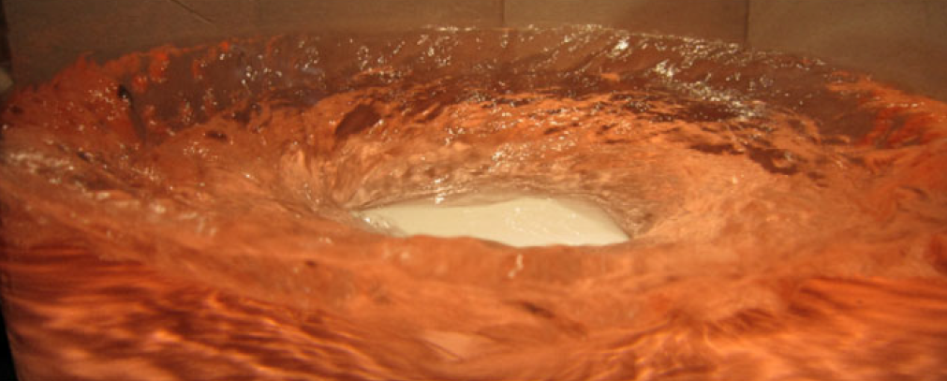
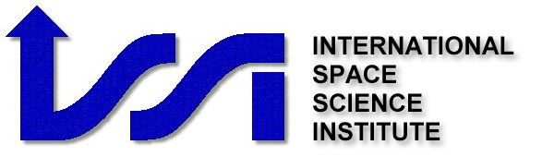

On the mechanism of centrifugal-gravity wave resonant instability in swirling free surface rotating polygons
BERN 2017
Ron Yellin-Bergovoy, Eyal Heifetz &
Orkan M. Umurhan

Slide 2
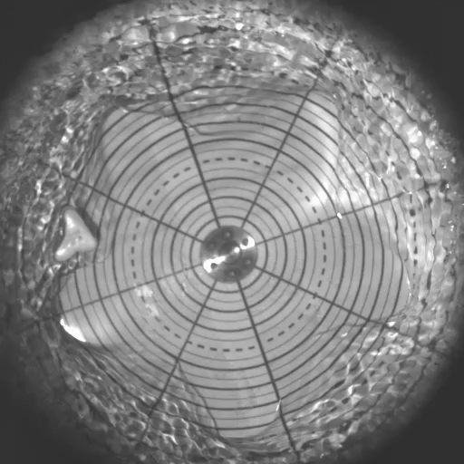
the Rotating Polygon Instability
Ingredients :
Water/liquid nitrogen.
Rotating bottom/cylinder walls.
Parameters:
  R-Radius.
  H- height of liquid at rest,
  f- rotation of the bottom plate/walls.

Slide 3
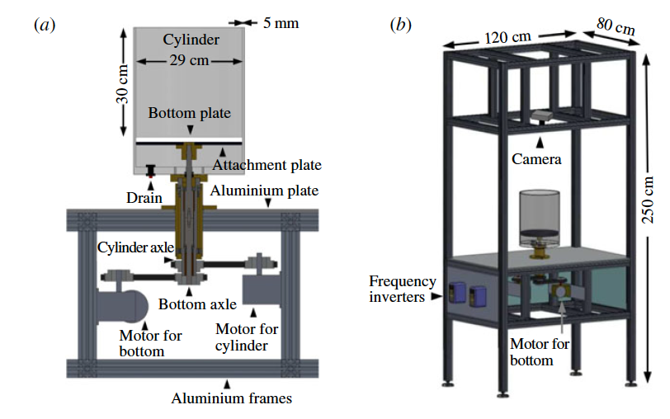
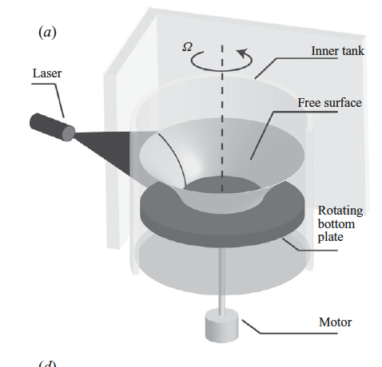
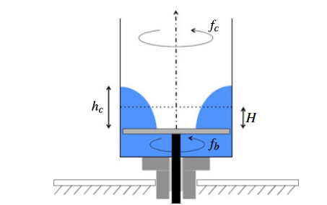
Bach el. 2014
Tophøj at el. 2013
Setups

Slide 4
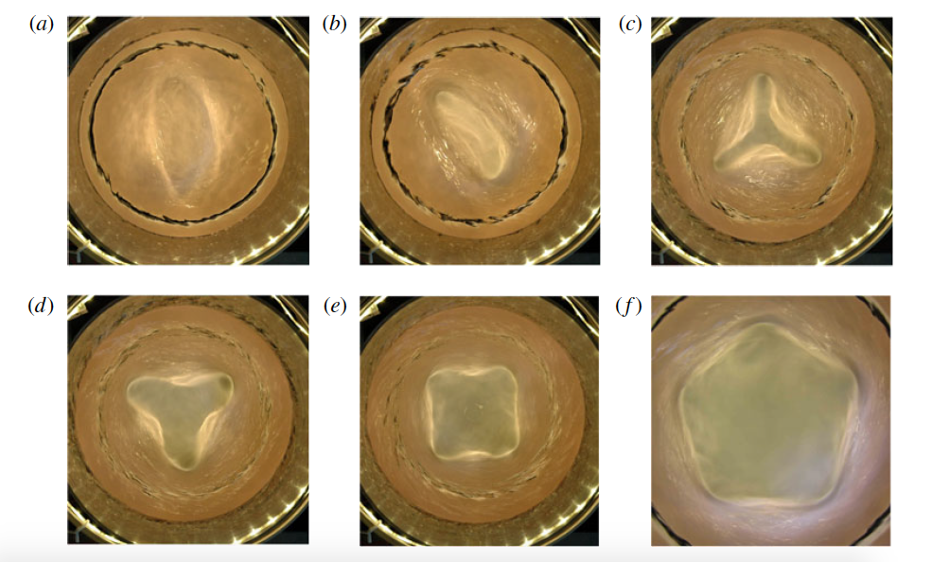
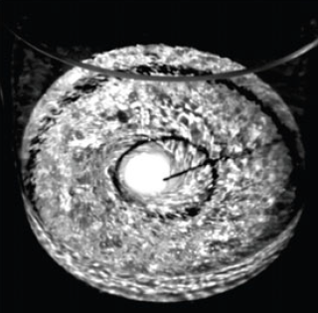
Steady Polygons
Bach el. 2014

Slide 5
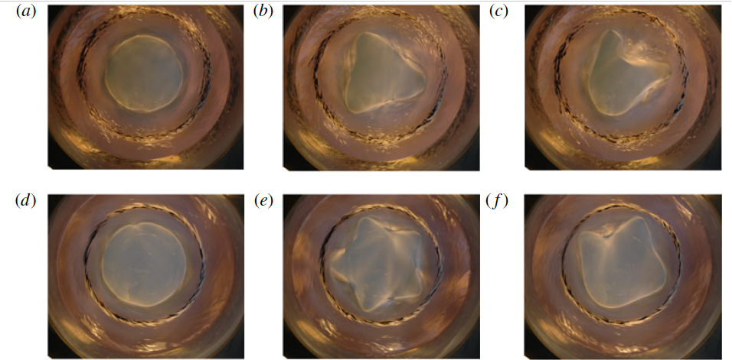
Unsteady polygons
Bach el. 2014

Slide 6
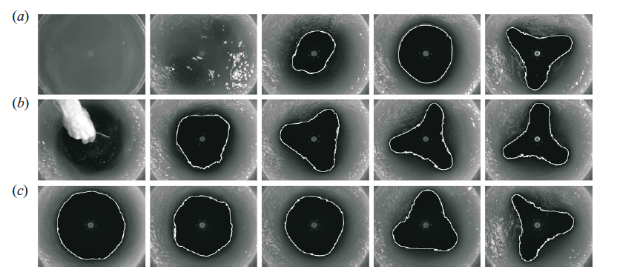
All ways lead to polygons…
Bergmann at el. 2011

Slide 7
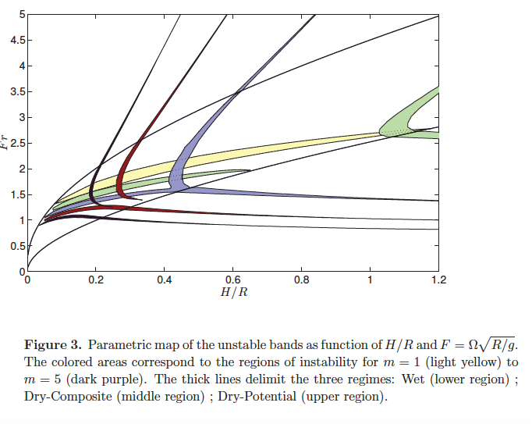
Fabre et al; 2014.

Slide 8
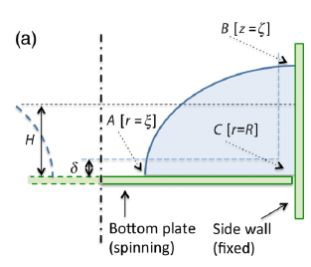
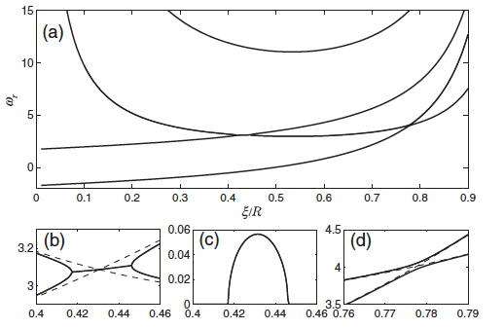
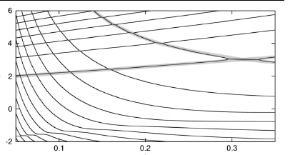
NM Full vs simplified model
Tophøj at el. 2013
simplified
Full
Notes:
Diffren m , sqrt(g/R)

Slide 9
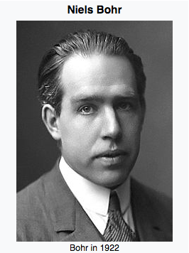


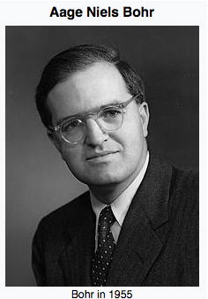


So how did we end up here?
Notes:
In lab
Erdos

Slide 10
Goals
to understand the nature of the inner surface centrifugal waves.
to understand how they form resonant instability with the outer vertical gravity waves located on perpendicular surfaces.

Slide 11
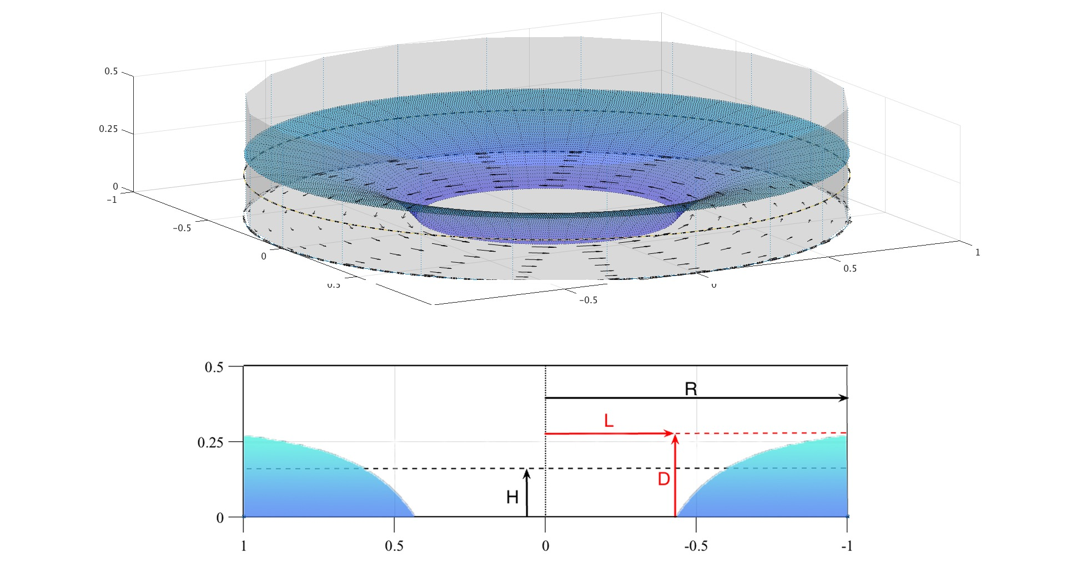

Setup

Slide 12
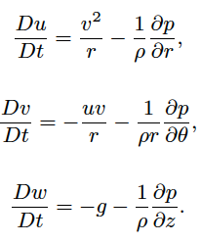
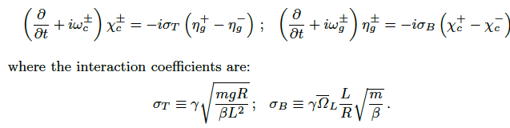
Equations
Basic eq: potential flow
Wave interaction:

Slide 13
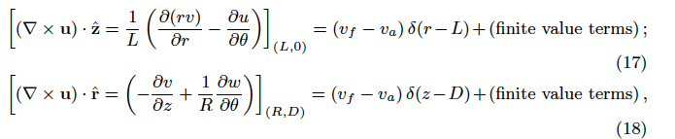
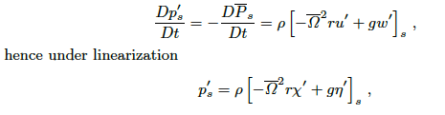
vorticity/velocity to displacement & displacement to velocity vorticity/velocity
And also,Baroclinic torque

Slide 14

Counter propagating centrifugal wave

Slide 15
Counter propagating gravity wave

Slide 16
Real part of dispersion relation as a function of L/R(m=3,H/R=0.276)

Slide 17

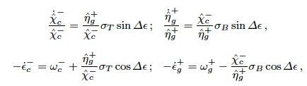


“Near” resonance wave interaction

Slide 18
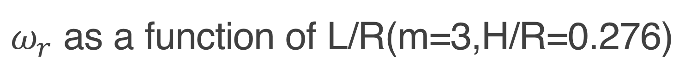
$ω_{r}$ as a function of L/R(m=3,H/R=0.276)

Slide 19
Eigen structure analysis as a function of L/R(m=3,H/R=0.276)

Slide 20
Instability

Slide 21


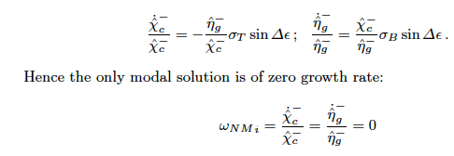
“Near” resonance wave interaction

Slide 22
“Near” resonance wave interaction

Slide 23


Slide 24
Conclusions and work need
the centrifugal waves are a potential representation of baroclinic edge waves, where the sharp gradients of density and pressure across the free fluid-air interface yield baroclinic torque which generates a wavy vortex sheet at the edge.
instability is obtained by phase locking resonance between the two counter-propagating vorticity waves (one is centrifugal and the other is gravity) and the induced velocity fields act both to phase lock the waves to propagate with the same frequency and to amplify each other amplitudes.

Slide 25
Conclusions and work need
The “near” resonance instability regime of pro and counter propagating wave is an interaction that can lead to phase locking but not to instability.
More research is need on:
Non-linear evolution.
Saturation mechanism
Transient growth?

Slide 26
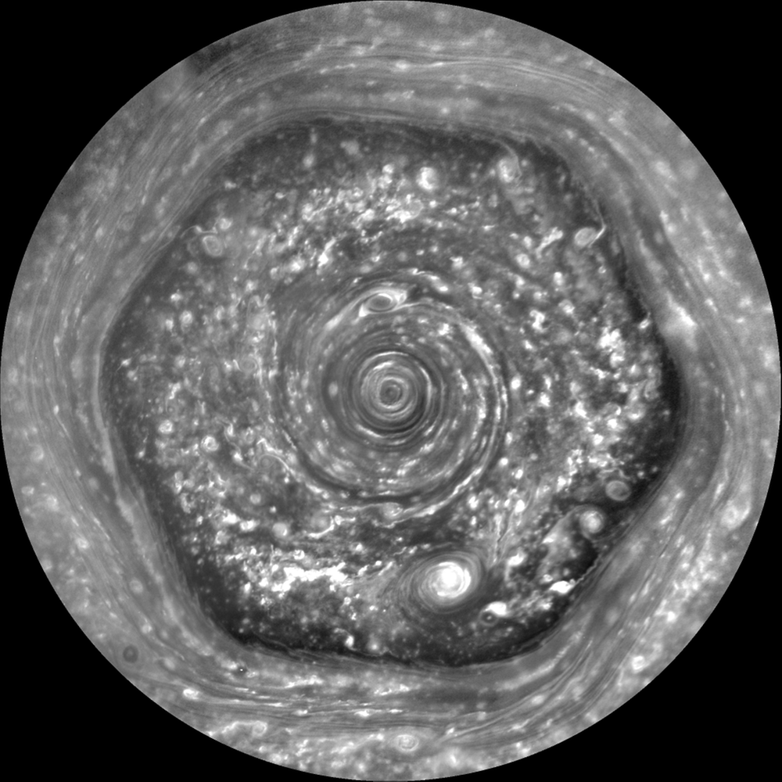
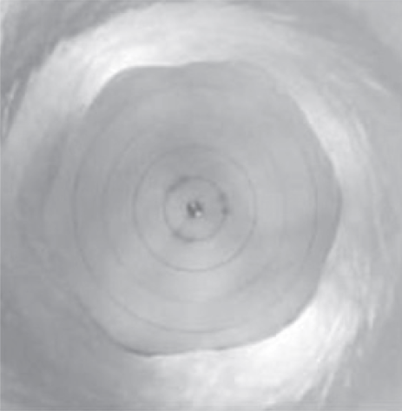
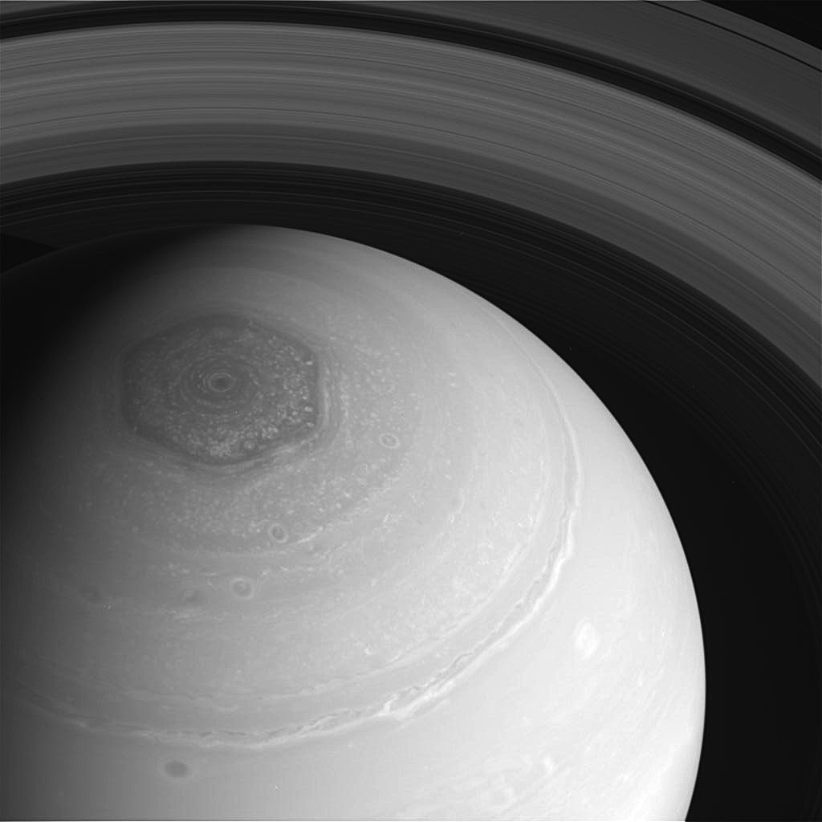
Applications?

Slide 27
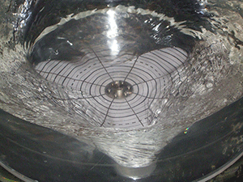
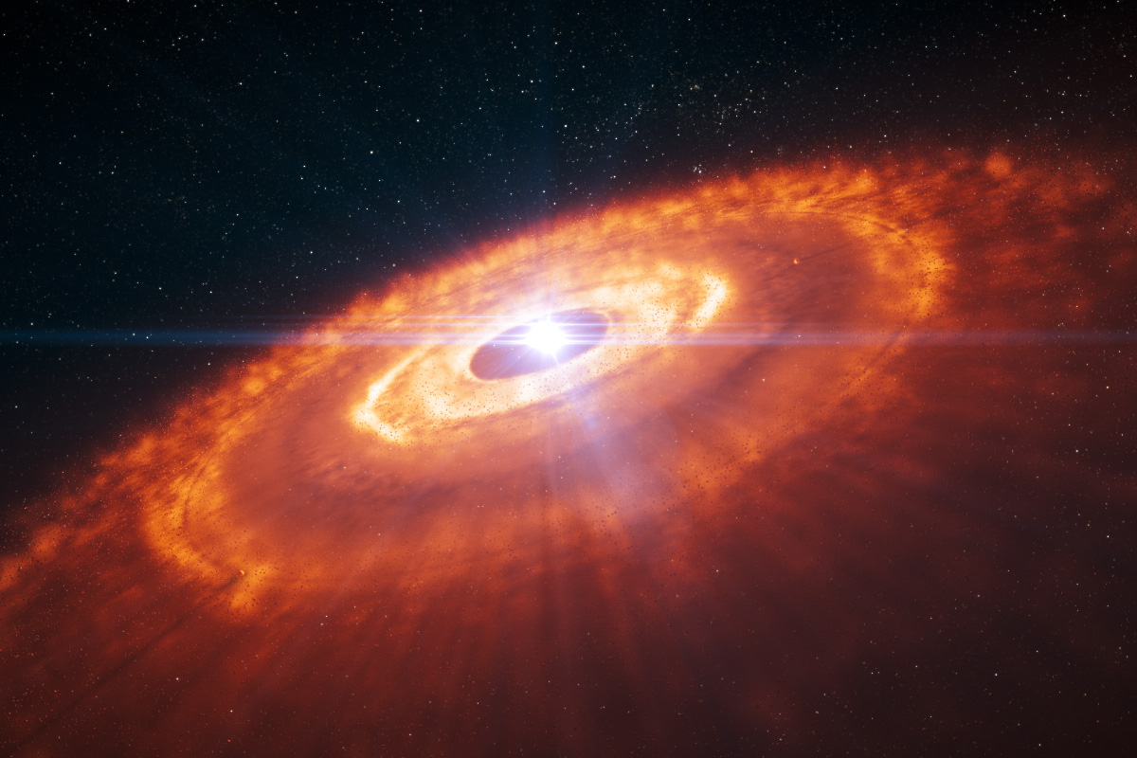
THANK YOU
THANK YOU

Slide 28
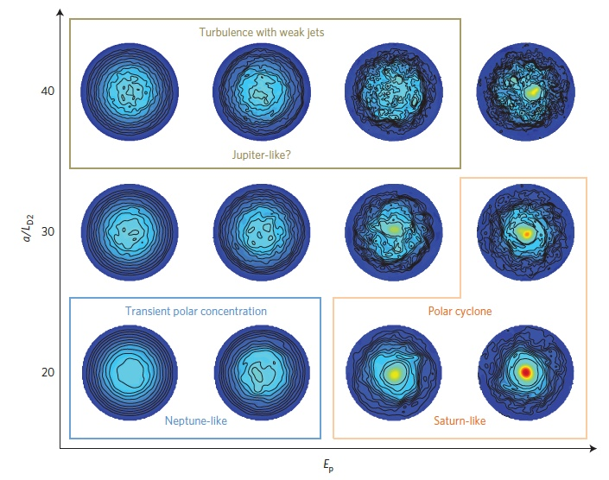
Why somw planets have polar vortex and some do not?
O’Neill 2015

