Slide 1
Rossby wave Instability in pp-discs
Short review summary
Ron Yellin-Bergovoy

Slide 2
Overview
History
Interfacial dynamics
RWI
Where can RWI and waves they be found
Evolution with and without self gravity
Vortex as a dust trap
In 3d

Slide 3
history
1.
2.
3.
4. Many papers
5.
6. 3D- Meheut (2012 a,b,c)
7. SG-
(2013)

Slide 4
Inverse PV

Slide 5
Interfacial dynamics

Slide 6
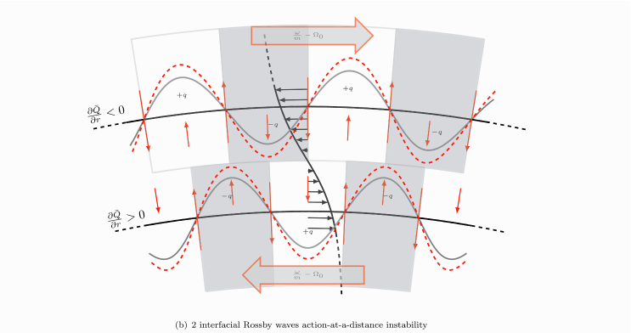
Interacting Rossby waves

Slide 7
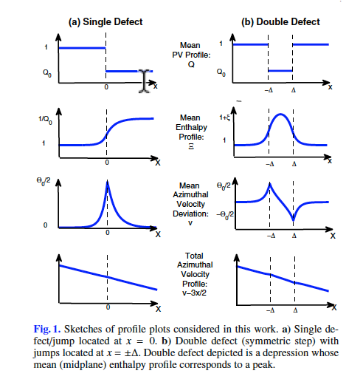
Interacting Rossby waves

Slide 8
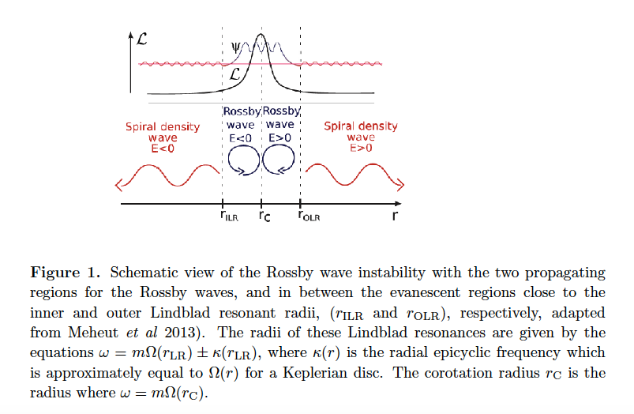
Radial propagation

Slide 9
Where can we find these in the disk- gaps

Slide 10
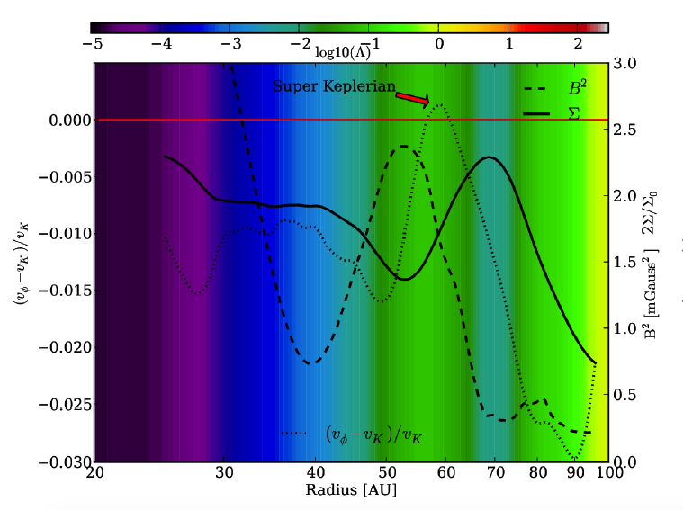
Dead Zone transition boundary

Slide 11
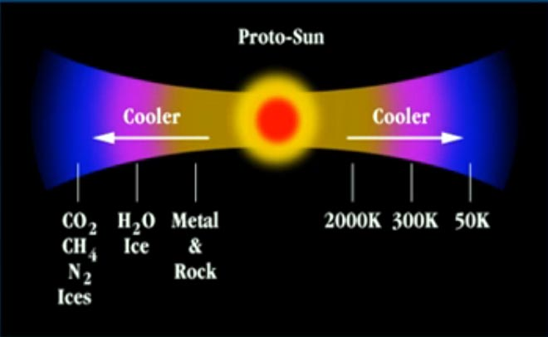
Dead Zone transition boundary

Slide 12
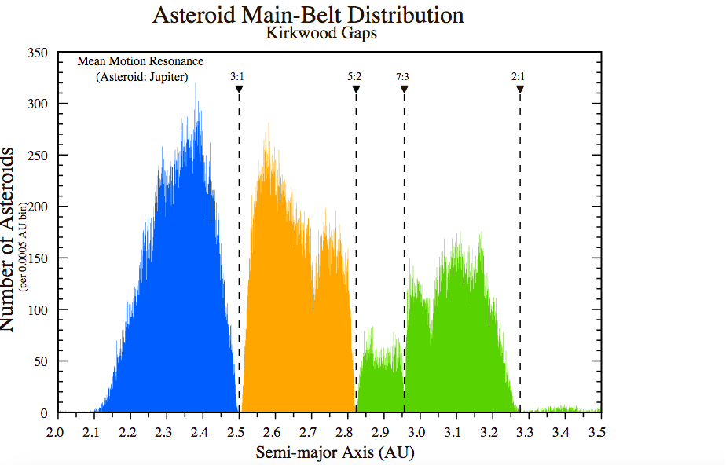
Kirkwood gaps

Slide 13
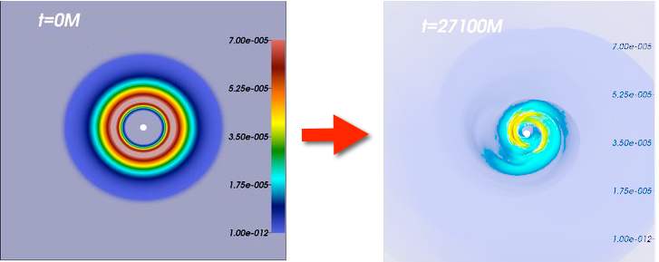
PPI

Slide 14
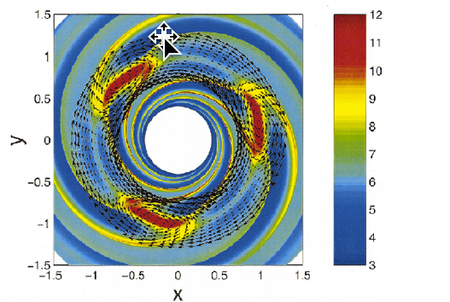
Simulation

Slide 15
Gap edges

Slide 16
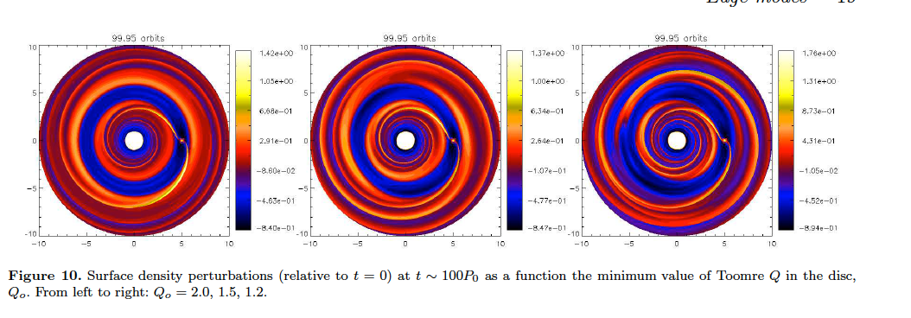
The effect of self gravity

Slide 17
The effect of self gravity

Slide 18
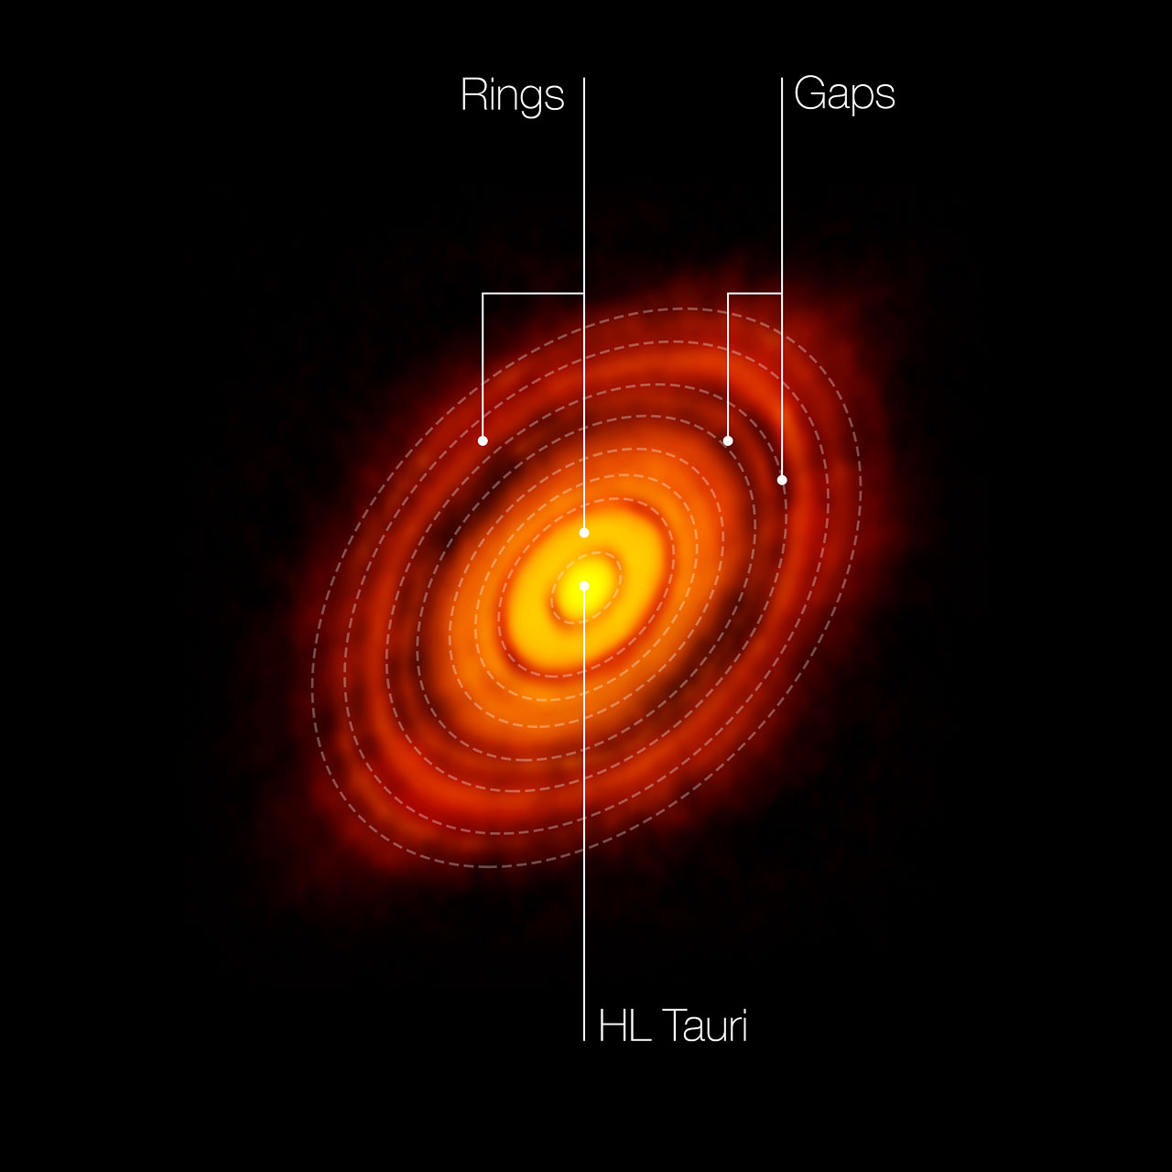
Observations axisymmetric gaps and rings

Slide 19
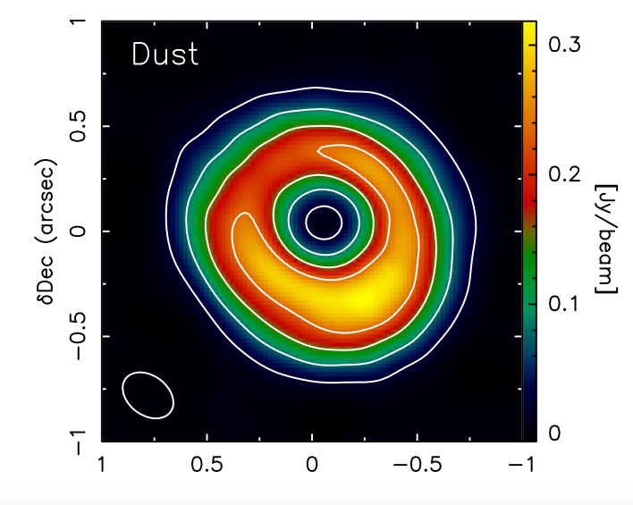
Vortex in the disk – ALMA observations

Slide 20
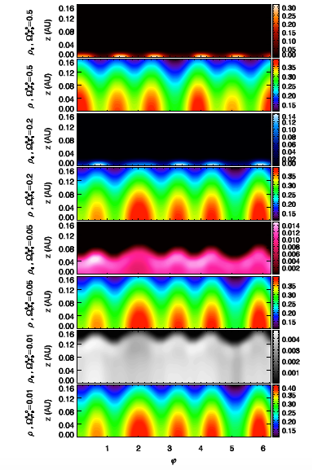
3d structure

Slide 21
The meter barrier

Slide 22
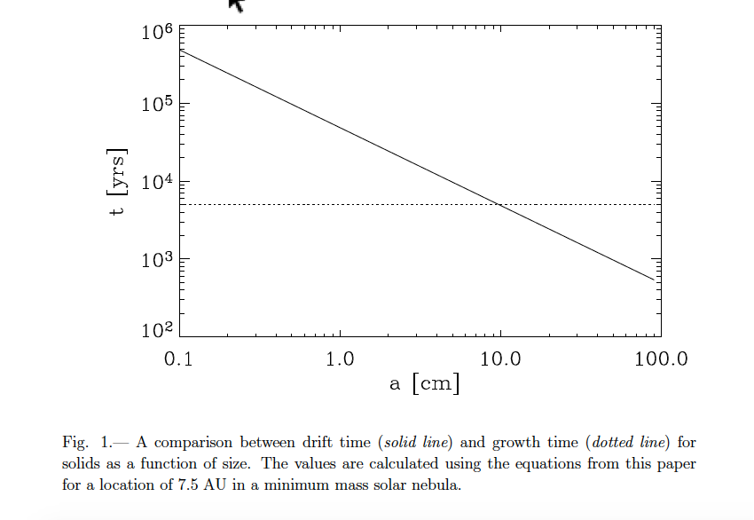

Slide 23
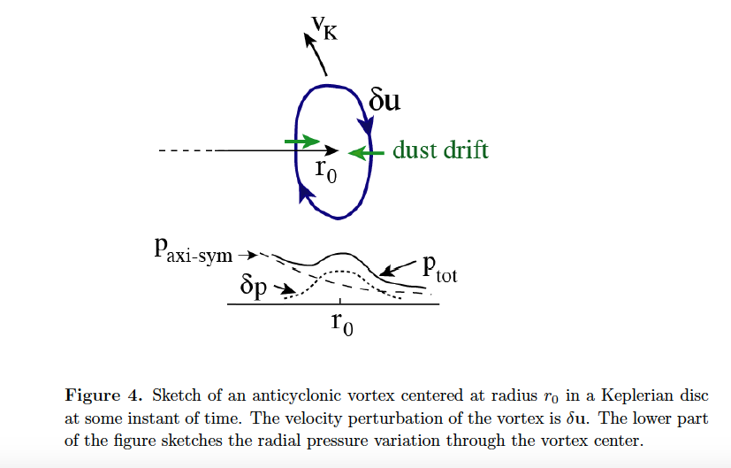
Dust trapping

Slide 24
Dust trapping

Slide 25
references

Slide 26
THANK YOU

