Slide 1
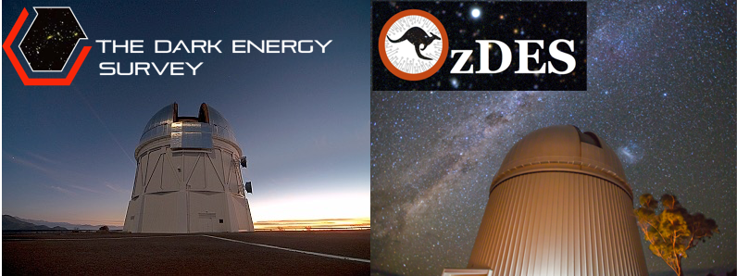
A limit on luminosity evolution of SNeIa from the OzDES project.
Jeremy Mould
ISSI meeting, December 2023

