Slide 1
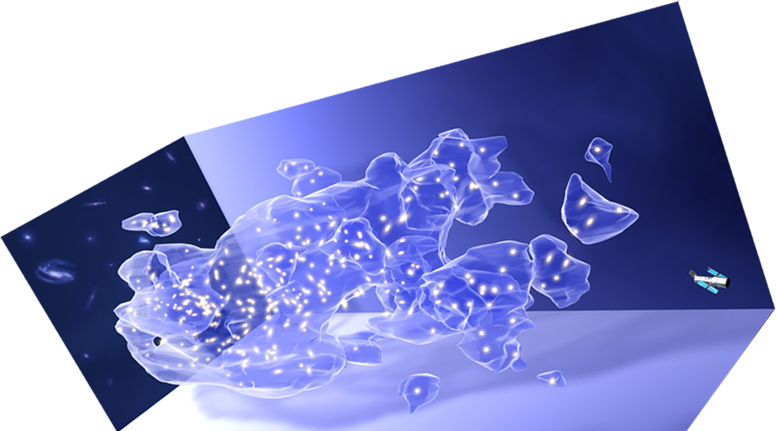
Exploring Galaxy Intrinsic Alignment with Full-sky Weak Lensing Simulation
Chengliang Wei
Purple Mountain Observatory, CAS
Collaborators: Guoliang Li, Xi Kang, et al.
December 19, 2018 @ ISSI.Bern
Cosmic Shear

Slide 2
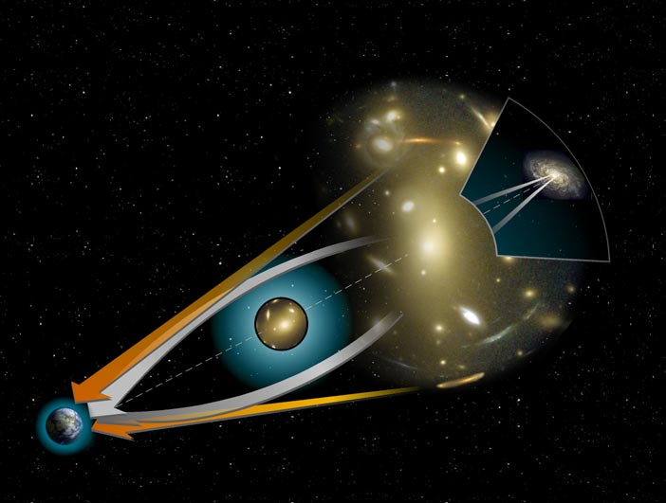
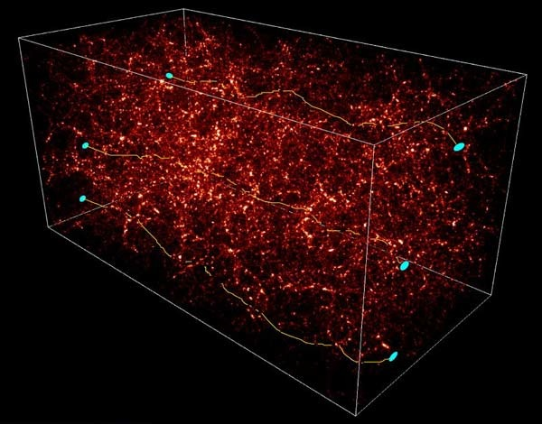
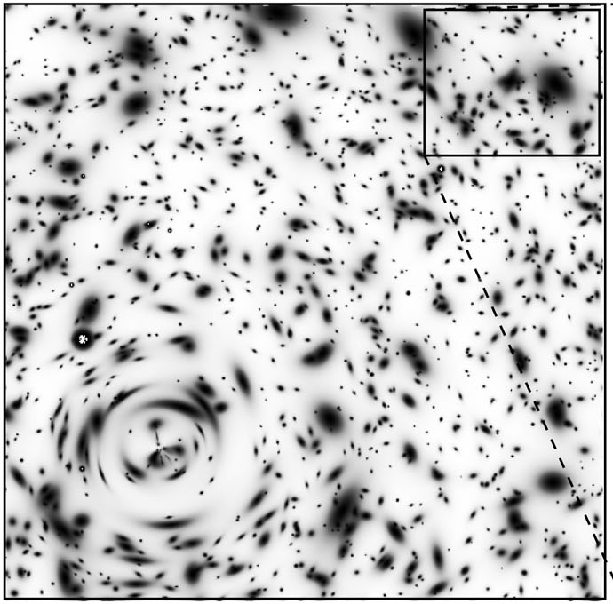
Gravitational Lensing
GL is powerful in directly mapping the mass distribution
Mellier, ARA&A 37, 127 (1999)
Jullo et al. (2010)
H. Y. Shan et al. (2017)

Slide 3
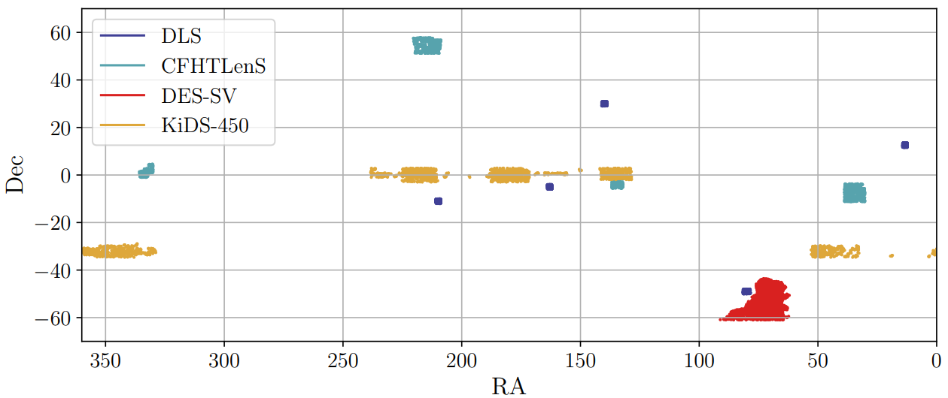
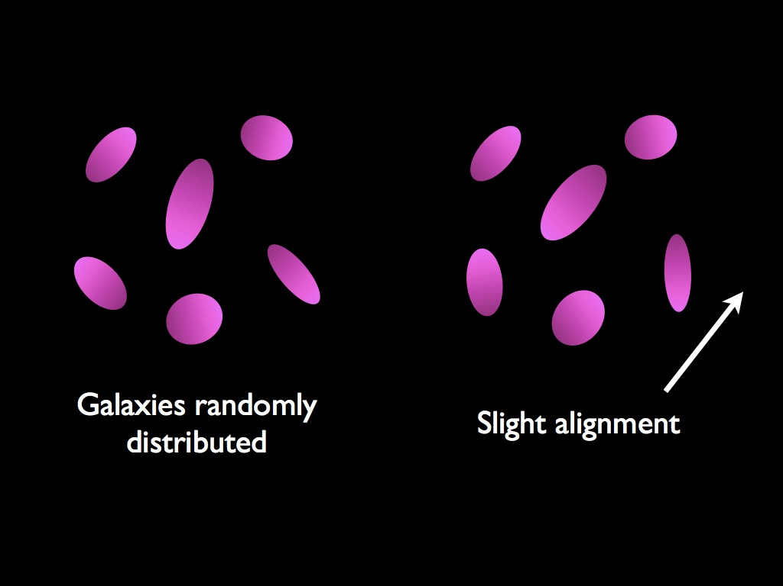
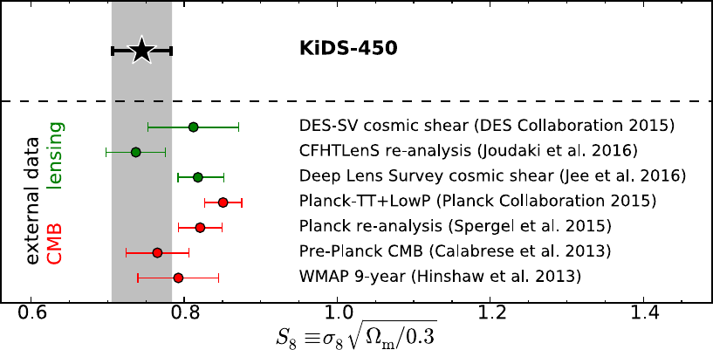
Tension in S₈ between recent weak lensing surveys
Chihway Chang, et al. (2018)
$$\left\langle γ_{i}^{obs} γ_{j}^{obs}\right\rangle = \left\langle γ_{i}{ γ}_{j}\right\rangle$$
$$γ^{obs}=γ+γ^{I}$$
$$\left\langle γ_{i}^{obs} γ_{j}^{obs}\right\rangle = \left\langle γ_{i}{ γ}_{j}\right\rangle +\left\langle γ_{i}^{I}{ γ}_{j}\right\rangle +\left\langle γ_{i}^{I}{ γ}_{j}^{I}\right\rangle$$
Hildebrandt, et al. (2017)
We need better understanding of the effects of:
• Systematic effects: IA, PSF, shear measurement, etc.
• Sky coverage, magnitude limit, source redshift distribution, mask effect, etc.
What cause the discrepancy between different WL surveys?

Slide 4
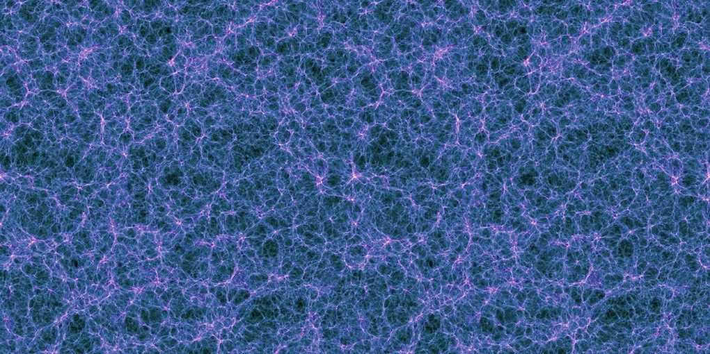
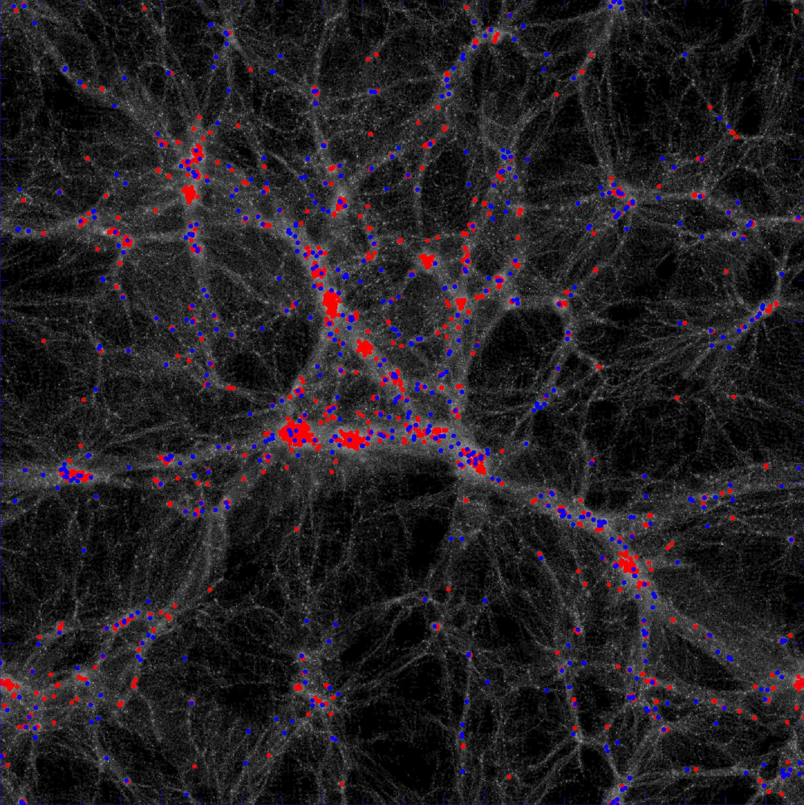
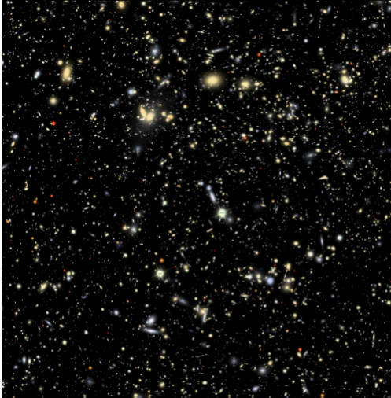
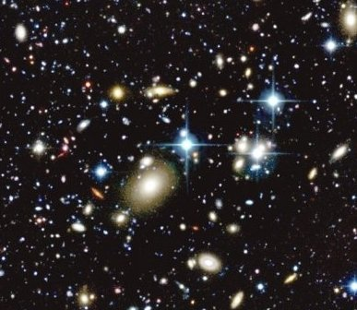
Realistic Simulation of WL
To understand different effects, we need the simulation: producing mock galaxy catalogues with lensed images: including galaxy intrinsic shape and lensing effect
Step 1
Step 2
Step 3
+
+
DM simulation
Semi-analytical model
Ray-tracing Simulation
cosmic shear
comparison
(credit: LSST group)
Simulated galaxy image
Real observation

Slide 5
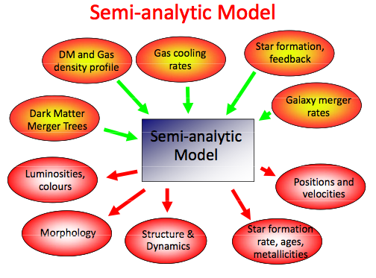
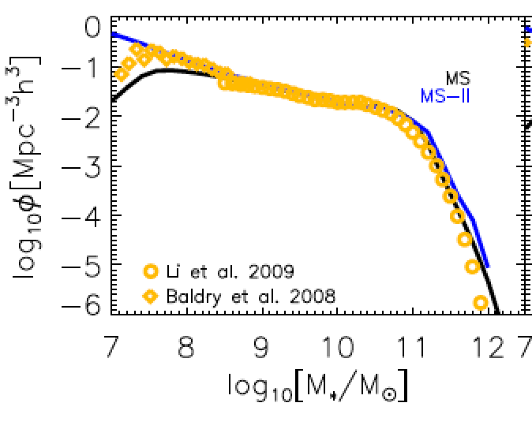
How to produce mock galaxy image catalogue
Step 1, N-body simulation: ELUCID
(local universe reconstructed)
Lbox=500Mpc/h, Np=3072³, mp=3.4*10⁸M⊙ , 2 times of the resolution of Millennium Simulation, WMAP9 cosmology: Ωm=0.28, 𝛔8=0.82 → S8=𝛔8(Ωm/0.3)^{0.5} ≃0.79
Lbox=1000Mpc/h, Np=3072³, for check of power spectrum on large scales
Step 2, Semi-analytical model for galaxy formation: Luo Y, KX., Kauffmann G., Fu J, 2016 (based on the L-Galaxy Munich model)

Slide 6
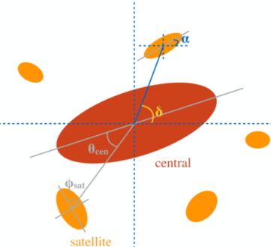
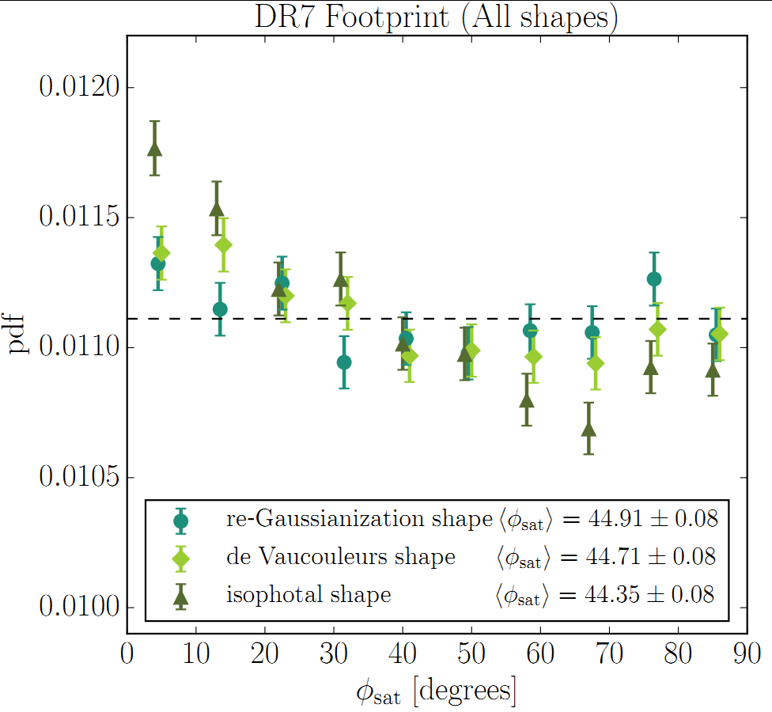
How to define galaxy intrinsic shape? (we follow Joachimi et al. 2013)
■ Central galaxies
Elliptical (Early-type)
Spiral (Late-type)
■ Random model
inertial tensor
spin
(Hung-Jin Huang, R. Mandelbaum et al. 2018)
■ Satellite galaxies
■ Joachimi et al. 2013 model (J13)
S_{e}
S_{S}
$$e_{3}$$
$$L$$
C

Slide 7
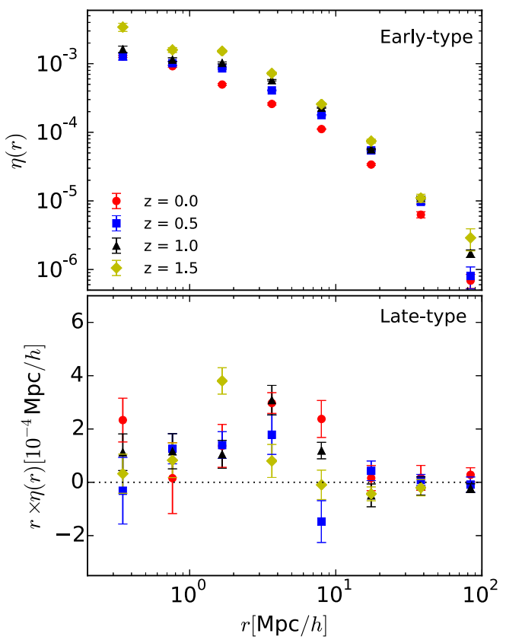
Galaxy intrinsic alignment: dependence on morphology
（Wei+, 2018, ApJ, 853, 25）
These correlations are consistent with that in Joachimi et al. (2013)

Slide 8
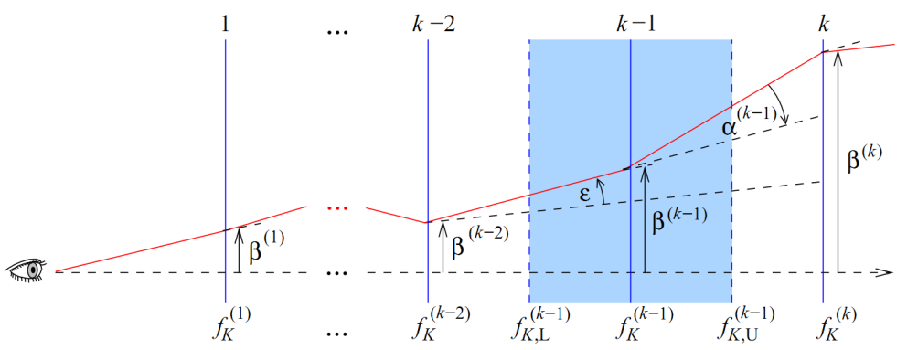
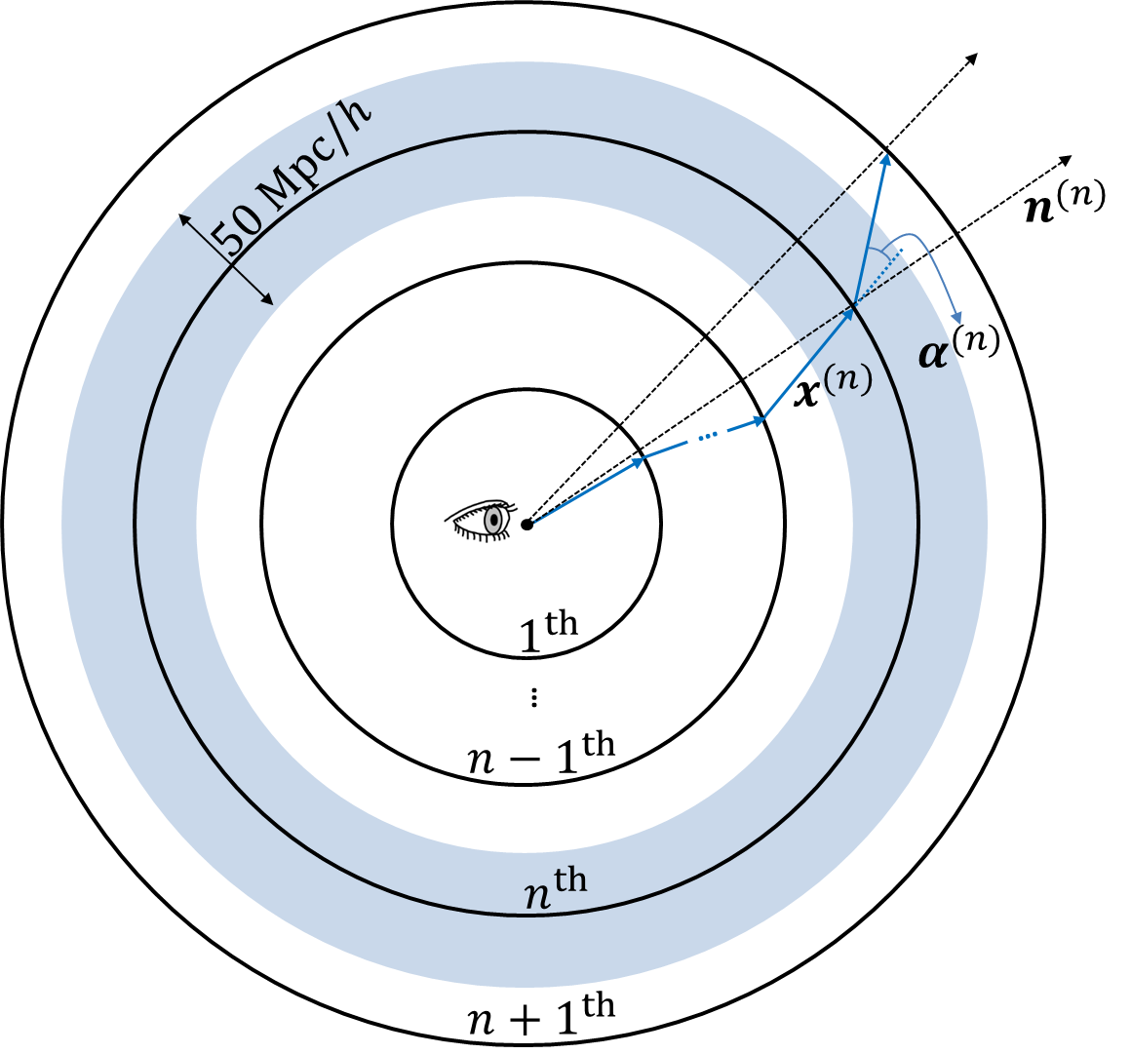
Step 3: Spherical Ray-tracing (RT) Simulation
●Multiple-lens-plane RT
●Spherical RT
Jain+(2000), White & Vale (2004), Hilbert+(2009), etc.
Das & Bode(2008), Fosalba+(2008), Teyssier+(2009), Becker (2013)
S. Hilbert et al.(2009)
The Flat-sky Approx.
● good enough for current lensing surveys (Kilbinger+, 2017)
● suppress power by > 1% on scales of $ℓ<40$, which would account for at least 11% of the total budget for systematic effects for a power spectrum analysis of a Euclid or LSST-like experiment (Kitching+, 2016)

Slide 9
How accurate is our ray-tracing?
The power spectrum of E/B model, also show comparison with theoretical prediction.
Our RT is accurate
The simulated power spectrum from RT agree with both Born approximation and Halofit theoretical prediction, up to very small scales
The B-mode is strongly suppressed (numerical effect is very small)

Slide 10
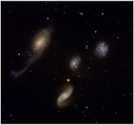
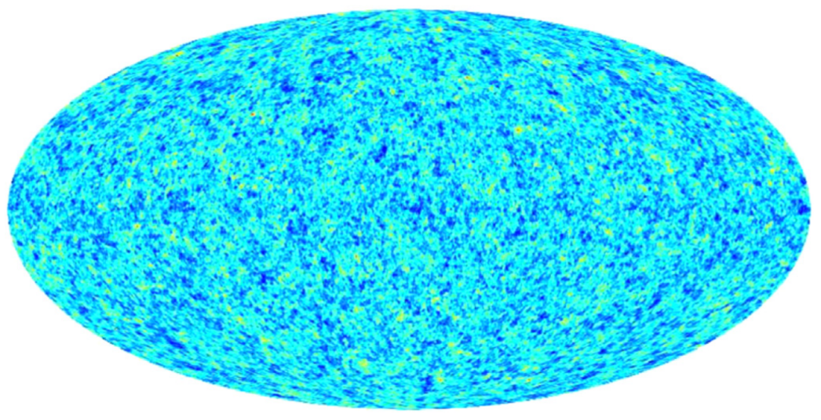
Full-Sky Convergence/Shear Field Map
$z=$2
$$z=0$$
Wei C, Li G, Kang X, +, 2018 ApJ, 853, 25

Slide 11
To compare with the data, we select simulated galaxies which have the same
Redshift distribution of source galaxies
Sky coverage (KiDS: 450 deg²)
Source galaxies number density
DIR

Slide 12
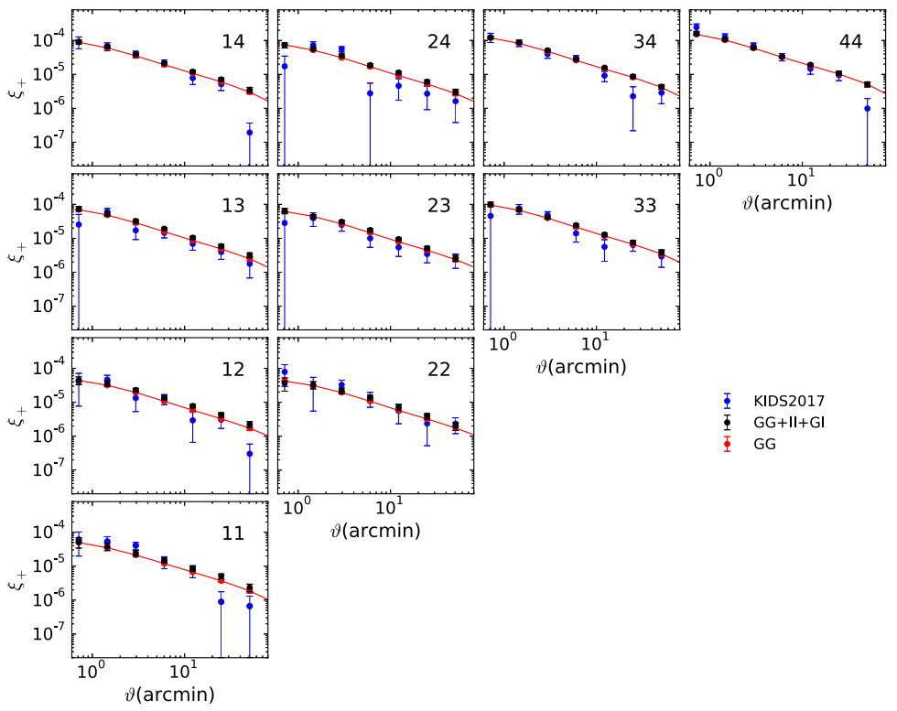
Model predictions VS Observations
Tomographic shear correlations: comparison with KiDS-450 results by Hildebrandt et al. (2017)
, where
Our model agrees well with KiDS, with reduced 𝛘 ²=1.36 and S=1.80σ

Slide 13
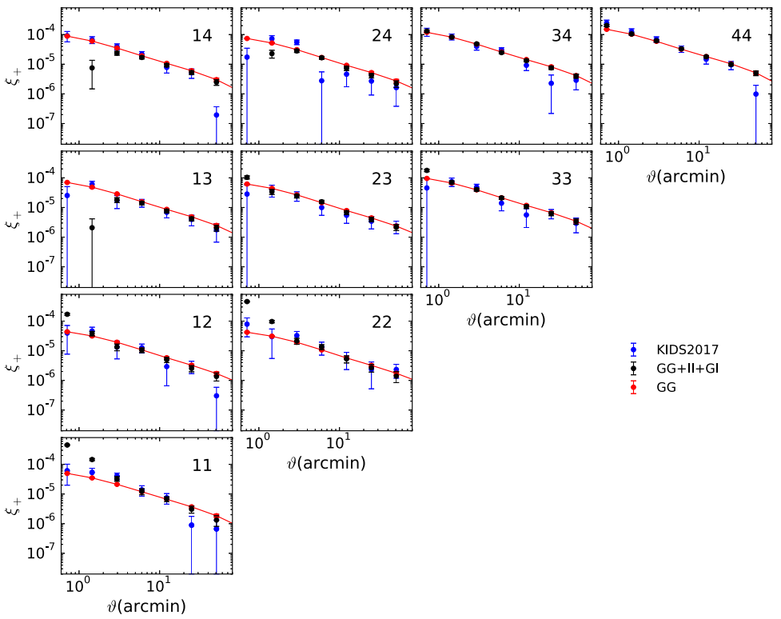
Model predictions VS Observations constraints on satellite alignment model
$$χ_{}^{2}=3.73$$
■ J13 model
S_{e}
S_{S}
$$e_{3}$$
$$L$$
C
J13 model produces too strong power on small scales

Slide 14
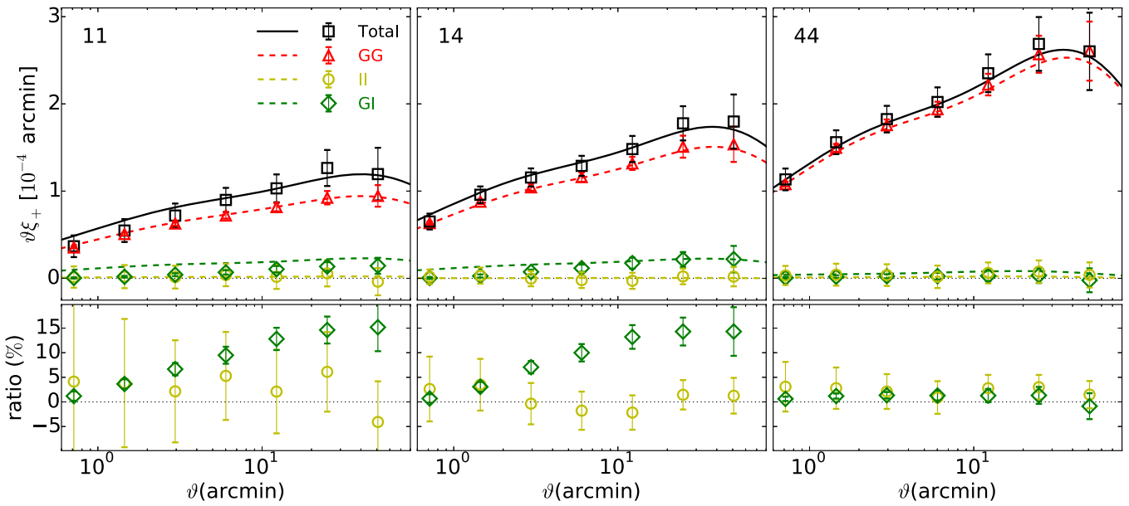
Contribution of II and GI terms
Non-linear model of galaxy IA:
$$A_{IA}=−0.972±0.217$$
We found II term is very weak, GI is 10% of the matter power spectrum
The GI term is positive, not negative from the linear model (Hirata & Seljak 2004)
$$A_{IA}>0$$
$1.10±0.$64 for KiDS-450 (Hildebrandt et al. 2017)
${1.0}_{−0.7}^{+0.4}$ for DES Y1 Fiducial (Troxel et al. 2017)
${6.27}_{−1.01}^{+1.10}$ for SDSS LRG (Joachimi et al. 2013)
$$A_{IA}<0$$
$−0.9$ for DES Y1 tidal torque model (Troxel et al. 2017)
$−3.6±1.6$ for CFHTLenS revisit (Joudaki et al. 2017)
$−{1.18}_{−1.17}^{+0.96}$ for CFHTLenS Full(Heymans et al. 2013)

Slide 15
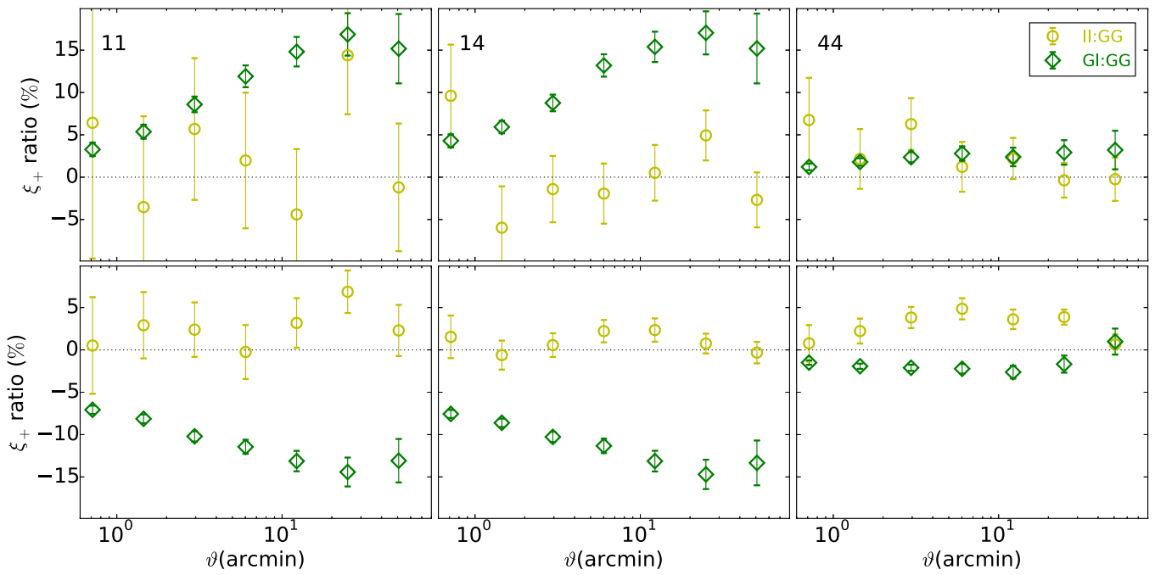
The GI terms: dependence on galaxy morphology
$$P_{GI}>0$$
Pure Spirals
Pure Ellipticals
$$P_{GI}<0$$
We argue the existed WL theory (intrinsic IA model) should consider the GI contribution from early-type and late-type galaxies separately (actually, most observed galaxies are spirals)

Slide 16
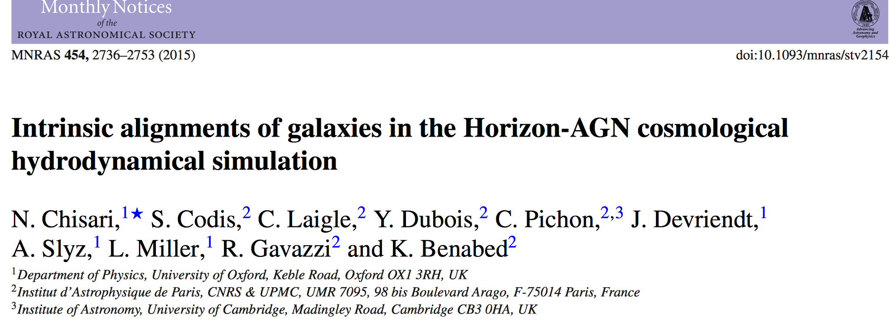
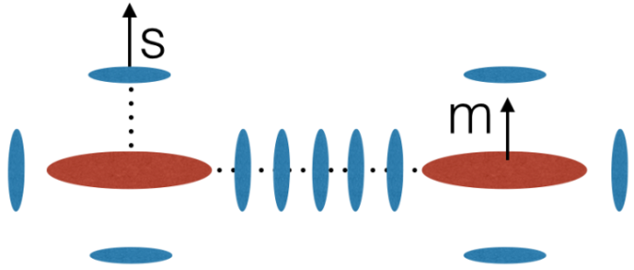
Galaxy II and GI model
G
I
G
Hirata & Seljak (2004)
N. Chisari et al. (2015)

Slide 17
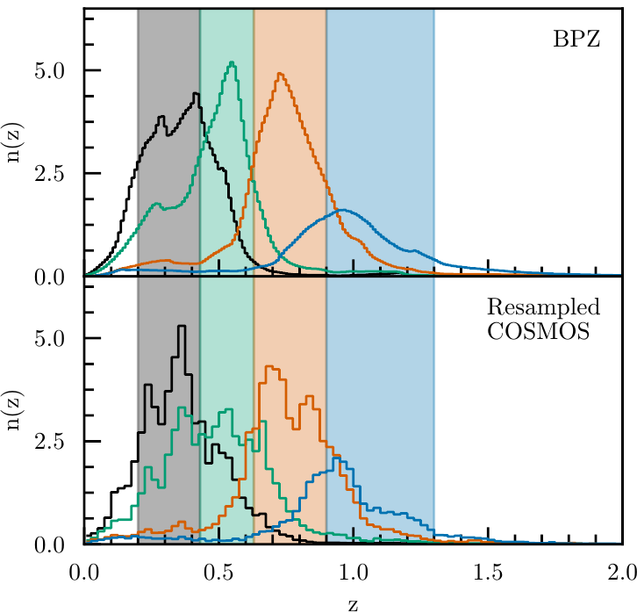
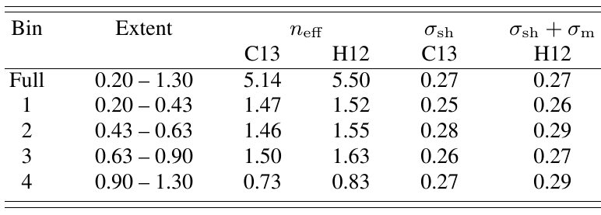
Redshift Distribution in DES Y1 (2018)

Slide 18
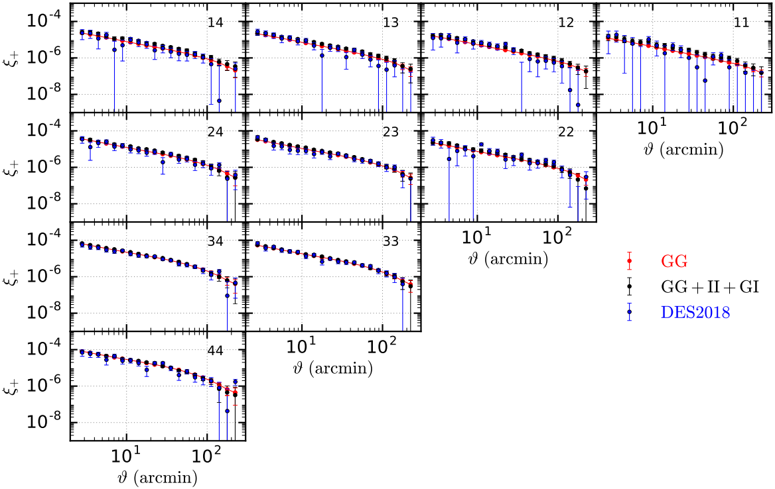
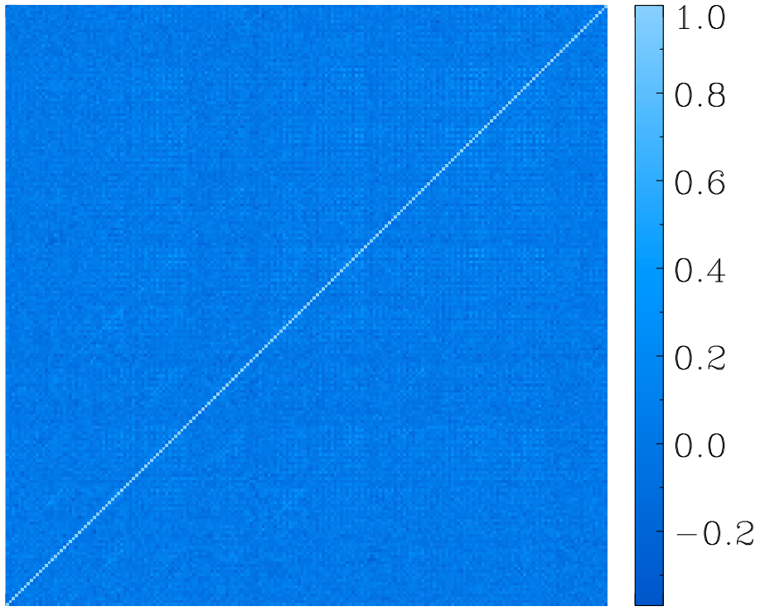
Results in tomographic test
$χ_{dof}^{2}=1.$348 (1.347)
$S=1.65$ (1.15)
$S_{8}≡σ_{8}\sqrt{Ω_{m}/0.3}$
${0.789}_{−0.026}^{+0.024}$ for DES Y1
$0.79$ for mock data

Slide 19
Summary
We have constructed a mock galaxy catalog (lensed images) , using ray tracing simulation with realistic galaxy formation
Our cosmic shear correlations agree well with KiDS
We favor a random distribution for satellite orientation around central galaxy
We found a significant Positive GI signal, from spiral galaxies, contrary to usual expectation from linear model for elliptical galaxy
Thanks for your attention!

