Slide 1
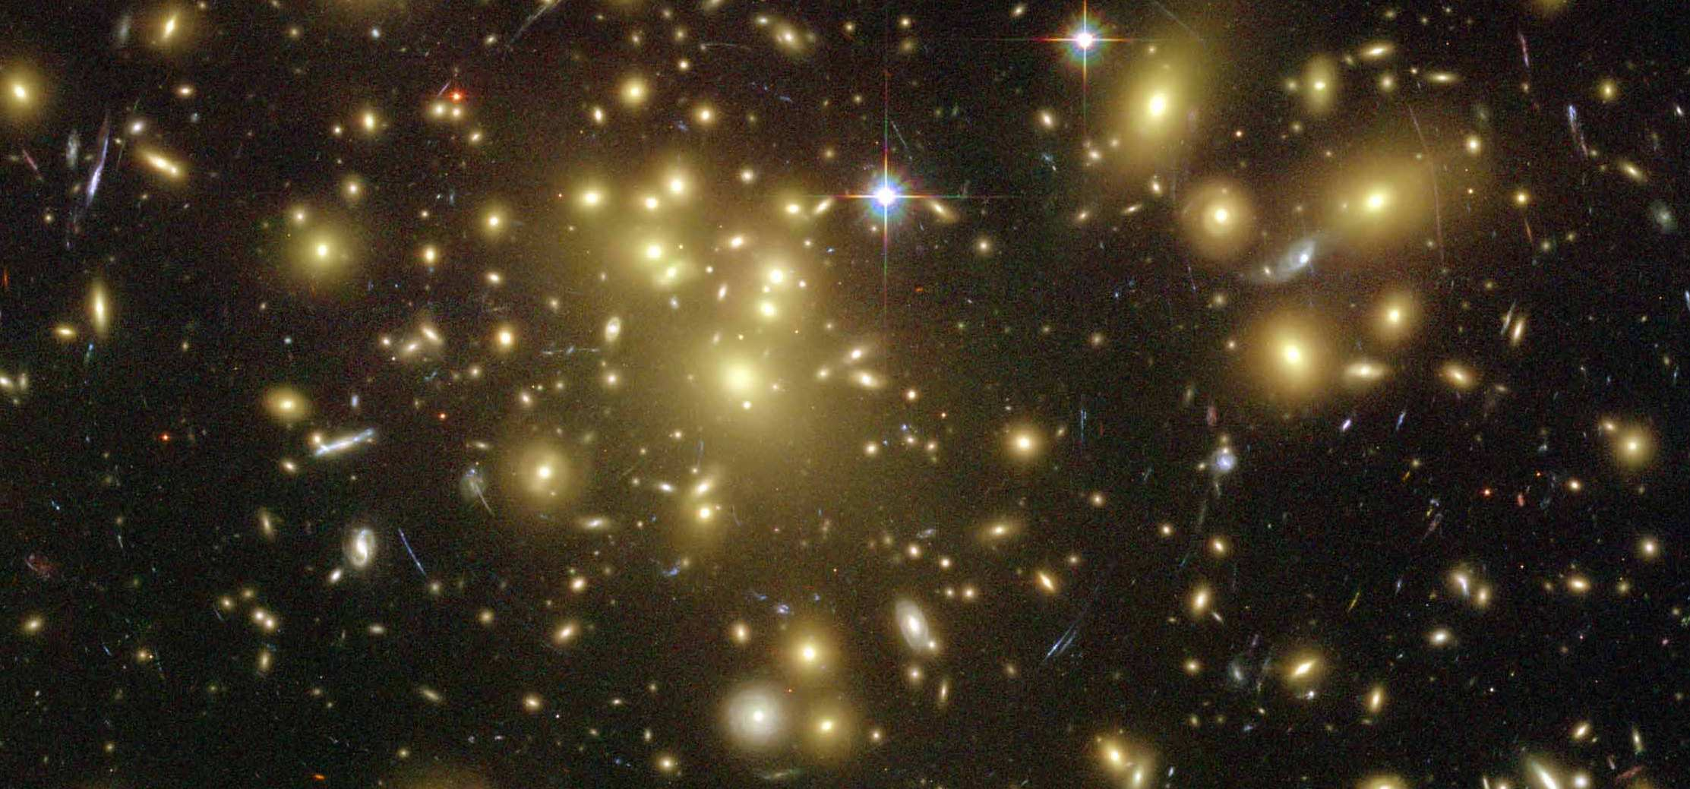
Fourier_Quad，a Shear Measurement Method in Fourier Space
Jun Zhang (张骏)
(Shanghai Jiao Tong University)
Collaborators:
Fuyu Dong, Hekun Li, Yingke Li, Xiangchong Li, Tianhuan Lu, Wentao Luo, Xiaohu Yang, Pengjie Zhang, Yipeng Jing (SJTU); Dezi Liu, Zuhui Fan (PKU); Liping Fu (SHNU); Guoliang Li (PMO); Eiichiro Komatsu (MPA); Nobuhiko Katayama (IPMU).
Collaboration Meeting at ISSI, Bern, Dec 18, 2018

Slide 2
Outline:
The Fourier_Quad method
Application on the CFHTLenS data
Summary

Slide 3
Outline:
The Fourier_Quad method
Application on the CFHTLenS data
Summary

Slide 4
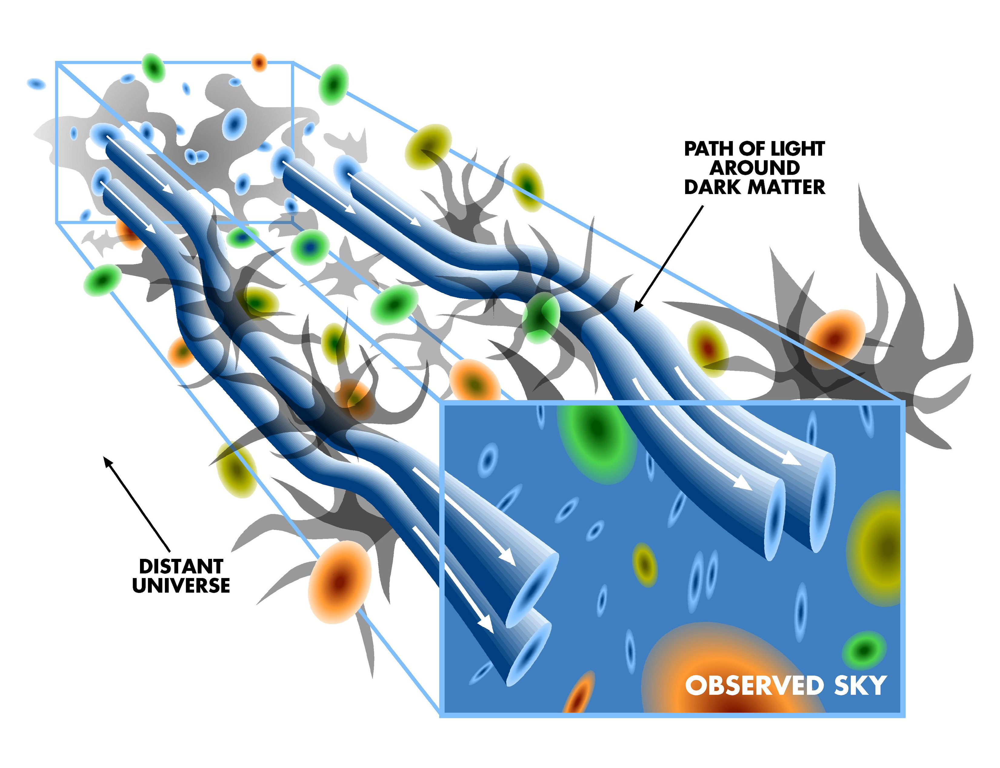
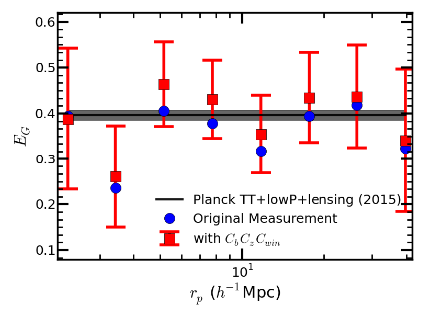
Weak Lensing & Cosmology
The Cosmic Growth Factor;
The Cosmic Expansion History;
Properties of the Dark Stuff;
Testing Gravity Theories;
Image credit: Wittman et al. (2000)
Alam et al. (2017), Zhang et al. (2007)
Fu et al. (2014)

Slide 5
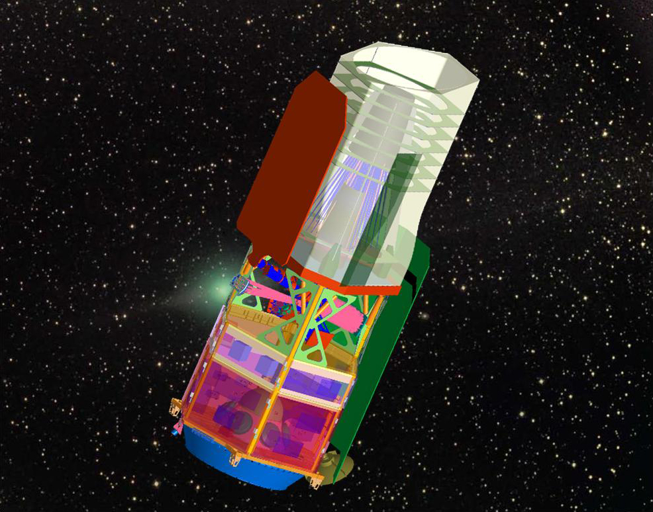
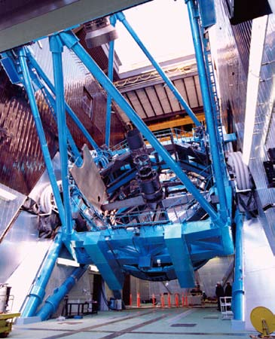
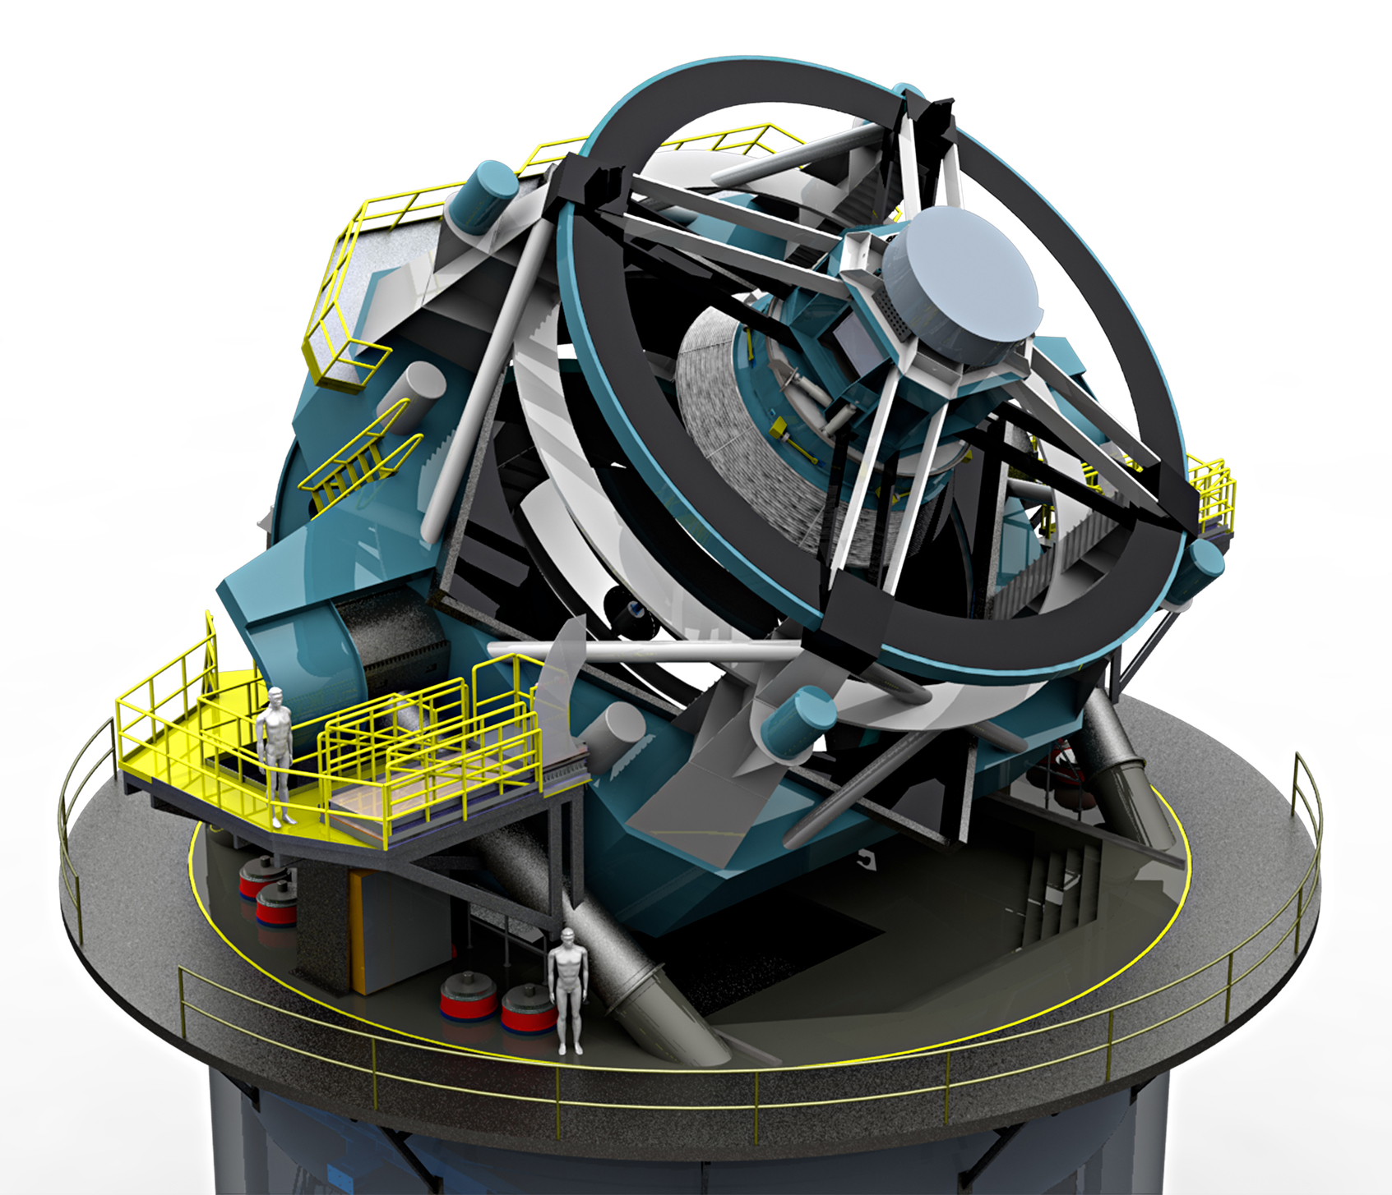
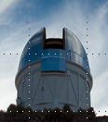
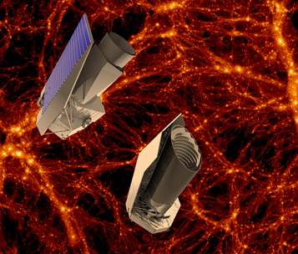
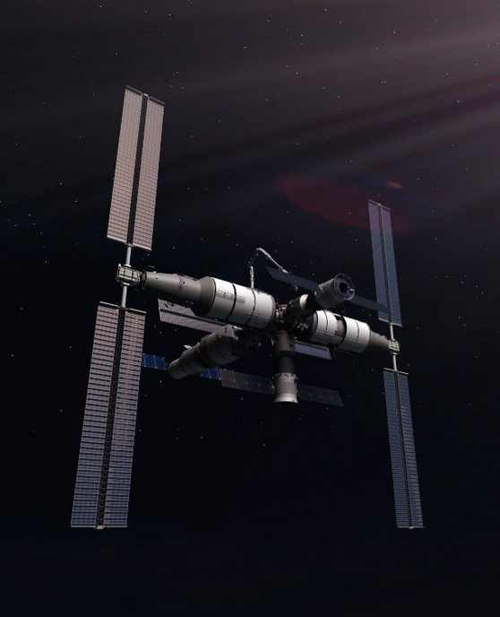
Our Opportunities
WFIRST
Subaru HSC
LSST
DES
EUCLID
CSST(China)
Project Name | HSC | DES | LSST | Euclid | WFIRST | CSS-OS
Starting Time | 2014 | 2013 | 2022 | 2020 | 2025 | ~2024
Survey Area (deg²) | 1400 | 5000 | 18000 | 15000 | 2700 | 17500
Total Gal No. | ~ 100M | ~300M | ~ 2B | ~ 1B | ~300M | ~ 1B

Slide 6

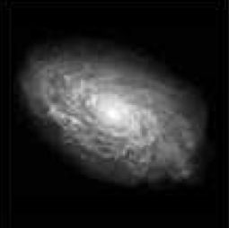
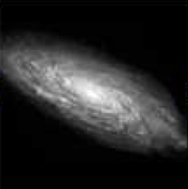
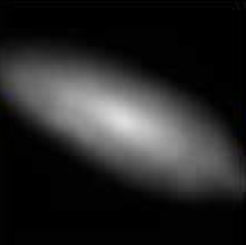
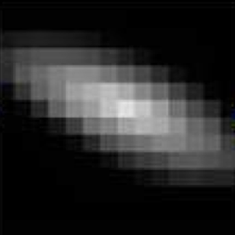
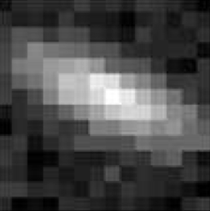
Our Challenges
Require Very High Precision
Require Fast Image Processing
Require Optimal Statistics
LSST
Lensing
PSF
Pixelation
Noise

Slide 7
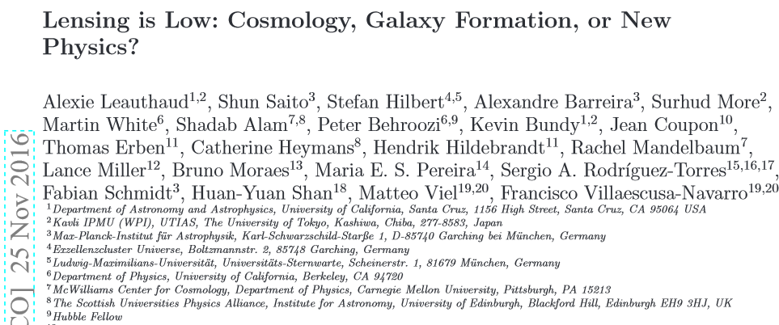
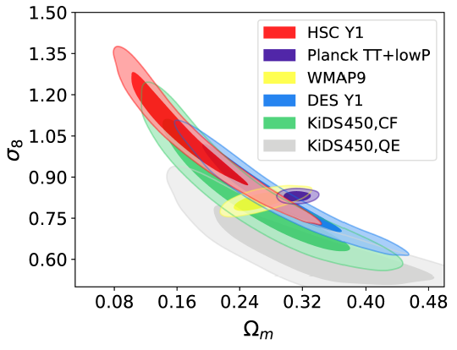
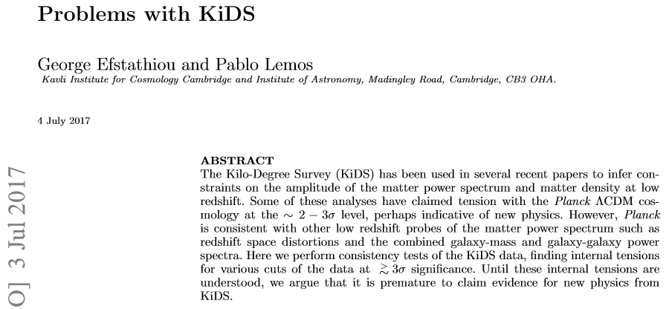
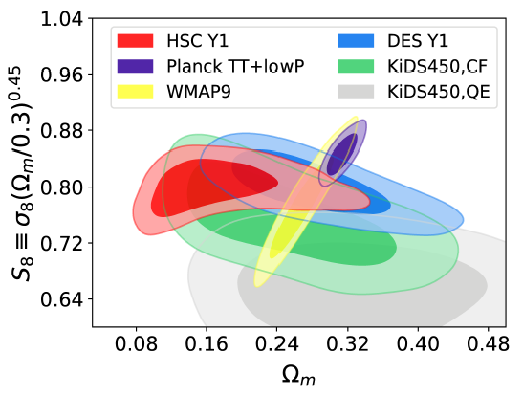
Opportunities & Challenges
Chiaki Hikage et al., arXiv:1809.09148

Slide 8
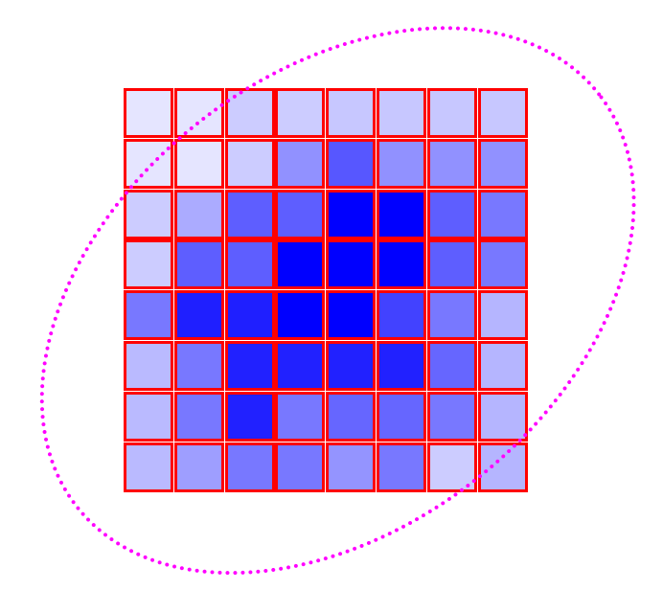
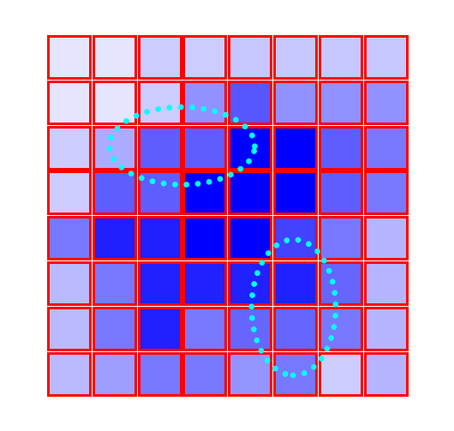
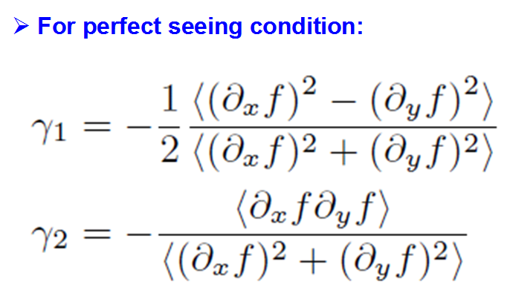
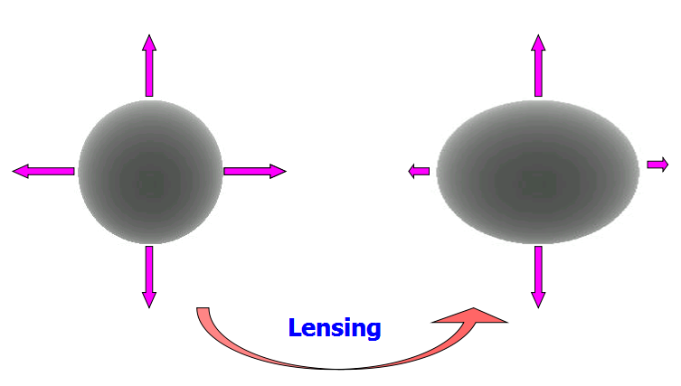
A Different Way to Measure Shear
Seljak & Zaldarriaga, 1999

Slide 9
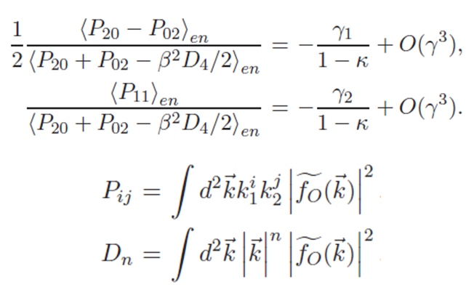
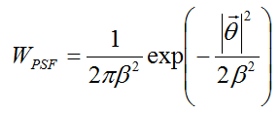
A Different Way to Measure Shear
Formulae in Fourier Space
JZ,JCAP,11,041(2011)

Slide 10
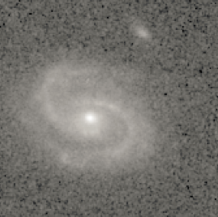
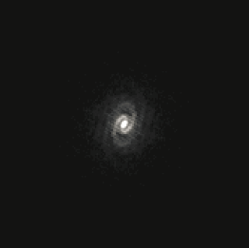

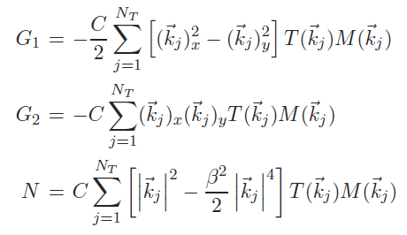
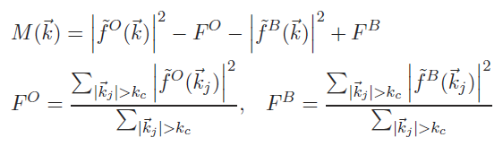

The Fourier_Quad Method
From Source Img
From Bkg Img
JZ, Luo, Foucaud, 2015

Slide 11
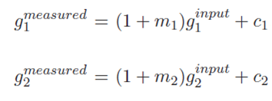
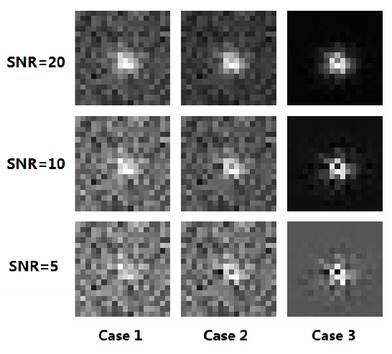
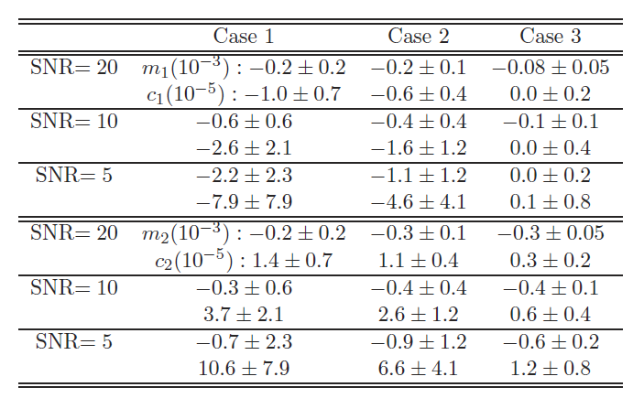
Test Results
JZ,Luo,Foucaud,JCAP,01,024(2015)

Slide 12
History of Fourier_Quad
1. JZ, MNRAS, 383, 113 (2008) Correct for the PSF effect model-independently;
2. JZ, MNRAS, 403, 673 (2010) Remove the background noise contamination;
3. JZ, JCAP, 11, 041 (2011) Clarify the impact of pixel size and high order terms;
4. JZ, Komatsu, MNRAS, 414, 1047 (2011)
A general discussion about the form of shear estimator;
5. JZ, Luo, Foucaud, JCAP, 01, 024 (2015)
Correct for the Poisson noise contamination;
6. JZ, Zhang, Luo, ApJ, 834, 8 (2017)
Optimize the way of doing shear statistics to approach the Cramer-Rao bound.
Lensing
PSF
Pixelation
Noise
√
√
√

Slide 13
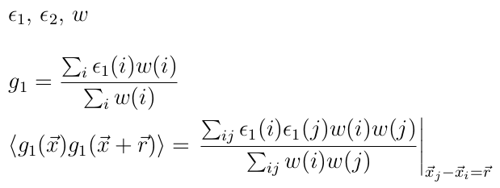
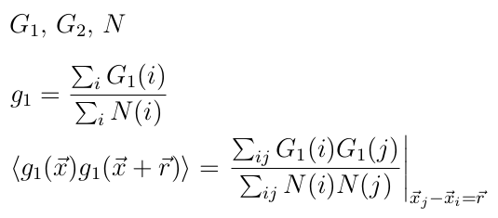
Regarding the Shear Statistics
Order One
Nonnegative
Conventional Form:
~ 0± for faint sources
New Form:
JZ,Komatsu,MNRAS,414,1047(2011)

Slide 14
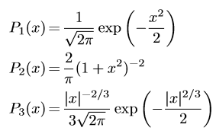

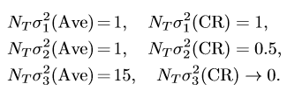

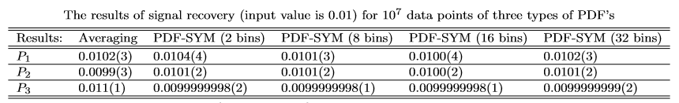
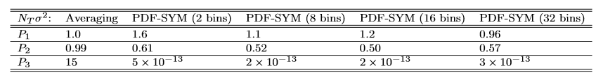
Approaching the Cramer-Rao Bound
C-R BOUND
Examples
JZ,Zhang,Luo,ApJ,834,8(2017)

Slide 15
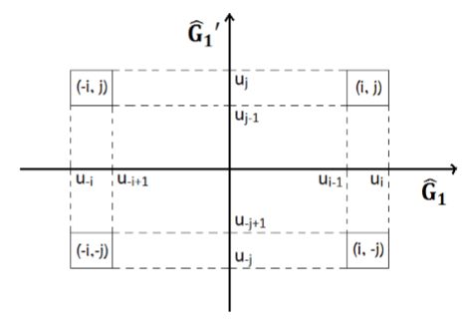
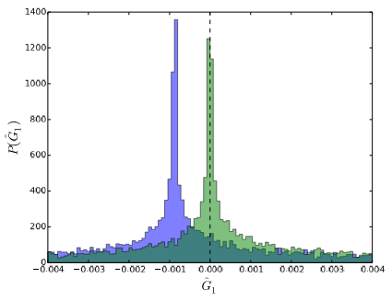
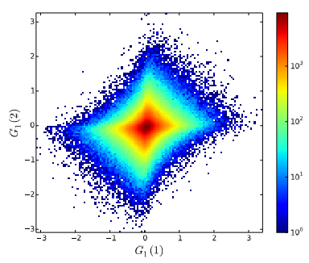
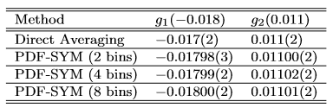
Approaching the Cramer-Rao Bound
JZ,Zhang,Luo,ApJ,834,8(2017)

Slide 16
Outline:
The Fourier_Quad method
Application on the CFHTLenS data
Summary

Slide 17
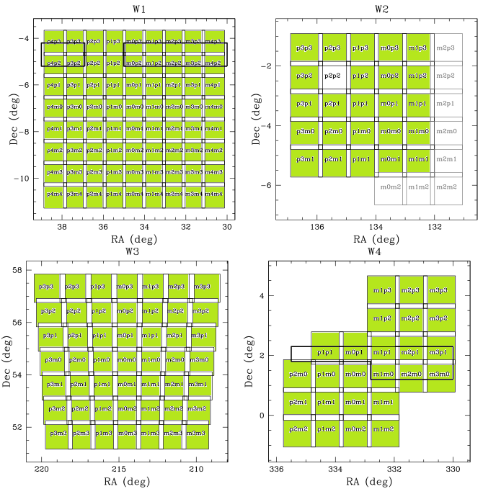
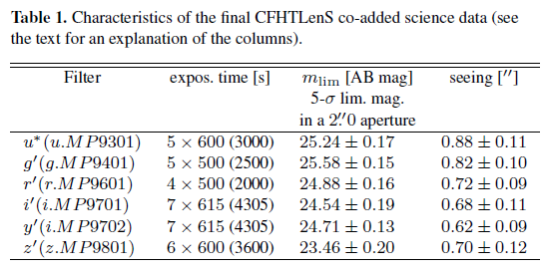
Application on the CFHTLenS data
CFHTLenS
http://www.cfhtlens.org
Erben et al (2012)
Heymans et al (2012)
Miller et al (2012)

Slide 18
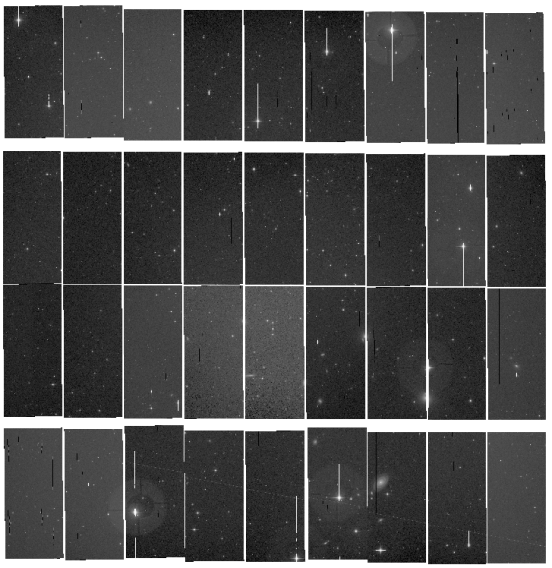
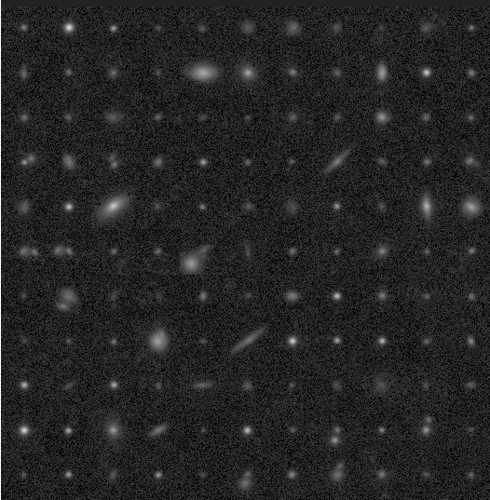
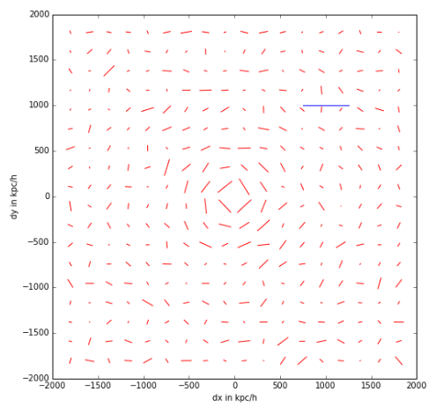
Application on the CFHTLenS data
Single Exposure
Source catalog
Shear Catalog
We have developed an accurate shear measurement pipeline. Starting with almost raw CCD images (after flat-fielding correction), our code does background removal, masking, astrometric calibration, cosmic ray identification, source selection, PSF reconstruction, shear measurement, etc.. The overall speed is around 0.02 CPU•sec/galaxy, which is about 100 times faster than typical model-fitting methods.

Slide 19
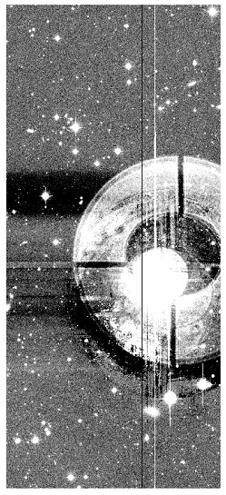
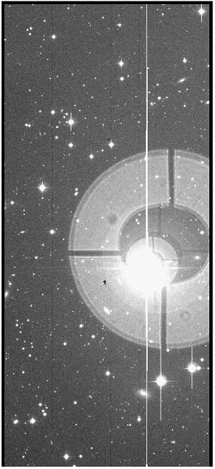
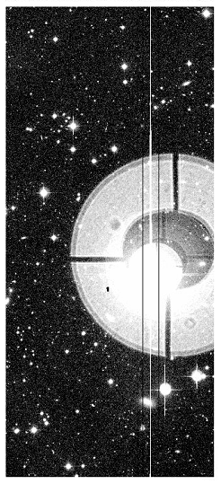
Problems in Background Removal
THELI Processed
Original Image
We Processed

Slide 20
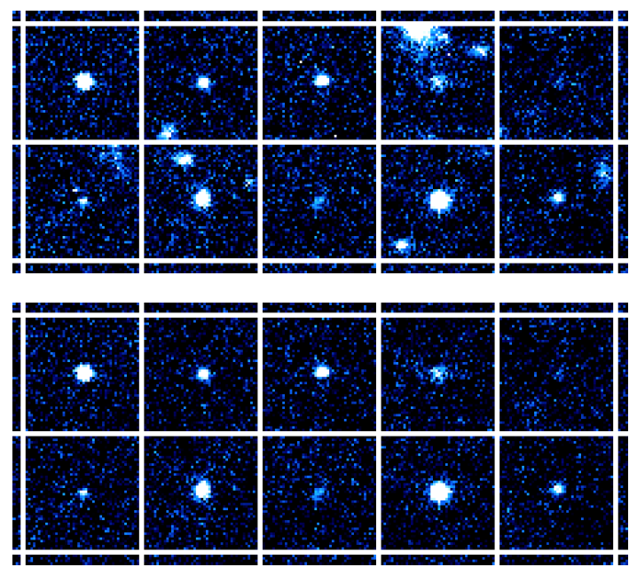
Deblending
source stamps
deblended

Slide 21






PSF Reconstruction（Find Bright Stars，Build PSF）
Global Polynomial n = 10
Kriging
Chipwise Polynomial n = 1
Shepard
Lu, et al. , 2017, AJ, 153, 197

Slide 22

Noise Reduction
Source Images
Their PS
Noise-reduced PS

Slide 23


Accuracy of Astrometry
?

Slide 24

Accuracy of Astrometry (with our code)

Slide 25


Accuracy of Astrometry ( a new idea )

Slide 26

Accuracy of Astrometry ( a new idea )

Slide 27



Accuracy of Astrometry（Pattern Matching）
Reference (Gaia)
Target CCD

Slide 28


Accuracy of Astrometry（Pattern Matching）

Slide 29

Accuracy of Astrometry（Pattern Matching）
△Y
△X

Slide 30

Accuracy of Astrometry（Pattern Matching）
△Y
△X

Slide 31

Accuracy of Astrometry（Pattern Matching）
△Y
△X

Slide 32


Accuracy of Astrometry (with our code)
3rd order polynomial fit
9th order polynomial fit

Slide 33

About PSF Interpolation
Global Polynomial n = 10
Kriging
Chipwise Polynomial n = 1
Shepard
Lu, et al. , 2017, AJ, 153, 197

Slide 34



About PSF Interpolation
Lu, et al. , 2017, AJ, 153, 197

Slide 35

About PSF Interpolation
Heymans et al., 2012, MNRAS, 421, 381

Slide 36



About PSF Interpolation
Lu, et al. , 2018, ApJ, 858, 122

Slide 37


Test Shear Recovery with Field Distortion
Right：FD distribution on MegaCam, enlarged by 30 times.

Slide 38


Test Shear Recovery with Field Distortion
With our own source catalog
With CFHTLenS source catalog
JZ et al., arXiv:1808.02593

Slide 39


A Brief Comparison with Lensfit

Slide 40


Shear-Shear Tomography
Heymans et al, MNRAS, 432, 2433 (2013)

Slide 41

Shear-Shear Tomography (preliminary)

Slide 42
Outline:
The Fourier_Quad method
Application on the CFHTLenS data
Summary

Slide 43
Summary
The Fourier_Quad method is an efficient and accurate way of measuring shear. It has the following advantages:
Correct for the PSF effect model-independently;
Exact & Simple Math;
Statistically exact removal of the contamination from the background and source Possion noise;
Accurate to the 2nd Order in shear/convergence;
Immune to misidentification of stars as galaxies;
Fast data processing speed: ~ 10⁻² CPU*sec/Gal;
Shear statistics can approach the Cramer-Rao Bound.

Slide 44
Summary
Remaining Problems:
Deblending & Selection Effects;
Sampling Issues for Space-based Surveys;
CCD Effects;
Photo-z Errors;
Intrinsic Alignment;
Nonlinear Evolution of the Density Field & Baryonic Effects;
... ... ... ...

Slide 45
Stay Tuned !
Thank You !

